Slide 1
Complexity Classes
Categories of Computational Problems
Computational Complexity / Lecture 3
Franck Chauvel
axbit & NTNU
franck.chauvel@ntnu.no

Slide 2

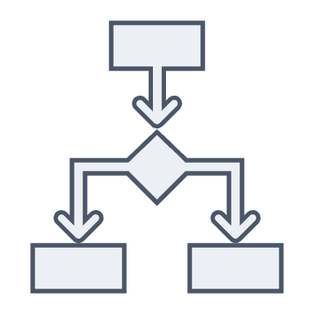


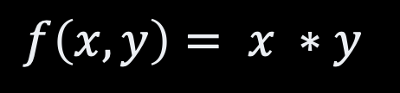
Remember…
Programs
Algorithms
Problems
correctness
Algorithm 1
$$f\left(x,y\right)= x ∗y$$
efficiency
Algorithm 2

Slide 3
Agenda
Decision Problems
Computation Models
Complexity Classes: P, NP, EXP
NP-Completeness & Reductions

Slide 4
Decision Problems
Inputs
Every ”computational” problem can be rephrased as a
“decision” problem
Decision
Problem
Yes
No

Slide 5
Traveling Salesperson Problem (TSP) An example
Given a graph of cities, find a tour that visits each city exactly once and returns to the starting city.
Solving
Verifying
Given a graph of cities, is there a tour that visits each city exactly once and returns to the starting city?
Given a graph of cities and a tour, does it visit each city exactly once and returns to the starting city?

Slide 6

Decision Problems as Languages
Every decision problem can be viewed as checking whether a word belongs to a given language
Is franckc@ntnu.no a valid email?
Does the graph $G=(V,E)$ admits a “hamiltonian” tour?

Slide 7

Languages & Machines
Regular languages
DFA
What “machine” recognizes $a^{n}b^{n}$ ?
Recursively enumerable
Context sensitive
Context-free
Regular (Regex)

Slide 8
Languages and Computation Models
Languages
Computation Model
Regular Expression
Finite Automata
Context-free Languages
Pushdown Automata
Context-senstive Languages
Linear-bound Automata
Recursively enumerable
Languages
Turing Machine
More computational “power”

Slide 9
Computation Models
Automata are machines
consume inputs
and transition table
to produce a result
Computation Models = executor + algorithm
limit = 100
inputs
algorithm
Executor
output
sum = 2550

Slide 10
Computation Models
Abstract Machines
RAM
Functional Models
Turing machine
Lambda Calculus
Pushdown
Automata
Combinatory Calculus
DFA
Rewriting Systems
Concurrent Model
Actors
Celullar Automata
Petri Nets

Slide 11





Turing Machine: $M=(Q, q_{0},A, Σ,δ)$
input tape (symbols)
$$δ:Q ×A^{3}→Q×A^{2}×{\left\{L,R,S\right\}}^{3}$$
Automaton
$$q_{0}$$
$$q_{1}$$
$$q_{n}$$
“scratch pad” tape (symbols)
output tape (symbols)

Slide 12
Turing-Completeness
We don’t know anything more powerful than a Turing machine
RAM, Lambda-calculus, Actors, etc. are all turing-complete
A computation model is turing-complete,
if it can emulate a Turing machine

Slide 13
Computable Functions
Can we solve
every problem?
Only, those that can be
solved with a Turing-machine
(Church-Turing Thesis)
Example:
the halting problem

Slide 14
Non-Deterministic Turing Machine
A non-deterministic machine
always picks
the right branch

Slide 15
Efficiency
Given a problem,
some computation models are “faster"
than a Turing machine
but never more powerful than
a Turing Machine

Slide 16

Playing Sudoku With a non-deterministic Turing Machine
Easy !
$O\left(n^{2}\right)$
Just guess “right” every cell!

Slide 17
Complexity Class
Complexity Class
(set of decision problems)
Computation Model
(TM, RAM, DFA, etc.)
A resource
(time of space)
A bound
O(n)
NL: The problems that can be solved by a non-deterministic turing machine in linear time

Slide 18
Common Classes
Class P
Solved by a deterministic turing machine in polynomial time
Class NP:
Solved by a non-deterministic Turing machine in polynomial time
Problems verifiable in polynomial time by a deterministic turing machine
Class EXP
Solved by a deterministic turing machine in exponential time
NL
P
NP
PSPACE
EXP
EXPSPACE

Slide 19
If P = NP…
We don’t know yet…
Every “hard” problem has an efficient solution, yet to be found!
Non-determinism is useless
Mathematicians are useless, we just need theorem provers
Cryptography is just a joke

Slide 20
NP-Completeness
A problem is NP-complete
the problem is in NP
at least as hard as every other problem in NP
the hardest problems in NP
A problem is NP-hard
it is not in NP
at least as hard as every other problem in NP
harder than the hardest
NP-hard
NP
NP-complete
P

Slide 21


Problem Reduction It is at least as easy as …
Algorithm that converts a problem into another
and conserves the correctness of solution
A is at least as easy as B
Problem A
Algorithm?
Reduction
(algorithm)
$$O(m^{j})$$
Problem B
$$O(n^{k})$$
Algorithm 2

Slide 22
Problem Reduction It is at least as hard as …
Provided there is algorithm that solves B in polynomial time
By contradiction
Suppose A is easy to solve
Because there is a reduction,
Can’t be that easy …
B is at least as hard as A
Problem A
Algorithm
Reduction
(algorithm)
$$O(m^{j})$$
Problem B
$$O(n^{k})$$
Algorithm 2

Slide 23
Why all of that?
Before to attack a problem
check how hard it is
☺

Slide 24
Recap
Turing-completeness
nothing beats the turing machine
Non-deterministic turing machine
“Perfect guesser”
Do not know how to build that
Complexity class
Resource
Machine
Bound
Show NP-completeness using reduction
at least as hard/easy than
NP-complete
hard to solve / easy to verify
NP-hard
hard to solve / hard to verify
P =?= NP
If we solve one, we solve many

Slide 25
Questions, Comments, or Ideas?
Franck Chauvel
Axbit & NTNU
franck.chauvel@ntnu.no

