Slide 1
Simple Sorting
Introduction to Sorting Sequences
Sequences / Lecture 5
Franck Chauvel
Ask anything on www.menti.com
with code 8466 4411
Axbit & NTNU
franck.chauvel@ntnu.no

Slide 2
Binary Search
Find “67”
27 < 67
54 < 67
Found
86 > 67
0
1
2
3
4
5
6
7
8
9
10
11
8
11
23
27
35
37
39
54
55
67
86
213
1st pick
3rd pick
2nd pick
smaller
larger

Slide 3

Agenda
What is “Sorting”?
Selection Sort
Insertion Sort
Bubble Sort
Recap

Slide 4
What is “Sorting”?
Put things in order
Numerical
Lexicographical
Find a permutation where
Items are ordered

Slide 5
Key vs. Information
Information is your “data set”
Key: What you use to compare
Compound keys
Name | Surname | Subject | Score
John | Doe | Alg. & DS | 50
John | Doe | DB | 76
Lara | Croft | DB | 23
Lara | Croft | Alg & DS | 46
Harry | Potter | OS | 10
Harry | Potter | DB | 65
Bob | Sponge | OS | 97
Bob | Sponge | Alg & DS | 34
Sarah | Connor | OS | 90
Sarah | Connor | Alg.&DS | 78

Slide 6
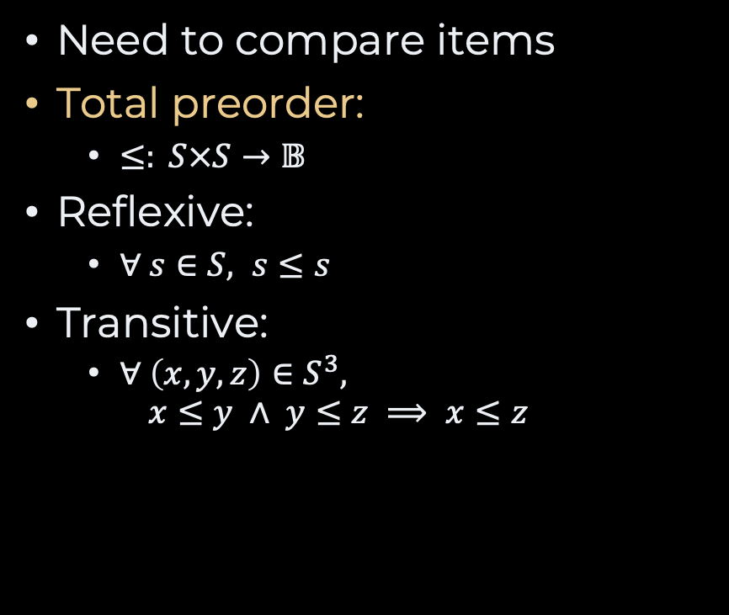
Comparable Items
Need to compare items
Total preorder:
$≤: S×S→𝔹$
Reflexive:
$∀ s∈S, s≤s$
Transitive:
$∀ \left(x, y, z\right)∈S^{3},$ $x≤y ∧ y≤z ⟹ x≤z$
int compare<T>(T left, T right) {
return ...
}

Slide 7
Stability
Stable
Given input
order preserved
order changed
order preserved
Unstable

Slide 8
How Would you do?
Give it a try for a few minutes …

Slide 9
Selection Sort
smallest
largest
2
5
17
22
22
23
28
35
36
36
50
51
minimum comes first!
sub array
Intuition:
select the minimum
put it first
repeat for the remaining elements

Slide 10
Selection Sort—Slow Motion
minimum
minimum
28
35
22
36
22
22
22
28
36
35
ok
swap
minimum
minimum
22
35
28
36
22
22
22
28
36
35
swap
swap

Slide 11

Selection Sort
def selection_sort(sequence)
for index in 0 .. sequence.length-2
minimum = find_minimum(sequence, index)
swap(sequence, index, minimum)
end
end
def swap(sequence, left, right)
tmp = sequence[right]
sequence[right] = sequence[left]
sequence[left] = tmp
end
def find_minimum(sequence, start)
minimum = start
for index in start+1 .. sequence.length-1
if sequence[index] < sequence[minimum]
minimum = index
end
end
return minimum
end

Slide 12
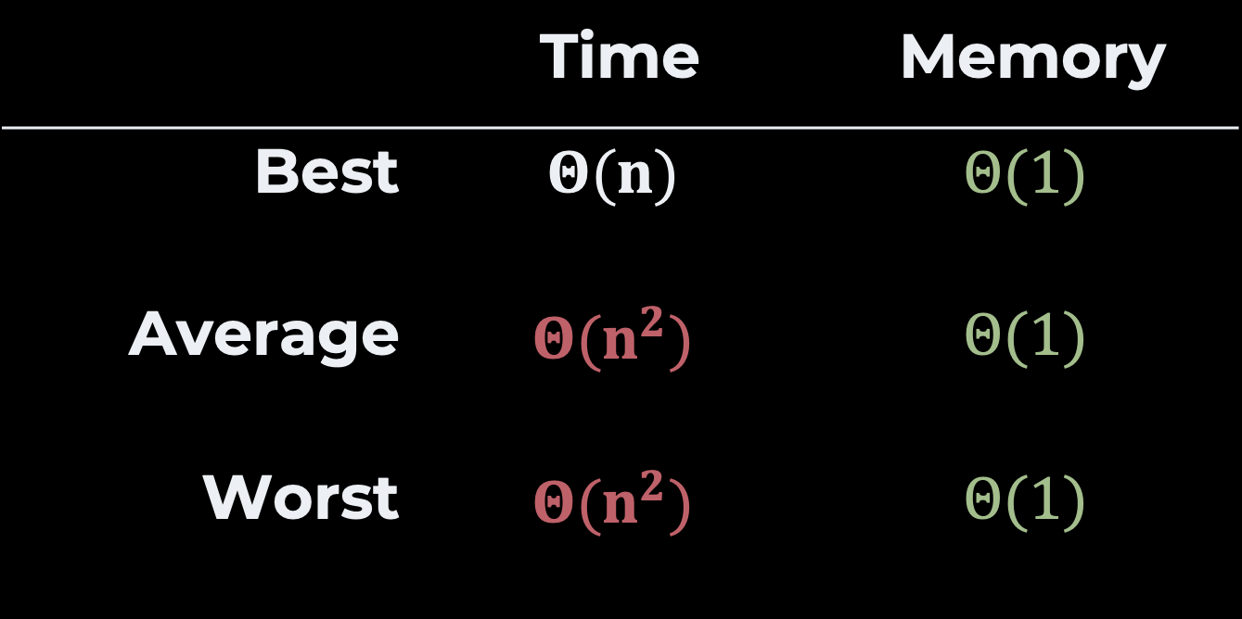
Time & Space Complexity
 | Time | Memory
Best | $$Θ(n)$$ | $$Θ(1)$$
Average | $$Θ(n^{2})$$ | $$Θ(1)$$
Worst | $$Θ(n^{2})$$ | $$Θ(1)$$
Exercise How would you proove the average case?

Slide 13
Insertion Sort
28
larger
22
22
23
35
36
smaller
Idea:
To keep an array sorted,
we insert new items
between the smaller and the bigger

Slide 14
Insertion Sort—Slow Motion
Step 1
Step 4
28
35
22
36
22
22
28
35
36
22
Step 2
Step 5
28
35
22
36
22
22
28
35
36
22
Step 3
28
35
22
36
22

Slide 15
Insertion Sort
def insertion_sort(sequence)
for index in 1 .. sequence.length-1
position = find_position(sequence, index)
insert(sequence, position, index)
end
end
def insert(sequence, position, last)
value = sequence[last]
for index in last.downto(position)
sequence[index] = sequence[index-1]
end
sequence[position] = value
end
def find_position(sequence, last)
for index in 0 .. last
if sequence[index] >= sequence[last]
return index
end
end
return last
end

Slide 16
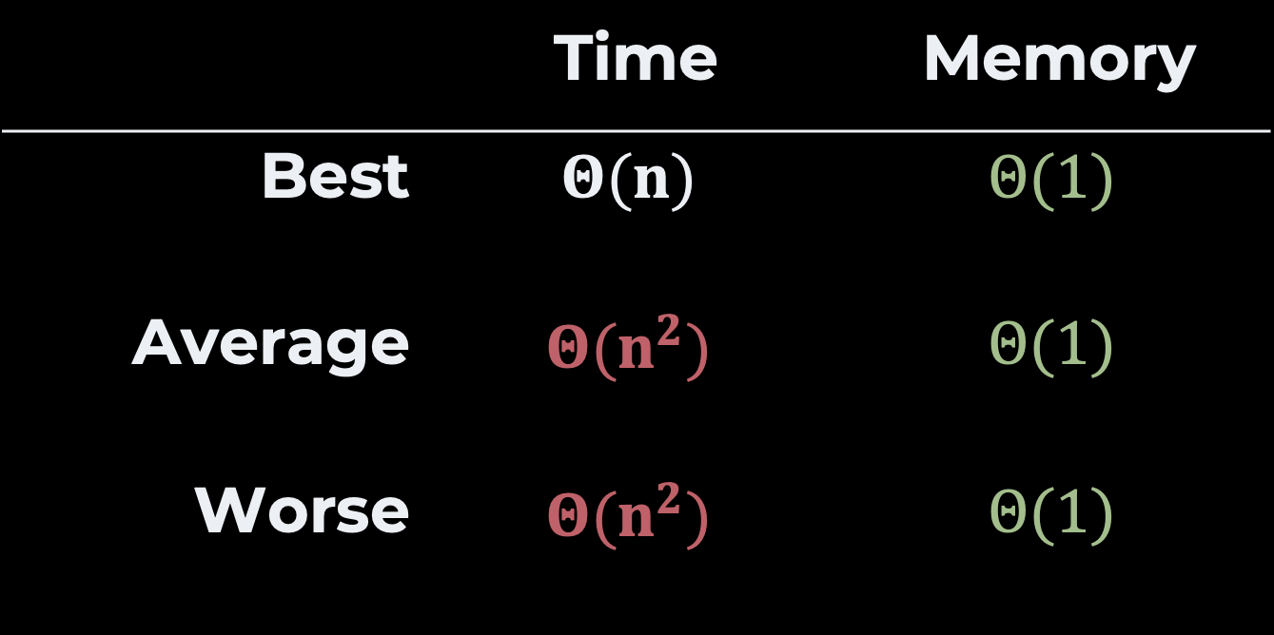
Time & Space Complexity
 | Time | Memory
Best | $$Θ(n)$$ | $$Θ(1)$$
Average | $$Θ(n^{2})$$ | $$Θ(1)$$
Worse | $$Θ(n^{2})$$ | $$Θ(1)$$
Exercise How would you proove the average case?

Slide 17




Bubble Sort
pair
smallest
$$left≤right$$
largest
2
5
17
22
22
23
28
35
36
36
50
51
$$left≤right$$
$$left≤right$$
$$left≤right$$
pair
pair
pair
Intuition:
Keep traversing the array
Swapping pairs that are disordered
Until there is no more pair to swap

Slide 18
Bubble Sort
Step 1
Step 4
28
35
22
36
22
28
22
35
36
22
ok
swap
Step 2
Step 5
28
35
22
36
22
28
22
35
22
36
swap
swap
Step 3
Step 6
28
22
35
36
22
22
28
35
36
22
ok
ok

Slide 19
Bubble Sort
Step 6
Step 10
22
28
35
22
36
22
28
22
35
36
ok
ok
Step 7
Step 10
22
28
35
22
36
22
28
22
35
36
swap
ok
Step 8
22
28
22
35
36
ok

Slide 20
Code
def bubble_sort(sequence)
swapped = true
while swapped
swapped = false
for index in 1 .. sequence.length-1
if sequence[index] < sequence[index-1]
swap(sequence, index-1, index)
swapped = true
end
end
end
end
def swap(sequence, left, right)
tmp = sequence[right]
sequence[right] = sequence[left]
sequence[left] = tmp
end

Slide 21
Time & Space Complexity
 | Time | Memory
Best | $$Θ(n)$$ | $$Θ(1)$$
Average | $$Θ(n^{2})$$ | $$Θ(1)$$
Worse | $$Θ(n^{2})$$ | $$Θ(1)$$
Exercise How would you proove the average case?

Slide 22
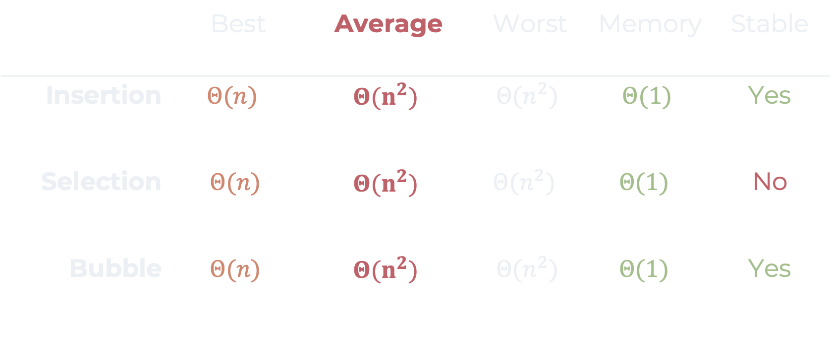
Recap
 | Best | Average | Worst | Memory | Stable
Insertion | $$Θ(n)$$ | $$Θ(n^{2})$$ | $$Θ(n^{2})$$ | $$Θ(1)$$ | Yes
Selection | $$Θ(n)$$ | $$Θ(n^{2})$$ | $$Θ(n^{2})$$ | $$Θ(1)$$ | No
Bubble | $$Θ(n)$$ | $$Θ(n^{2})$$ | $$Θ(n^{2})$$ | $$Θ(1)$$ | Yes

Slide 23
Questions, Comments, or Ideas?
Franck Chauvel
Axbit & NTNU
franck.chauvel@gmail.com

Slide 24
Home Exam 1
Week 4 – 5
Optional! Does not count in your final grade
I suggest you try in “simulated conditions”
I can grade it, if you would like
We will go through together during a lab session
Home exam 2 around Week 8 – 9

