Slide 1
Stacks and Queues
Introducing New Abstract Data Types
Sequences / Lecture 6
Franck Chauvel
Ask anything on www.menti.com
with code 8466 4411
Axbit & NTNU
franck.chauvel@ntnu.no

Slide 2
Agenda
Stacks
Queues
Deques
Recap

Slide 3
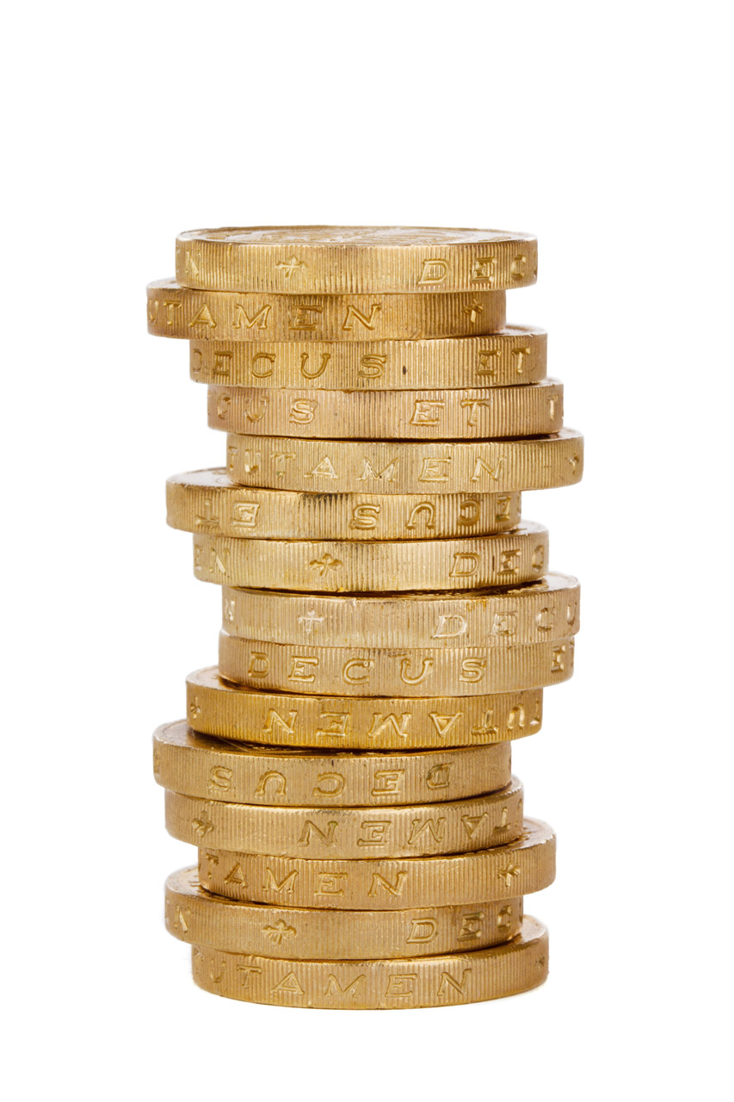
Stacks
Incoming
item
Outgoing
item
Item 3
top
Item 2
length
Item 1
bottom

Slide 4
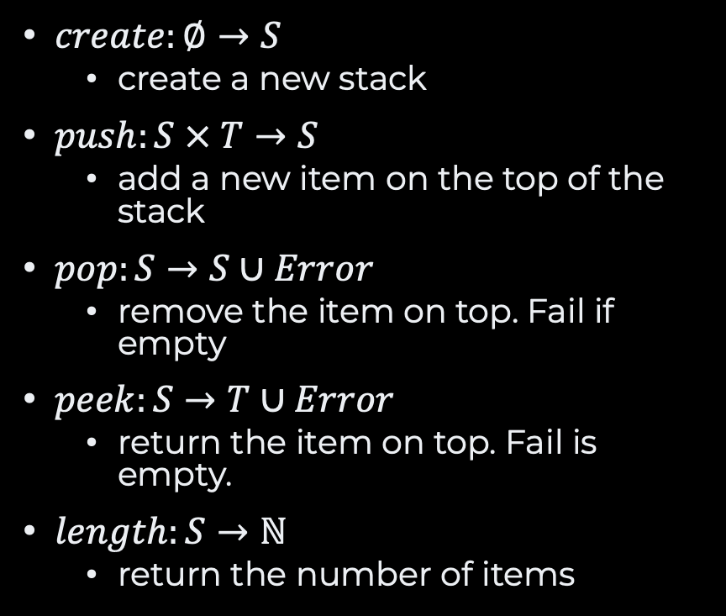
The Stack ADT
Domains
Item, T
Stack, S<T>
Error, E
$create:∅→S$
create a new stack
$push:S × T→S$
add a new item on the top of the stack
$pop:S→S∪Error$
remove the item on top. Fail if empty
$peek:S→T∪Error$
return the item on top. Fail is empty.
$length:S→ℕ$
return the number of items
Exercise What are the axioms?

Slide 5
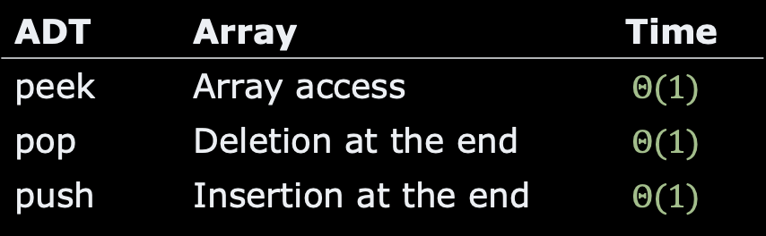
Array-based Stacks
???
addresses
Item 1
base
ADT | Array | Time
peek | Array access | $$Θ(1)$$
pop | Deletion at the end | $$Θ(1)$$
push | Insertion at the end | $$Θ(1)$$
Item 2
size
Item 3
top
Res.
Res.
capacity
Res.
???

Slide 6
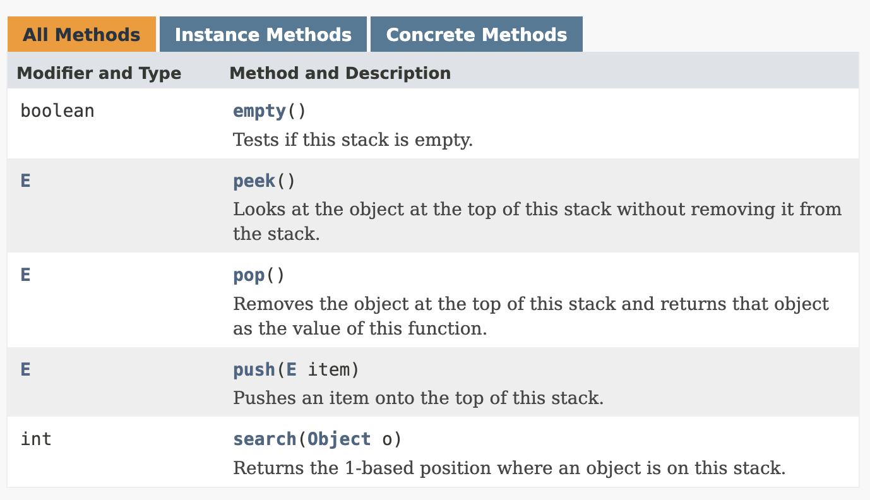
Stacks in Java
java.util.Stack<T>

Slide 7
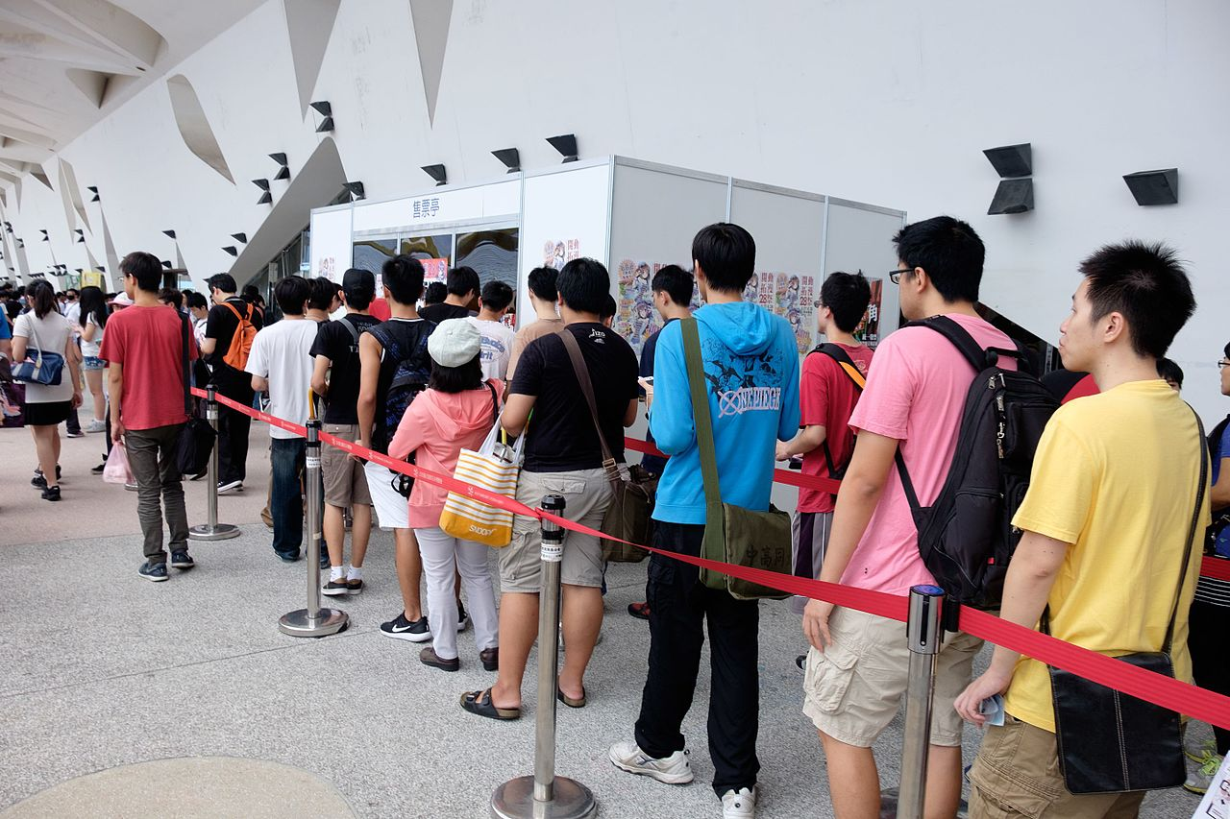
Queues
Incoming
item
back
Item 3
Item 2
length
front
Item 1
Outgoing
item

Slide 8
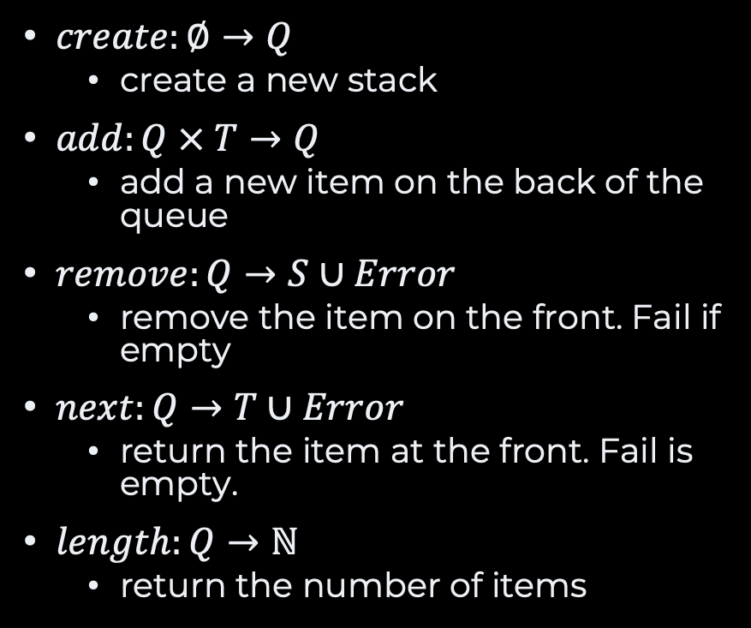
The Queue ADT
Domains
Item, T
Queue, Q<T>
Error, E
$create:∅→Q$
create a new stack
$add:Q × T→Q$
add a new item on the back of the queue
$remove:Q→S∪Error$
remove the item on the front. Fail if empty
$next:Q→T∪Error$
return the item at the front. Fail is empty.
$length:Q→ℕ$
return the number of items
Exercise What are the axioms?

Slide 9
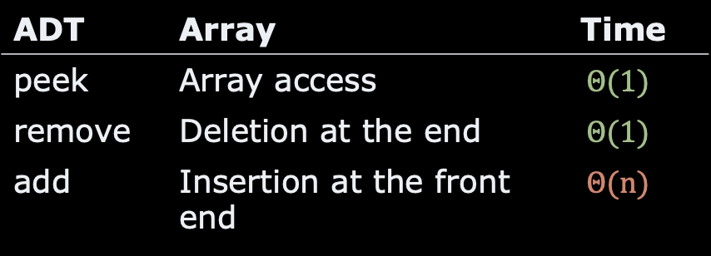
Array-based Queues
???
addresses
Item 1
base
ADT | Array | Time
peek | Array access | $$Θ(1)$$
remove | Deletion at the end | $$Θ(1)$$
add | Insertion at the front end | $$Θ(n)$$
Item 2
size
Item 3
top
Res.
Res.
capacity
Res.
???

Slide 10
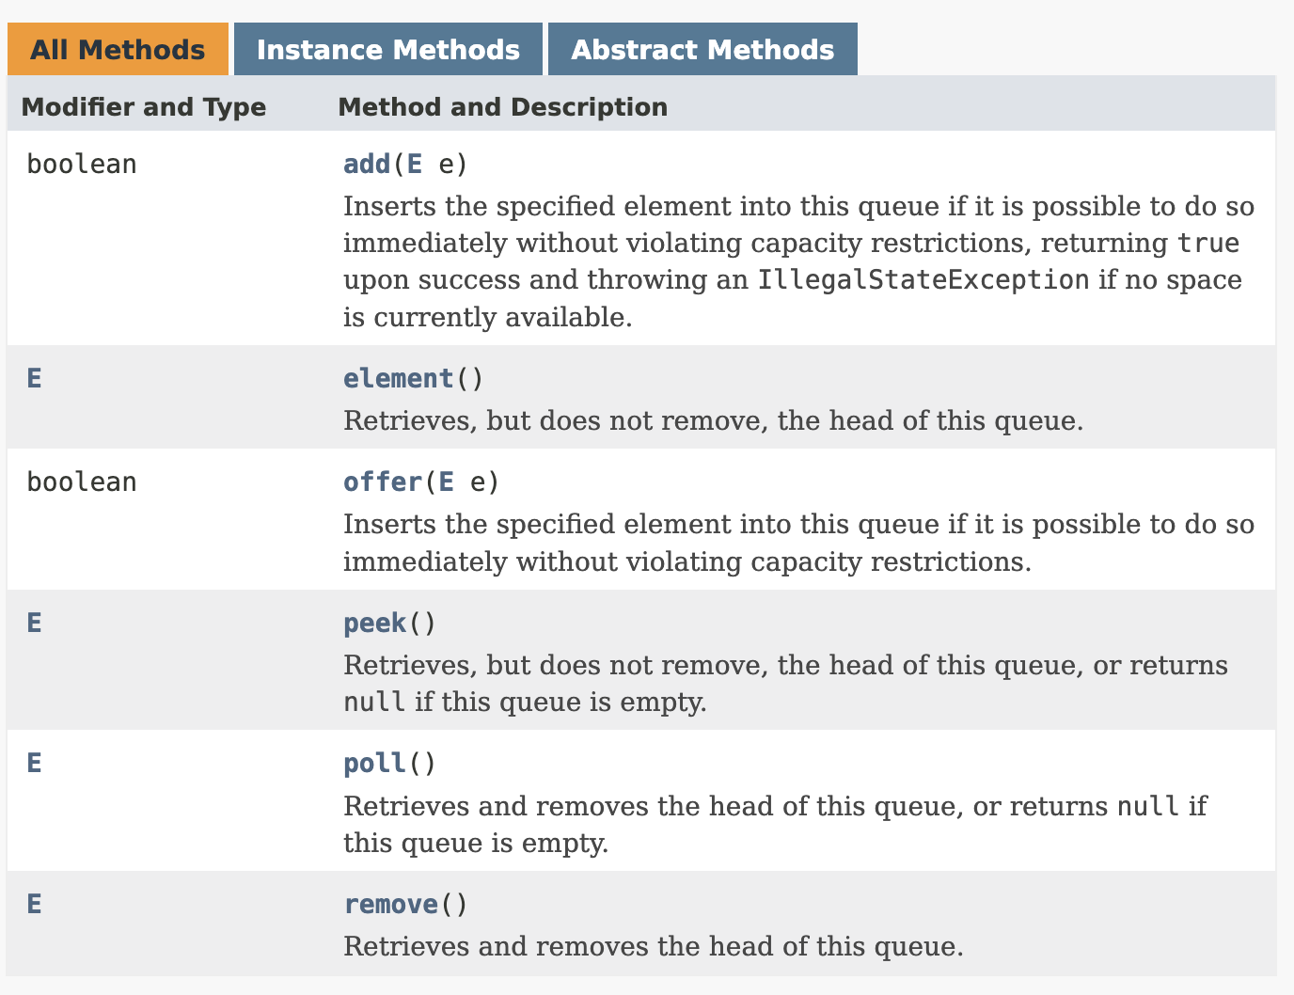
Queues in Java
java.util.Queue<E>
⚠️ interface
Many implementations
since 1.5

Slide 11


Queues vs. Stacks?
The differences is in the axioms
Stacks
Queues
$$peek(push\left(push\left(S,x\right), y\right))=y$$
$$peek(add\left(add\left(Q,x\right), y\right))=x$$

Slide 12
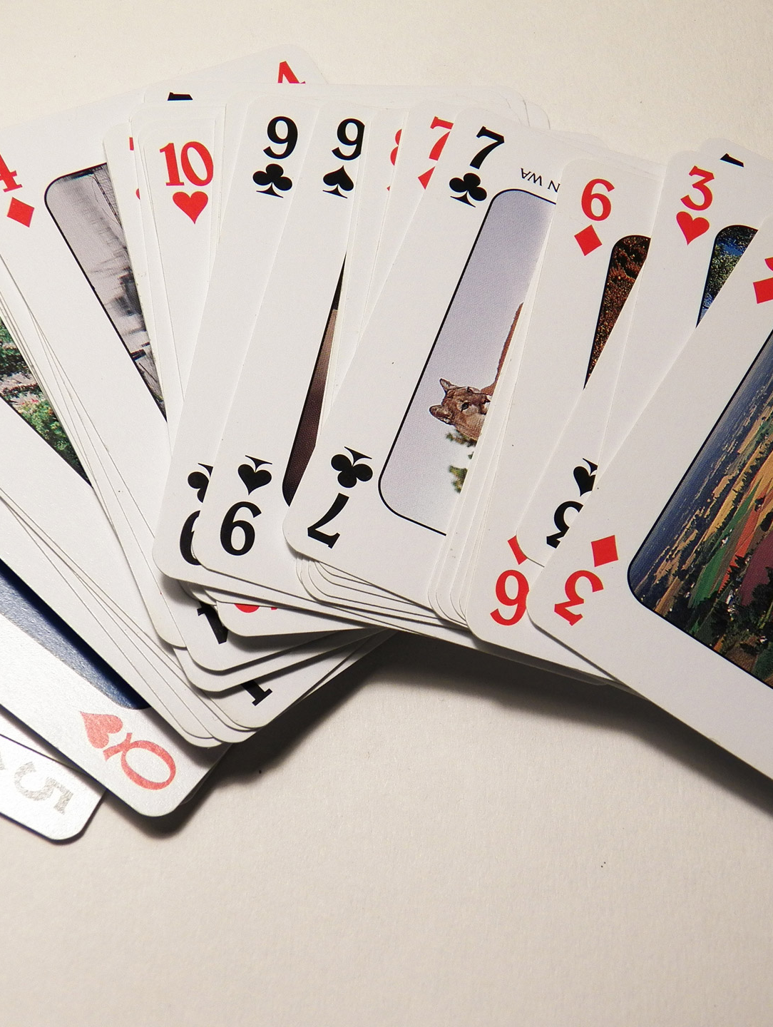
Deques Double-end Queues
Incoming
item
Outgoing
item
back
Item 3
Item 2
length
front
Item 1
Incoming
item
Outgoing
item

Slide 13
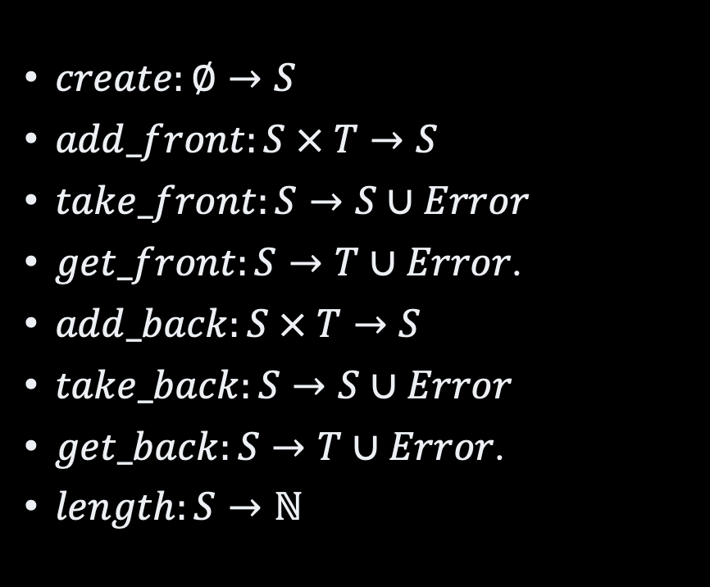
The Deque ADT
Domains
Item, T
Deque, D<T>
Error, E
$create:∅→S$
$add_front:S × T→S$
$take_front:S→S∪Error$
$get_front:S→T∪Error$.
$add_back:S × T→S$
$take_back:S→S∪Error$
$get_back:S→T∪Error$.
$length:S→ℕ$
Exercise What are the axioms?

Slide 14
Deques in Java
java.util.Deque<E>
⚠️ interface
Many implementations
since 1.6

Slide 15
Example: Arithmetic Expression
“12 + [(15 * 3) / 2]) – [(1 + 4) * 3] + 2)”
—How can we check that brackets
are balanced this?

Slide 16

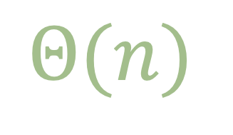
Use a Stack!
public boolean isBalanced(text: String) {
var stack = new Stack<Character>();
for (var any: text) {
if (isOpening(any)) {
stack.push(any);
} else if (isClosing(any)) {
var open = stack.pop();
if (!matchBrackets(open, any))
return false;
} else {}
}
return stack.size() == 0;
}
[(15 * 3) / 2])
$$Θ(n)$$

Slide 17
Recap
Abstract Data Types
Specification vs. implementation
Domains + operations + axioms
Many
Stacks, queues, lists, interval, numbers, wallet, etc
Sequences, with restrictions
Stacks
LIFO: Last in, first out
Queues
FIFO: First in, first out
Deques
Stack + Queue

Slide 18
Questions, Comments, or Ideas?
Franck Chauvel
axbit & NTNU
franck.chauvel@ntnu.no

Slide 19
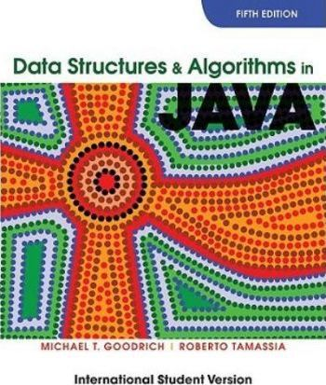
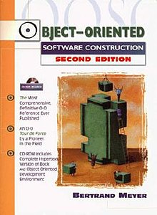
Suggested Readings
M. T. Goodrich, R Tamassia. Stacks and Queues (Chap. 5) in Data Structures and Algorithms in Java. 5th ed. Wiley. 2011
B. Meyer. Abstract Data Types (Chap 6) in “Object-oriented software construction”. Prentice Hall. 1997

