Slide 1
Binary Heaps
Handling Priorities
Week 8 / Lecture 3
Franck Chauvel
axbit & NTNU
Ask questions on menti.com
with code 4780 3393
franck.chauvel@ntnu.no

Slide 2

Beyond FIFO …
Queues
FIFO: First-in first out
How to handle priorities?

Slide 3
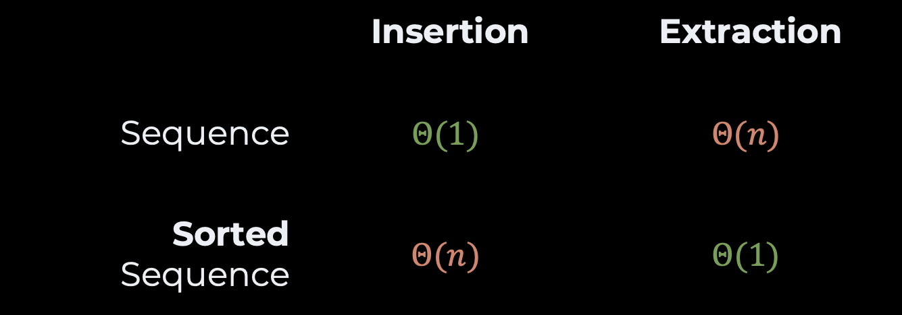
Sequences or Ordered Sequences?
 | Insertion | Extraction
Sequence | $$Θ(1)$$ | $$Θ(n)$$
Sorted Sequence | $$Θ(n)$$ | $$Θ(1)$$

Slide 4
Agenda
ADT: Priority Queue
Binary Heap
Insert(key, value)
extractMin()
Implementation
Heap Sort
Recap

Slide 5
ADT: Priority Queue
add(item)
Add a new element with a given priority
takeNext(): item
Extract the item with the highest priority
isEmpty(): Boolean
True is the binary heap is empty
length(): Integer
Return the number of items in the queue

Slide 6
2. Binary Heap
A different Binary Tree

Slide 7
Binary Trees
Each node has
0, 1 or 2 children
N
L
R

Slide 8
Completness Rules of the Binary Heap
Completeness
All levels are full but the last one
The nodes on the last level are “left-packed”
incomplete
intermediate level
not left-packed
left-packed

Slide 9
Heap Ordering Rules of the Binary Heap
Max-heap
Every node is greater than its children
Min-heap
Every node is smaller than its children
4
7
9
12
45
10
67
12
99
56
78
11

Slide 10
Insertion

Slide 11
Step 1: Insertion Insertion in a Binary Heap
2 steps
Insertion
Ordering
4
7
9
12
45
10
67
12
99
56
78
11
next insertion

Slide 12
Step 2: Reordering Insertion in a Binary Heap
Bubble up
Swap with misplaced child
4
7
9
9
5
10
9
5
12
45
10
67
10
12
99
56
78
11
5
invalid tree!

Slide 13
deletion

Slide 14
Step 1: Deletion Extraction of the minimum
Replace with the last element
rightmost on the last level
4
4
11
7
9
12
45
10
67
12
99
56
78
11
11

Slide 15
Step 2: Reordering Extraction of the minimum
Bubble-down
Chose the child with the smallest / greatest key
Swap with child
11
11
7
11
11
9
7
7
7
9
12
45
10
67
12
99
56
78
invalid tree!

Slide 16
3. Implementation

Slide 17
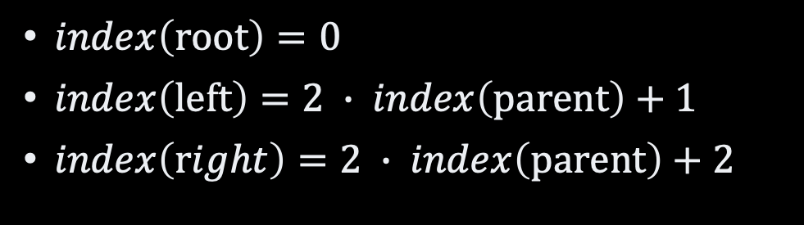
Numbering Nodes
0
4
7
1
9
2
12
3
45
4
10
5
67
6
45
$index\left(root\right)=0$
$index\left(left\right)=2 ∙ index\left(parent\right)+1$
$index\left(right\right)=2 ∙ index\left(parent\right)+2$
12
99
56
78
56
78
11
7
8
9
10
11
12
13
14
0
1
2
3
4
5
6
7
8
9
10
11
4
7
9
12
10
67
12
99
56
78
11
45
56
78
45

Slide 18
The Code Heap Creation
public class Heap<Item extends Comparable<Item>> {
private final ArrayList<Item> items;
public Heap() {
this.items = new ArrayList<Item>();
}
// Helpers
}
private int parentIndex(int childIndex) {
return (childIndex - 1) / 2;
}
private int leftChildIndex(int parentIndex) {
return 2 * parentIndex + 1;
}
private int rightChildIndex(int parentIndex) {
return 2 * parentIndex + 2;
}

Slide 19
The Code Heap Insertion
public Heap<Item> insert(Item givenItem) {
items.add(givenItem);
bubbleUp(lastIndex());
return this;
}
private void bubbleUp(int nodeIndex) {
while (!isRoot(nodeIndex)) {
int parentIndex = parentIndex(nodeIndex);
int difference = itemAt(parentIndex) .compareTo(itemAt(nodeIndex));
if (difference > 0) {
swap(parentIndex, nodeIndex);
}
nodeIndex = parentIndex;
}
}

Slide 20
The Code Heap Top Extraction
public Item next() {
swap(lastIndex(), 0);
Item nextItem = items.remove(lastIndex());
bubbleDown(0);
return nextItem;
}
private void bubbleDown(int parentIndex) {
while (hasAnyChildren(parentIndex)) {
int leastChildIndex = leastChildIndex(parentIndex);
int difference = itemAt(parentIndex) .compareTo(itemAt(leastChildIndex));
if (difference <= 0) break;
swap(parentIndex, leastChildIndex);
parentIndex = leastChildIndex;
}
}

Slide 21
4. Heap Sort

Slide 22
Heap Sort
Random Sequence
4
45
12
78
7
67
56
…
9
Get an array/list of items
Build a heap
Pull out all items in order
Heapify
Binary Heap
4
7
9
12
45
10
67
12
99
56
78
11
Pull
Sorted Sequence
4
7
9
10
11
12
12
…
99

Slide 23
Heapify
12 keys
0
1
2
3
4
5
6
7
8
9
10
11
12
13
14
12
12
67
67
67
99
99
99
11
11
11
45
45
45
7
7
7
56
56
56
4
4
78
78
12
12
10
10
9
9
12
12
4
12
4
10
67
67
99
7
99
45
12
11
45
7
56
67
99
11
10
9
11
4
12
10
99
4
78
9
67
11
45
invalid tree!
invalid tree!
invalid tree!

Slide 24
The Code Heapify
public Heap(Item[] givenItems) {
this.items = new ArrayList<Item>();
for (Item eachItem: givenItems) {
items.add(eachItem);
}
heapify();
}
private void heapify() {
int currentIndex = parentIndex(size()-1);
while (currentIndex >= 0) {
bubbleDown(currentIndex);
currentIndex--;;
}
}

Slide 25
Recap
Priority Queue ADT
Binary Heap
Completeness
Ordering: tree > children
Insert / ExtractMin
Bubbling up and down
Array Implementation
Heap Sort

Slide 26
Questions, Comments, or Ideas?
Franck Chauvel
Axbit & NTNU
franck.chauvel@ntnu.no

