Slide 1
Merge Sort
Sorting with “Divide and Conquer”
Week 6 / Lecture 2
Franck Chauvel
axbit & NTNU
Go to www.menti.com and use the code 66 89 99 1
franck.chauvel@ntnu.no

Slide 2
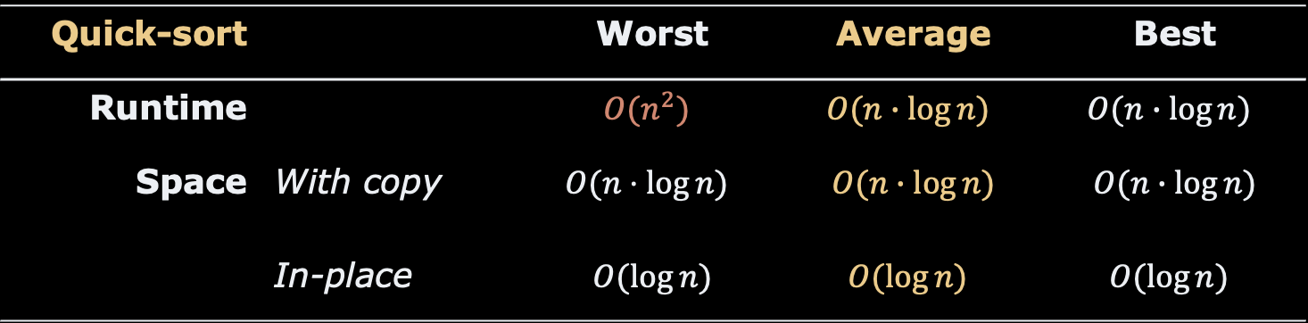
Faster than “Quick sort”?
Quick-sort |  | Worst | Average | Best
Runtime |  | $$O(n^{2})$$ | $$O(n∙\log{n)}$$ | $$O(n∙\log{n)}$$
Space | With copy | $$O(n⋅\log{n)}$$ | $$O(n∙\log{n)}$$ | $$O(n∙\log{n)}$$
 | In-place | $$O(\log{n)}$$ | $$O(\log{n)}$$ | $$O(\log{n)}$$
Can we do better?

Slide 3
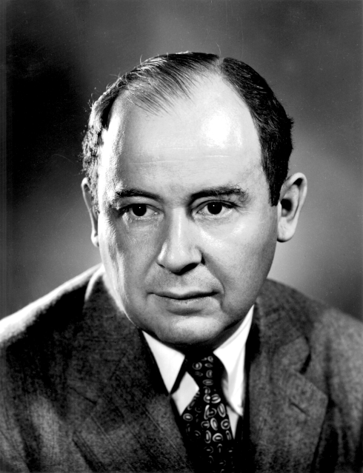
Agenda
The idea: Split and Merge
Merging Ordered Sequences
Merge Sort
Efficiency
Quick-sort vs. Merge-sort
John von Neumann (1903 – 1957)

Slide 4
1. Idea: Split & Merge
Merge sort from 30 000 feet

Slide 5
Split The idea
23
2
7
18
11
10
5
split
23
2
7
18
11
10
5
split
split
23
2
7
18
11
10
split
split
split
23
2
7
18
10
5
23
2
7
18
11
10
5
11
all already sorted!

Slide 6
Merge The idea
many sorted arrays
23
2
7
18
11
10
5
merge
merge
merge
2
23
7
18
10
11
merge
merge
2
7
18
23
5
10
11
merge
2
5
7
10
11
18
23
Sorted!

Slide 7
2. How to “merge”?
these sorted sequences

Slide 8

Merging Sorted Sequences The idea
minimum
sorted
2
7
18
23
5
10
11
sorted
minimum
merge
2
5
7
10
11
18
23

Slide 9

Merging Sorted Sequences The Code
static int[] merge(int[] left, int[] right, int[] merged) {
int leftIndex = 0, rightIndex = 0;
while (leftIndex < left.length && rightIndex < right.length) {
if (left[leftIndex] <= right[rightIndex]) {
merged[leftIndex + rightIndex] = left[leftIndex];
leftIndex += 1;
} else {
merged[leftIndex + rightIndex] = right[rightIndex];
rightIndex += 1;
}
}
while (leftIndex < left.length) {
merged[leftIndex + rightIndex] = left[leftIndex];
leftIndex += 1;
}
while (rightIndex < right.length) {
merged[rightIndex + leftIndex] = right[rightIndex];
rightIndex += 1;
}
return merged;
}

Slide 10

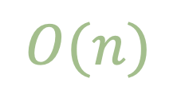
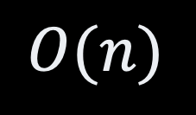
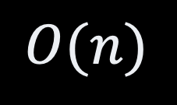
Merging Sorted Sequence Runtime Efficiency
static int[] merge(int[] left, int[] right, int[] merged) {
int leftIndex = 0, rightIndex = 0;
while (leftIndex < left.length && rightIndex < right.length) {
if (left[leftIndex] <= right[rightIndex]) {
merged[leftIndex + rightIndex] = left[leftIndex];
leftIndex += 1;
} else {
merged[leftIndex + rightIndex] = right[rightIndex];
rightIndex += 1;
}
}
while (leftIndex < left.length) {
merged[leftIndex + rightIndex] = left[leftIndex];
leftIndex += 1;
}
while (rightIndex < right.length) {
merged[rightIndex + leftIndex] = right[rightIndex];
rightIndex += 1;
}
return merged;
}
$$O(n)$$
$$O(n)$$
$$O(n)$$
$$O(n)$$

Slide 11
3. Merge Sort
Putting pieces together

Slide 12
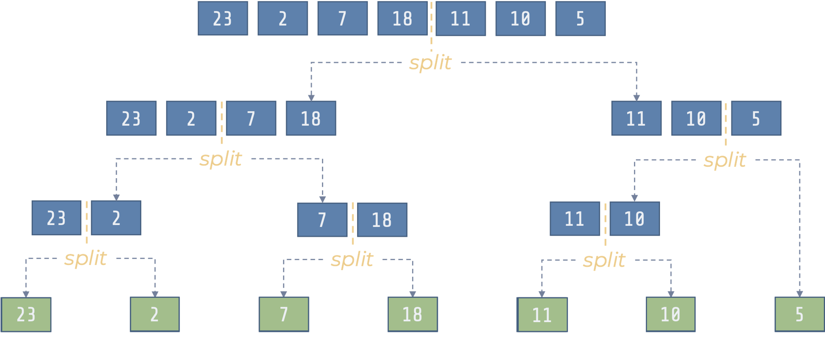
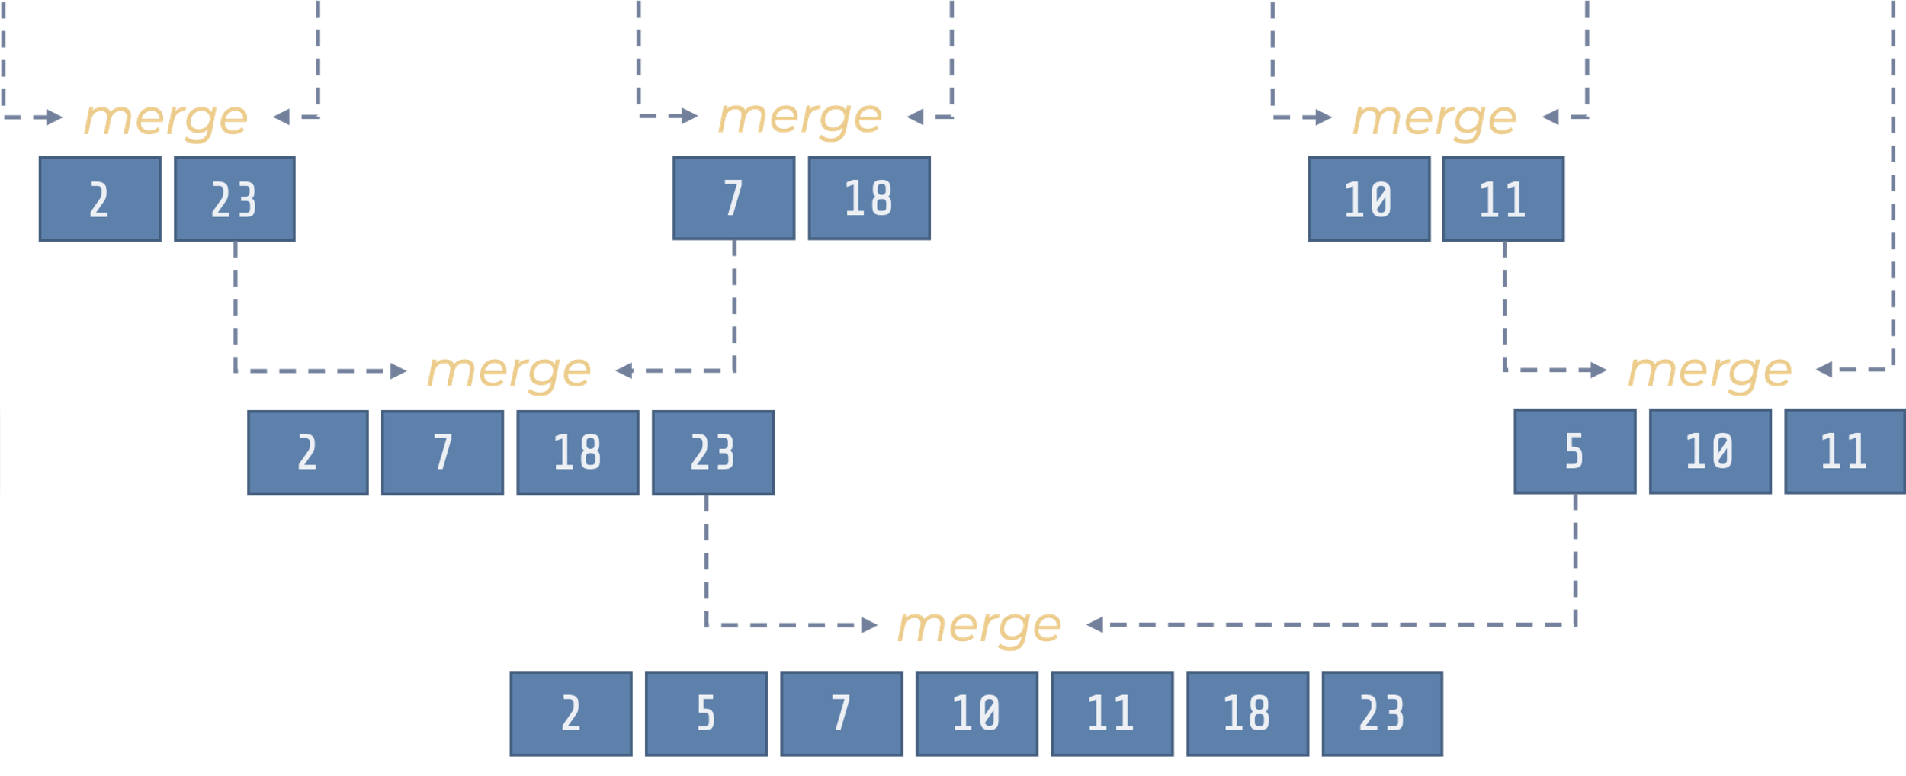
The Merge Sort
Recursive
left, right = split(array)
merge(sort(left), sort(right))

Slide 13
Merge Sort The Code
static int[] mergeSort(int[] array) {
if (array.length < 2) {
return array;
}
int middle = (int) array.length / 2;
int[] left = new int[middle];
for (int i=0 ; i<middle ; i++) left[i] = array[i];
int[] right = new int[array.length-middle];
for (int i=0 ; i<array.length-middle ; i++) right[i] = array[middle+i];
int[] result = new int[array.length];
return merge(mergeSort(left), mergeSort(right), result);
}
base cases
(recursion)
split
merge

Slide 14
4. Efficiency
Runtime & Memory

Slide 15
Merge Sort Memory Efficiency
static int[] mergeSort(int[] array) {
if (array.length < 2) {
return array;
}
int middle = (int) array.length / 2;
int[] left = new int[middle];
for (int i=0 ; i<middle ; i++) left[i] = array[i];
int[] right = new int[array.length-middle];
for (int i=0 ; i<array.length-middle ; i++) right[i] = array[middle+i];
int[] result = new int[array.length];
return merge(mergeSort(left), mergeSort(right), result);
}

Slide 16

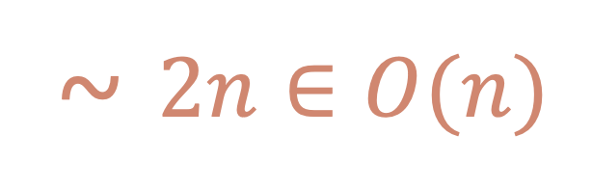




Merge Sort Memory Efficiency
~ $2n∈O(n)$
allocation
$$n$$
23
2
7
18
11
10
5
split
$$2 ×\frac{n}{2}$$
23
2
7
18
11
10
5
split
split
$$4 ×\frac{n}{4}$$
23
2
7
18
11
10
split
split
split
$$n ×\frac{n}{n}$$
23
23
2
2
7
7
18
18
11
10
10
5
11
5

Slide 17



Merge Sort Runtime Efficiency
return merge(mergeSort(left), mergeSort(right), result);
$$time∈O(n)$$
$$\frac{n}{2}$$
$$n$$

Slide 18
Master Theorem Simple form
if
then

Slide 19

So What?

Slide 20
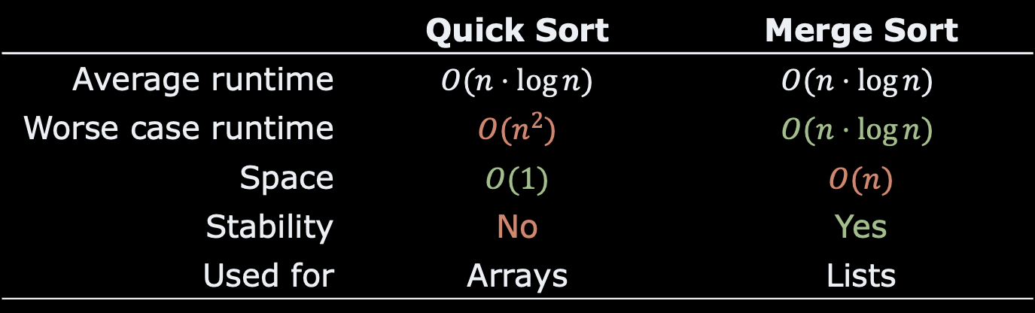
Quick Sort vs. Merge Sort
 | Quick Sort | Merge Sort
Average runtime | $$O(n⋅\log{n)}$$ | $$O(n⋅\log{n)}$$
Worse case runtime | $$O(n^{2})$$ | $$O(n⋅\log{n)}$$
Space | $$O(1)$$ | $$O(n)$$
Stability | No | Yes
Used for | Arrays | Lists

Slide 21
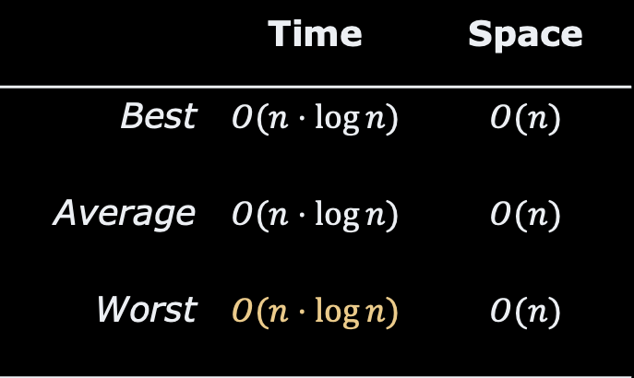
Recap
Merge Sort is Fast
Alternative to Quick sort
Recursive
Merging sorted sequences
Master Theorem
 | Time | Space
Best | $$O(n⋅\log{n})$$ | $$O(n)$$
Average | $$O(n⋅\log{n})$$ | $$O(n)$$
Worst | $$O(n⋅\log{n})$$ | $$O(n)$$

Slide 22
Questions, Comments, or Ideas?
Franck Chauvel
Axbit & NTNU
franck.chauvel@gmail.com

