Slide 1
Selected Graph Algorithms
Minimum Spanning Trees and Maximum Flows
Week 10 / Lecture 3
Franck Chauvel
axbit & NTNU
Go to www.menti.com and use the code 1147 7932
franck.chauvel@ntnu.no

Slide 2
Putting down wires
Trondheim
12
Max-flow networks
Ålesund
4
5
12
Lillehammer
12
Bergen
Hamar
10
20
Minimum
Spanning Trees
Oslo
8
18
14
Kristiansand

Slide 3
Agenda
Minimum Spanning Trees
Prim’s Algorithm
Kruskal’s Algorithm
Maximum Flow
Residual Flows and Augmenting paths
Ford-Fulkerson
Recap on Graphs

Slide 4
Minimum Spanning Trees

Slide 5
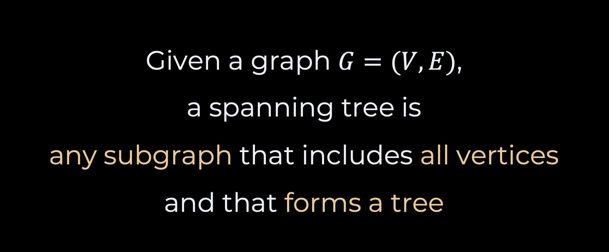
Spanning Trees
Given a graph $G=(V,E)$, a spanning tree is any subgraph that includes all vertices and that forms a tree

Slide 6
Examples Spanning Trees
A
a graph
B
C
A
A
A
B
C
C
B
C
B

Slide 7
More Examples
-4
1
C
B
E
3
2
-5
1
4
D
A
A

Slide 8
Finding Spanning Trees?
Depth-first Search
Breadth-first Search
C
B
E
C
B
E
D
A
A
D
A
A

Slide 9
Minimum Spanning Trees For weighted graphs
Weighted Graphs
Spanning Tree with
Minimum Total Weight
-4
1
C
B
E
3
2
-5
1
4
D
A
A

Slide 10
Prim’s Algorithm
MST
under construction
A
D
C
-4
1
C
C
B
E
B
E
3
3
1
5
3
2
-5
1
8
G
E
4
D
D
A
B
A
F
unvisited vertices

Slide 11
The Code Prim’s Algorithm
public Tree<T> prim() {
var tree = new Tree<T>();
var edges = allEdges();
while (tree.size() < size()) {
var minimumEdge = findMinimumEdge(tree, edges);
if (!tree.contains(minimumEdge.start) || !tree.contains(minimumEdge.end)) {
tree.add(minimumEdge);
}
edges.remove(minimumEdge);
}
return tree;
}

Slide 12
Kruskal’s Algorithm
3
A
D
-4
1
4
5
C
B
E
2
3
C
B
B
3
2
1
-5
8
7
1
4
B
B
D
A
9
Idea: Merging spanning trees

Slide 13
The Code Kruskal’s Algorithm
public Tree<T> kruskal() {
var trees = new ArrayList<Tree<T>>();
for (var eachVertex: vertices) trees.add(new Tree<T>(eachVertex));
var edges = allEdges();
while (!anySpanningTree(trees)) {
var minimumEdge = findMinimumEdge(edges);
var startTree = findTree(trees, minimumEdge.start);
var endTree = findTree(trees, minimumEdge.end);
if (startTree != endTree) {
merge(trees, startTree, endTree);
}
edges.remove(minimumEdge);
}
return anySpanningTree(trees);
}
often implemented with
an union-find data structure

Slide 14
Maximum Flows

Slide 15
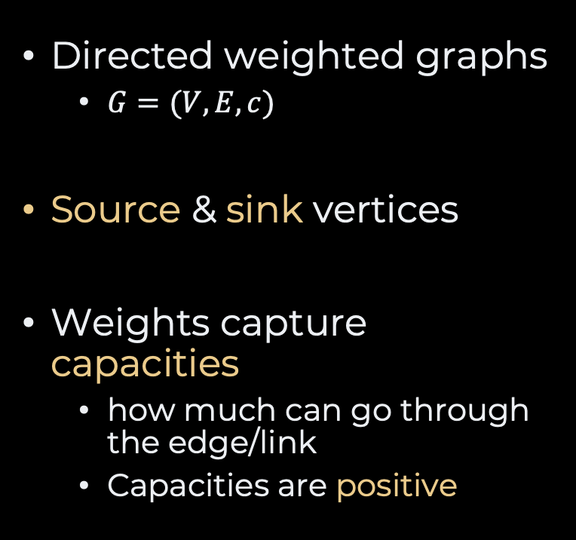
Flow Networks
Trondheim
12
capacities
Directed weighted graphs
$G=(V,E, c)$
Source & sink vertices
Weights capture capacities
how much can go through the edge/link
Capacities are positive
Ålesund
4
5
12
Lillehammer
12
Hamar
Bergen
Hamar
Bergen
10
source
20
sink
Oslo
8
18
14
Kristiansand

Slide 16
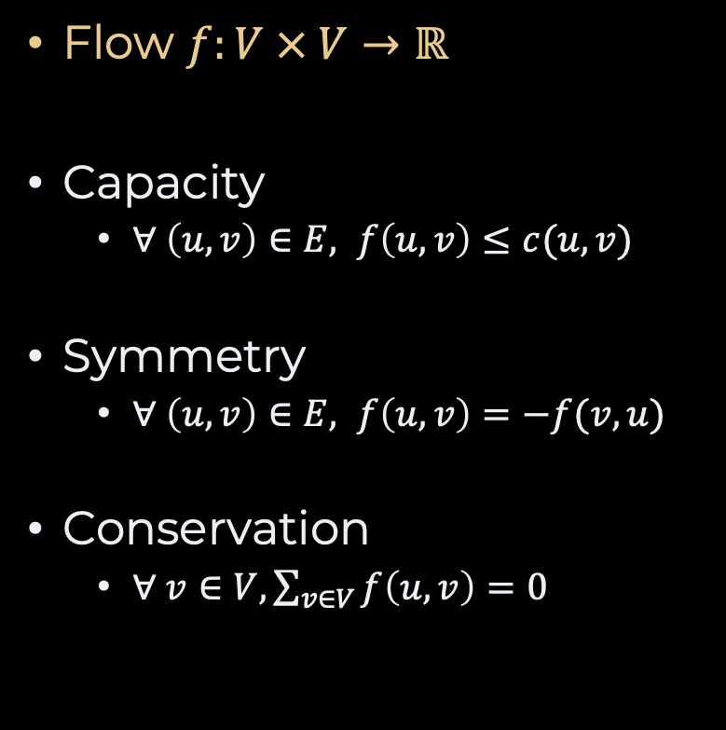
Flows
Trondheim
2 /
12
Flow $f:V × V→ℝ$
Capacity
$∀ \left(u,v\right)∈E, f\left(u,v\right)≤c(u,v)$
Symmetry
$∀ \left(u,v\right)∈E, f\left(u,v\right)=−f(v, u)$
Conservation
$∀ v∈V, \sum_{v∈V}{f\left(u, v\right)=0}$
Ålesund
2 /
4
4 /
5
2 /
12
8 /
12
Lillehammer
Hamar
Bergen
Hamar
Bergen
source
1 /
20
4 /
10
sink
Oslo
8 /
8
3 /
18
8 /
14
Kristiansand

Slide 17

Residual Networks
Trondheim
10 /
12
How much extra can be pushed between vertices?
$r\left(u,v\right)=c\left(u,v\right)−f(u,v)$
Ålesund
2 /
4
1 /
5
10 /
12
Lillehammer
4 /
12
Hamar
Bergen
Hamar
Bergen
source
19 /
20
6 /
10
sink
Oslo
0 /
8
15 /
18
6 /
14
Kristiansand

Slide 18
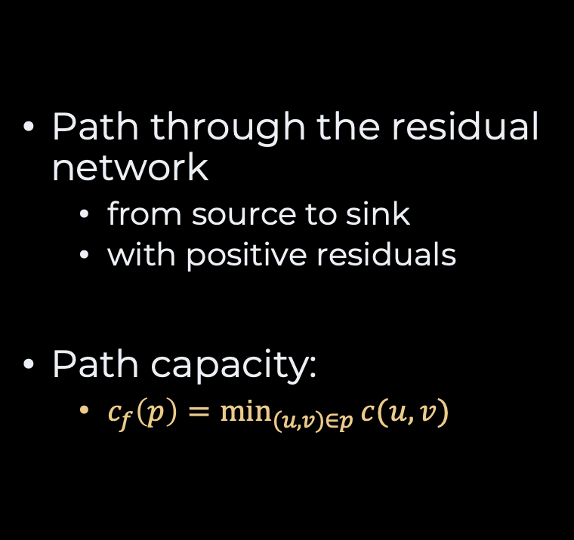
Augmenting Paths
Trondheim
10 /
12
Path through the residual network
from source to sink
with positive residuals
Path capacity:
$c_{f}\left(p\right)=\min_{(u,v)∈p}{c(u,v)}$
Ålesund
2 /
4
1 /
5
10 /
12
Lillehammer
4 /
12
Hamar
Bergen
Hamar
Bergen
source
6 /
10
sink
source
19 /
20
Oslo
0 /
8
15 /
18
6 /
14
Kristiansand

Slide 19
Slow Motion Ford-Fulkerson Algorithm
Trondheim
12 /
12
Ålesund
4 /
4
minimum
12 /
12
5 /
7 /
0 /
5
12 /
12
Lillehammer
7 /
Hamar
Bergen
Hamar
Bergen
source
20 /
20
10 /
10
sink
Oslo
10 /
18
minimum
8 /
8
18 /
0/
6 /
14 /
14
Kristiansand

Slide 20
Slow Motion Ford-Fulkerson Algorithm
Ålesund
4
5 /
5
5 /
12
Lillehammer
5 /
12
Hamar
Bergen
Hamar
Bergen
source
sink
Oslo
8/
8
8 /
18
8 /
14
Kristiansand

Slide 21
The Code Ford-Fulkerson
public Graph<T> newZeroFlow() {
var graph = new Graph();
for (var eachEdge: allEdges()) {
graph.connect(eachEdge.start,
eachEdge.end,
eachEdge.capacity);
}
return graph;
}
public void augmentWith(Path<T> path) {
int minimumFlow = path.minimumFlow();
for (var anyEdge: path.edges.values()) {
var edge = findEdge(anyEdge.start,
anyEdge.end);
edge.reserve(minimumFlow);
}
}
public Graph<T> maximumFlowBetween(T source, T sink) {
var flow = newZeroFlow();
var path = flow.searchAugmentingPath(source, sink);
while (path != null) {
flow.augmentWith(path);
path = flow.searchAugmentingPath(source, sink);
}
return flow;
}

Slide 22
Searching For Augmenting Paths
public Path<T> searchAugmentingPath(T source, T sink) {
var path = new Path<T>();
var visited = new HashSet<T>();
var nextVertices = new LinkedList<T>();
nextVertices.add(source);
while (!nextVertices.isEmpty()) {
var current = nextVertices.remove(0);
visited.add(current);
for(var eachEdge: edgesFrom(current)) {
if (eachEdge.hasResidual() && !visited.contains(eachEdge.end)) {
path.add(eachEdge);
nextVertices.add(eachEdge.end);
if (eachEdge.end == sink) return path;
}
}
}
return null;
}
breadth-first search
dijkstra’s
etc.

Slide 23
Recap
Minimum spanning trees
Prim: MST + Vertex
Kruskal: MST + MST
Maximum Flow
Residual
Augmenting Path
Many more graphs problems
Connected components
Longest path
Transitive closure
Graph Coloring
Graph Isomorphism
Topological Sorting
Vertex Cover
Traveling Salesperson Problem
Vehicule Routing Problem
etc.

Slide 24
Questions, Comments, or Ideas?
Franck Chauvel
Axbit & NTNU
franck.chauvel@ntnu.no

