Slide 1
Heuristic Search
Search through Infinite Spaces
Week 11 / Lecture 3
Franck Chauvel
axbit & NTNU
Go to www.menti.com and use the code 2226 1383
franck.chauvel@ntnu.no

Slide 2
Just too many
Hard problems
TSP, SAT, Clique, vertex cover, subsets, etc.
A set of 100 elements has
1,26x 10^30 partition
Total number of DNA pair on Earth (biomass) is 3.6 x 10^37
Infinitely many solution?
Continuous domain

Slide 3
Agenda
What is Optimization?
Random Walks
Hill Climbing
Simulated Annealing
Tabu Search

Slide 4





Knapsack Problem
2 kg / 9 000 NOK
laptop
7 kg / 3 000 NOK
books
3 kg / 4 000 NOK
music instruments
8 kg / 7 000 NOK
cooking tools
box (max 10 kg)

Slide 5
Neighbourhood
What is a solution
What can we change?
Constraint & Reachability
{C}
{B, C, L}
-L
+B
{C, L}
-C
+M
{L}
{C, L, M}

Slide 6
Solution Landscape
{B, C}
{B}
{B, L}
{B, C, L}
{C}
{B, M}
{B, C, M}
{}
{B, C, L, M}
{L}
{C, L}
{B, L, M}
{M}
{C, M}
{C, L, M}
{L, M}

Slide 7
Fitness Landscape
10 000 NOK
{B, C}
15 kg
3 000 NOK
12 000 NOK
19 000 NOK
{B}
{B, L}
{B, C, L}
7 kg
9 kg
17 kg
7 000 NOK
{C}
7 000 NOK
{B, M}
14 000 NOK
{B, C, M}
0 NOK
8 kg
10 kg
18 kg
23 000 NOK
{}
{B, C, L, M}
0 kg
9 000 NOK
{L}
16 000 NOK
{C, L}
14 000 NOK
{B, L, M}
20 kg
2 kg
10 kg
12 kg
4 000 NOK
{M}
11 000 NOK
{C, M}
20 000 NOK
{C, L, M}
3 kg
11 kg
13 kg
13 000 NOK
{L, M}
5 kg

Slide 8
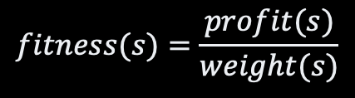
Looking at NOK/kg Fitness Landscape
$$fitness(s)=\frac{profit(s)}{weight(s)}$$
666
{B, C}
428
{B}
1333
{B, L}
1 117
{B, C, L}
875
{C}
700
{B, M}
777
{B, C, M}
{}
1150
{B, C, L, M}
4 500
{L}
1 600
{C, L}
1166
{B, L, M}
1 333
{M}
1 000
{C, M}
1538
{C, L, M}
2 600
{L, M}

Slide 9
Mutliple Objectives
23 000
{B, C, L, M}
pareto front
20 000
{C, L, M}
19 000
{B, C, L}
16 000
{C, L}
14 000
{B, L, M}
{B, C, M}
13 000
{L, M}
{B, L}
12 000
11 000
{C, M}
10 000
{L}
{B, C}
9 000
7 000
{C}
{B, M}
4 000
{M}
3 000
{B}
0
{}
0
2
3
5
7
8
9
10
11
12
13
15
17
18
19
20

Slide 10
How to find the optimal solution? when the problem is large or infinite

Slide 11
Random Walk
We walk the solution space randomly
Remembering the best solution we found.
Stop when we are bored
If we wait long enough,
we are guaranteed to find the best solution

Slide 12
The Code Random Walk
static Solution randomWalk(Problem problem, int limit) {
var current = problem.simpleSolution();
var bestSoFar = current;
for (int stepCount=0 ; stepCount < limit ; stepCount++) {
current = problem.randomNeighbourOf(current);
bestSoFar = problem.bestOf(bestSoFar, current);
}
return bestSoFar;
}

Slide 13
Good Enough
cheapest
cost
initial
solution
The optimal solution may not worth
the time it takes to find it.
sub optimal
solution
optimal
solution
time

Slide 14
How to find the optimal solution faster?

Slide 15
Hill Climbing
Move to the fittest neighbour
if it is increase the fitness
Steppest ascent
N1
N6
N2
S
N5
N3
N4

Slide 16
The Code Hill Climbing
static Solution hillClimbing(Problem problem, int limit) {
var solution = problem.simpleSolution();
for (int stepCount=0 ; stepCount < limit ; stepCount++) {
boolean noProgres = true;
for (var eachNeighbour: problem.neighboursOf(solution) {
solution = problem.bestOf(solution, eachNeighbour);
noProgress &= solution != eachNeighbour;
}
if (noProgress) break;
}
return solution;
}

Slide 17
Traps
Follow the slope
Problem
Local extrema
plateau/shoulder
ridges
fitness
solutions

Slide 18
Hill Climbings Variants
Stochastic Hill Climbing
Pick a better neighbor
at random
Iterated Hill Climbing
Rince and Repeat
Gradient Descent
Follow the derivative of
the fitness function
Beam Search
best k-neighbours
of k solutions

Slide 19
Simulated Annealing
A way to

Slide 20




Annealing
Metallurgy
Change in hardness
by heat and cooling down
temperature
crystallisation
time
$$t_{1}$$
$$t_{2}$$
$$t_{3}$$
$$t_{4}$$

Slide 21
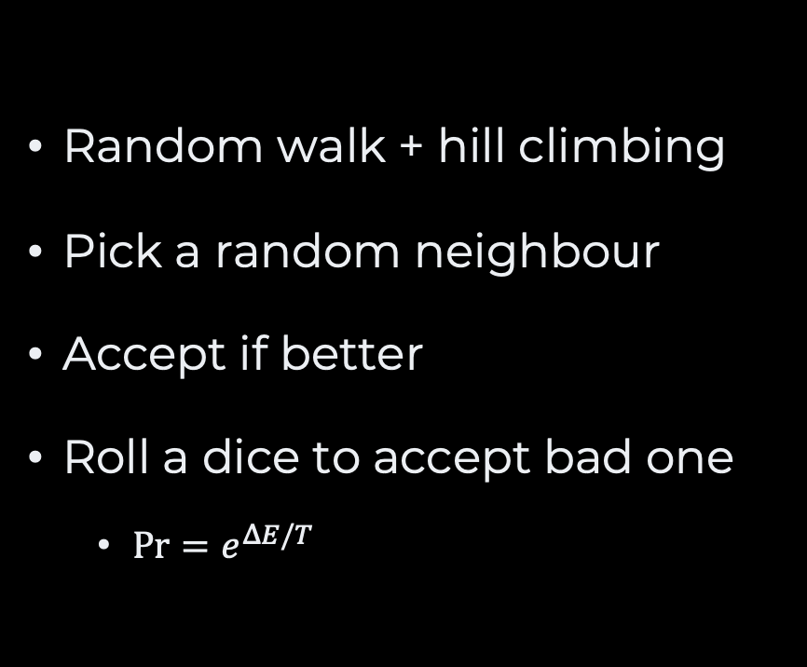
Simulated Annealing
Random walk + hill climbing
Pick a random neighbour
Accept if better
Roll a dice to accept bad one
$\operatorname{Pr}{=e^{ΔE/T}}$
temperature
(time)
Unlikely
accepted
Very rarely
accepted
Possibly
accepted
Unlikely
accepted
Very Likely
accepted
Possibly
accepted
Not too bad
Very bad

Slide 22
The Code Simulated Annealing
static Solution simulatedAnnealing(Problem problem, Schedule schedule) {
var solution = problem.simpleSolution();
var time = 0;
var temperature = schedule.temperatureAt(time);
while (temperature != 0) {
var candidate = problem.randomNeighbourOf(solution);
var profit = problem.profit(solution, candidate);
if (profit > 0 || random() < Math.exp(profit/temperature)) {
solution = candidate;
}
temperature = schedule.temperature(++time);
}
return current;
}

Slide 23
Takeaway
Given an infinte time, simulated annealing will eventually find the global optima

Slide 24
Tabu Search
What if we remember the past solutions

Slide 25
The Idea Tabu Search
Accept “bad moves”
pick the best neighbour
Remember some past
Don’t go back
0
2
0
4
0
2
3
2
0
3
1
0
1
2
0
0

Slide 26
The Code Tabu Search
static Solution tabuSearch(Problem problem, int limit) {
var tabu = new ArrayList<Solution>();
var current = problem.simpleSolution();
var best = current;
tabu.add(current);
for (int stepCount=0 ; stepCount<limit ; stepCount++) {
current = problem.bestNeighbour(current, tabu);
best = problem.bestOf(current, best);
tabu.add(current);
}
}

Slide 27
Many More Algorithms
Linear Programming
Breaking Linear
Equations
PSO
Particle Swarm Optimization
Genetic Algorithms
Mimic and evolution
process
Ant Colonny
Mimic how ants find
and exploit resources

Slide 28
Tackling Hard Problems
Read solution and similar problems
What neighborhood
what fitness
Select a set of problem instances
Develop a simple/naïve solution
Collect statistics
Improve
ORTools
Z3
Depends on the problem
SAT
VRP
etc.

Slide 29

Further Readings
Artificial Intelligence: A Modern Approach by Peter Norvig and Stuart J. Russell
4th Edition

Slide 30
Questions, Comments, or Ideas?
Franck Chauvel
Axbit & NTNU
franck.chauvel@ntnu.no

