Slide 1
Regular Expressions
A little more on finite automata
Computational Complexity/ Lecture 2
Franck Chauvel
axbit & NTNU
Go to www.menti.com and use the code 8780 6768
franck.chauvel@ntnu.no

Slide 2
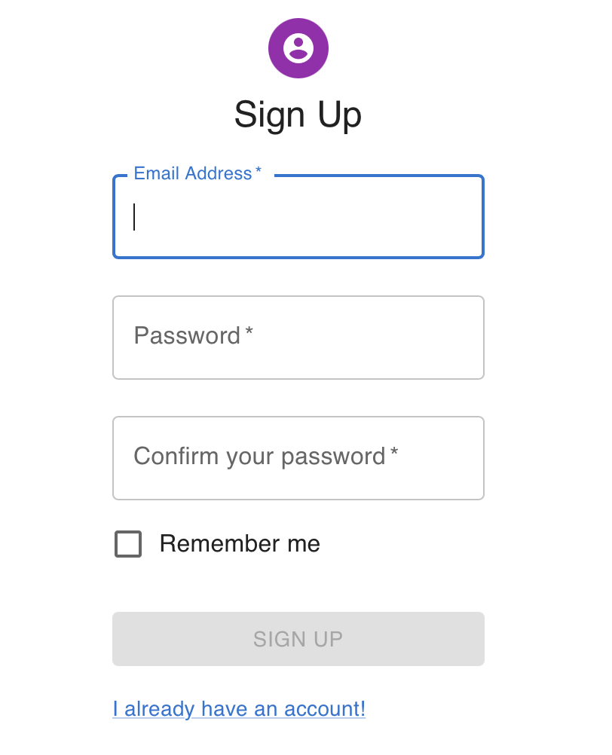
Input Validation
What is a valid email?
What is a valid date?
Infinitely many emails, dates, etc.
Set membership

Slide 3
Regular Expressions
A valid email matches
.+@.+\..+
A valid email matches
[0-9]{2}/[0-9]{2}/[0-9]{4}

Slide 4
Simple Dates Regular Expressions Example
[0-9]{2}/[0-9]{2}/[0-9]{4}
A symbol in the set
{0, 1, 2, ... , 9}
x2
“/”
A symbol in the set
{0, 1, 2, ... , 9}
x2
“/”
A symbol in the set
{0, 1, 2, ... , 9}
x4

Slide 5
Simple Emails Regular Expressions Example
.+@.+\..+
whatever
at least
once
the
“@”
symbol
whatever
at least
once
the
“.”
symbol
whatever
at least
once

Slide 6
Regex = Finite Automaton
[0-9]{2}/[0-9]{2}/[0-9]{2}
[0-9]
[0-9]
/
[0-9]
[0-9]
/
[0-9]
[0-9]

Slide 7
Agenda
What are “Regular Expressions”?
How to Build an Automaton?
How to make it “deterministic”?
How to make it minimal
Recap

Slide 8
How to Build an Automaton?
regex text
ab
Parsing
→
Syntax Tree
a
b
Generation
a
b
Automaton
0
1
2

Slide 9
Syntax Trees
ab
(ab)|c
((ab)|c)?
(((ab)|c)?)|([def])*
?
|
|
→
→
c
|
?
*
a
b
a
b
→
c
|
[def]
a
b
→
c
a
b

Slide 10








A “Grammar” For simple regular expressions
$$RE ∷=RE_{1}→RE_{2}$$
concatenation / sequence
$∷=RE_{1}∗$
zero to many repetitions
$$∷=RE_{1}+$$
one to many repetitions
$$∷=RE_{1} ?$$
zero to one repetitions
$$∷=RE_{1} | RE_{2}$$
alternative
$$∷=[s_{1}, s_{2},…, s_{n}]$$
a symbol from a given set
$$∷=s$$
a given symbol
$$∷=( RE_{1} )$$
a regex delimited by brackets

Slide 11
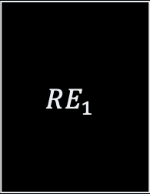


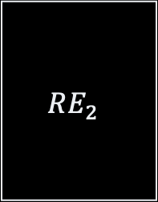

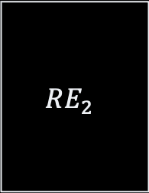
Building Finite Automata
$$RE ∷=RE_{1}→RE_{2}$$
$$RE ∷=RE_{1} | RE_{2}$$
$$RE_{1}$$
$$RE_{1}$$
$$RE_{2}$$
ε
ε
ε
$$RE_{2}$$
ε

Slide 12
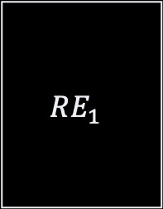

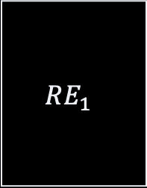

Finite Automata
$$RE ∷=RE_{1} ?$$
$$RE ∷=RE_{1}+$$
$$RE_{1}$$
$$RE_{1}$$
ε
ε
ε
ε
ε
ε

Slide 13
Example From a regex to an automaton
a
(((ab)|c)?)|([aef])+
e
|
ε
f
?
ε
+
a
ε
b
|
ε
ε
[def]
ε
c
ε
→
c
ε
a
b

Slide 14
Non-Deterministic Automata The cost of ε-transitions
Which state should I reach on an “a”?
State 8?
State 2?
a
e
ε
f
8
9
ε
a
ε
b
ε
1
2
3
4
ε
0
ε
7
c
ε
5
6
ε

Slide 15
3. How to make it “deterministic”?

Slide 16
NFA-determinization ε-transitions & conflicting transitions
a
e
a,e,f
ε
f
8
9
{8, 9}
ε
a,e,f
a
b
{2, 3, 8, 9}
ε
ε
1
2
3
4
ε
a
b
0
ε
7
{0,1,5,7,8}
{7}
c
ε
5
6
c
ε
{6, 7}

Slide 17
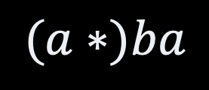
Minimality
a
0
a
2
0
a
b
b
b
$$(a∗)ba$$
1
3
1
a
a
a
4
2

Slide 18
4. How to make it minimal?

Slide 19





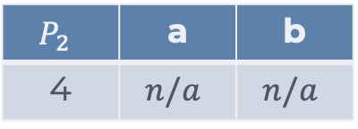
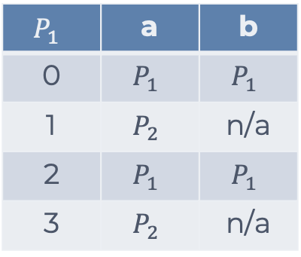
Minimality
$$P_{1}$$
a
$$P_{1}$$ | a | b
0 | $$P_{1}$$ | $$P_{1}$$
1 | $$P_{2}$$ | n/a
2 | $$P_{1}$$ | $$P_{1}$$
3 | $$P_{2}$$ | n/a
a
$$P_{1}$$
0
a
2
a
0
2
b
b
b
b
1
3
1
3
$$P_{3}$$
$$P_{2}$$
a
a
$$P_{2}$$ | a | b
4 | $$n/a$$ | $$n/a$$
a
a
4
$$P_{2}$$
4

Slide 20


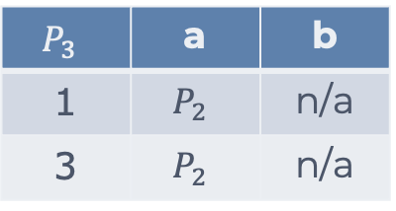

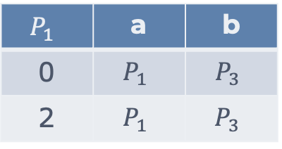
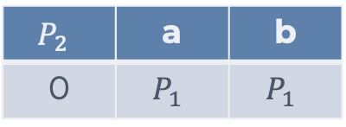



Minimality
$$P_{1}$$ | a | b
0 | $$P_{1}$$ | $$P_{3}$$
2 | $$P_{1}$$ | $$P_{3}$$
a
$$P_{1}$$
a
$$P_{1}$$
0
a
2
a
0
2
b
b
$$P_{3}$$ | a | b
1 | $$P_{2}$$ | n/a
3 | $$P_{2}$$ | n/a
b
b
1
3
$$P_{3}$$
$$P_{3}$$
1
3
a
a
$$P_{2}$$
a
a
$$P_{2}$$
4
4
$$P_{2}$$ | a | b
0 | $$P_{1}$$ | $$P_{1}$$

Slide 21



Minimality
$$P_{1}$$ | a | b
0 | $$P_{1}$$ | $$P_{3}$$
2 | $$P_{1}$$ | $$P_{3}$$
a
0
a
2
$$P_{1}$$
a
b
b
$$P_{3}$$ | a | b
1 | $$P_{2}$$ | n/a
3 | $$P_{2}$$ | n/a
b
1
3
$$P_{3}$$
a
a
a
4
$$P_{2}$$
$$P_{2}$$ | a | b
0 | $$P_{1}$$ | $$P_{1}$$

Slide 22
Full Blown Regex
back referencing
named groups
word boundaries
etc.
sed, grep, awk, perl
Java, Python, Javascript, Ruby, etc.
See RegexPlanet

Slide 23

How Powerful Are Regex?
Regular languages
DFA
What automaton recognizes $a^{n}b^{n}$ ?
Recursively enumerable
Context sensitive
Context-free
Regular (Regex)

Slide 24
Recap
Regex: Useful tool!
Learn it
For every set, there is an ”automaton” that recognizes its member
Finite Automata
DFA: we always know where to go next
NFA: we don’t because of ε-transition
Compilation 101
Build a tree
Transform that tree into something useful
Optimize the output

Slide 25
Questions, Comments, or Ideas?
Franck Chauvel
Axbit & NTNU
franck.chauvel@ntnu.no

