Slide 1
Linked Lists
Non-contiguous Memory Allocation
Recursion / Lecture 3
Franck Chauvel
axbit & NTNU
Ask questions on menti.com with the code 1727 7990
franck.chauvel@ntnu.no

Slide 2
Beyond Arrays?
Using Arrays
Contiguous memory fragment
Insertion/deletion are expensive
Require resizing at some point.
Linked List

Slide 3
Agenda
Sequence using Nodes
Singly Linked Lists
Doubly Linked Lists
Iteration
Theory: A Recursive Data Type
Recap

Slide 4
What Is a Linked-list?
@6754
@0033
Data Structure
Implement the Sequence ADT
Each item goes into its own record
Each record points to the next
head
john
0033
1234
Header
next
@1234
Laura
4567
class List<T> {
Node<T> head;
}
class Node<T> {
T item;
Node<T> next;
}
next
@4567
Hilde
NULL

Slide 5
Space-efficiency
Linked list requires
more memory than arrays
We need to store
an extra pointer
for each item

Slide 6
Creating a Linked List
Create an empty “list” record
Head “points” nowhere
@6754
NULL
Header

Slide 7
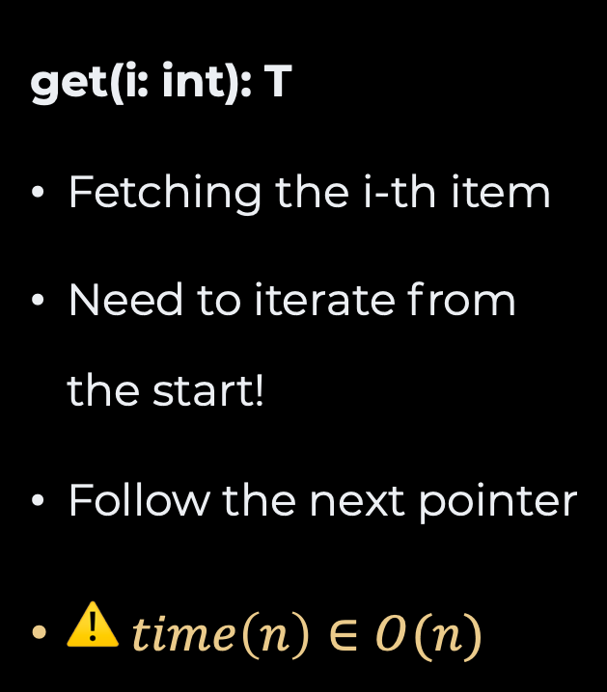
Access
@6754
get(i: int): T
Fetching the i-th item
Need to iterate from the start!
Follow the next pointer
$⚠️ time\left(n\right)∈O(n)$
@0033
head
john
0033
1234
Header
next
@1234
Laura
4567
next
@4567
Hilde
NULL

Slide 8

Insertion
Allocate a new node
Find the “previous” node
Set next of new node to the next of previous
Set next of previous to new node
List
First
Node N-1
/
New Node
Node N
/

Slide 9
Insertion in Front
Allocate a new node
Set the list head to be the new node
List
First
New Node
Node 1
/

Slide 10
Search
Plain old linear search
Just like for arrays
int search(List* list, int value) {
int index = -1;
Node* current = list-> first;
while (current != NULL) {
index += 1;
if (current->value == value) {
return index;
}
current = current->next;
}
return -1;
}

Slide 11
Deletion
Find the “previous” node
Save a reference to the target
Set next of previous to be the next of the next of previous
Free target node
Node N-1
Node N
Node N+1

Slide 12
Deletion (in Front)
Save a reference to the target
Set head to be the next of the next of head
Free target node
List
first
Node 1
Node 2
/

Slide 13
“Doubly” Linked Lists
List
Each node points forward and backward
last
first
/
Node 1
n
p
Node 2
n
p
Node 3
/

Slide 14
Insertion
List
void
insert(List* list, int value, int index) {
Node* new_node = malloc(sizeof(Node));
new_node->value = value;
Node* previous = getNode(list, index-1);
new_node->previous = previous;
new_node->next = previous->next;
previous->next->previous = new_node;
previous->next = new_node;
}
last
first
/
Node 1
n
p
Node 3
n
p
Node 2
/

Slide 15
Insertion (at the end)
void
insert(List* list, int value, int index) {
Node* new_node = malloc(sizeof(Node));
new_node->value = value;
Node* previous = get(list, index-1);
new_node->previous = previous;
new_node->next = previous->next;
if (previous->next == NULL) {
list->last = new_node;
previous->next = new_node;
} else {
previous->next->previous = new_node;
previous->next = new_node;
}
}
List
last
first
/
Node 1
n
p
Node 2
n
p
Node 3
/

Slide 16
Insertion (in front)
void insert(List* list, int value, int index) {
Node* new_node = malloc(sizeof(Node));
new_node->value = value;
if (list->first == NULL) {
list->first = new_node;
list->last = new_node;
} else if (index == 0) {
list->first->previous = new_node;
new_node->next = list->first;
list->first = new_node;
} else {
// Previous code
}
}
List
last
first
/
Node 3
n
p
Node 1
n
p
Node 2
/

Slide 17
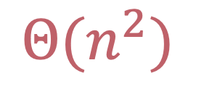
Iteration
void printAll(List list) {
for(int i=1 ; i<=list.length() ; i++) {
System.out.println(list.get(i));
}
}
$$Θ(n^{2})$$

Slide 18

Iterator ADT
create(List, index): Iterator
next(): Iterator
hasNext(): boolean
insert(T item)
remove ()
Just a “pointer” to a node.
$$Θ(1)$$

Slide 19
Structure of Iterator
@6754
@0033
head
john
0033
1234
Header
next
@1234
1234
Laura
4567
4567
Iterator pointing
at the 2nd node
class Iterator<T> {
Node<T> previous;
Node<T> current;
}
next
@4567
Hilde
NULL

Slide 20
A Recursive Data Type
typedef struct Node {
int value;
struct Node* next;
} Node;
class List<T> {
T item;
List<T> next;
}
base case is when next == null

Slide 21
Using Recursion
class List<T> {
T item;
List<T> next;
public T get(int index) {
if (index < 1)
throw new IllegalArgumentException("Invalid index.");
if (index == 1) return item;
if (next == null)
throw new IllegalStateException("The list is empty!");
return next.get(index - 1);
}
}

Slide 22
Deletion
List
last
first
void delete(List* list, int index) {
Node* target = get(list, index);
target->previous->next = target->next;
target->next->previous = target->previous;
free(target);
}
/
Node 1
n
p
Node 2
n
p
Node 3
/

Slide 23
Deletion (at the end)
List
void delete(List* list, int index) {
Node* target = get(list, index);
if (target->next == NULL) {
list->last = target->previous;
target->previous->next = NULL;
} else {
target->previous->next = target->next;
target->next->previous = target->previous;
}
free(target);
}
last
first
/
Node 1
n
p
Node 2
n
p
Node 3
/

Slide 24
Deletion (in front)
void delete(List* list, int index) {
if (index == 0) {
Node* target = list->first;
if (target->next == NULL) {
list->first = NULL;
list->last = NULL;
} else {
list->first = target->next;
target->next->previous = NULL;
}
free(target);
} else {
// Previous code
}
}
List
last
first
/
Node 1
n
p
Node 2
n
p
Node 3
/

Slide 25
Recap
Recursive data type
Sequence ADT
Item = Record
Chain of records
Take more space
extra pointer with every node
Use when
Many insertions/deletions
Possibility to use an iterator

Slide 26
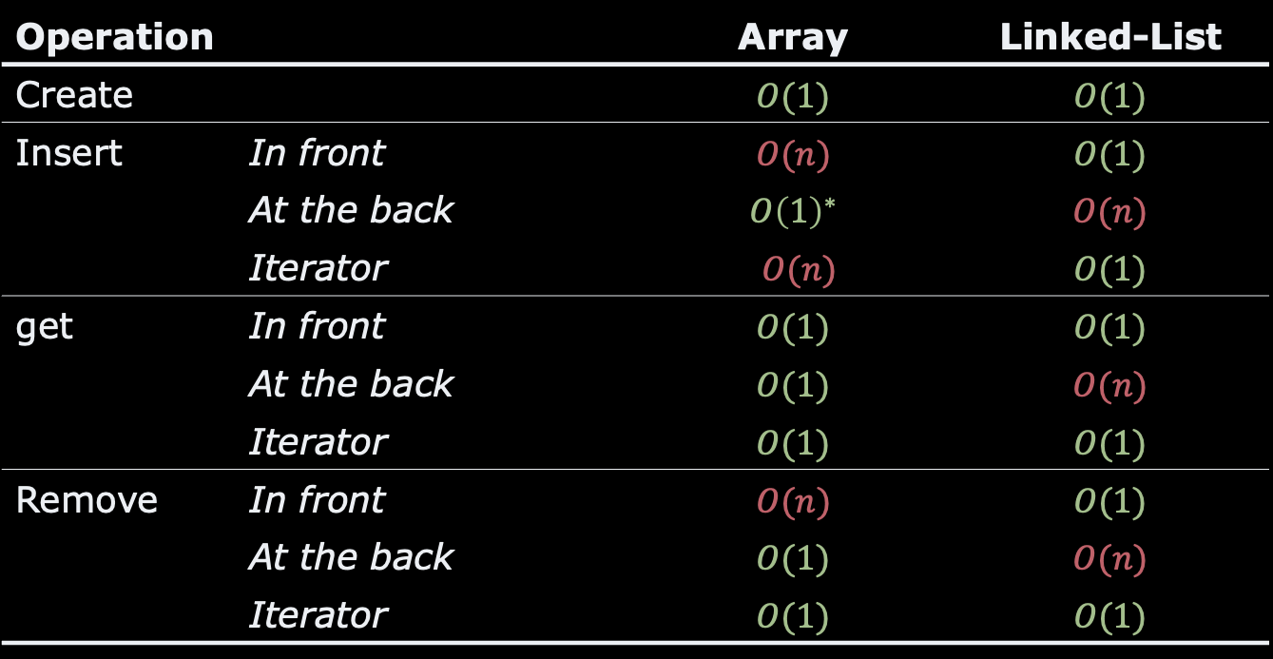
Recap
Operation |  | Array | Linked-List
Create |  | $$O(1)$$ | $$O(1)$$
Insert | In front | $$O(n)$$ | $$O(1)$$
 | At the back | $$O{\left(1\right)}^{∗}$$ | $$O(n)$$
 | Iterator | $O(n)$ | $$O(1)$$
get | In front | $$O(1)$$ | $$O(1)$$
 | At the back | $$O(1)$$ | $$O(n)$$
 | Iterator | $$O(1)$$ | $$O(1)$$
Remove | In front | $$O(n)$$ | $$O(1)$$
 | At the back | $$O(1)$$ | $$O(n)$$
 | Iterator | $$O(1)$$ | $$O(1)$$

Slide 27
Questions, Comments, or Ideas?
Franck Chauvel
axbit & NTNU
franck.chauvel@ntnu.no

