Slide 1
Procedure Calls
Static & Dynamic Memory Allocation
Recursion / Lecture 1
Franck Chauvel
axbit & NTNU
Ask questions on menti.com with the code 1727 7990
franck.chauvel@ntnu.no

Slide 2

Procedure Calls
def selection_sort(sequence)
for index in 0 .. sequence.length-2
minimum = find_minimum(sequence, index)
swap(sequence, index, minimum)
end
end
def swap(sequence, left, right)
tmp = sequence[right]
sequence[right] = sequence[left]
sequence[left] = tmp
end
def find_minimum(sequence, start)
minimum = start
for index in start+1 .. sequence.length-1
if sequence[index] < sequence[minimum]
minimum = index
end
end
return minimum
end

Slide 3
Agenda
Procedure Calls
Compilation: Inlining vs. Linking
Call Stack
Dynamic Memory Allocation

Slide 4
Pointers
Memory:
0000
A memory cell
that contains the address of another memory cell
Indirect addressing
Dereferencing
Get the value stored at in the cell refered by the pointer
0001
0002
0005
0003
0004
0005
0006

Slide 5
RAM & Pointers
…
How to load the value referenced by a pointer?
ADD address
ACC += Memory[address]
iADD pointer
ACC += memory[memory[pointer]]
2 approaches:
Add new instructions
Use the compiler
pointer
address
…
address
25
…
LOAD 0
ADD pointer
STORE iadd+1
iadd: ADD 0
CONSTANT TIME!

Slide 6
Why Procedure Calls?
Problem Decomposition
Logical decomposition
Don’t Repeat Yourself
Procedures:
Algorithms for sub-problems
Algorithms
Single entry points
Inputs & Outputs Parameters
Local variables
def find_minimum(sequence, start)
minimum = start
for index in start+1 .. sequence.length-1
if sequence[index] < sequence[minimum]
minimum = index
end
end
return minimum
end

Slide 7
Procedure Calls?
What does it cost in term of
time and space?
Let’s go back to the RAM…

Slide 8
Two Approaches To Compile Procedure Calls
RAM does not have “procedures”
Compilers’ Magic
“inlining” Copy-paste the procedure body
in-place of the call
“linking” JUMP to the procedure body ,
and back on return

Slide 9
Principle Inlining Procedure Calls
def selection_sort(sequence)
for index in 0 .. sequence.length-2
minimum = find_minimum(sequence, index)
swap(sequence, index, minimum)
end
end
def swap(sequence, left, right)
tmp = sequence[right]
sequence[right] = sequence[left]
sequence[left] = tmp
end
def selection_sort(sequence)
for index in 0 .. sequence.length-2
minimum = find_minimum(sequence, index)
tmp = sequence[minimum]
sequence[minimum] = sequence[index]
sequence[index] = tmp
end
end

Slide 10
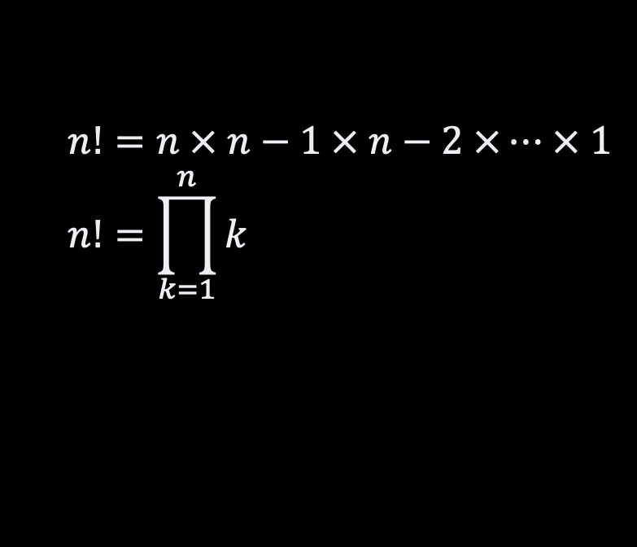
Pros & Cons Inlining Procedure Calls
Cons
Pros
Not always possible
no extra time
no extra space
“Fat” code
$$n!=n × n−1 × n−2 ×… × 1 \\ n!=\prod_{k=1}^{n}{k}$$
long factorial(int value) {
if (value == 0) return 1;
return value * factorial(value-1);
}

Slide 11
Linking The Other Approach
We JUMP!
Yes, but…
How do we jump back?
How do we pass parameters?
How do we get the result?
We need a “calling agreement”.
Code for “sort”
…
JUMP swap
…
Code for “swap”
address

Slide 12
Introducing the “Call-stack”
Dedicated memory segment
Requires a convention between:
Caller, he who “calls”
Callee, he who is called
Like the Stack ADT
but can read and update anywhere
Call-stack
Free Memory
Call-stack
growth
Program Data
Address
Program Instructions

Slide 13
Stack “Discipline”
stack bottom
previous callers
Caller
Push a ”dummy” result
Push where to come back
Push each arguments
JUMP to the callee entry point
Callee
Push & Pop local variables
Save result
Pop arguments
JUMP back
Caller
Pop the result
Pop the return address
result placeholder
Local variables
Argument #N
...
Argument #2
Argument #1
caller
Return address
result placeholder
callee
Local variables
stack top

Slide 14
Procedure Calls
Every procedure call
push one record
Every “return” statement
pop one record

Slide 15
Selection Sort Example
def selection_sort(sequence)
for index in 0 .. sequence.length-2
minimum = find_minimum(sequence, index)
swap(sequence, index, minimum)
end
end
test = [3, 12, 2]
selection_sort(test)
index = 0
minimum = 0
find_minimum
(activation frame)
right = 2
start = 0
swap
(activation frame)
start = index
left = index
sequence = test
sequence = test
minimum = ??
minimum = 2
selection_sort
(activation frame)
index = 0
sequence = test
main
(activation frame)
test = [3, 12, 2]
stack bottom

Slide 16
Memory Allocation
Where does the compiler place our variables?
“in the stack” local variables, declared explicitly
“in the heap” memory explicitly allocated
(e.g., malloc, new, etc.)

Slide 17
Introducing the “Heap”
Segment of memory dedicated for “dynamic variables”
Manual allocation
in C, malloc and co.
in Java, new
etc.
Call-stack
Free Memory
Call-stack
growth
Heap
Heap
growth
Static data
Address
Program Instructions

Slide 18
Dynamic Memory Allocation
All goes into the “Heap”
2 operations
allocate(size).
Reserve a “block” of a given size
free(address).
Release the block starting at the given address
Built-in the language
“new” in Java
Through libraries
”malloc” in C
Your
code
Language Runtime
(libraries)
Operating
System
Machine / Hardware

Slide 19
Heap & Fragmentation
Memory (Heap)
reserved
internal
fragmentation
2 operations
allocate(size). Reserve a “block” of a given size
free(address). Release a block
Problem: Fragmentation
Internal: blocks are over-allocated. Memory is not used in practice
External: only small blocks are free, but none is big enough
reserved
external
fragmentation
reserved
free blocks
growing addresses

Slide 20
How Fast is it? Heap Allocation
Depends on the “allocator” implementation
OS concern
Best case O(1)
Worst case O(n)
n is the number of blocks already allocated
Beyond the scope of an algorithm
Not accounted for in practice.

Slide 21
Finding a Free Block
Memory (Heap)
reserved
block
start
size
Uses a “free list”
Many “allocation” strategy:
Find the best fit
Find the worse fit
Find the first fit
and more …
Not constant time!
critical for high performance applications
block
start
size
block
start
size
best
NOT CONSTANT TIME!
reserved
block
start
size
worse
reserved
request
first

Slide 22
Recap
Call-stack
Memory Allocation
Free Memory
Call-stack
growth
Stack
Automated allocation
Local variables
Contiguous allocation
Procedures Calls
Heap
Manual allocation / deallocation
Non-local variables
Non contiguous allocation
Heap
Heap
growth
Static data
Address
Program Instructions

Slide 23
Questions, Comments, or Ideas?
Franck Chauvel
Axbit & NTNU
franck.chauvel@gmail.com

Slide 24
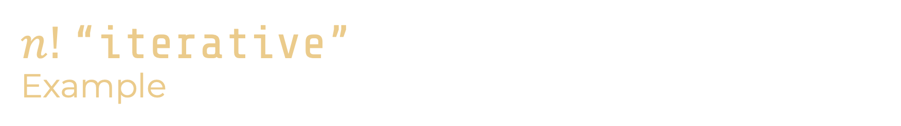
$n!$“iterative” Example
stack bottom
x: 5
result: ??
long factorial(int value) {
long product = 1;
for(int each=2 ; each <= value ; each++) {
product = product * each;
}
return product;
}
int main() {
int x = 5;
printf("5! = %d\n", factorial(x));
}
come back
value: 5
product: 1
CONSTANT SPACE!
each: 2
Address

Slide 25
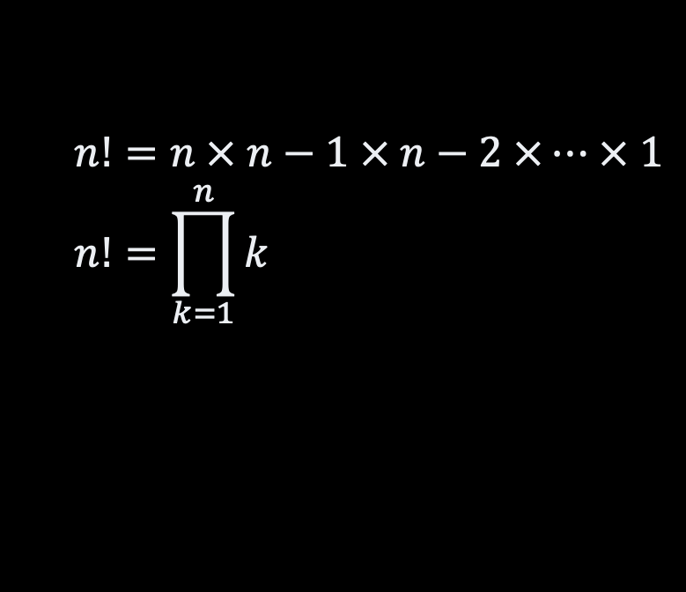
Example: n! recursive
#include <stdio.h>
long factorial(int value) {
if (value == 0) return 1;
return value * factorial(value-1);
}
int main() {
printf("5! = %d\n", factorial(5));
}
$$n!=n × n−1 × n−2 ×… × 1 \\ n!=\prod_{k=1}^{n}{k}$$

Slide 26
Slow Motion
stack bottom
“main” frame
#include <stdio.h>
long factorial(int value) {
if (value == 0) return 1;
return value * factorial(value-1);
}
int main() {
printf("5! = %d\n", factorial(5));
}
factorial(5)
factorial(4)
NOT CONSTANT SPACE!
factorial(3)
factorial(2)
factorial(1)
factorial(0)

