Slide 1
Sequences
Using Arrays
Week 3 / Lecture 2
Franck Chauvel
Axbit & NTNU
franck.chauvel@ntnu.no

Slide 2




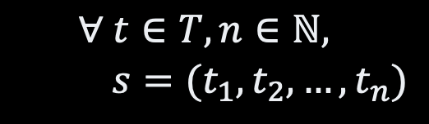
Sequences
“john”, “tracy”, “steve”, “robert”, “julie”
, “katerine”
in Maths
$$∀ t∈T, n∈ℕ,$$ $s=(t_{1},t_{2},…,t_{n})$
List
Array
List
Vector
This Photo by Unknown Author is licensed under CC BY-SA

Slide 3
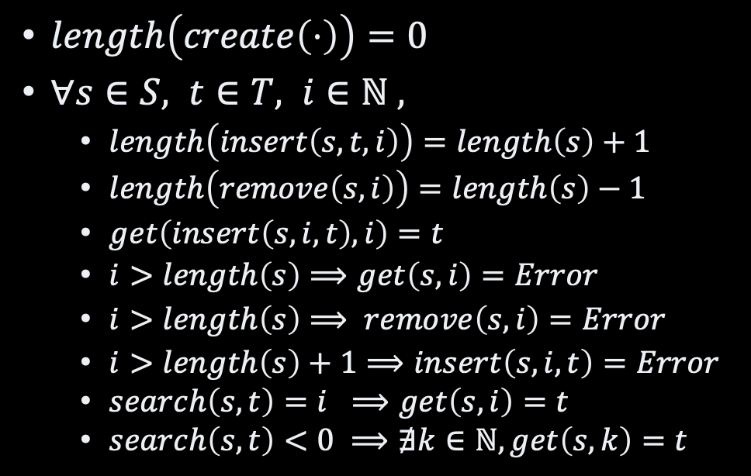
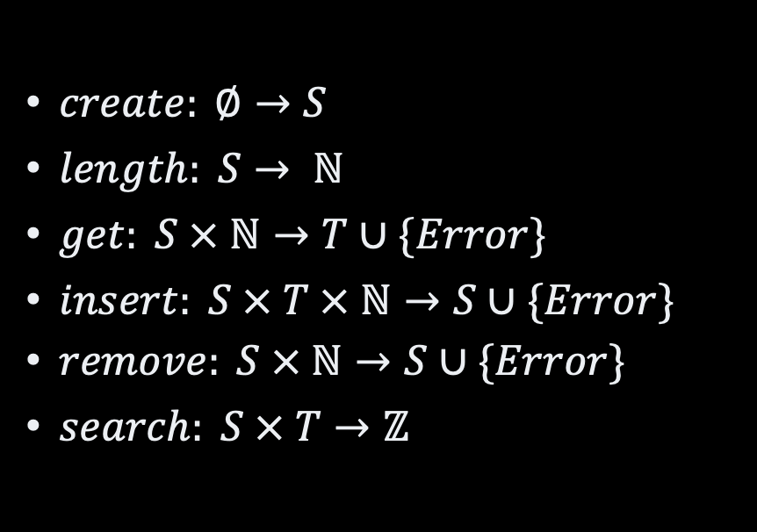
Sequence: Minimal ADT
Operations
Axioms
$create: ∅→S$
$length: S→ ℕ$
$get: S × ℕ→T∪\{Error\}$
$insert: S × T × ℕ→S∪\{Error\}$
$remove: S × ℕ→S∪\{Error\}$
$search: S × T→ℤ$
$length\left(create\left(⋅\right)\right)=0$
$∀s∈S, t∈T, i∈ℕ ,$
$length\left(insert\left(s, t, i\right)\right)=length\left(s\right)+1$
$length\left(remove\left(s, i\right)\right)=length\left(s\right)−1$
$get\left(insert\left(s, i, t\right),i\right)=t$
$i>length\left(s\right)⟹get\left(s, i\right)=Error$
$i>length\left(s\right)⟹ remove\left(s, i\right)=Error$
$i>length\left(s\right)+1⟹insert\left(s, i, t\right)=Error$
$search\left(s, t\right)=i ⟹get\left(s, i\right)=t$
$search\left(s,t\right)<0 ⟹∄k∈ℕ, get\left(s,k\right)=t$

Slide 4
Recall Array?
sign
value
Record:
1
23
capacity
(25 buckets)
Memory:
bucket 1
bucket 2
bucket 3
bucket 25
0
1
…
40
41
42
43
44
45
46
47
48
…
88
89
∞
1
1
45
1
23
2
??
??
base address
(index = 0)
bucket size
length
(3 buckets)

Slide 5

Using Arrays
41
42
4
capacity
43
2
length
typedef struct {
int capacity;
int length;
int* buckets;
} Sequence;
44
0
buckets
[0]
45
23
46
1
[1]
47
125
48
??
[2]
49
??
50
??
[3]
51
??
52
┇

Slide 6
Creation
Sequence*
create() {
Sequence* sequence = malloc(sizeof(Sequence));
sequence->capacity = 2;
sequence->length = 0;
sequence->buckets = (int*) malloc(sizeof(int) * sequence->capacity);
return sequence;
}

Slide 7


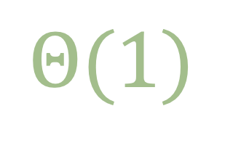

Access
$$Θ(1)$$
$$Θ(1)$$
address = ‘base address’ + (index * sizeof(bucket))
Memory:
bucket size
bucket 3
0
1
…
40
41
42
43
44
45
46
47
48
…
88
89
∞
1
1
45
1
23
2
base address
(index = 0)
40 + 2 * 2

Slide 8
Access
int
get (Sequence* sequence, int index) {
assert(index > 0 && index <= sequence->length);
return sequence->buckets[index-1];
}
void
set (Sequence* sequence, int index, int item) {
assert(index > 0 && index <= sequence->length);
sequence->buckets[index-1] = item;
}

Slide 9
Insertion The idea
capacity = 26 buckets
length = 3 buckets
Memory:
bucket size
0
1
…
40
41
42
43
44
45
46
47
48
…
90
91
∞
23
1
1
1
45
1
45
2
23
2
B1
B2
B3
7
1
new bucket
(index = 1)

Slide 10
Code Insertion
void
insert (Sequence* sequence, int index, int item) {
assert(index > 0 && index <= sequence->length+1);
assert(sequence->length == sequence->capacity);
int each = sequence->length;
while(each > index) {
set(sequence, each+1, get(sequence, each));
each--;
}
sequence->buckets[index-1] = item;
sequence->length++;
}

Slide 11


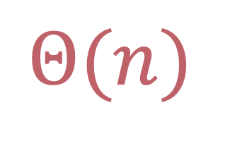

Worst-case vs. best-case? Insertion
worst case
best case
“insert at first”
“insert at last”
shift the whole array
by one
no shift
$$Θ(n)$$
$$Θ(1)$$

Slide 12

Deletion The idea
capacity = 25 buckets
length = 4 buckets
length = 3 buckets
Memory:
bucket size
0
1
…
40
41
42
43
44
45
46
47
48
…
88
89
∞
7
23
23
1
1
45
2
2
1
1
7
1
B1
B2
B3
B4
delete(2)

Slide 13
Deletion The C code
void
delete (Sequence* sequence, int index) {
assert(index > 0 && index <= sequence->length);
assert(sequence->length < sequence->capacity);
int each = index;
while (each < sequence->length) {
set(sequence, each, get(sequence, each+1));
each++;
}
sequence->length--;
}

Slide 14
Worst-case vs. best-case? Deletion
worst case
best case
“delete at first”
“delete at last”
shift the whole array
by one
no shift
$$Θ(n)$$
$$Θ(1)$$

Slide 15
Search The idea
capacity = 26 buckets
length = 3 buckets
Memory:
bucket size
0
1
…
40
41
42
43
44
45
46
47
48
…
90
91
∞
E
M
2
A
2
2
2
V
2
B1
B2
B3
B4
Find “M”?
no!
no!
Yes!

Slide 16
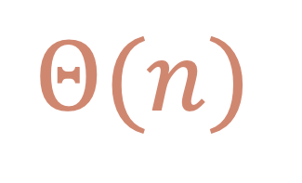
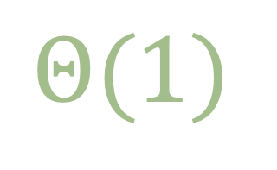
Search The Code
int
search (Sequence* sequence, int item) {
int index = 1;
while (index <= sequence->length) {
if (item == get(sequence, index)) {
return index;
}
index++;
}
return 0;
}
$$Θ(n)$$
$$Θ(1)$$

Slide 17
Growing and Shrinking
to exhibit infinte capacity

Slide 18
Growing Insertion Revised
void
insert (Sequence* sequence, int index, int item) {
assert(index > 0 && index <= sequence->length+1);
if (sequence->length == sequence->capacity) resize(sequence, 2);
int each = sequence->length;
while(each > index) {
set(sequence, each+1, get(sequence, each));
each--;
}
sequence->buckets[index-1] = item;
sequence->length++;
}

Slide 19
Resizing Arrays
void
resize (Sequence* sequence, double factor) {
sequence->capacity = (int) sequence->capacity * factor;
int* oldBuckets = sequence->buckets;
sequence->buckets = (int*) malloc(sizeof(int) * sequence->capacity);
for(int index=0 ; index<sequence->length ; index++) {
sequence->buckets[index] = oldBuckets[index];
}
free(oldBuckets);
}

Slide 20
Shrinking Deletion Revised
void
delete (Sequence* sequence, int index) {
assert(index > 0 && index <= sequence->length);
if (sequence->length < sequence->capacity) resize(sequence, 0.5);
int each = index;
while (each < sequence->length) {
set(sequence, each, get(sequence, each+1));
each++;
}
sequence->length--;
}

Slide 21
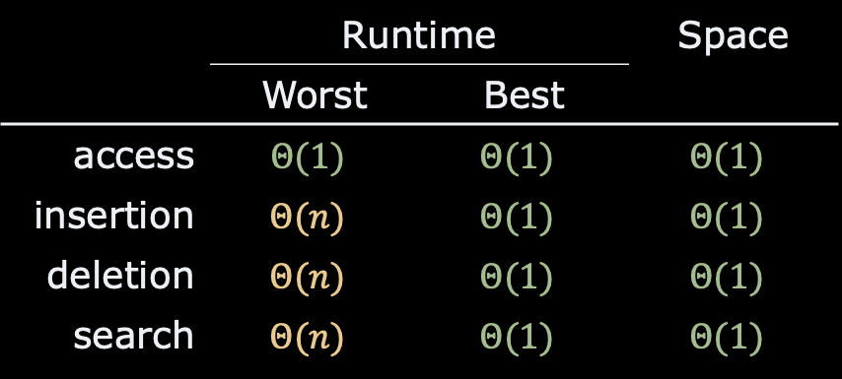
Recap
Sequence ADT
infinite capacity
Using array to implement sequence
reallocate when needed
 | Runtime | Runtime | Space
 | Worst | Best
access | $$Θ(1)$$ | $$Θ(1)$$ | $$Θ(1)$$
insertion | $$Θ(n)$$ | $$Θ(1)$$ | $$Θ(1)$$
deletion | $$Θ(n)$$ | $$Θ(1)$$ | $$Θ(1)$$
search | $$Θ(n)$$ | $$Θ(1)$$ | $$Θ(1)$$

Slide 22
Questions, Comments, or Ideas?
Franck Chauvel
Axbit & NTNU
franck.chauvel@ntnu.no

Slide 23
Where Are We?
Foundations
Arrays
Lists
Sorting
Hashing
Trees
Graphs
Wrapping-up
correctness
big Oh
RAM
Searching
deletion
insertion
simple sorting
Calls & Recursions
Stacks & Queues
Recurrences
ADT
Quick sort
Merge sort
Radix sort
Chaining
Hash functions
Open addressing
Binary trees
Search trees
Self-balancing trees
Probing Further
directed graphs
cycles
spanning trees
A*
Sets
Parallel Computing
Quantum Computing
P vs. NP
Optimization
Pattern matching

Slide 24
Menu
Records
Arrays
Insertion
Deletion
Search

Slide 25
Records
Memory:
0
Contiguous allocation of
Heterogenous items
Example,
item, count
name, lastname, age, status
etc.
Often a “type” definition
Given by the compiler
1
2
…
item: Integer
59
base
count: Integer
60
+ size of integer
…
∞

Slide 26
Takeaway
An record is a contiguous allocation
of “fields” of varying size,
which we access by name or index.

Slide 27
Records in C
typedef struct {
int item;
int count;
} Frequency;
Frequency frequency;
frequency.item = 12;
frequency.count = 0;

Slide 28
Takeaway
An array is a contiguous allocation
of items of similar size,
which we access by index.

Slide 29
Creation
#define CAPACITY 25
int array[CAPACITY] = {5, 4, 3, 5, 1};
int length = 5;

Slide 30
Operations
access(index: Integer): Value
Give the content at a given index
insert(value: Value index: Integer)
Insert an element at a given index
delete(index: Integer)
Delete an element at a given index
search(value: Value): Integer
Find which bucket contains a given value

Slide 31
Multi-dimensional Arrays
width
1
2
3
4
A
B
B3
0
1
2
3
4
5
6
7
8
…
15
B3
C
base address
(index = 0)
D
address(row, column) = ‘base address’ + (row * width + column) * ‘sizeof(bucket)

Slide 32
Insertion (at the End) The idea
capacity = 25 buckets
length = 3 buckets
Memory:
bucket size
0
1
…
40
41
42
43
44
45
46
47
48
…
88
89
∞
1
1
45
1
23
2
new bucket
(index = 3)
7
1
new bucket

Slide 33


Insertion At the End The C code
void insert(int value) {
if (length >= CAPACITY) {
return -1;
}
array[length] = value;
length += 1;
}
$$Θ(1)$$
$$Θ(1)$$
This Photo by Unknown Author is licensed under CC BY-SA

Slide 34
Insertion (anywhere) The C code
int insert (int value, int position) {
if (length >= CAPACITY) {
return -1;
}
length += 1;
for (int index=length-1; index>=position ; index--) {
array[index+1] = array[index];
}
array[position] = value;
}
$$Θ(n)$$
$$Θ(1)$$
This Photo by Unknown Author is licensed under CC BY-SA
This Photo by Unknown Author is licensed under CC BY-SA

Slide 35
Deletion The idea
capacity = 25 buckets
length = 4 buckets
length = 3 buckets
Memory:
bucket size
0
1
…
40
41
42
43
44
45
46
47
48
…
88
89
∞
7
23
23
1
1
45
2
2
1
1
7
1
B1
B2
B3
B4
delete(2)

Slide 36
Deletion (anywhere) The C code
int delete (int position) {
if (length >= CAPACITY) return -1;
int deleted = array[position];
length -= 1;
for (int index=position ; index<length ; index++) {
array[index] = array[index+1];
}
return deleted;
}
$$Θ(n)$$
$$Θ(1)$$
This Photo by Unknown Author is licensed under CC BY-SA

Slide 37
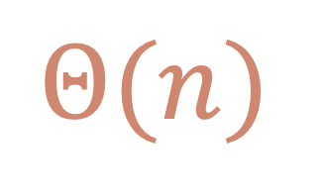
Lab Session
Pen & Paper
Look at the average runtime complexity of the “search”
$$Θ(n)$$

