Slide 1
Parallel Computing
What about Cloud and Multicore Architectures?
Beyond RAM / Lecture 1
Franck Chauvel
axbit & NTNU
Go to www.menti.com and use
the code 4482 2802
franck.chauvel@ntnu.no

Slide 2
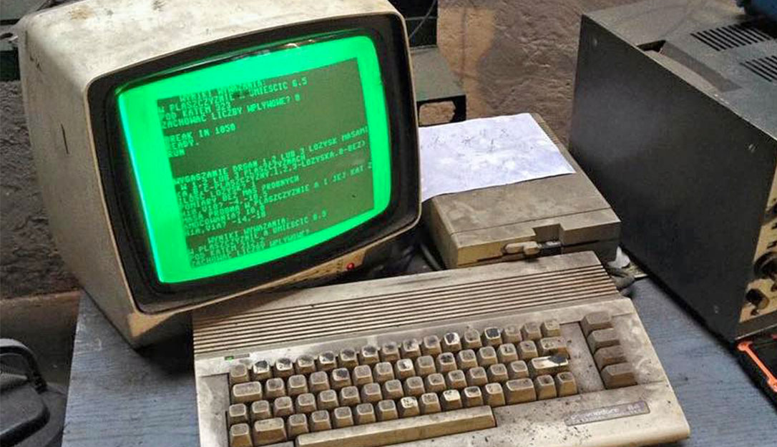
Multicore Architectures
The RAM model is like a computer from the 80ies.

Slide 3
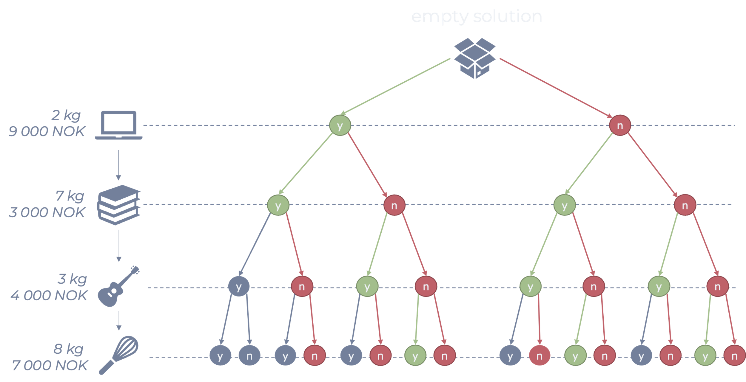
Non-Deterministic Turing Machine
A non-deterministic machine
always picks
the right branch

Slide 4
Concurrent vs. Parallel
Write
Code
Write
Documentation
Write
Code
Write
Documentation

Slide 5
Agenda
PRAM model
Parallel Linear Search
Work, Time & Speed Up
Limitations of PRAM
NC = P

Slide 6
RAM
Random Access
Machine
Memory
00
02
input device
02
03
CPU
ACC
04
IP
05
06
output device
arithmetic and logic
operations
⇣
∞

Slide 7
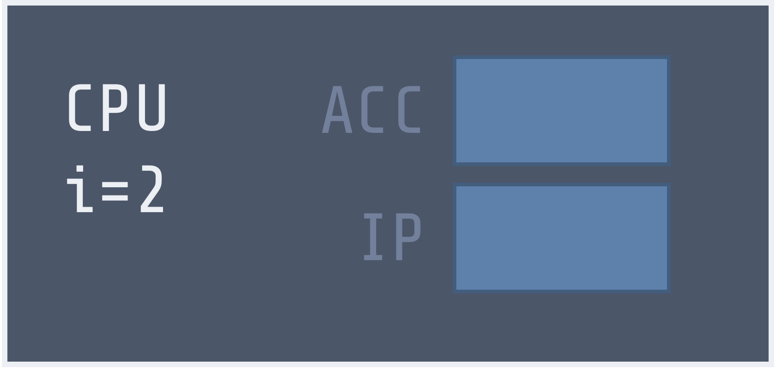
P-RAM: Parallel RAM
Random Access
Machine
Memory
00
02
input device
CPU
ACC
02
i=1
CPU
IP
ACC
i=k
03
IP
04
infinitely many
CPU
05
06
output device
⇣
∞

Slide 8






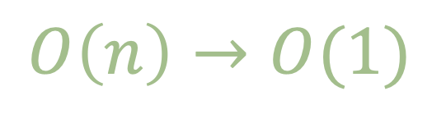


Parallel Linear Search With Too Many Processors
00
01
02
03
04
05
07
08
?
?
?
?
?
?
?
?
time = 1
$$p_{0}$$
$$p_{1}$$
$$p_{2}$$
$$p_{3}$$
$$p_{4}$$
$$p_{5}$$
$$p_{6}$$
$$p_{7}$$
$$O\left(n\right)→O(1)$$

Slide 9
Linear Search With Infinitely Many Processors
int contains(int[] givenArray, int expected) {
int index = 0;
if (givenArray[processorId] == expected) {
index = processorId;
}
System.out.println(index);
}

Slide 10











Parallel Linear Search With only $p$ Processors
00
01
02
03
04
05
07
08
?
?
?
?
?
?
?
?
time = 1
$$p_{0}$$
$$p_{1}$$
$$p_{2}$$
time = 2
$$p_{1}$$
$$p_{2}$$
$$p_{3}$$
$$p_{1}$$
$$p_{2}$$
$$p_{3}$$
time = 3
$$O\left(n\right)→O(n/p)$$

Slide 11
The Code With Too Many Processors
int contains(int[] givenArray, int expected) {
int index = 0;
int offset = givenArray.length / processorCount;
int bucket = processorId;
while (bucket < givenArray.length) {
if (givenArray[bucket] == expected) {
index = bucket;
}
int bucket = processorId + offset;
}
System.out.println(index);
}

Slide 12







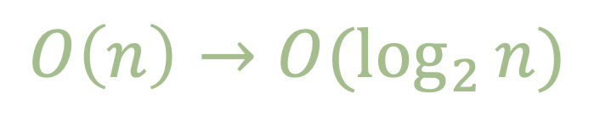
Vector Sum
00
01
02
03
04
05
07
08
?
?
?
?
?
?
?
?
$$p_{0}$$
$$p_{1}$$
$$p_{2}$$
$$p_{3}$$
time = 1
time = 2
$$p_{0}$$
$$p_{2}$$
$$O\left(n\right)→O(\log_{2}{n})$$
time = 3
$$p_{0}$$

Slide 13
Alternative Architectures
single
data stream
multiple
data stream
Code \ Data
single
instruction stream
SISD
Uniprocessor
SIMD
Vector Machines
mutliple
instruction stream
MISD
Data Pipelines
MIMD
Multi-Computer

Slide 14
Concurrent Accesses
What happens when many processors access the same memory cell at the same time

Slide 15
P-RAM Flavors
Exclusive
Writes
Concurrent
Writes
Exclusive
Reads
EREW
ERCW
Concurrent Reads
CREW
CRCW

Slide 16
CRCW P-RAM Variations
Common—all processors write the same value; otherwise is illegal
Arbitrary—only one arbitrary attempt is successful, others retry
Priority—processor rank indicates who gets to write
Another kind of array reduction operation like SUM, Logical AND or MAX.

Slide 17


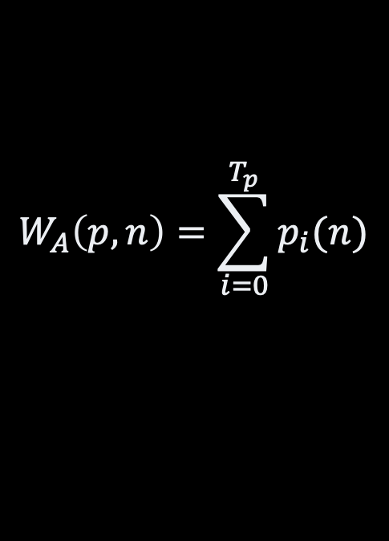



Efficiencies
Time
number of time steps
with p processors
Work
Cost
total
number of instructions
performed accross processors
Cost of have p processor
for t time steps
$$T_{1}(1,n)$$
$$T_{p}(n)$$
$$T_{∞}(n)$$
$$W_{A}\left(p,n\right)=\sum_{i=0}^{T_{p}}{p_{i}(n)}$$
$$C_{p}=p × T_{p}(n)$$
Active Processors
(number of processor active
at a given time t)
$$a_{t}\left(n\right)$$

Slide 18


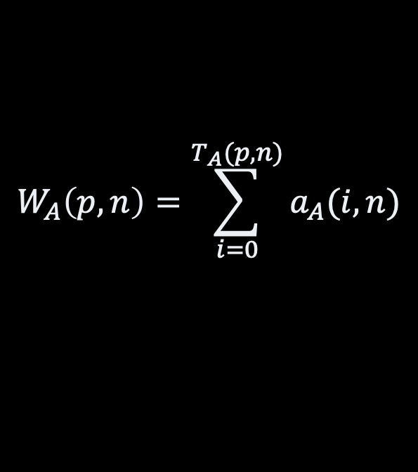

Efficiencies
Cost
Cost of having
p processor
for t time steps
00
01
02
03
04
05
07
08
$$C_{A(p,n)}=p × T_{A}(p, n)$$
?
?
?
?
?
?
?
?
𝑝
𝑝
𝑝
𝑝
0
0
0
0
Time
$$a_{A}\left(i,n\right)$$
number
of time steps
with p processors
𝑝
𝑝
number of
active processors
at a given time t
0
0
$$T_{A}(p, n)$$
𝑝
0
Work
total
number of instructions
performed across processors
$$W_{A}\left(p,n\right)=\sum_{i=0}^{T_{A}(p,n)}{a_{A}(i, n)}$$

Slide 19

Optimality
Work-optimal
Cost-optimal
if it does the same work
as the best known serial
algorithm
if it has the same cost
as the best known serial
algorithm
$${W_{A}\left(n, p\right)∈O(T}_{S}(1,n))$$

Slide 20

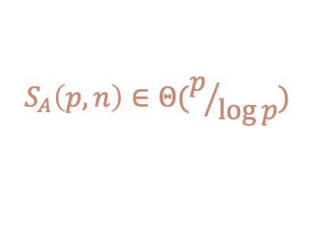
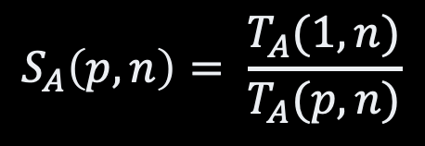

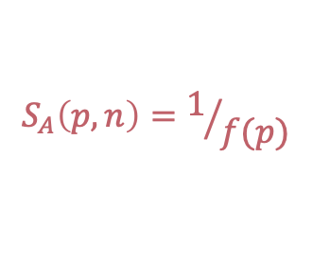

Speed Up
$$S_{A}\left(p,n\right)≥ p$$
Speed-up
$$S_{A}\left(p,n\right)=p$$
Speed-Up
$$S_{A}\left(p,n\right)∈Θ(p)$$
number of time steps
with p processors
$$S_{A}\left(p,n\right)∈Θ(p/{\log{p}})$$
$$S_{A}\left(p, n\right)= \frac{T_{A}(1, n)}{T_{A}(p, n)}$$
$$S_{A}\left(p,n\right)=1/{f(p)}$$
Processor
count

Slide 21
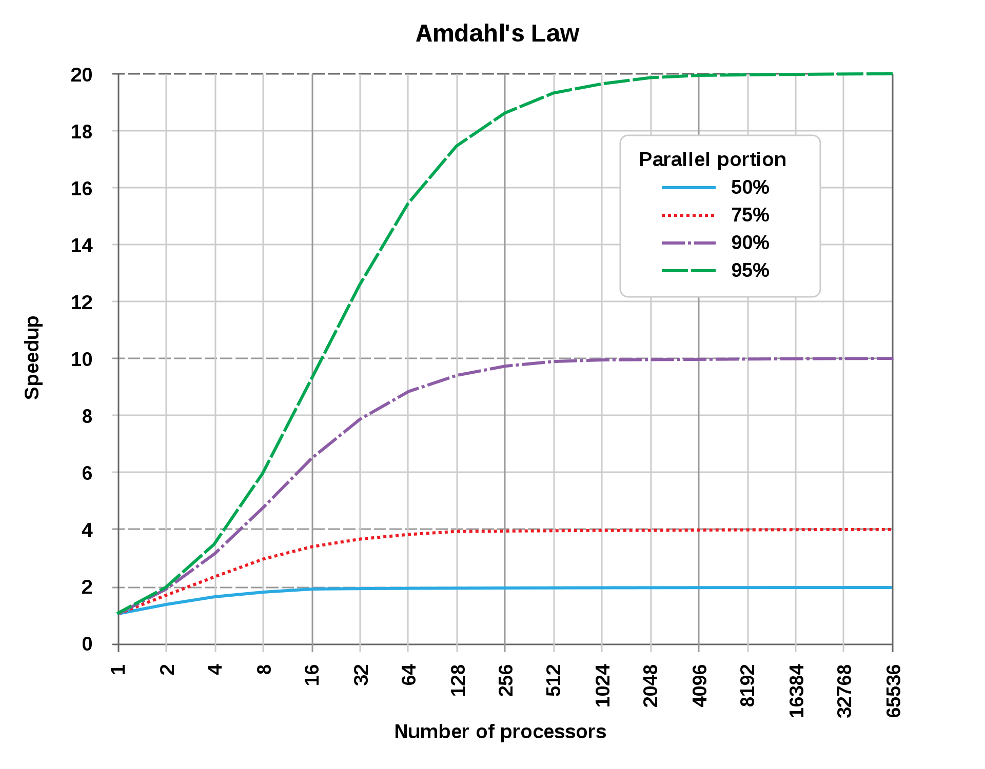
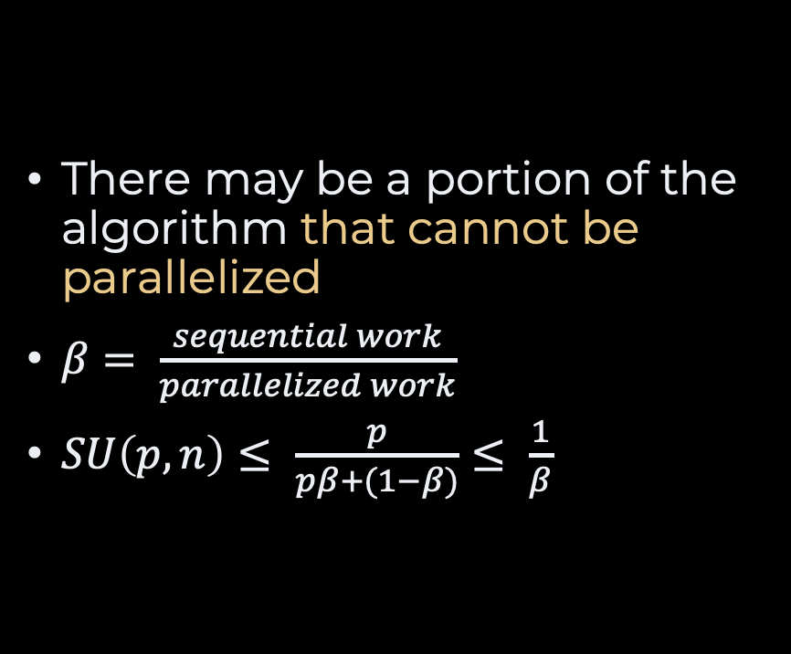
Amsdahl’s Law
There may be a portion of the algorithm that cannot be parallelized
$β= \frac{sequential work}{parallelized work}$
$SU\left(p,n\right)≤ \frac{p}{pβ+(1−β)}≤ \frac{1}{β}$

Slide 22
Nick’s Class
NP
NC
Problems that can be solved
in polylogarithmic time
on P-RAM
with polynomial number of processors
NC = P?
Are there tractable problems that are inherently sequential?
P
NC

Slide 23
Is P-RAM Realistic?
Nope ☺
Uniform memory access cost does not exist in practice!
Resource contention?
Synchronization between processors?
Globally synchronized clock ?

Slide 24
Recap
We can parallelize!
Not easy
but give speed-up
Efficiency
Work/time/cost
Speed Up
Compare best “serial” algorithms
Amsdahl’s Law
P-RAM gives an idea of what is not feasible
NC
Polylogarithmic time
on P-RAM
P = NC?

Slide 25
Questions, Comments, or Ideas?
Franck Chauvel
Axbit & NTNU
franck.chauvel@ntnu.no

