Slide 1
Algorithm Analysis
Modelling Efficiency of Algorithms
Foundations / Lecture 5
Franck Chauvel
Ask questions on menti.com
with code 1384 3192
Axbit & NTNU
franck.chauvel@ntnu.no

Slide 2



Computations vs. Algorithms
#include <stdio.h>
#define N 100
int main(int argc, char** argv) {
int sum = 0;
int each = 0;
while (each <= N) {
sum += each;
each = each + 1;
}
printf("Total: %d\n", sum);
}
509 cycles
1 cell
What if N is given by the user?

Slide 3

Agenda
Problem Size
Worse Case Analysis
Best Case Analysis
Average Case Analysis

Slide 4
Handling Algorithms
Code | Cost | Run Count | Total
int sum_up_to(int N) {
int sum = 0; | 1 | 1 | 1
int each = 0; | 1 | 1 | 1
while (each <= N) { | 1 | N+2 | N+2
sum = sum + each; | 2 | N+1 | 2N+2
each = each + 1; | 2 | N+1 | 2N+2
}
printf("Total: %d\n", sum); | 1 | 1 | 1
}
Grand Total |  |  | 5N+9

Slide 5

Takeaway #1
Efficiency is a function of
the problem size
$$time\left(n\right)=5∙n+9$$

Slide 6
What is the “Problem Size”? aka “input size”
void print(int[] array)
boolean contains(int[] array, int x)
int product(int l, int r)
inputs
(sequence of symbols)
Problem
outputs
(sequence of symbols)

Slide 7

Example
Code | Cost | Run Count | Total
def sum_of_even(numbers):
sum = 0 | 1 | 1 | 1
index = 0 | 1 | 1 | 1
while index < len(numbers): | 1 | N+1 | N+1
if numbers[index] % 2 == 0: | 2 | N | 2N
sum = sum + numbers[index] | 2 | ??? | ???
index = index + 1 | 2 | N | 2N
return sum | 1 | 1 | 1
Grand Total |  |  | ???

Slide 8
Algorithm Analysis
Algorithm Analysis
Best case
Average case
Worst case

Slide 9
Worse Case Runtime Efficiency
def sum_of_even(numbers):
sum = 0
index = 0
while index < len(numbers):
if numbers[index] % 2 == 0:
sum = sum + numbers[index]
index = index + 1
return sum
What scenario takes the most time?
When the user gives only even numbers!

Slide 10
Worse Case Runtime Efficiency
Code | Cost | Run Count | Total
def sum_of_even(numbers):
sum = 0 | 1 | 1 | 1
index = 0 | 1 | 1 | 1
while index < len(numbers): | 1 | N+1 | N+1
if numbers[index] % 2 == 0: | 2 | N | 2N
sum = sum + numbers[index] | 2 | N | 2N
index = index + 1 | 2 | N | 2N
return sum | 1 | 1 | 1
Grand Total |  |  | 7N+4

Slide 11
Best Case Runtime Efficiency
def sum_of_even(limit):
total = 0
counter = 0
while counter < limit:
value = int(input("?"))
if value % 2 == 0:
total = total + value
counter = counter + 1
return total
What scenario takes the least cycles?
When the user input only odd numbers!
def sum_of_even(numbers):
sum = 0
index = 0
while index < len(numbers):
if numbers[index] % 2 == 0:
sum = sum + numbers[index]
index = index + 1
return sum

Slide 12
Best Case Runtime Efficiency
Code | Cost | Run Count | Total
def sum_of_even(numbers):
sum = 0 | 1 | 1 | 1
index = 0 | 1 | 1 | 1
while index < len(numbers): | 1 | N+1 | N+1
if numbers[index] % 2 == 0: | 2 | N | 2N
sum = sum + numbers[index] | 2 | 0 | 0
index = index + 1 | 2 | N | 2N
return sum | 1 | 1 | 1
Grand Total |  |  | 5N+4

Slide 13
Average Case Runtime Efficiency
def sum_of_even(numbers):
sum = 0
index = 0
while index < len(numbers):
if numbers[index] % 2 == 0:
sum = sum + numbers[index]
index = index + 1
return sum
In average, what shall we expect?
We can’t say without more knowledge

Slide 14
Average Case Runtime Efficiency
def sum_of_even(numbers):
sum = 0
index = 0
while index < len(numbers):
if numbers[index] % 2 == 0:
sum = sum + numbers[index]
index = index + 1
return sum
How likely is a number to be
an even number?
an odd number?
We have to make an hypothesis

Slide 15
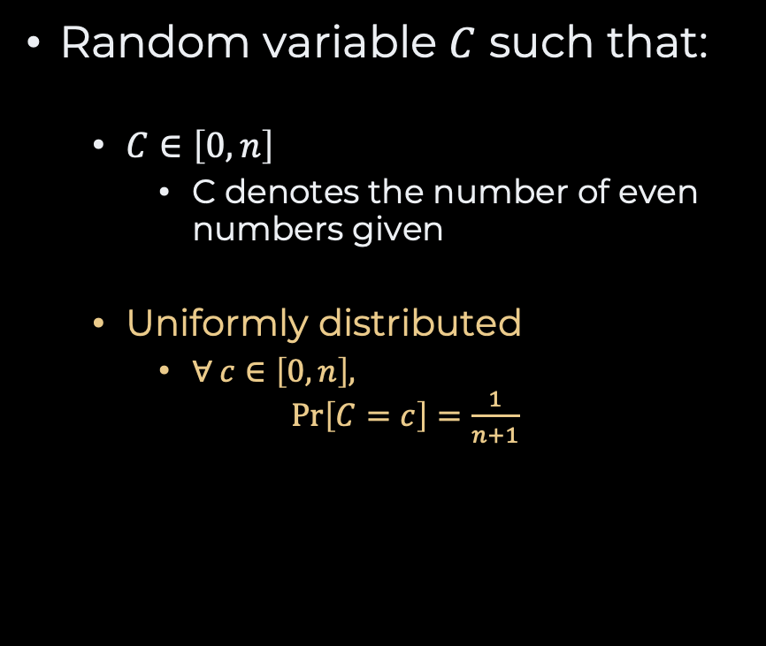
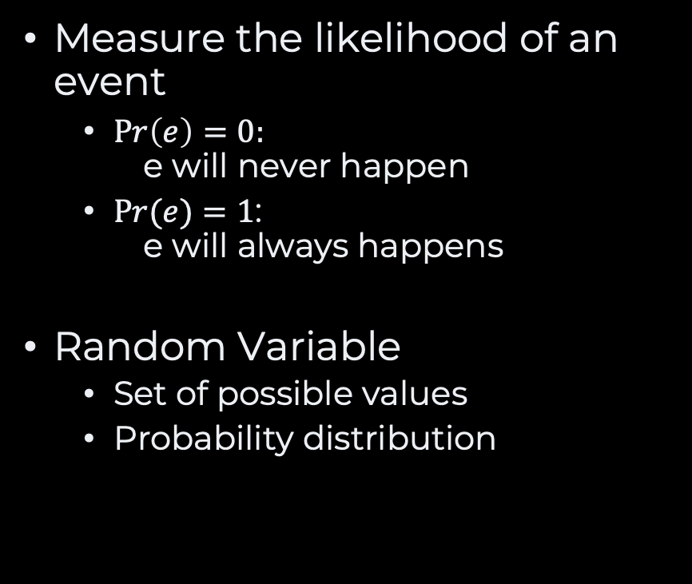
Probability
Measure the likelihood of an event
$Pr\left(e\right)=0:$ e will never happen
$Pr(e)=1$: e will always happens
Random Variable
Set of possible values
Probability distribution
Random variable $C$ such that:
$C∈\left[0, n\right]$
C denotes the number of even numbers given
Uniformly distributed
$∀ c∈\left[0, n\right],$ $\operatorname{Pr}\left[C=c\right]=\frac{1}{n+1}$

Slide 16
Best Case Runtime Efficiency
Code | Cost | Run Count | Total
def sum_of_even(numbers):
sum = 0 | 1 | 1 | 1
index = 0 | 1 | 1 | 1
while index < len(numbers): | 1 | N+1 | N+1
if numbers[index] % 2 == 0: | 2 | N | 2N
sum = sum + numbers[index] | 2 | C | 2C
index = index + 1 | 2 | N | 2N
return sum | 1 | 1 | 1
Grand Total |  |  | 5N+2C+4

Slide 17
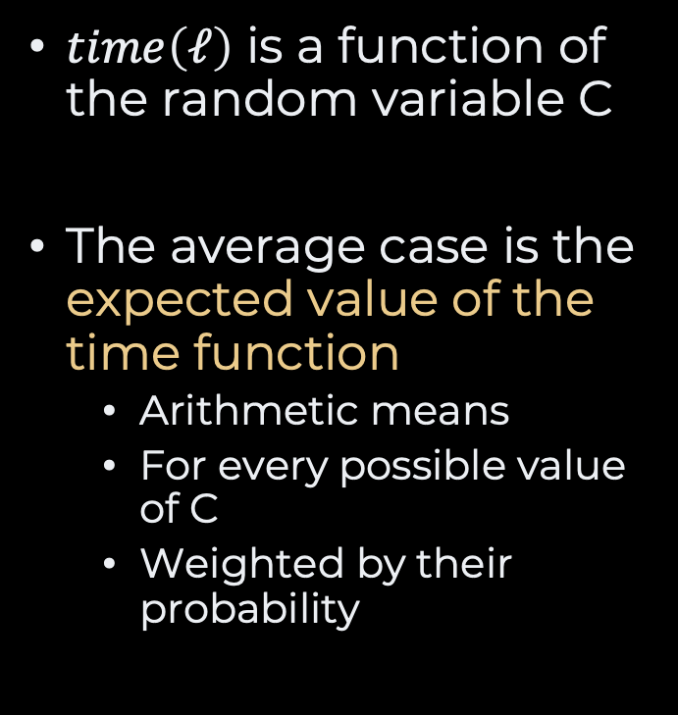
Average Case
$time\left(ℓ\right)$ is a function of the random variable C
The average case is the expected value of the time function
Arithmetic means
For every possible value of C
Weighted by their probability

Slide 18
Takeaway #2
Average cases require making an hypothesis.
A very general hypothesis may not apply to a real-life situation

Slide 19
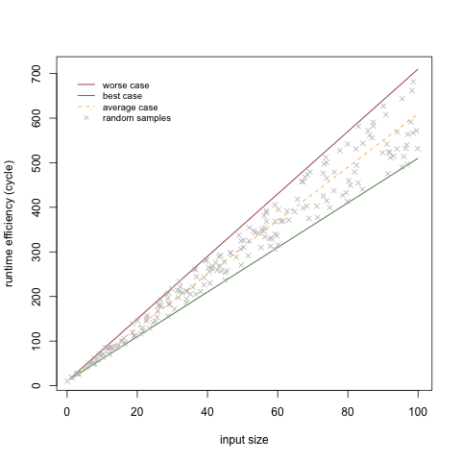
Algorithm Analysis

Slide 20
Recap
Problem Size:
Depends on the problem
Efficiency Model:
function of problem size
For a given problem size:
Worst case
Things will never be worse
Best case
Things will never get any better
Average case
What we should expect, in average
Is the hypothesis relevant?

Slide 21
Questions, Comments, or Ideas?
Franck Chauvel
Axbit & NTNU
franck.chauvel@ntnu.no

