Slide 1
The “Big-Oh” Notation
A classification of algorithms efficiencies
Foundations / Lecture 6
Franck Chauvel
Axbit & NTNU
Ask questions on menti.com
with code 1384 3192
franck.chauvel@ntnu.no

Slide 2
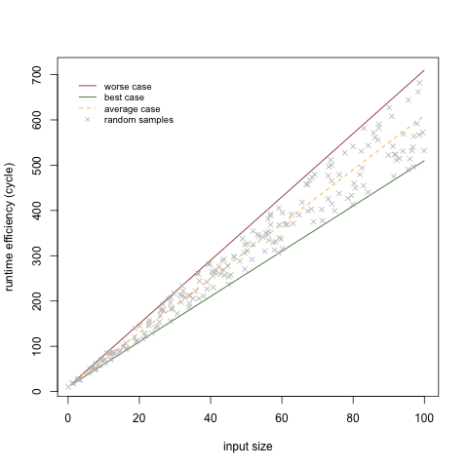

Algorithm Analysis
def sum_of_even(limit):
total = 0
counter = 0
while counter < limit:
value = int(input("?"))
if value % 2 == 0:
total = total + value
counter = counter + 1
return total

Slide 3
How to compare algorithms?
children
teens
adults
seniors
age
0
10
18
65

Slide 4
Agenda
Dominance Relations
Intractability
Big-Oh notation
Pitfalls

Slide 5
Looking at Larger Inputs
Efficiency decreases as input size increases
Large input sizes
Negligle differences for small inputs
efficiency
input size

Slide 6

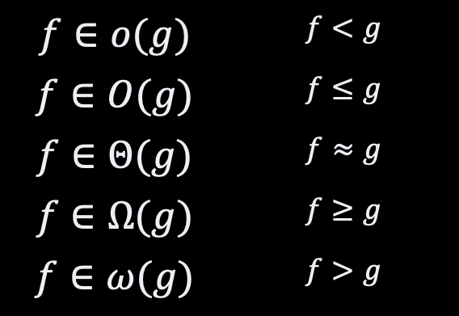
Dominance Relations
upper bound
efficiency
$$f∈o(g)$$ | $$f<g$$
$$f∈O(g)$$ | $$f≤g$$
$$f∈Θ(g)$$ | $$f≈g$$
$$f∈Ω(g)$$ | $$f≥g$$
$$f∈ω(g)$$ | $$f>g$$
$$f(n)$$
lower bound
input size

Slide 7
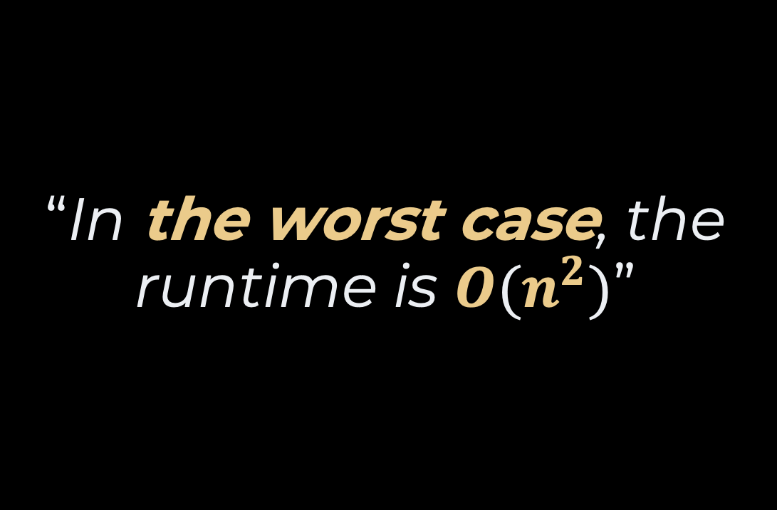
Takeaway #1
“In the worst case, the runtime is $O(n^{2})$”
scenario
dominance relation
actual bound

Slide 8
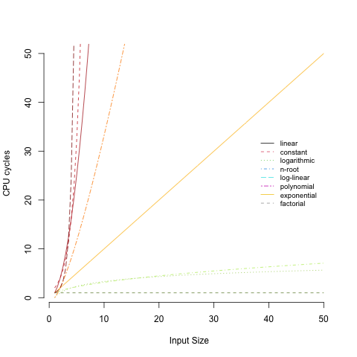
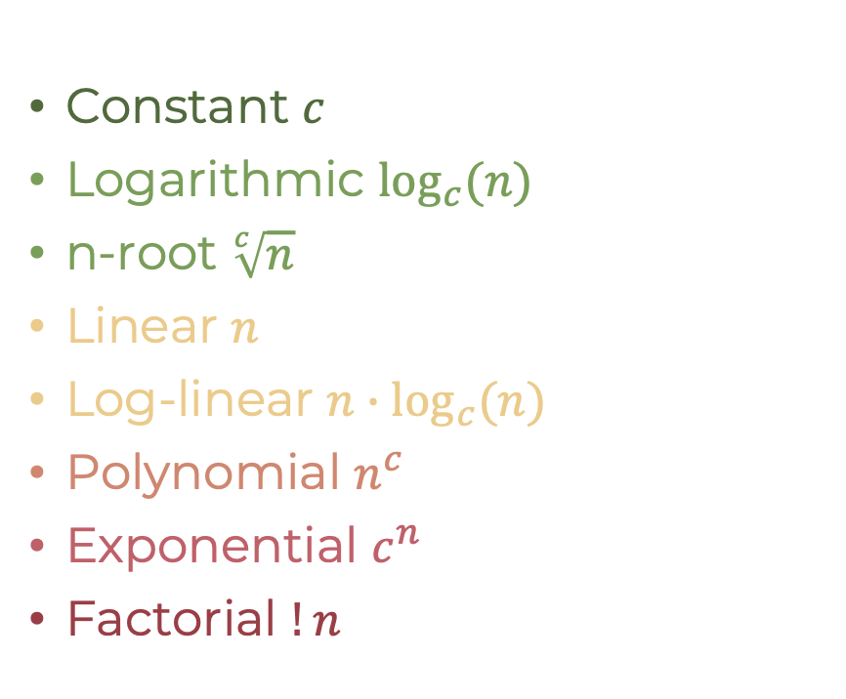
Bounds?
Constant $c$
Logarithmic $\log_{c}(n)$
n-root $\sqrt[c]{n}$
Linear $n$
Log-linear $n∙\log_{c}{(n)}$
Polynomial $n^{c}$
Exponential $c^{n}$
Factorial $!n$

Slide 9
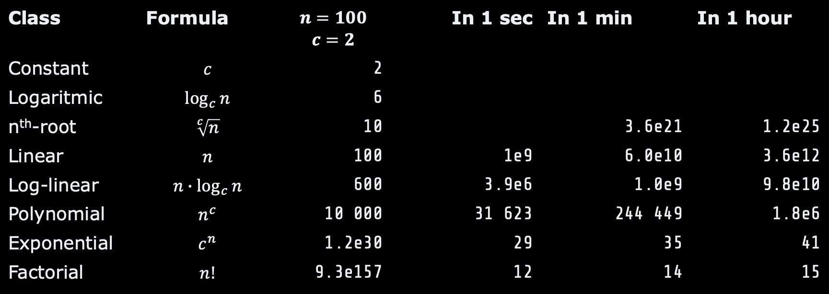
Intractability
Class | Formula | $$n=100$$ $$c=2$$ | In 1 sec | In 1 min | In 1 hour
Constant | $$c$$ | 2
Logaritmic | $$\log_{c}{n}$$ | 6
n^{th}-root | $$\sqrt[c]{n}$$ | 10 |  | 3.6e21 | 1.2e25
Linear | $$n$$ | 100 | 1e9 | 6.0e10 | 3.6e12
Log-linear | $$n∙\log_{c}{n}$$ | 600 | 3.9e6 | 1.0e9 | 9.8e10
Polynomial | $$n^{c}$$ | 10 000 | 31 623 | 244 449 | 1.8e6
Exponential | $$c^{n}$$ | 1.2e30 | 29 | 35 | 41
Factorial | $$n!$$ | 9.3e157 | 12 | 14 | 15

Slide 10




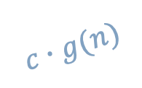
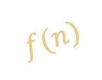
$O$ for Upper Bounds
$$c∙g(n)$$
efficiency
$$f(n)$$
$f∈O\left(g\right) ⟺$ $∃ \left(c, n_{0}\right)∈ℝ^{2},$ $∀ n≥n_{0}, f\left(n\right)≤c∙g(n)$
$$n_{0}$$
n: input size

Slide 11


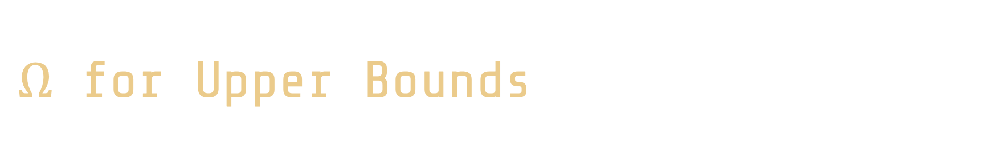
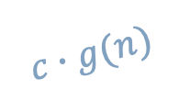
$Ω$ for Upper Bounds
efficiency
$$f(n)$$
$$c∙g(n)$$
$f∈Ω\left(g\right) ⟺$ $∃ \left(c, n_{0}\right)∈ℝ^{2},$ $∀ n≥n_{0}, f\left(n\right)≥c∙g(n)$
$$n_{0}$$
n: input size

Slide 12


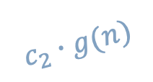
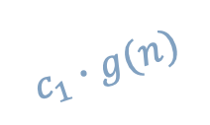
$Θ$ for “order-of”
$$c_{1}∙g(n)$$
efficiency
$$f(n)$$
$$c_{2}∙g(n)$$
$f∈Θ\left(g\right) ⟺$ $∃ \left(c_{1},c_{2}, n_{0}\right)∈ℝ^{3},$ $∀ n≥n_{0},$ $c_{1}∙g\left(n\right)≥f\left(n\right)≥c_{2}∙g(n)$
$$n_{0}$$
n: input size

Slide 13


Other bounds
Little-o
Little-⍵
$f<g$
$f∈o\left(g\right)⟺$ $∀ c∈ℝ, ∃ n_{0}∈ℝ, ∀ n≥n_{0},$ $f<c∙g(n)$
$f>g$
$f∈ω\left(g\right)⟺$ $∀ c∈ℝ, ∃ n_{0}∈ℝ, ∀ n≥n_{0},$ $f>c∙g(n)$

Slide 14



Bounds In Practice
$$23n^{2}+\frac{7}{5} n+234$$
$$23n^{2}+\frac{7}{5} n+234$$

Slide 15
Pitfalls
A couple of things to keep in mind

Slide 16




Within a Class Pitfall #1
x100 speed up!
$$t_{A}\left(n\right)=1000n+45$$
$$t_{B}\left(n\right)=10n+12$$
$$t_{A}∈Θ\left(n\right)$$
$$t_{B}∈Θ\left(n\right)$$
same bounds does not means same efficiency,
only that the difference will matter less and less as the input increases in size

Slide 17







Tight bounds Pitfall #2
$$t_{A}\left(n\right)=1000n+45$$
$$t_{A}∈O\left(n\right)$$
$$t_{A}∈O\left(\sqrt{n}\right)$$
$$t_{A}∈O\left(n^{2}\right)$$
$$t_{A}∈O\left(2^{n}\right)$$
$$t_{A}∈O\left(n!\right)$$

Slide 18
What About Smaller Inputs? Pitfall #4
slower algorithm
efficiency
fast algorithm
n: input size

Slide 19
Bounds vs. Scenarios Pitfall #3
Best case → Ω
Average case → Θ
Worst case → O
but, these are common uses of these bounds

Slide 20


Putting it All Together
best case
classification
Algorithm analysis
average case
classification
worst case
classification

Slide 21
Recap
Compare efficiency models
Classifcation
O for upper bound
Ω for lower bound
Θ for order
Some algorithms are useless
Big-O gives a “birdview”

Slide 22
Questions, Comments, or Ideas?
Franck Chauvel
Axbit & NTNU
franck.chauvel@gmail.com

