Slide 1
Computation Efficiency
The Art of Counting
Foundations / Lecture 4
Franck Chauvel
Ask questions on menti.com
with code 1384 3192
Axbit & NTNU
franck.chauvel@ntnu.no

Slide 2





Correctness and Efficiency
Programs
Algorithms
Problems
correctness
Algorithm 1
efficiency
$$f\left(n\right)=1+2+…+n$$
Algorithm 2

Slide 3
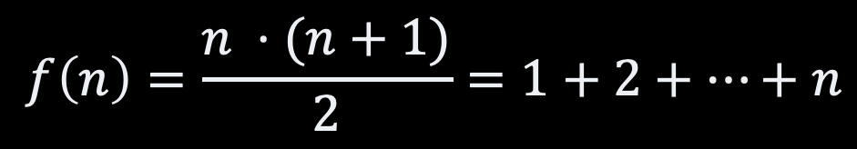
Which one Would you Choose?
$$f\left(n\right)=\frac{n ⋅(n+1)}{2}=1+2+…+n$$
start
sum := 0
each := 0
start
each ≤ N
[no]
stop
sum ← tmp*(tmp+1) / 2
each := each + 1
[yes]
end
sum := sum + each

Slide 4
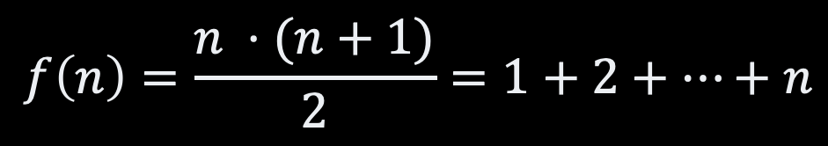
Let’s see?
$$f\left(n\right)=\frac{n ⋅(n+1)}{2}=1+2+…+n$$
#include <stdio.h>
#define N 100
int main(int argc, char** argv) {
int sum = 0;
int each = 0;
while (each <= N) {
sum += each;
each = each + 1;
}
printf("Total: %d\n", sum);
}
N = 100
total = (N * (N+1)) / 2
print(f"Total: {total}")

Slide 5
Agenda
Resources: Time and Memory
Measuring Time
Cost Model
Frequency Count
Measuring Memory
Example

Slide 6


Runtime & Memory
The two things that matters (here)

Slide 7
Runtime

Slide 8
Measuring Runtime
Performance testing
Many runs + statistics
Describe executors/programs more than algorithms!
$ time ./a.out
Total: 2550
./a.out 0.00s user 0.00s system 63% cpu 0.002 total
Macbook Air
Apple M1 8 cores
MacOS 11.3
Python 3.9.5
Apple C-Lang 12.0.5
$ time python3 sum.py
Total: 2550.0
python3 sum.py 0.01s user 0.01s system 42% cpu 0.046 total

Slide 9
Counting Steps
segment: data
N 1 100
divisor 1 2
total 1 0
segment: code
LOAD 1
ADD N
MUL N
DIV divisor
STORE total
PRINT total
N = 100
total = (N * (N+1)) / 2
print(f"Total: {total}")
5
+ 1
6

Slide 10
Cost Model
Code | Mnemonic | Parameter | Cost
1 | LOAD | value | 1
2 | ADD | address | 1
3 | SUBTRACT | address | 1
4 | STORE | address | 1
5 | JUMP | address | 1
6 | READ | address | 1
7 | PRINT | address | 1
? | HALT |  | 1
 | MUL | address | ?
 | DIV | address | ?
segment: data
N 1 100
divisor 1 2
total 1 0
segment: code
LOAD 1
ADD N
MUL N
DIV divisor
STORE total
PRINT total
cost(LOAD) = 1
cost(ADD) = 1
cost(MUL) = 1
cost(DIV) = 1
cost(STORE) = 1
cost(PRINT) = 1
6

Slide 11
Takeaway
The cost model defines how long every instruction takes.

Slide 12
What about Pseudocode?
Code | Cost | Run Count | Total
int main(int argc, char** argv) {
int sum = 0; | 1 | 1 | 1
int each = 0; | 1 | 1 | 1
while (each <= 100) { | 1 | 102 | 102
sum = sum + each; | 2 | 101 | 202
each = each + 1; | 2 | 101 | 202
}
printf("Total: %d\n", sum); | 1 | 1 | 1
}
Grand Total |  |  | 509

Slide 13
Runtime Comparison
#include <stdio.h>
#define N 100
int main(int argc, char** argv) {
int sum = 0;
int each = 0;
while (each <= N) {
sum += each;
each = each + 1;
}
printf("Total: %d\n", sum);
}
N = 100
total = (N * (N+1)) / 2
print(f"Total: {total}")
Time = 6
Time = 509

Slide 14
Memory
The other important resource

Slide 15
Measuring Memory
$ /usr/bin/time -l python3 sum.py
Total: 2550.0
0.04 real 0.01 user 0.01 sys
8257536 maximum resident set size
0 average shared memory size
0 average unshared data size
0 average unshared stack size
493 page reclaims
199 page faults
0 swaps
0 block input operations
0 block output operations
0 messages sent
0 messages received
0 signals received
110 voluntary context switches
16 involuntary context switches
102597177 instructions retired
44639544 cycles elapsed
4932640 peak memory footprint
$ /usr/bin/time -l ./a.out
Total: 2550
0.00 real 0.00 user 0.00 sys
1245184 maximum resident set size
0 average shared memory size
0 average unshared data size
0 average unshared stack size
81 page reclaims
4 page faults
0 swaps
0 block input operations
0 block output operations
0 messages sent
0 messages received
0 signals received
1 voluntary context switches
4 involuntary context switches
4562725 instructions retired
2047296 cycles elapsed
754456 peak memory footprint
7.8 MiB
1.18 MiB

Slide 16
Counting Memory Cells
segment: data
N 1 100
divisor 1 2
total 1 0
segment: code
LOAD 1
ADD N
MUL N
DIV divisor
STORE total
PRINT total
input (ignored)
1 cell
LIMIT = 100
half = LIMIT / 2
total = half * (half + 1)
print(f"Total: {total}")
output (ignored)
6 instructions
12 cells (ignored)

Slide 17
What about Pseudocode?
#include <stdio.h>
#define N 100
int main(int argc, char** argv) {
int sum = 0;
int each = 0;
while (each <= N) {
sum += each;
each = each + 1;
}
printf("Total: %d\n", sum);
}
1 variable, input (ignored)
1 variable, output (ignored)
1 variable

Slide 18
Memory Comparison
#include <stdio.h>
#define N 100
int main(int argc, char** argv) {
int sum = 0;
int each = 0;
while (each <= N) {
sum += each;
each = each + 1;
}
printf("Total: %d\n", sum);
}
LIMIT = 100
half = LIMIT / 2
total = half * (half + 1)
print(f"Total: {total}")
1 cell
1 cell

Slide 19


Full Comparison (for N=100)
Runtime
Memory
Loop
509
1
Formula
6
1

Slide 20
Recap
Efficiency
Depends on the machine
Memory
CPU
Measuring describes programs & machines
Just counting things ☺
Runtime
Counting
Cost model cost(op) = 1
Arithmetic
Logic
Assignments
Frequency count
Memory
Counting Variables / cells
Ignore code & inputs

Slide 21
Questions, Comments, or Ideas?
Franck Chauvel
Axbit & NTNU
franck.chauvel@ntnu.no

Slide 22
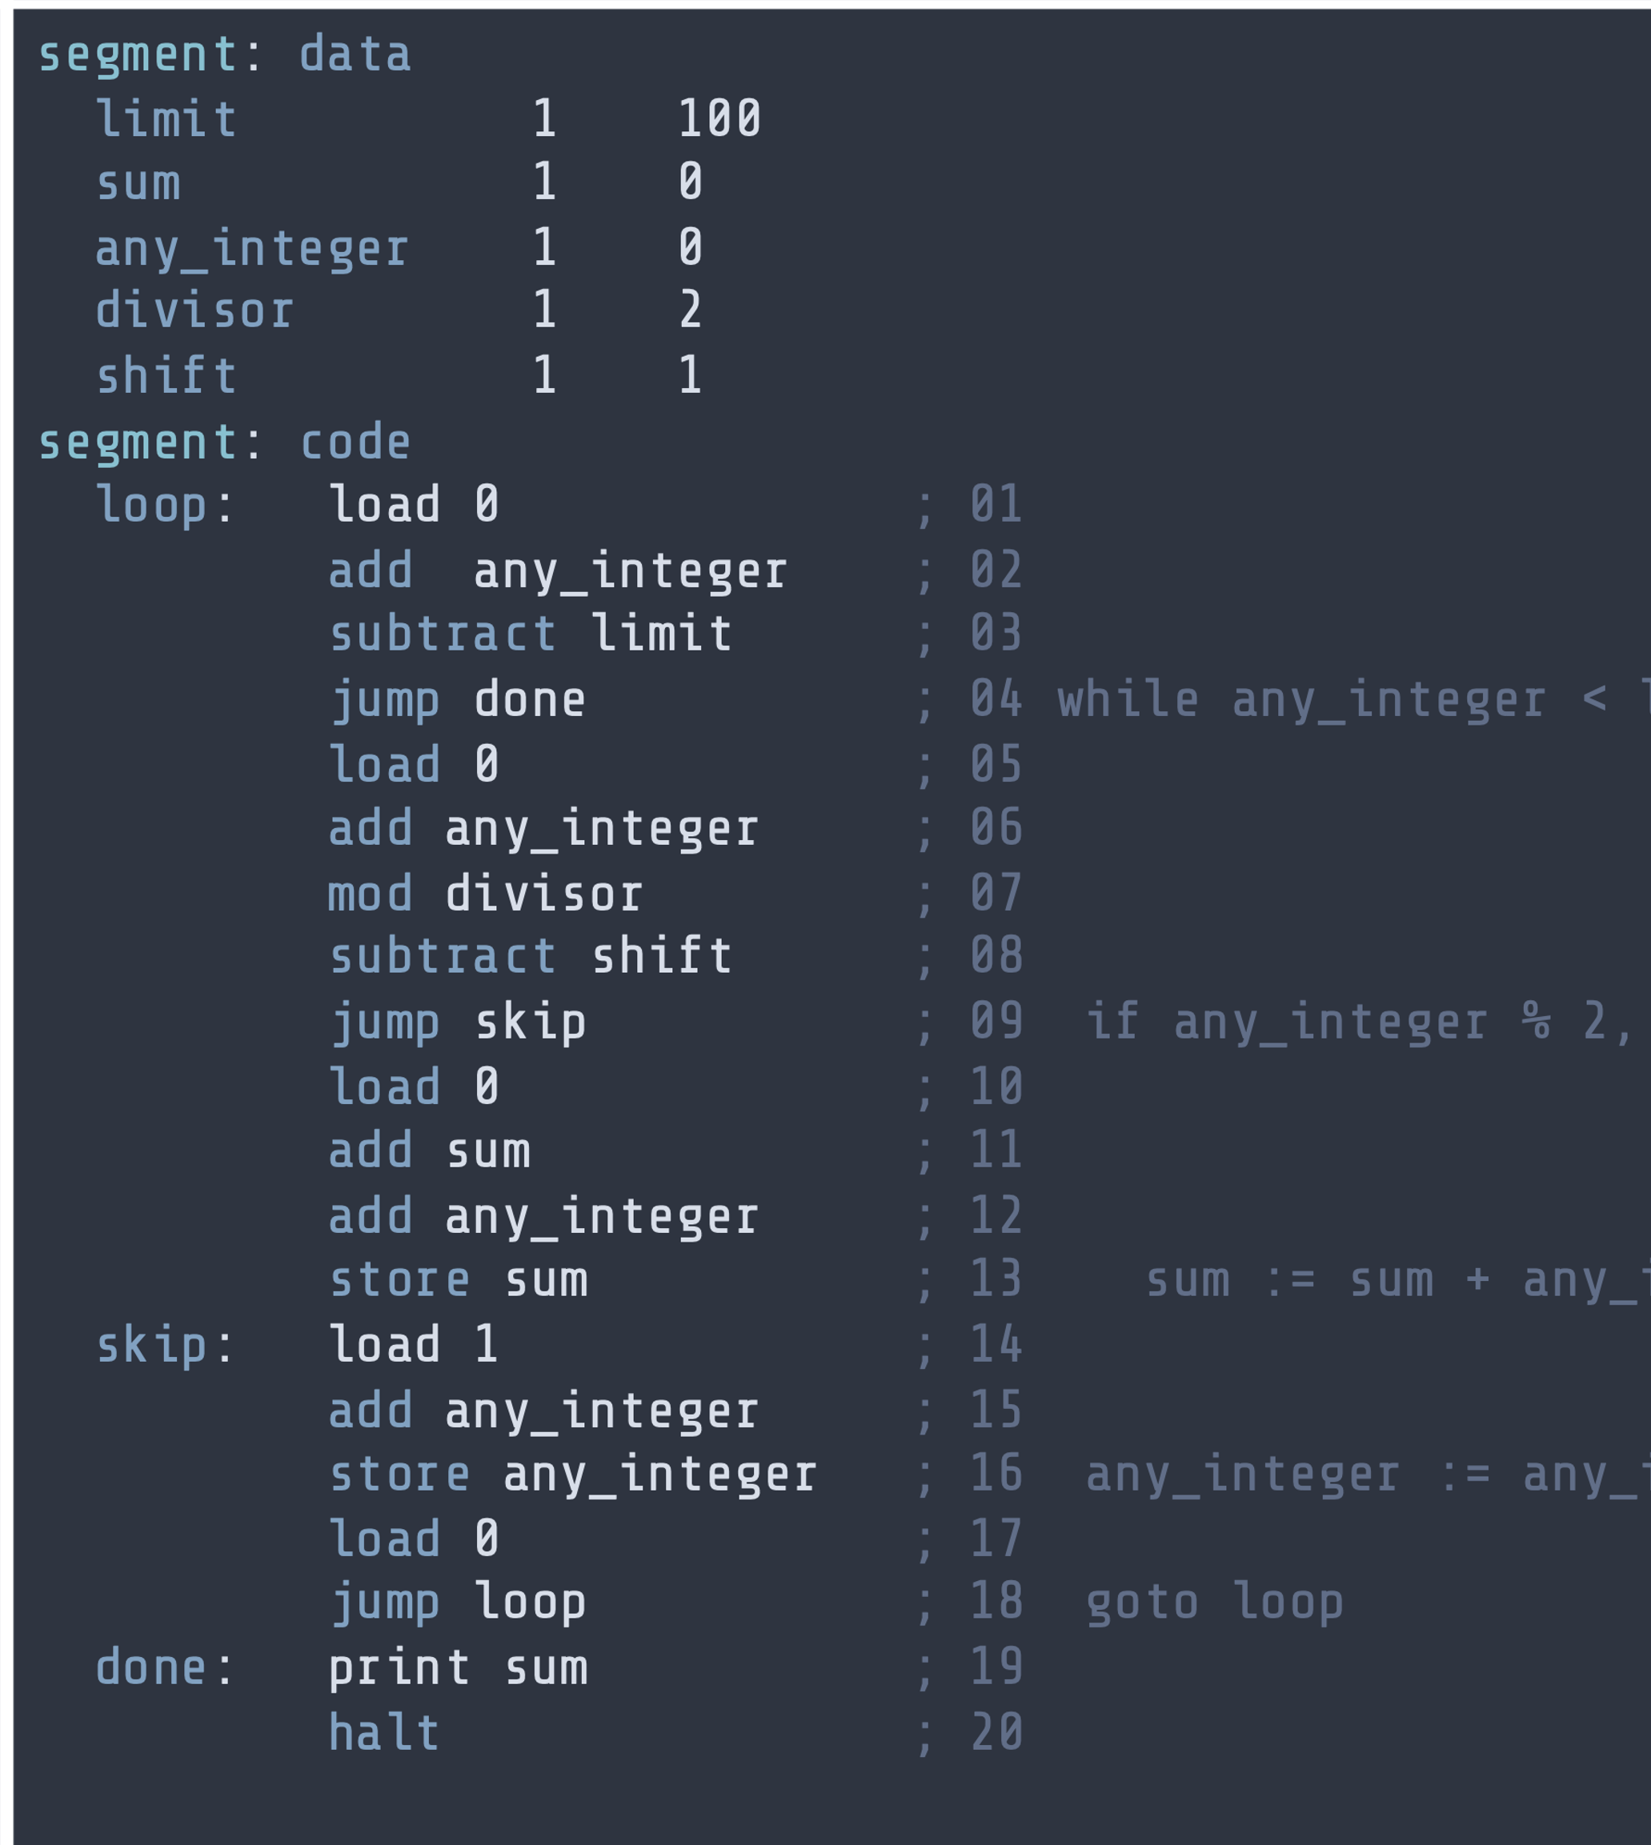
Lab Session
Runtime & Memory efficiency for small programs
On RAM assembly
On Pseudo-code

Slide 23
Adding Three Numbers Problem 1: Java
public static void main(String[] args) {
int total = 0;
Scanner input = new Scanner(System.in);
total = total + input.nextInt();
total = total + input.nextInt();
total = total + input.nextInt();
System.out.println("Total: " + total);
}
Runtime
Memory

Slide 24
Adding Three Numbers Problem 1
SEGMENT: data
value 1 0
total 1 0
SEGMENT: code
load 0
read value
add value
read value
add value
read value
add value
store total
print total
halt -1
Runtime
Memory

Slide 25
Maximum of Two Numbers Problem 2.1: Java
public static void main(String[] args) {
Scanner input = new Scanner(System.in);
int left = input.nextInt();
int right = input.nextInt();
int maximum = 0;
if (left < right) {
maximum = right;
} else {
maximum = left;
}
System.out.println("Maximum: " + maximum);
}
Runtime
Memory

Slide 26
Maximum of Two Numbers Problem 4: RAM ASM
SEGMENT: data
left 1 0
right 1 0
maximum 1 0
SGEMENT: code
read left
read right
load 0
add left
subtract right
jump lmax
load 0
add right
store maximum
load 0
jump done
lmax: load 0
add left
store maximum
done: print maximum
halt -1
Runtime
Memory

Slide 27
Multiplication Problem 5: Java
public static void main(String[] args) {
Scanner input = new Scanner(System.in);
int multiplicand = input.nextInt();
int multiplier = input.nextInt();
int result = 0;
for (int i=0 ; i<multiplier; i++) {
result = result + multiplicand;
}
System.out.println("Result: " + result);
}
Runtime
Memory

