Slide 1
Dynamic Programming
Faster recursive algorithms
Optimization / Lecture 2
Franck Chauvel
axbit & NTNU
Ask questions on menti.com
with code 3490 3073
franck.chauvel@ntnu.no

Slide 2





Knapsack Problem
2 kg / 9 000 NOK
laptop
7 kg / 3 000 NOK
books
3 kg / 4 000 NOK
music instruments
8 kg / 7 000 NOK
cooking tools
box (max 10 kg)

Slide 3





With Recursion?
empty solution
{L,B,M,C} / 10 kg
2 kg
9 000 NOK
y
n
{B,M,C} / 8 kg
{B,M,C} / 10 kg
7 kg
3 000 NOK
y
n
y
n
{M,C} / 1 kg
{M,C} / 8 kg
{M,C} / 3 kg
{M,C} / 10 kg
3 kg
4 000 NOK
y
n
y
n
y
n
y
n
{C} / -2 kg
{C} / 5 kg
{C} / 0 kg
{C} / 7 kg
{C} / 1 kg
{C} / 8 kg
{C} / 3 kg
{C} / 10 kg
8 kg
7 000 NOK
y
n
y
n
y
n
y
n
y
n
y
n
y
n
y
n

Slide 4
Recursive Solution
Try without the i^{th} object
Try with the i^{th} object

Slide 5
Recursive Solution?
private int recurse(int index, int capacity) {
if (index >= items.length-1) {
if (items[index].weight <= capacity) {
return items[index].value;
} else {
return 0;
}
}
var item = items[index];
return Math.max(recurse(index+1, capacity),
item.value + recurse(index+1, capacity - item.weight));
}

Slide 6
Question
How to avoid
computing solving the same problem
again and again?

Slide 7
Agenda
Fibonnacci Sequence
Dynamic Programming
Caching
Ordering
Bact to the Knapsack
Recap

Slide 8

Dynamic Programming
Memoization
(caching computation)
Bottom-up
traversal
save time

Slide 9
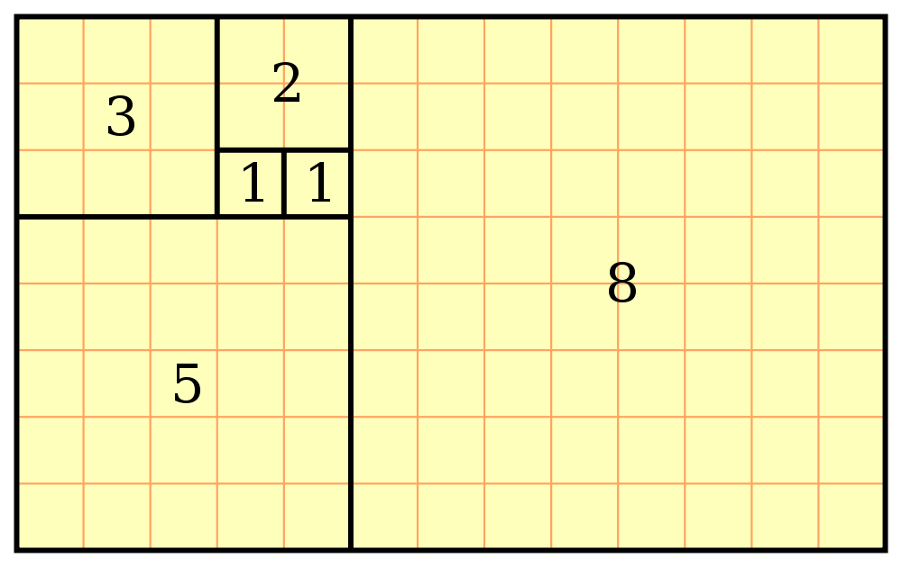
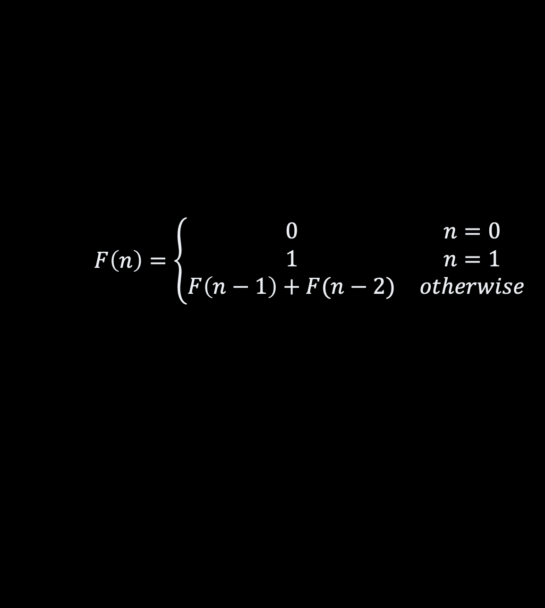
Fibonacci Sequence
$$F\left(n\right)=\left\{\begin{matrix}0 & n=0 \\ 1 & n=1 \\ F\left(n−1\right)+F(n−2) & otherwise\end{matrix}\right.$$

Slide 10
The Code Fibonacci Sequence
long recursive(long n) {
if (n == 0) return 0;
if (n == 1) return 1;
return recursive(n-1) + recursive(n-2);
}
With recursion
F(50) = 12 586 269 025
Time = 41 320 ms

Slide 11















Recursion Tree
$$F(5)$$
$$F(4)$$
$$F(3)$$
$$F(3)$$
$$F(2)$$
$$F(2)$$
$$F(1)$$
$$F(2)$$
$$F(1)$$
$$F(1)$$
$$F(0)$$
$$F(1)$$
$$F(0)$$
$$F(1)$$
$$F(0)$$

Slide 12















Memoization
5
$$F(5)$$
cache
$$F(4)$$
3
$$F(3)$$
n
F(n)
2
0
0
1
1
$$F(3)$$
$$F(2)$$
2
1
$$F(2)$$
$$F(1)$$
2
1
3
2
$$F(2)$$
$$F(1)$$
1
$$F(1)$$
$$F(0)$$
$$F(1)$$
$$F(0)$$
4
3
5
5
$$F(1)$$
$$F(0)$$

Slide 13















Memoization aka Caching
$$F(5)$$
cache
n
F(n)
$$F(4)$$
$$F(3)$$
0
0
1
1
$$F(3)$$
$$F(2)$$
$$F(2)$$
$$F(1)$$
2
1
3
2
$$F(2)$$
$$F(1)$$
$$F(1)$$
$$F(0)$$
$$F(1)$$
$$F(0)$$
4
3
5
5
$$F(1)$$
$$F(0)$$

Slide 14
The Code Memoization
long withMemoization(long n, long[] cache) {
var n1 = cache[(int) n-1];
if (n1 == -1L) {
n1 = withMemoization(n-1, cache);
cache[(int) n-1] = n1;
}
var n2 = cache[(int) n-2];
if (n2 == -1L) {
n2 = withMemoization(n-2, cache);
cache[(int) n-2] = n2;
}
return n1 + n2;
}
With memoization F(50) = 12 586 269 025
Time = 19 µs

Slide 15
Takeaway
Speed up using memoization
is the biggest benefit
of dynamic programming
But, can we do more?

Slide 16
Bottom up traversal
$$F(5)$$
cache
n
F(n)
$$F(4)$$
$$F(3)$$
0
0
1
1
$$F(3)$$
$$F(2)$$
$$F(2)$$
$$F(1)$$
2
1
3
2
$$F(2)$$
$$F(1)$$
$$F(1)$$
$$F(0)$$
$$F(1)$$
$$F(0)$$
4
3
5
5
$$F(1)$$
$$F(0)$$

Slide 17
The Code Dynamic Programming
long withDynamicProgramming(long n) {
long[] cache = new long[(int) (n+1)];
cache[0] = 0;
cache[1] = 1;
for(int i=2 ; i<=n; i++) {
cache[i] = cache[i-1] + cache[i-2];
}
return cache[(int) n];
}
With dynamic programming
F(50) = 12 586 269 025
Time = 0 ns

Slide 18
So What?
How can we improve our solution
to the knapsack problem?

Slide 19
With Memoization Knapsack 0/1
Capacities
0
1
2
3
4
5
6
7
8
9
10
Items
0
Laptop
?
?
?
?
?
?
?
?
?
?
?
?
?
?
?
?
?
?
?
?
?
?
Books
0
0
Guitar
?
?
?
?
?
?
?
?
?
?
?
8 kg
7 000 $
0
0
0
0
0
0
0
?
?
?
?
?
?
?
?
?
7000
7000
?
7000
Cooking
0
?

Slide 20
The Code With memoization
int memoize(int index, int capacity, int[][] cache) {
var item = items[index];
var without = cache[index+1][capacity];
if (without == -1) {
without = memoize(index+1, capacity, cache);
cache[index+1][capacity] = without;
}
var next = Math.max(capacity-item.weight, 0);
var with = cache[index+1][next];
if (with == -1) {
with = item.value + memoize(index+1, next, cache);
cache[index+1][next] = with;
}
return Math.max(with, without);
}
int withMemoization(int capacity) {
int[][] cache = new int[items.length][capacity+1];
for (int n=0 ; n<=items.length-1 ; n++) {
for (int c=0 ; c<capacity+1 ; c++) {
cache[n][c] = -1;
if (c == 0) cache[n][c] = 0;
if (n == items.length-1)
cache[n][c] = c < items[n].weight ? 0 : items[n].value;
}
}
return memoize(0, capacity, cache);
}

Slide 21
With Dynamic Programming Knapsack 0/1
Capacities
0
1
2
3
4
5
6
7
8
9
10
Items
0
Laptop
?
?
?
?
?
?
?
?
?
?
?
?
?
?
?
?
?
?
?
?
?
?
Books
0
3 kg
4 000 $
0
?
?
?
?
?
?
?
?
?
?
?
?
Guitar
+ 4 000 $
7000
8 kg
7 000 $
0
0
0
0
0
?
0
0
0
?
?
?
?
?
?
?
?
7000
7000
?
7000
Cooking
0
7000
?

Slide 22
The Code With dynamic programming
int dynamicProgramming(int capacity) {
int[][] cache = new int[items.length+1][capacity+1];
for (int n=0 ; n<=items.length ; n++) {
for (int c=0 ; c<capacity+1 ; c++) {
cache[n][c] = 0;
if (c == 0) cache[n][c] = 0;
if (n == items.length-1)
cache[n][c] = c < items[n].weight ? 0 : items[n].value;
}
}
solve(capacity, cache);
return cache[0][capacity];
}
void solve(int[][] cache) {
for (int n=items.length-1 ; n>=0 ;n--) {
for (int c=capacity ; c>=0 ;c--) {
var item = items[n];
var without = cache[n+1][c];
var next = Math.max(c-item.weight, 0);
var with = (item.weight <= c)
? item.value + cache[n+1][next]
: 0;
cache[n][c] = Math.max(with, without);
}
}
}

Slide 23
Recap
Recursive algorithm
may repeat the same computations
Dynamic Programming
Speed up
trade up memory for time
Some recursive algorithm
combinatorial things
memoization
bottom up traversal
Work best when
natural ordering
text, arrays, points, etc.

Slide 24
Questions, Comments, or Ideas?
Franck Chauvel
Axbit & NTNU
franck.chauvel@ntnu.no

