Slide 1
Combinatorial Search
Permutations, Arrangements, Subsets and more
Optimization / Lecture 1
Franck Chauvel
axbit & NTNU
Ask questions on menti.com
with code 3490 3073
franck.chauvel@ntnu.no

Slide 2

Optimization Problems
Finding the item $i$ in the set $S$,
such that $i$ satisfies the constraint $C$
and that $i$ optimizes an objective-function $f$
Discrete
Optimization
(S is countable)
Continuous
Optimization
(S in uncountable)

Slide 3

Breaking in
?
?
?
?

Slide 4
Brute Force
Try out all the possible solutions!
10 000 PIN code
Exhaustive search
int breakIn(Vault vault, int digitCount) {
int limit = Math.power(10, digitCount);
for (int anyKey=0 ; anyKey<limit ; anyKey++) {
if (vault.opensWith(anyKey)) {
return anyKey;
}
}
throw new RuntimeError("Could not find a key!");
}

Slide 5
Agenda
Examples
Size Problem: How big is a million?
Back-tracking
Pruning
Branch-and-bound

Slide 6
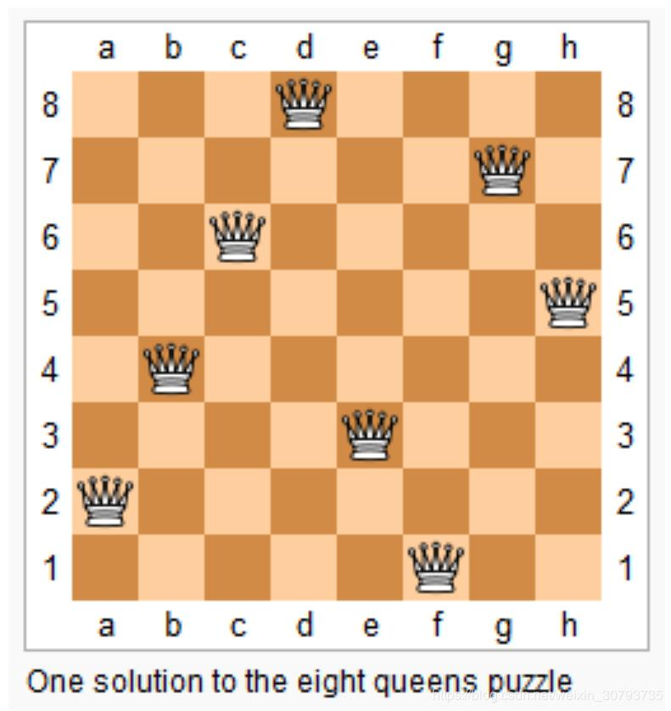
N Queens

Slide 7
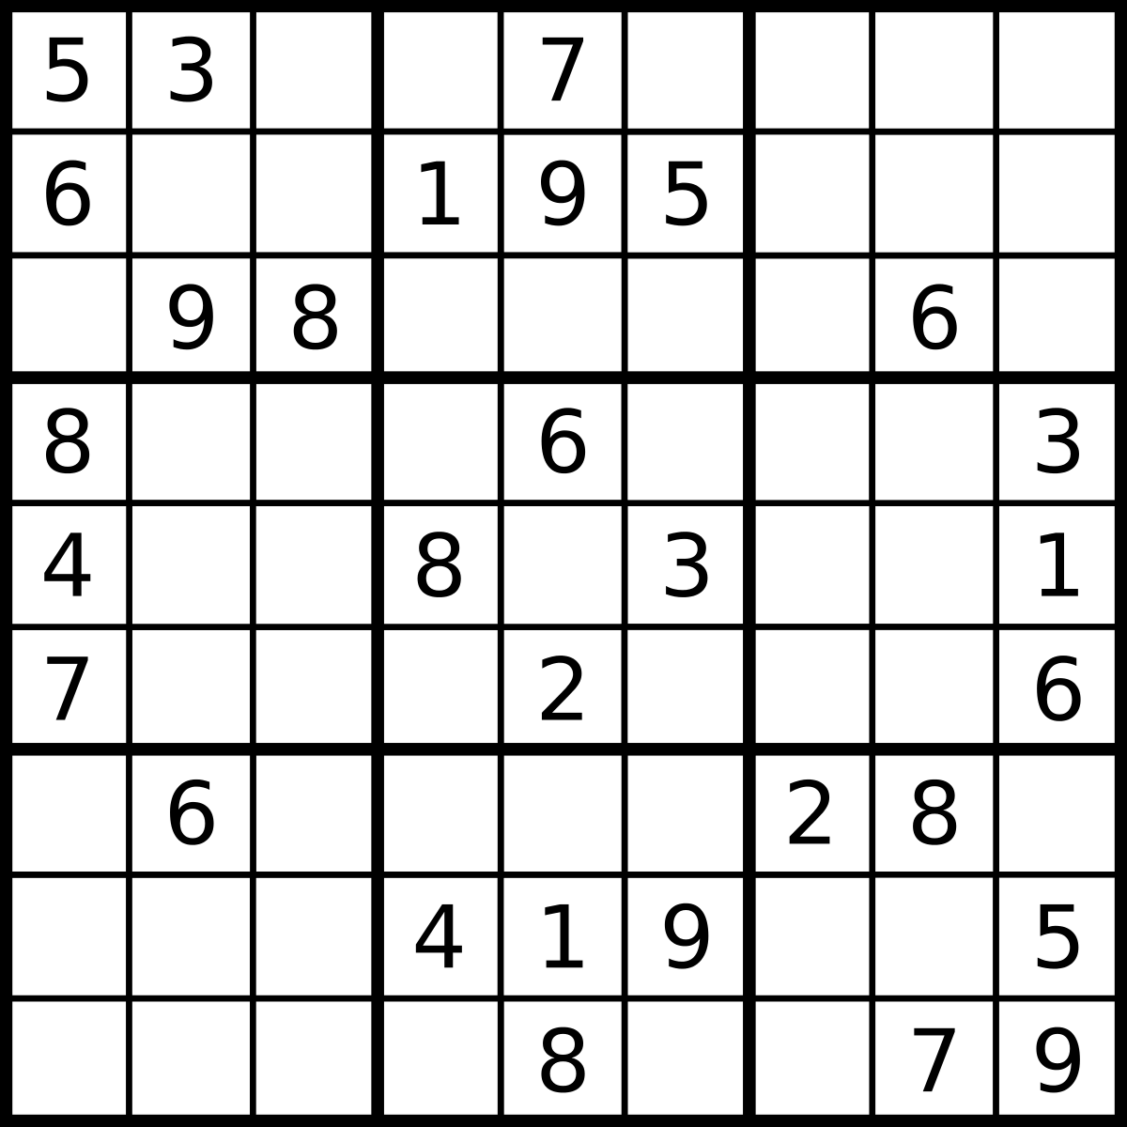
Sudoku
Found one grid
that satisfies all the constraintsq

Slide 8


Motion Planning

Slide 9
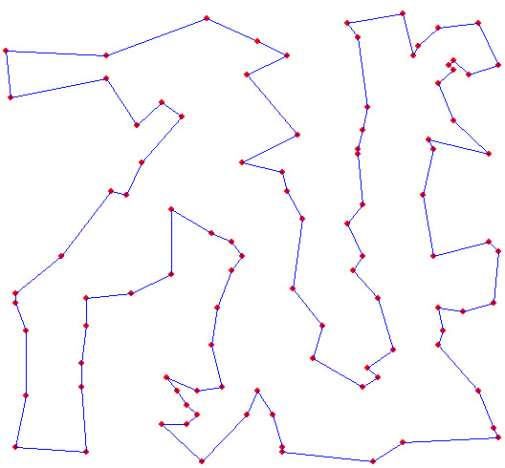
Traveling Salesperson Problem
Find an hamiltonian circuit
pass everywhere once
ends where it starts

Slide 10





Knapsack Problem
2 kg / 9 000 NOK
laptop
7 kg / 3 000 NOK
books
3 kg / 4 000 NOK
music instruments
8 kg / 7 000 NOK
cooking tools
box (max 10 kg)

Slide 11
How big is a Million?
1 048 576
partitions in a 20-item set
millions of operation
per second
3 628 800
10-item permutations
11 881 376
5-letter words

Slide 12

Enumerating all Solutions
Empty Solution
Valid Solution
1st choice
2nd choice
n-th choice

Slide 13





Backtracking Enumerate All
empty solution
1st
choice
y
n
2nd
choice
y
n
y
n
3rd
choice
y
n
y
n
y
n
y
n
4th
choice
y
n
y
n
y
n
y
n
y
n
y
n
y
n
y
n

Slide 14
The Code Backtracking
static Configuration solve(Problem problem) {
var start = problem.emptyConfiguration();
return backtrack(problem, start);
}
static Configuration backtrack(Problem problem, Configuration configuration) {
if (problem.isComplete(configuration)) {
if (problem.isValid(configuration)) {
process(configuration);
}
} else {
for (var eachChange: problem.allChanges(configuration)) {
eachChange.applyTo(configuration);
backtrack(problem, configuration);
eachChange.revertOn(configuration);
}
}
}

Slide 15
How can we avoid building
invalid solutions?
Use Pruning

Slide 16
Pruning
empty solution
2 kg
9 000 NOK
2 kg
y
n
9 kg
2 kg
7 kg
7 kg
3 000 NOK
y
n
y
n
5 kg
2 kg
10 kg
3 kg
3 kg
4 000 NOK
y
n
y
n
y
n
y
n
8 kg
7 000 NOK
y
n
y
n
y
n
y
n
y
n
y
n
y
n
y
n
10 kg

Slide 17
The Code With Pruning
static void solve(Problem problem) {
var start = problem.emptyConfiguration();
backtrack(problem, start);
}
static void backtrack(Problem problem, Configuration configuration) {
if (problem.isValid(configuration)) {
if (problem.isComplete(configuration)) {
process(configuration);
} else {
for (var eachChange: problem.allChanges(configuration)) {
eachChange.applyTo(configuration);
backtrack(problem, configuration);
eachChange.revertOn(configuration);
}
}
}
}
We discard sub tree that do not fit the problem constraints

Slide 18
We can find a solution.
What about the best solution?
Why not enumerate in descending order
and take the first one?

Slide 19
Branch-and-Bound
2 kg
9000 NOK
2 kg
9 000 NOK
Heuristic function
Bound the relevance
Relax constraints
Used for pruning
y
9 kg
12 000 NOK
7 kg
3 000 NOK
y
n
3 kg
4 000 NOK
y
n
y
n
8 kg
7 000 NOK
y
n
y
n
y
n
y
n
Upper bound
13 kg
20 000 NOK
Lower bound
9 kg
12 000 NOK

Slide 20
Branch-and-Bound
Best so far:
12 000 NOK
13 000 NOK
0 NOK
16 000 NOK
23 000 NOK
2 kg
9000 NOK
2 kg
9 000 NOK
y
n
23 000 NOK
14 000 NOK
9 kg
12 000 NOK
7 kg
3 000 NOK
y
n
y
n
23 000 NOK
20 000 NOK
5 kg
13 000 NOK
3 kg
4 000 NOK
y
n
y
n
y
n
y
n
16 000 NOK
8 kg
7 000 NOK
y
n
y
n
y
n
y
n
y
n
y
n
y
n
y
n
10 kg
16 000 NOK

Slide 21
The order matters!
Branch-and-bound works best
if we find the good solution quickly

Slide 22
The Code Branch-and-Bound
var gain = problem.gain(configuration);
if (bestGainSoFar < gain) {
bestGainSoFar = gain;
best = configuration.clone();
}
static void branchAndBound(Problem problem) {
var alternatives = new PriorityQueue<Configuration>();
alternatives.add(problem.zeroConfiguration());
while (!alternatives.isEmpty()) {
var configuration = candidates.poll()
if (problem.isValid(configuration)
&& problem.bound(configuration) > bestGainSoFar) {
if (problem.isComplete(configuration)) {
// Check if it’s better
} else {
// Refine configuration
}
}
}
}
for (var eachChange: problem.nextExtension(configuration)) {
eachChange.applyTo(configuration);
alternatives.add(configuration.clone());
eachChange.revert(configuration);
}

Slide 23

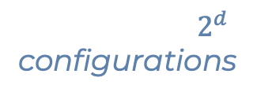
DFS vs. BFS vs. Priorities
$\log_{2}{d}$changes
DFS
y
n
y
n
y
n
y
n
y
n
y
n
y
n
$2^{d}$
configurations
BFS
y
n
y
n
y
n
y
n
y
n
y
n
y
n
y
n

Slide 24
Recap
Combinatorial Search
Enumerate all solutions
Partitions, Combinations, Permutations, etc.
Many Problems
TSP, VRP
SAT
Knapsack
Constraint Satisfaction Problems
Exhaustive Search
Search any solution
Can stop early!
Back-tracking + pruning
Optimal Solution
Need to check all branches!
Branch-and-bound

Slide 25
Questions, Comments, or Ideas?
Franck Chauvel
Axbit & NTNU
franck.chauvel@ntnu.no

