Slide 1
CaeZar
Team CCZZ:
Cheng Li, Xinlu Chen,
Xuan Zhang, Lijie Zhou

Slide 2
Overview
Project Introduction
Game Rules
Reasons of Choosing this Game
Expected Functionality of the Website
Wireframes
Technology Stack

Slide 3
CaeZar Game overview
CaeZar is an online Texas Hold’em game.
It supports multiple game rooms with up to 4 players in each game room.
Users need to register or sign in to enter the game lobby.
Users can create or join in a game room from the lobby to begin a game with friends.
CaeZar allows chatting in the game lobby and in each game room.
CaeZar provides game rules page for beginners as a reference.

Slide 4
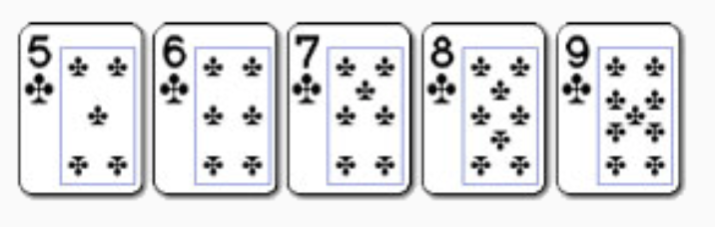
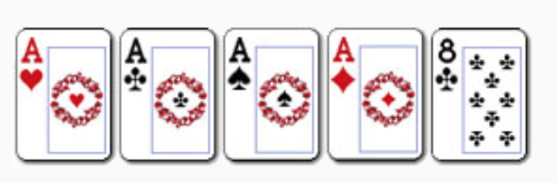
Game Rules
The game rule of CaeZar follows the classic Texas Hold’em game rule.
Ranks: Royal flush, straight flush, four of a kind, full house, flush, straight, three of a kind, two pairs, one pair, high card.
Straight flush:
Five cards in numerical order with identical suits.
Four of a Kind:
Four cards of the same rank and one side card.

Slide 5
REASON OF CHOOSING THIS GAME
It is less graphic so we can focus on the programming.
It is a classic poker game that many people love. That means we could have a large amount of potential users.
The rule is easy so people don’t need to spend lots of time learning how to play.

Slide 6
Expected functionality of website
Unregistered Users:
Register
Registered Users:
Login and Logout
Access the game lobby page
Access the game rule page
Access the user profile page
Create or join in a game room
Chat with other players
Admin
Manage website content and user data

Slide 7
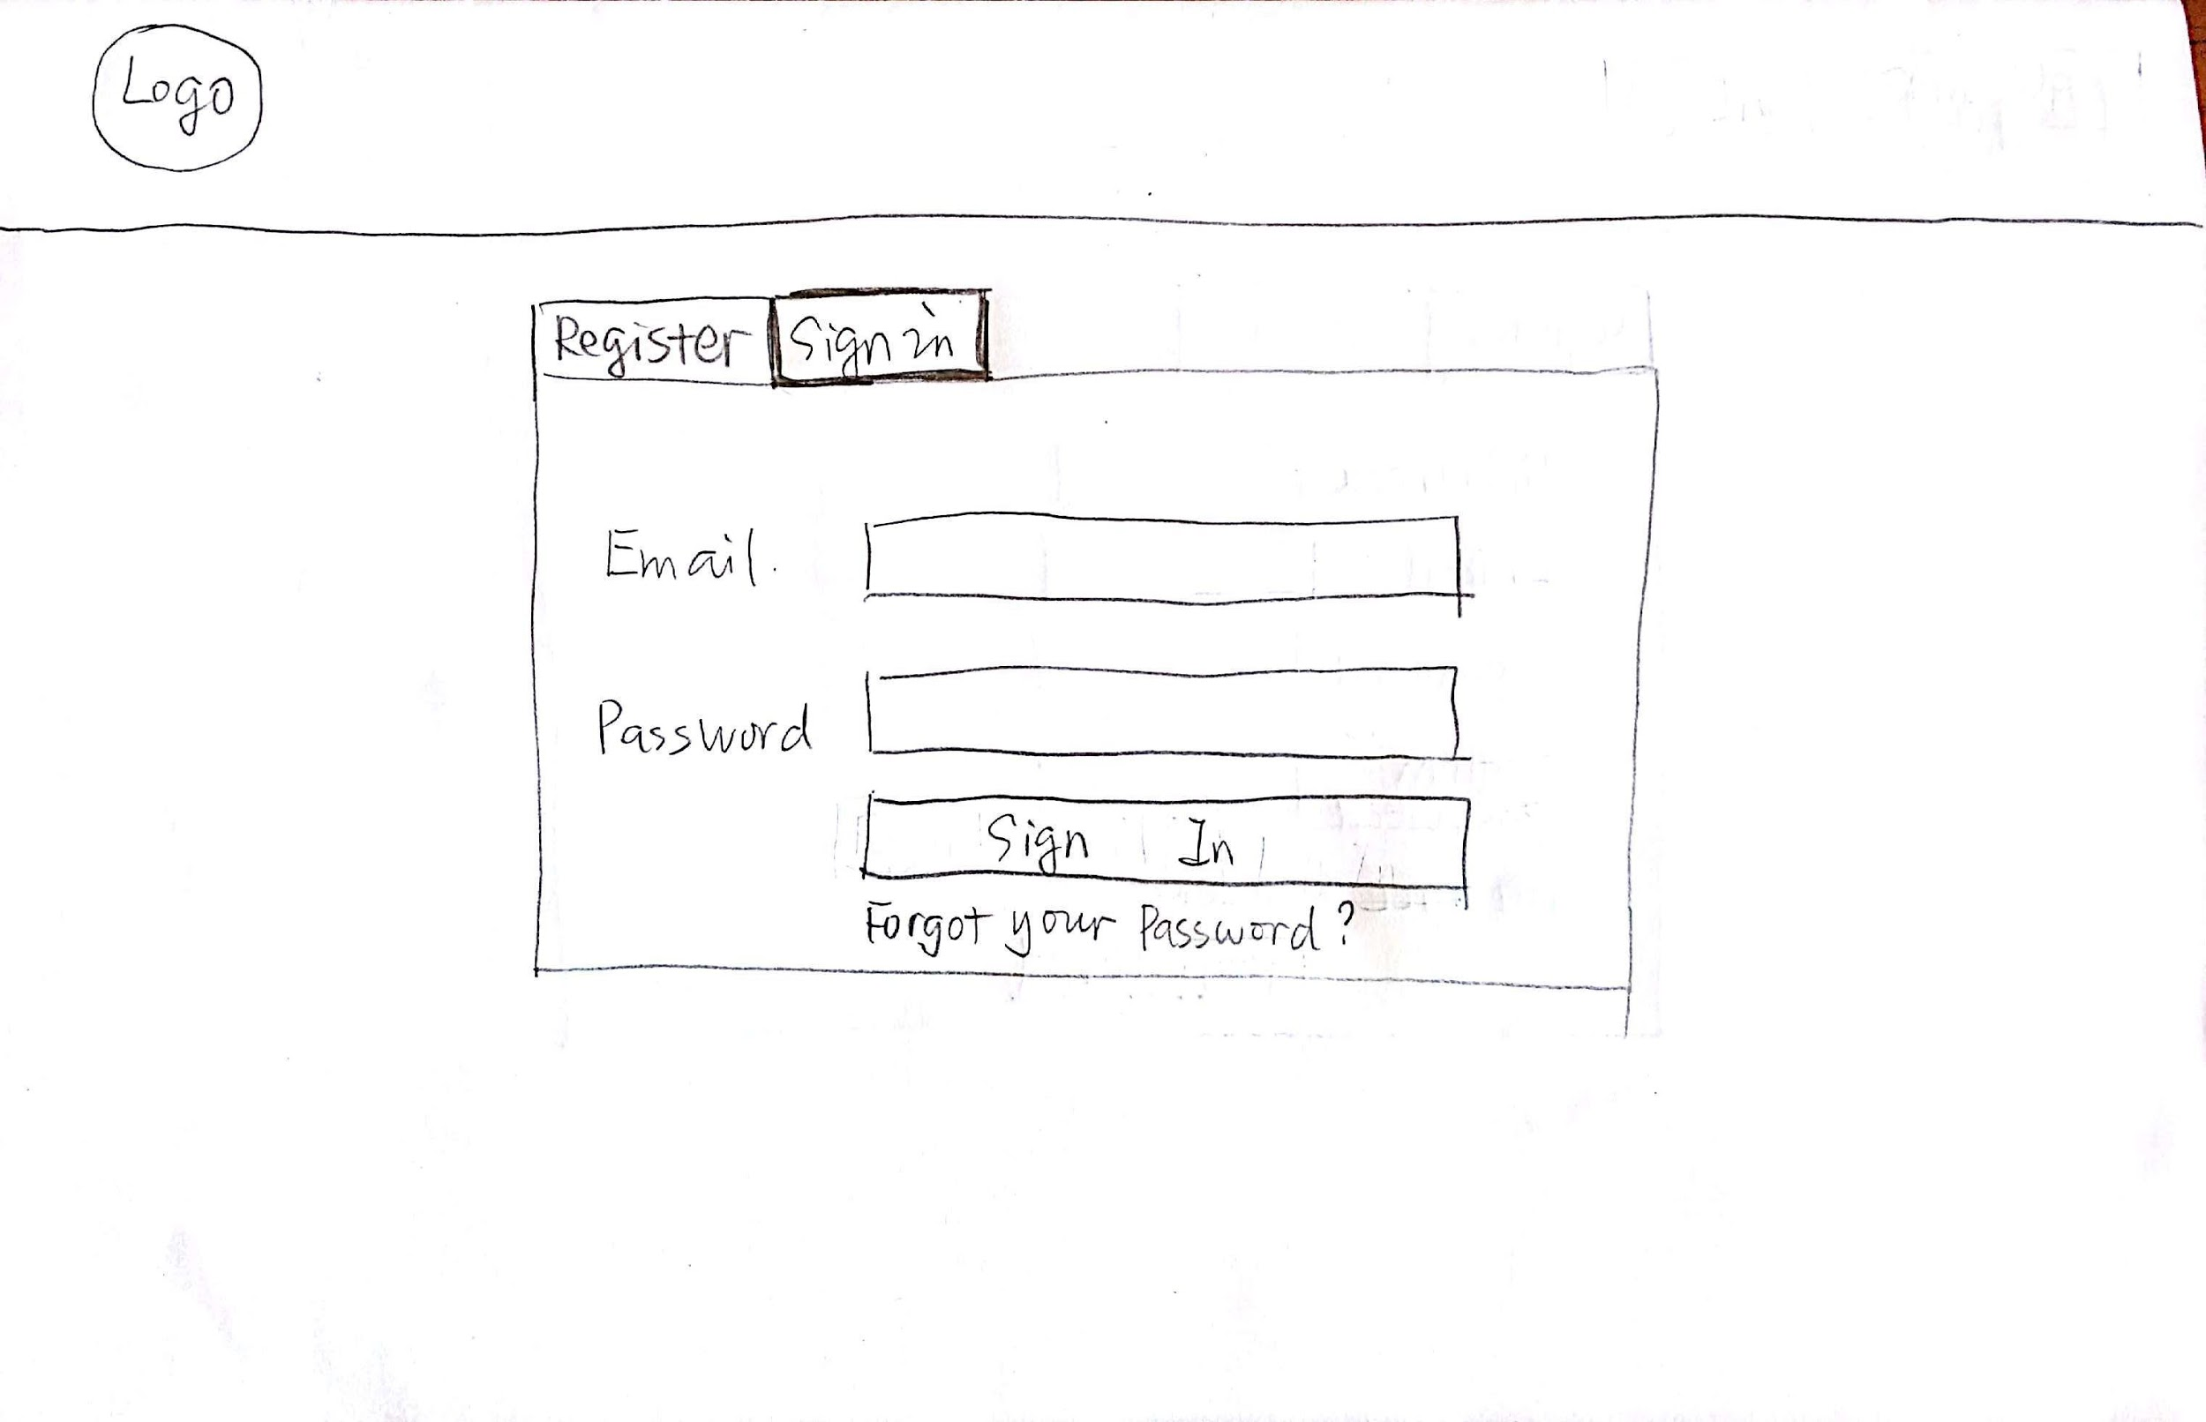
wireframe - Sign in Page

Slide 8
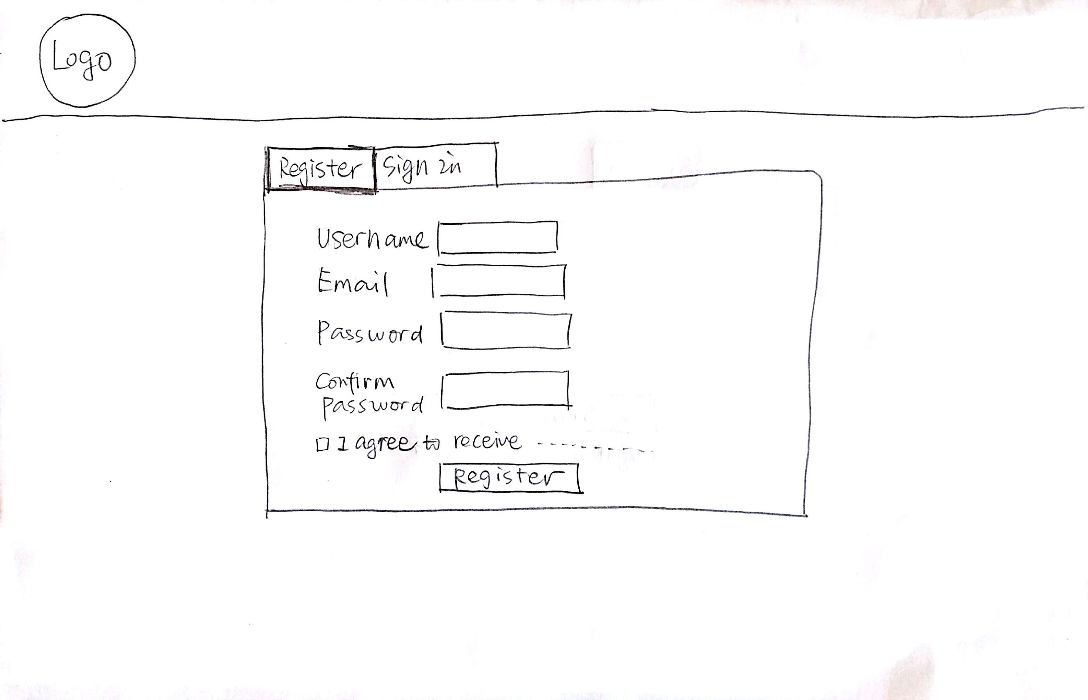
Registration Page

Slide 9
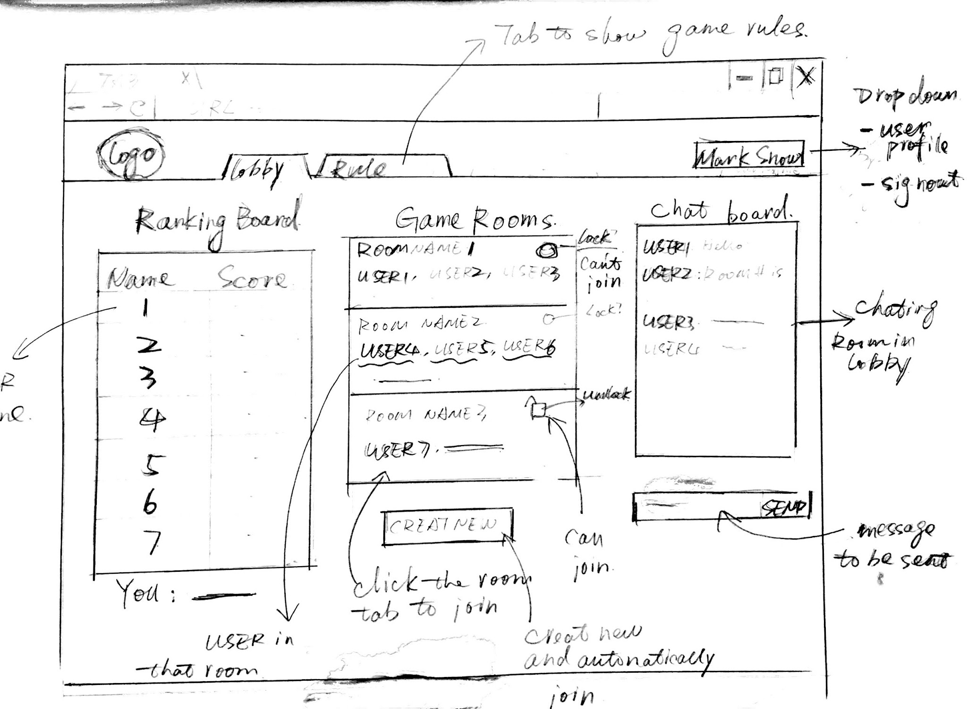
Game Lobby Page

Slide 10
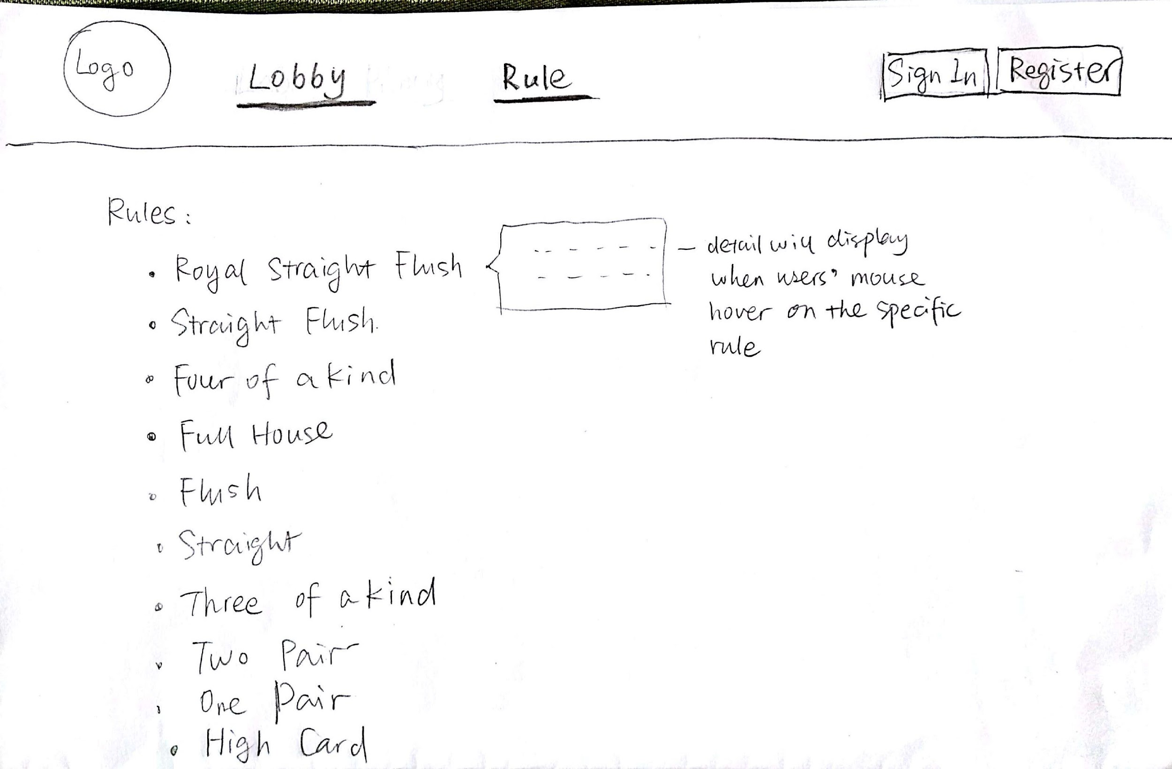
Game Rule Page

Slide 11
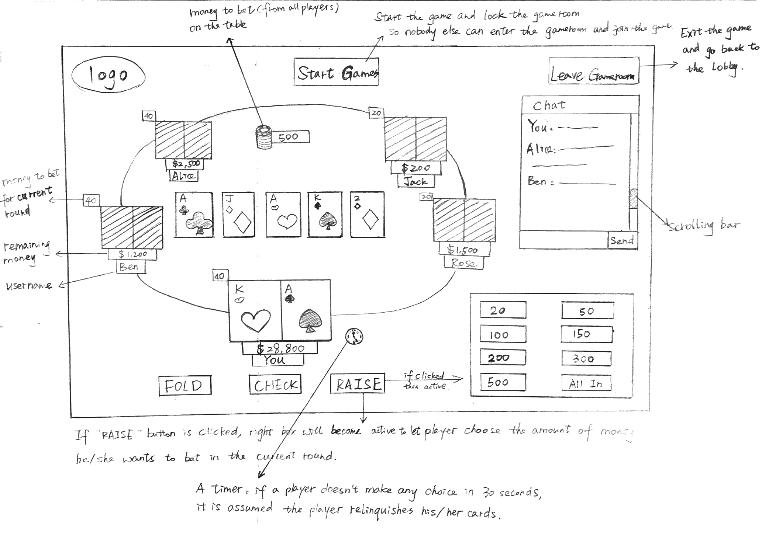
Game Room Page

Slide 12
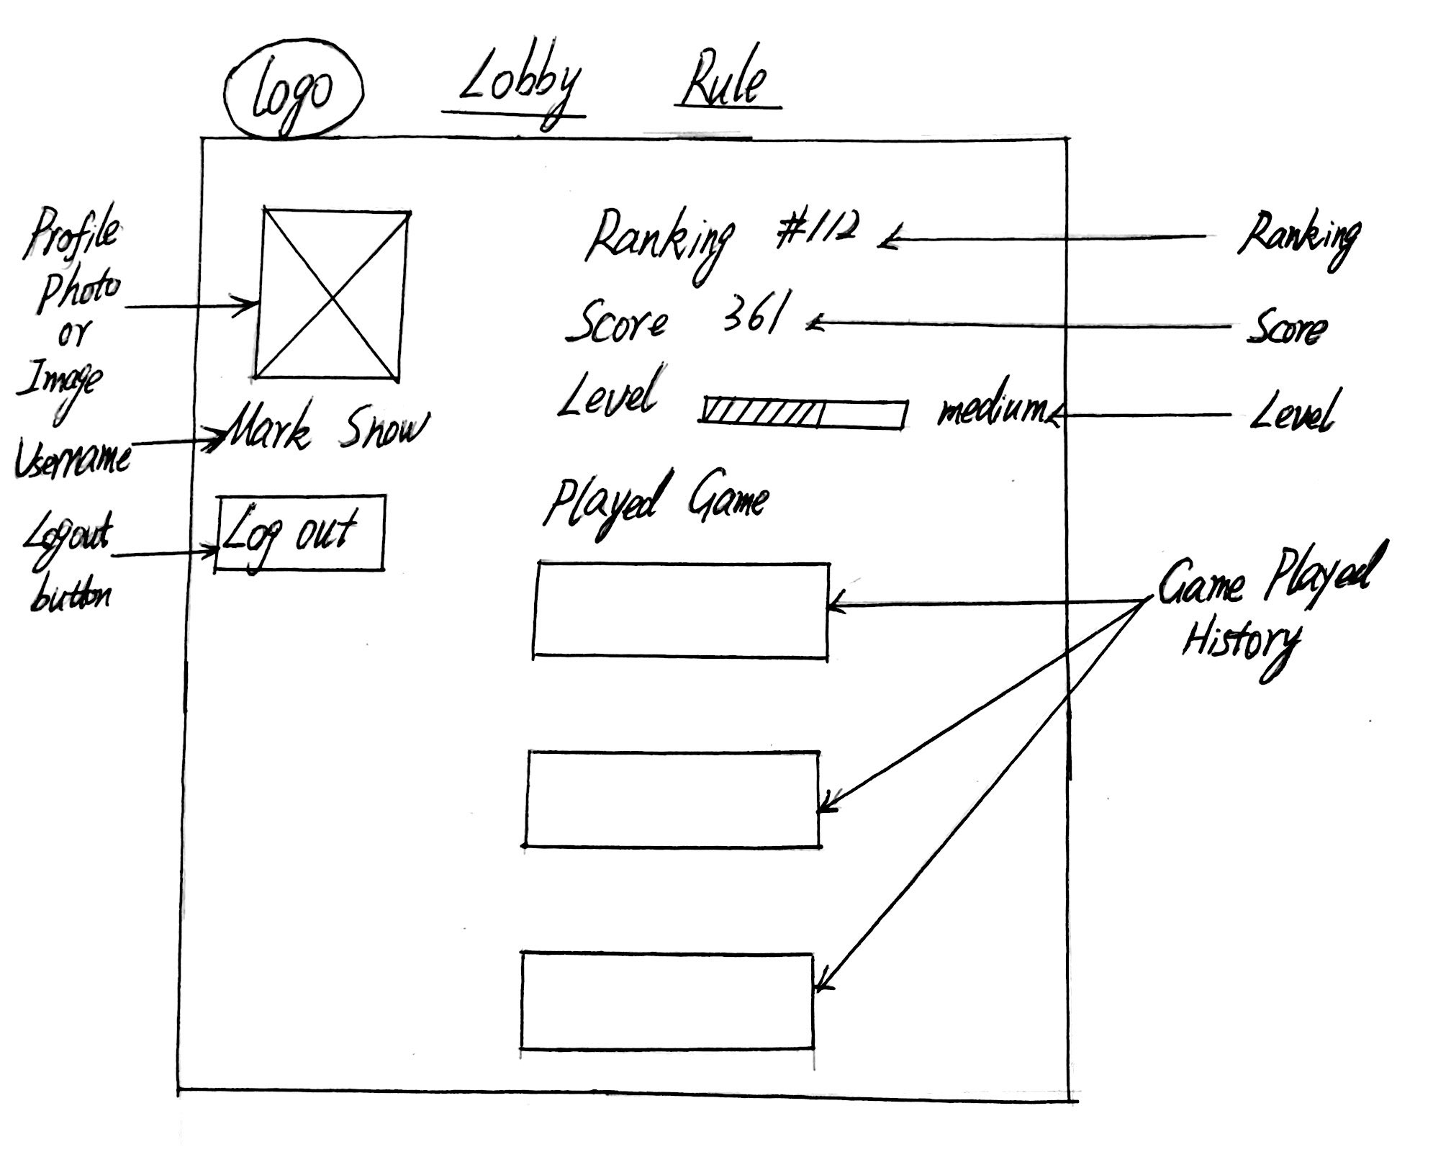
User Profile Page

Slide 13
Technology Stack
Frontend:
HTML5, CSS3, JavaScript
Backend:
Node.js, Express.js, SQL

Slide 14
Thanks for your time! ^_________^

