Slide 1
Project 1: SAT & ACT Data
Chrissy Smiley

Slide 2
Data
2 data sets: ACT & SAT, with associated values
ACT has national score & District of Columbia
10 columns per state; 500 data points
ACT includes science score and separate English and Reading, SAT combines Reading & Writing

Slide 3
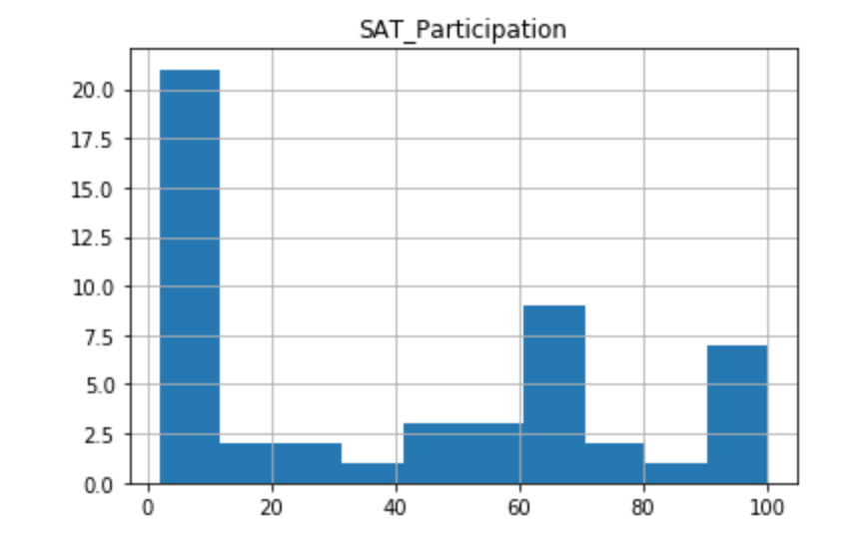
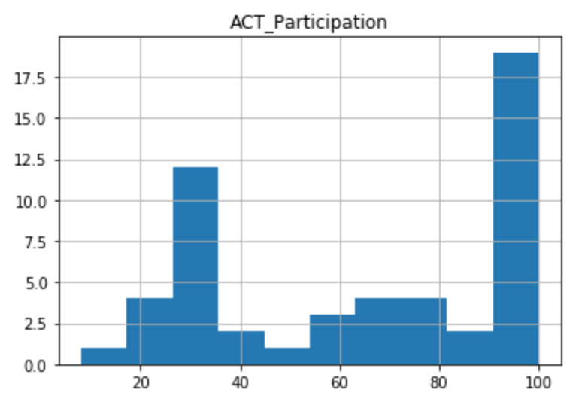
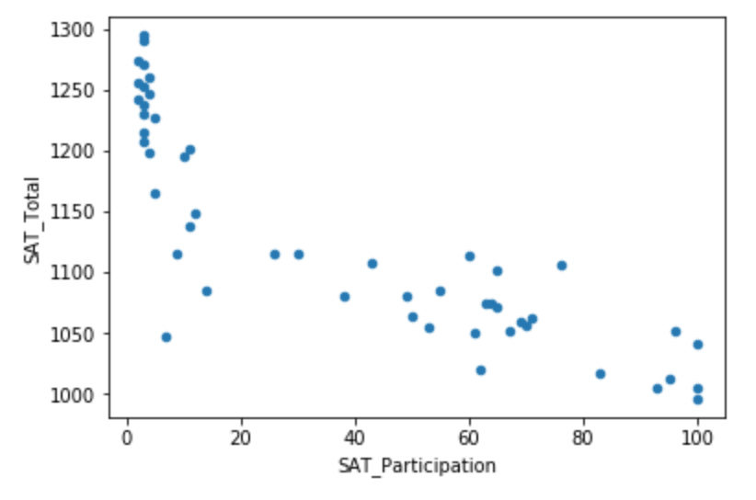
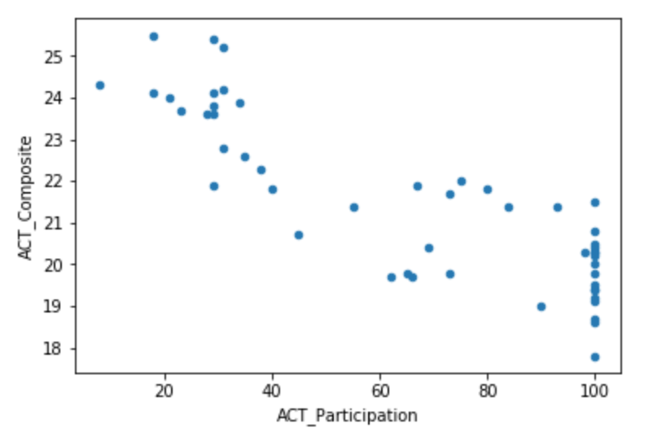
Observations

Slide 4
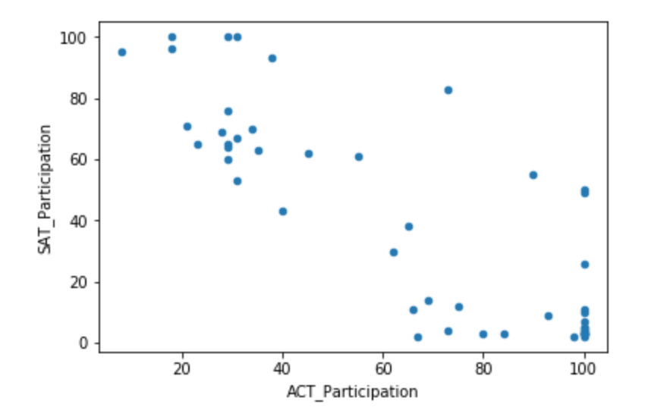
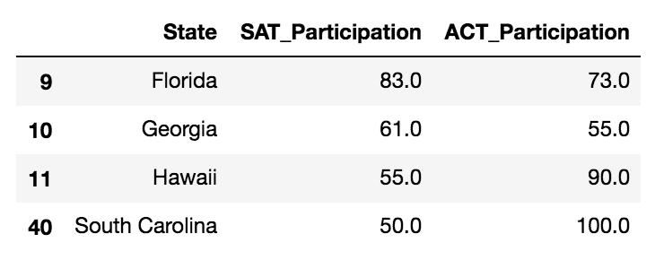
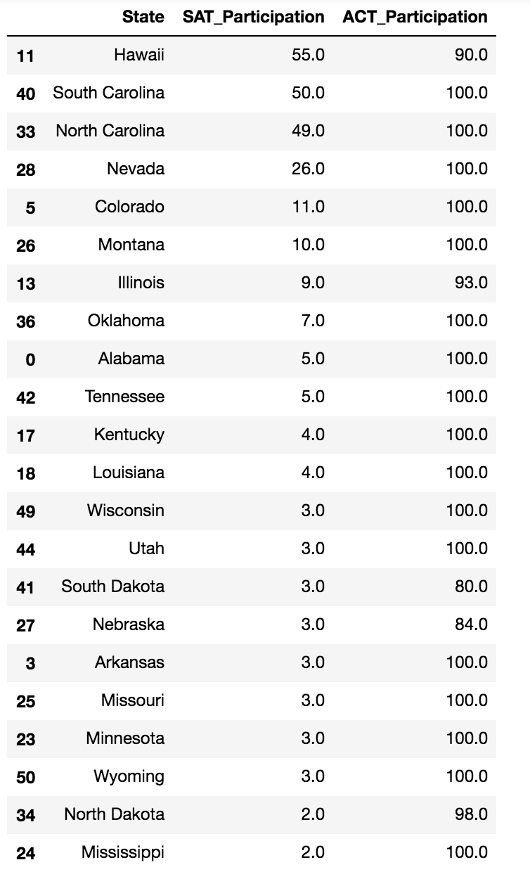
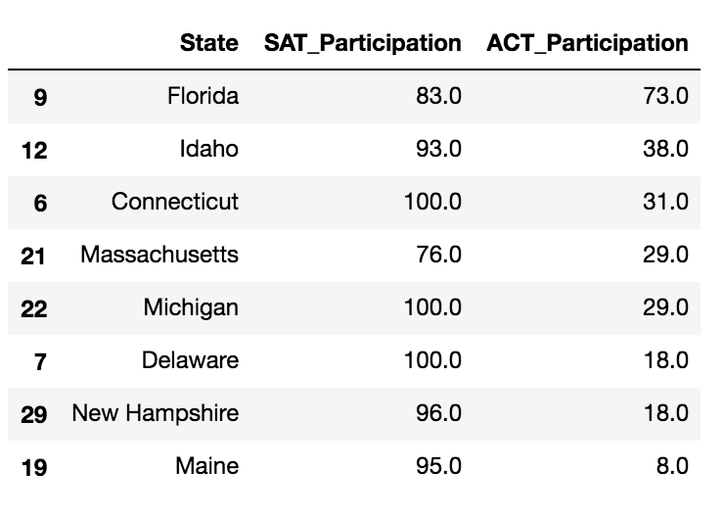

Slide 5
Conclusions & Next Steps
States with high ACT Participation seem to have low SAT Participation and vice versa; it makes sense since the tests are given in a mutually exclusive way.
Students do have opportunities to take both tests.

Slide 6
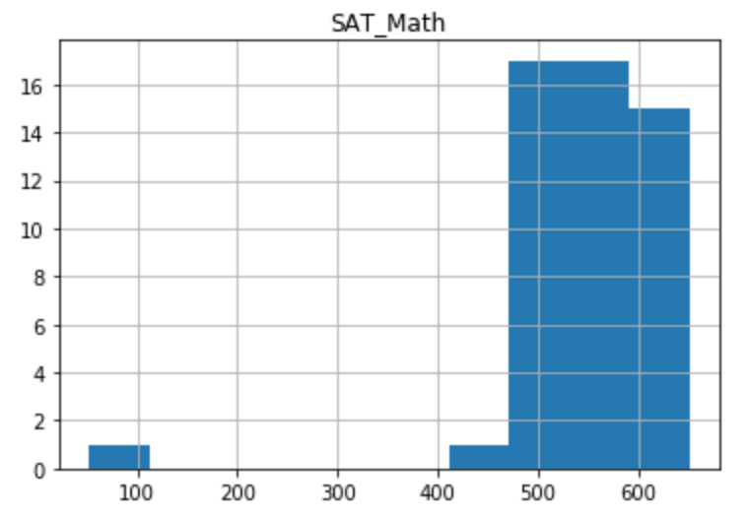
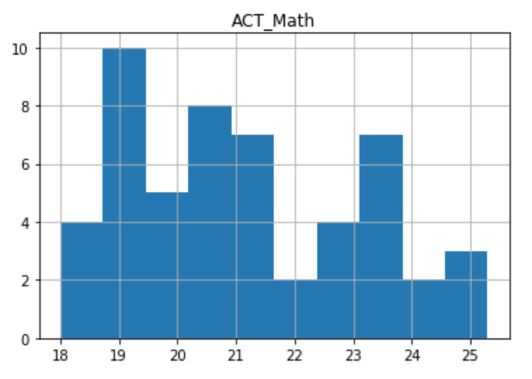
Interesting…
The SAT has a math section you cannot use a calculator for.

