Slide 1

INSAID VIRTUAL INTERNSHIP TASK
DATA SCIENCE AND MACHINE LEARNING
28/04/2023

Slide 2
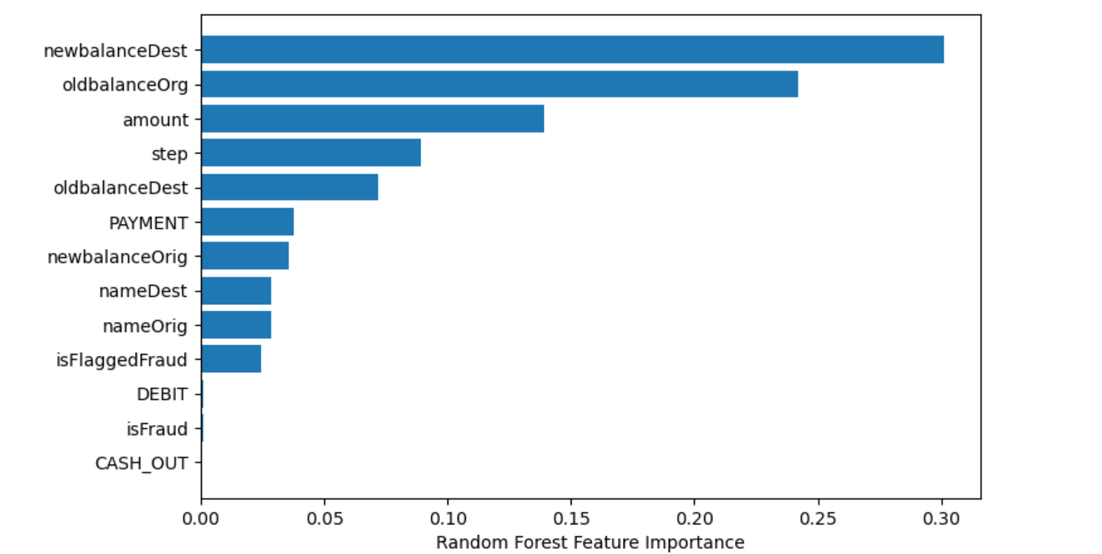
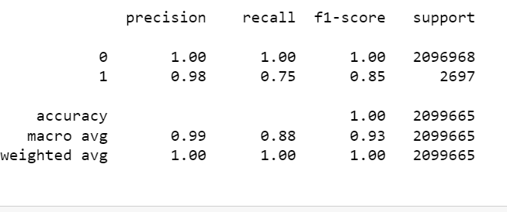
_{NEW BALANCE DEST} _{OLD BALANCE ORG} _{AMOUNT} _{STEP} _{OLD BALANCE DEST} MADE UP THE TOP FIVE(5) KEY FACTORS THAT DETERMINED CUSTOMER FRAUDULENCE.
We have trained the data set with Random forest classifier model and received :
_{THROUGH} THOROUGH REGRESSION AND CORRELATION ANALYSIS, I FOUND IT CONVENIENT TO KEEP ALL THE FEATURES IN THE DATASET.
I ALSO FOUND THE KEY FACTORS VALID FOR DETERMINING CUSTOMER FRAUD. THE TRANSACTION DIFFERENCES ARE VITAL AS PROPER ATTENTION TO CHECK MAJOR TRANSACTIONS BETWEEN ACCOUNTS WOULD HELP TO MITIGATE THE FRAUDULENCE.

