Slide 1



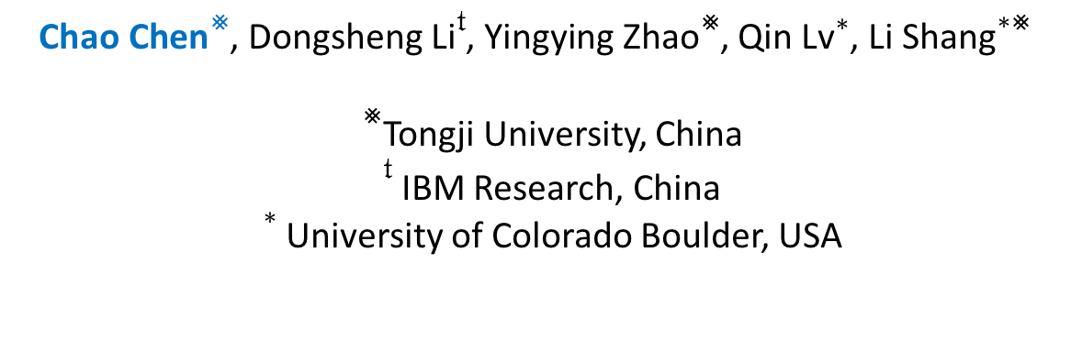
WEMAREC: Accurate and Scalable Recommendation through Weighted and Ensemble Matrix Approximation
${\text{Chao} \text{Chen}}^{⨳}$, ${\text{Dongsheng} \text{Li}}^{𝔱}$, ${\text{Yingying} \text{Zhao}}^{⨳}$, ${\text{Qin} \text{Lv}}^{∗}$, ${\text{Li} \text{Shang}}^{∗⨳}$
${}^{⨳}$Tongji University, China
${}^{𝔱}$IBM Research, China
${}^{∗}$University of Colorado Boulder, USA
Notes:
Thanks for the introduction. Hello everyone, thanks for attending my talk. I am Chao Chen from Tongji Univ. Today, I will present our recent work on ".....". This is a joint work with my colleagues, Dongsheng Li from IBM research, Yingying Zhao from Tongji. Univ., and Prof. Lv and Prof. Shang from University of Colorado Boulder.

Slide 2


Introduction
Matrix approximation based collaborative filtering
Better recommendation accuracy
High computation complexity: O(rMN) per iteration
Clustering based matrix approximation
Better efficiency but lower recommendation accuracy
 | 5 |  |  |  |  | 2
 | 5 |  | 5 |  | 5 | 3 |  | 4
 | 5 |  |  |  |  | 1
 | 4 | 3 |  | 3 |  | 2 |  | 3
 | 4 |  |  |  |  | 2
2 | 3 |  |  |  | 2 | 1 |  | 2
 | 5 |  |  |  |  | 3
 | 4 |  |  |  |  | 1
$$×$$
V
$$=$$
U
Users
Items
Notes:
Matrix .. methods have recently been proposed for recommender systems. Many studies have shown that they can achieve better recommendation accuracy, however, existing matrix approximation based methods suffer from high computational complexity for large-scale datasets. Specifically, given M users and N items, the computational complexity of each iteration is r times m times n, where r is the rank of the matrix.
In order to improve the recommendation efficiency and scalability, clustering based matrix approximation methods have been proposed, where the user-item matrix is partitioned into multiple submatrices. As a result, running matrix approximation on the submatrices is much more efficient.
However, since only partial information is used in each submatrix, the recommendation accuracy is reduced.
In this work, our goal is to improve clustering based matrix approximation method such that we can achieve both high recommendation accuracy AND high efficiency.

Slide 3
Outline
Introduction
WEMAREC design
Submatrices generation
Weighted learning on each submatrix
Ensemble of local models
Performance analysis
Theoretical bound
Sensitivity analysis
Comparison with state-of-the-art methods
Conclusion
Notes:
In the rest of this talk, I’ll first present the detailed design of our WEMAREC algorithm, which stands for Weighted and Ensemble Matrix Approximation for Recommendation, it consists of three components – submatrices generation, weighted learning on each submatrix, and ensemble of local methods.
After that, I’ll present the theoretical bound of the proposed algorithm. Using real-world data sets, we perform sensitivity analysis and compare the performance of the proposed WEMAREC algorithm to other state-of-the-art methods.
Finally, I will conclude this talk.

Slide 4
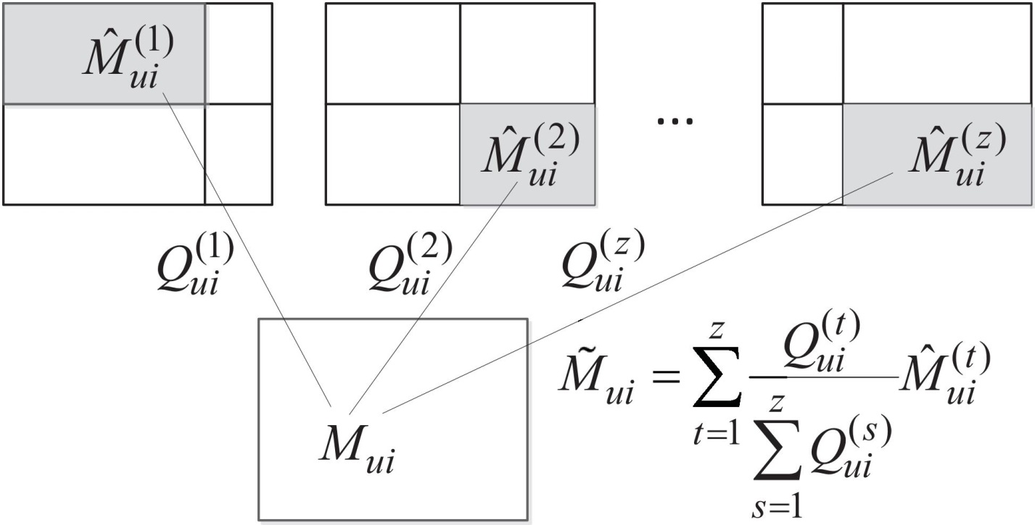
WEMAREC Design
Divide-and-conquer using submatrices
Better efficiency
Localized but limited information
Key components
Submatrices generation
Weighted learning on each submatrix
Ensemble of local models
Notes:
In the proposed WEMAREC algorithm, divide-and-conquer method is also adopted to increase recommendation efficiency as well as clustering based methods. The challenge is, since each submatrix only contains partial information, the overall accuracy is decreased.
To improve the recommendation accuracy, the intuition is that, for each matrix partition, we are looking for submatrices where the users give similar ratings, which lead to high-quality recommendations for such partial ratings. In other words, a biased local model, with uneven rating distribution, produces good recommendation for partial ratings that occur more frequently.
Next, by combining these biased local models across different matrix partitions, we can improve the overall recommendation accuracy.
Based on this idea, a weighted and ensemble recommendation method is proposed. It consists three key steps. First, submatrices generation to discover diverse inner structures. Second, weighted learning on each submatrix to overcome the limited information problem. Third, ensemble of local models to enhance the overall model performance.
In the following slides, these three methods will be explained in detail.

Slide 5

Step (1) – Submatrices Generation
Challenge
Low efficiency
e.g., O(kmn) per iteration for k-means clustering
Bregman co-clustering
Efficient and scalable
O(mkl + nkl) per iteration
Able to detect diverse inner structures
Different distance function + constraint set => different co-clustering
Low-parameter structure of the generated submatrices
Mostly uneven distribution of generated submatrices
1 | 2 | 1 | 2
3 | 4 | 3 | 4
1 | 2 | 1 | 2
3 | 4 | 3 | 4
1 | 1 | 2 | 2
1 | 1 | 2 | 2
3 | 3 | 4 | 4
3 | 3 | 4 | 4
After clustering
Matrix size: $4×4$
Co-clustering size: $2×2$
Notes:
In submatrices generation, efficiency is still a major concern. In WEMAREC, Bregman co-clustering is adopted, the reason is that, compared with conventional k-means method, it is efficient and scalable, the computation complexity is O(mkl + nkl) per iteration. For instance, Bregman co-clustering can produce a clustering results in 20 minutes on Netflix dataset, while k-means clustering would take more than 24 hours.
More importantly, by applying different combination of distance function and constraint set, Bregman co-clustering can produce different clustering results with different inner structures. The rating distributions of these submatrices are typically uneven, which may offer higher recommendation quality to partial ratings.
Let us look at this example, the original matrix on the left is a 4-by-4 matrix with a mixture of ratings. The generated four submatrices, shown on the right side, become rank-1 matrix and moreover they have uneven or biased rating distributions. This property is very important for weighted learning on each submatrix, let us discuss it in the next slide.

Slide 6
Step (2) – Weighted Learning on Each Submatrix
Challenge
Low accuracy due to limited information
Improved learning algorithm
Larger weight for high-frequency ratings such that the model prediction is closer to high-frequency ratings
To train a biased model which can produce better prediction on partial ratings
$$\hat{M}=\underset{X}{argmin}\left\|W⊗\left(M−X\right)\right\| \text{s}\text{.}\text{t}\text{.}\text{,} rank\left(X\right)=r, { W}_{ij}∝Pr\left[M_{ij}\right]$$
Rating | Distribution | RMSE without Weighting | RMSE with Weighting
1 | 17.44% | 1.2512 | 1.2533
2 | 25.39% | 0.6750 | 0.6651
3 | 35.35% | 0.5260 | 0.5162
4 | 18.28% | 1.1856 | 1.1793
5 | 3.54% | 2.1477 | 2.1597
Overall accuracy |  | 0.9517 | 0.9479
Case study on synthetic dataset
Notes:
Since each submatrix only contains partial information, it is a challenge to create a local model to produce high quality recommendation for all user-item ratings. Instead, if the submatrix contains uneven rating distribution, it becomes possible to produce high quality recommendation for a subset of, or partial, user-item ratings that occur more frequently.
Intuitively, if the prediction of model is trained to bias the high-frequency ratings, the model can produce more accurate prediction on high-frequency ratings. Even though the recommendation quality for low-frequency ratings may suffer, the overall recommendation accuracy will still improve as the high-frequency ratings dominate within the submatrix.
Based on this idea, we proposed a weighted learning algorithm, which set the weight W sub ij proportionally to the corresponding rate frequency. Therefore, the high-frequency ratings will have higher weights, and the model is biased towards high-frequency ratings.
This table shows a case study of the proposed method. Here the rating values of 2, 3, 4 occur more frequently, and our model is trained to bias towards these ratings. As a result, we achieve much better accuracy for these high-frequency ratings, and the overall increased.

Slide 7
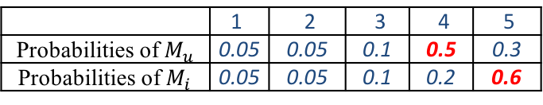
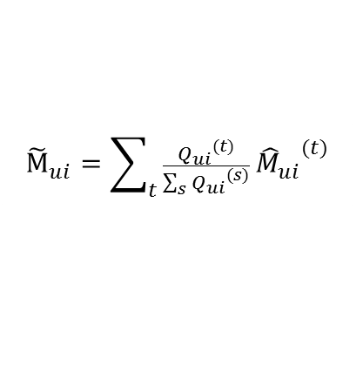
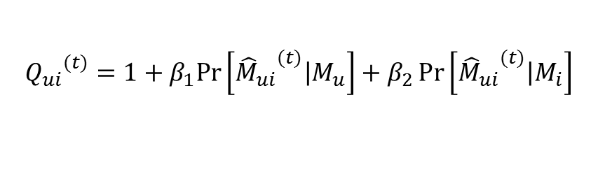
Step (3) – Ensemble of Local Models
Observations
User rating distribution User rating preferences
Item rating distribution Item quality
Improved ensemble method
Global approximation considering the effects of user rating preferences and item quality
Ensemble weight
$${\tilde{M}}_{ui}=\sum_{t}{\frac{{Q_{ui}}^{(t)}}{\sum_{s}{{Q_{ui}}^{(s)}}}}{{\hat{M}}_{ui}}^{(t)}$$
$${Q_{ui}}^{(t)}=1+β_{1}Pr\left[{{\hat{M}}_{ui}}^{(t)}\left|M_{u}\right.\right]+β_{2}\operatorname{Pr}\left[{{\hat{M}}_{ui}}^{(t)}\left|M_{i}\right.\right]$$
 | 1 | 2 | 3 | 4 | 5
Probabilities of $M_{u}$ | 0.05 | 0.05 | 0.1 | 0.5 | 0.3
Probabilities of $M_{i}$ | 0.05 | 0.05 | 0.1 | 0.2 | 0.6
1
1 + 0.05 +0.05 = 1.1
Model 1
5
1 + 0.3 +0.6 = 1.9
1.1 x 1 + 1.9 x 5 + 1.7 x 4
=
3.70 > 3.33
=
1 + 5 + 4
Model 2
1.1 + 1.9 + 1.7
3
Model 3
4
1 + 0.5 +0.2 = 1.7
Notes:
Once we have trained local models using weighted learning algorithm, we can then combine these models using ensemble method.
We observe that user rating distribution reflect user-specific rating preferences, while item rating distribution reelects item quality,
Our ensemble method aims to leverage these information when combining local models.
Specifically, for each user-item pair u and i, the corresponding ensemble model M_tilde_sub_ui is the weighted averge of local models M_hat_sub_ui,
where the weight Q_sub_ui is proportional to the probabilities of the rating M_hat_sub_ui occurring in user U's overall ratings M_sub_u and item I's overall ratings M_sub_i.
Now, let's look at a concrete example.
First, the table shows the user-specific rating distribution and item-specific rating distribution across values of 1 to 5, while the predicted ratings of the three local models are 1, 5, 4, respectively. Using simple averaging method, the overall predicted rating would be 3.33.
Using our ensemble method, in model 1,
the probabilities of rating 1 is 0.05 for M_sub_u and 0.05 in M_sub_i, therefore model 1 has a ensemble weight of 1.1.
similarly, model 2 has a ensemble weight of 1.9, and model 3 has a ensemble weight of 1.7.
finally, the overall predicted rating computed of our ensemble method is 3.70

Slide 8
Outline
Introduction
WEMAREC
Submatrices generation
Weighted learning on each submatrix
Ensemble of local models
Performance analysis
Theoretical bound
Sensitivity analysis
Comparison with state-of-the-art methods
Conclusion
Notes:
Next, I will present the performance analysis of WEMAREC, which includes the analysis of its theoretical bound, sensitivity analysis, and comparison with state –of-art methods.

Slide 9
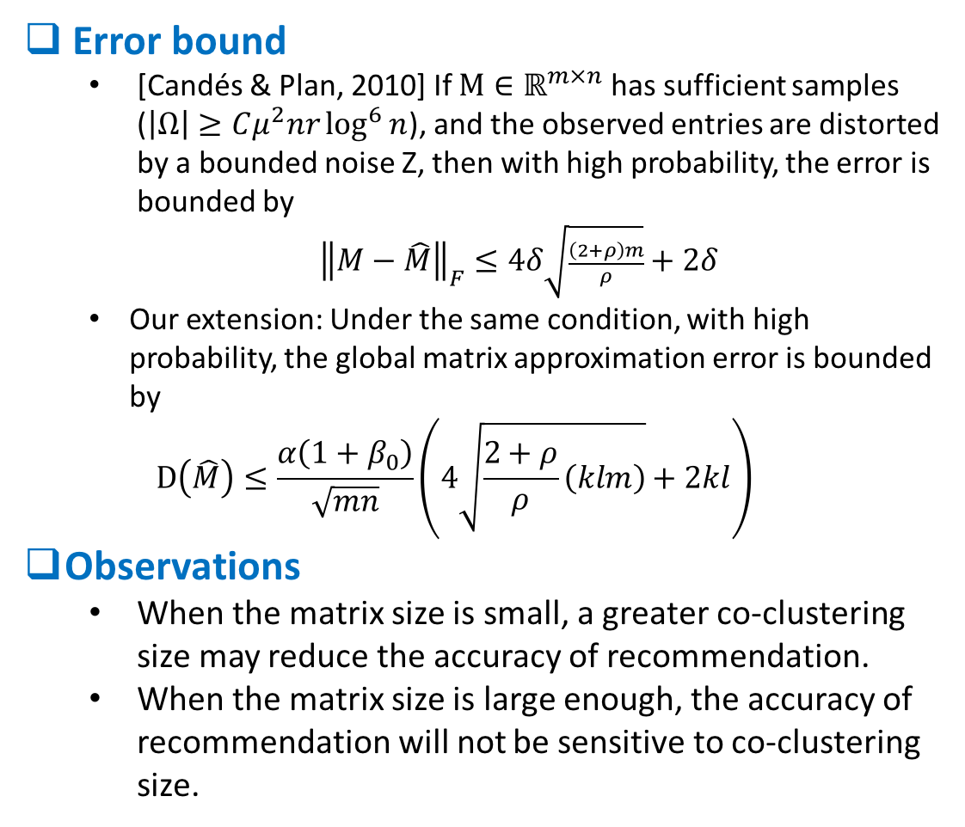
Theoretical Bound
Error bound
[Candés & Plan, 2010] If $M∈ℝ^{m×n}$ has sufficient samples ($\left|Ω\right|≥Cμ^{2}nr\log^{6}{n}$), and the observed entries are distorted by a bounded noise Z, then with high probability, the error is bounded by
${\left\|M−\hat{M}\right\|}_{F}≤4δ\sqrt{\frac{\left(2+ρ\right)m}{ρ}}+2δ$
Our extension: Under the same condition, with high probability, the global matrix approximation error is bounded by
$$D\left(\hat{M}\right)≤\frac{α\left(1+β_{0}\right)}{\sqrt{mn}}\left(4\sqrt{\frac{2+ρ}{ρ}\left(klm\right)}+2kl\right)$$
Observations
When the matrix size is small, a greater co-clustering size may reduce the accuracy of recommendation.
When the matrix size is large enough, the accuracy of recommendation will not be sensitive to co-clustering size.
Notes:
It has been shown previously that If the observed rating matrix has sufficient samples, and the involved noise is bounded, then with large probability the completion error will be bounded by the first formula.
In this work, we extend the error bound analysis to show that, when the same condition is hold, with high probability, the error of WEMAREC is bounded by the second formula, where m and n are matrix size, which denotes the number of rows and columns in the rating matrix, k and l are co-clustering size, which denotes the number of row and column clusters. Please refer to our paper for more details of this analysis.
Based on our error bound analysis, we have two key observations.
When matrix size is small, a greater co-clustering size may reduce the recommendation accuracy.
when the rating matrix is big enough, the recommendation accuracy is insensitive to co-clustering size.
In other words, when the rating matrix is big enough, it can be divided into more submatrices to improve the scalability, while at the same time the recommendation quality is maintained or even improved. These two points will be highlighted in the following experimental study.

Slide 10
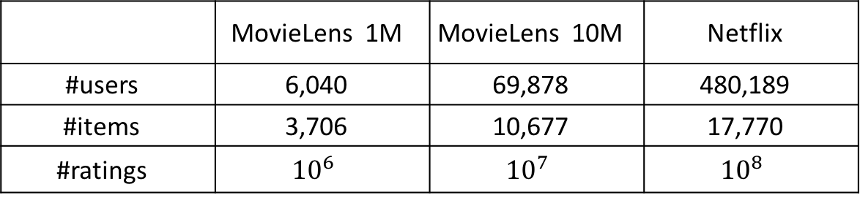
Empirical Analysis – Experimental Setup
 | MovieLens 1M | MovieLens 10M | Netflix
#users | 6,040 | 69,878 | 480,189
#items | 3,706 | 10,677 | 17,770
#ratings | $${10}^{6}$$ | $${10}^{7}$$ | $${10}^{8}$$
Benchmark datasets
Sensitivity analysis
Effect of the weighted learning
Effect of the ensemble method
Effect of Bregman co-clustering
Comparison to state-of-the-art methods
Recommendation accuracy
Computation efficiency
Notes:
To evaluate the performance of the WEMAREC algorithm, we use three real-world datasets representing small, medium and large datasets. This table shows the number of users, items, and ratings contained in each dataset.
For sensitivity analysis, we study the effects of the weighted learning, the ensemble method and Bregman co-clustering. Then, we compare WEMAREC with several state-of-the-art methods, considering both recommendation accuracy and computation efficiency.

Slide 11
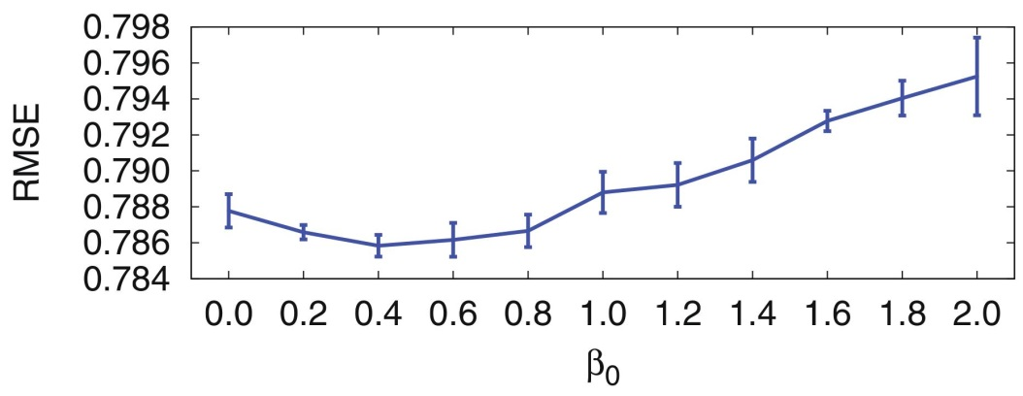
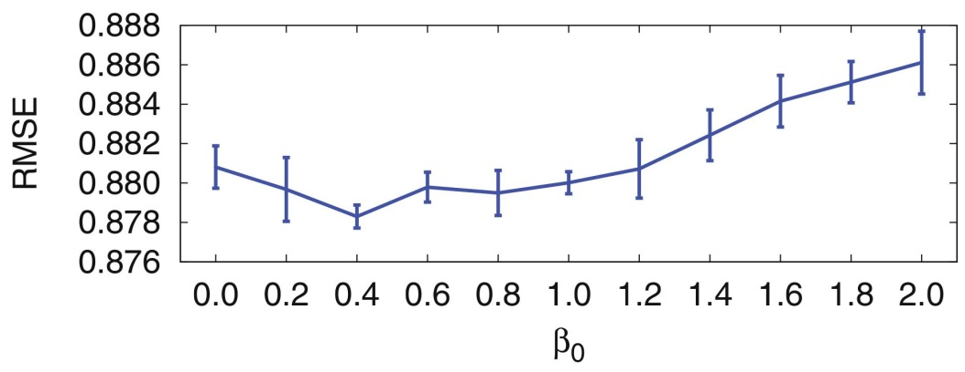
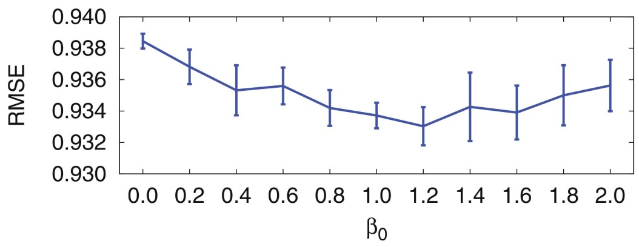
Sensitivity Analysis – Weighted Learning
uneven
weighted learning algorithm can outperform no-weighting methods
Rating | D1 (uneven) | D2 (medium) | D3 (even)
1 | 0.98% | 3.44% | 18.33%
2 | 3.14% | 9.38% | 26.10%
3 | 15.42% | 29.25% | 35.27%
4 | 40.98% | 37.86% | 16.88%
5 | 39.49% | 20.06% | 3.43%
even
Rating Distribution of Three Synthetic Datasets
optimal weighting parameter on uneven dataset is smaller than that on even dataset
Notes:
We first analyze the sensitivity of the weighted learning using three synthetic datasets, with their distributions ranging from uneven to even as shown in the table . The evaluation results are in the left, where x axis is the weighting value beta_0, and y axis is the root mean square error.
The blue dotted line shows the performance with no weighting, and this study shows that the proposed learning algorithm can perform better.
The red dotted line indicates the optimal weighting parameter, we can see the optimal weighting value is achieved at near 0.4 when the distribution is relative uneven. However, it increase to 1.2 when the data set is even.

Slide 12
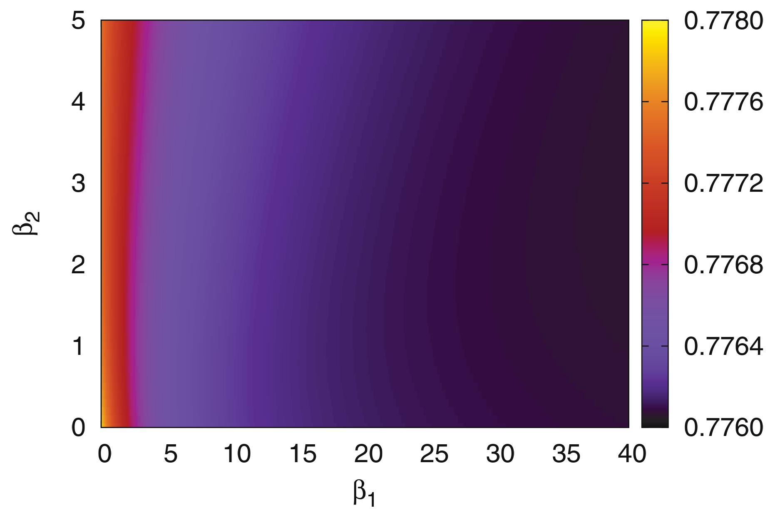
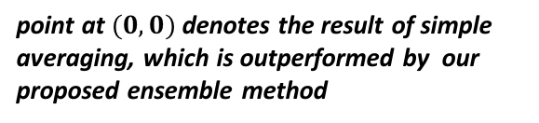
Sensitivity Analysis – Ensemble Method
point at $(0,0)$ denotes the result of simple averaging, which is outperformed by our proposed ensemble method
information about user rating preferences is more valuable than that of item quality
Notes:
we analyze the sensitivity of the ensemble method by varying user-weighting parameter beta_1and item-weighting parameter beta_2. The point at zero zero denotes the result of simple averaging method, which is always outperformed by our proposed ensemble method.
Furthermore from this figure, we can see that the information about user rating preference is more valuable than that of item quality, since the optimal value of beta_1 leads to much more significant improvement of recommendation quality

Slide 13
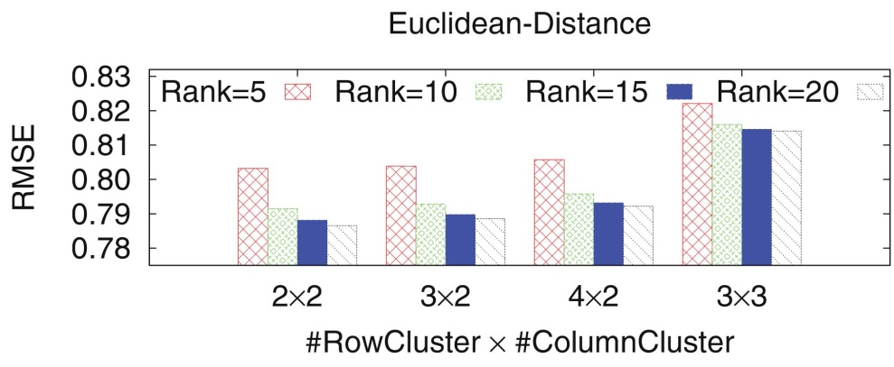
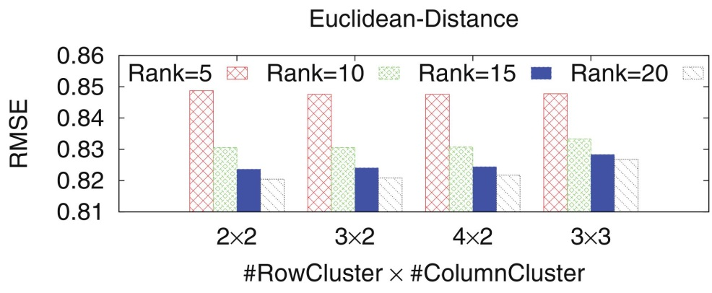
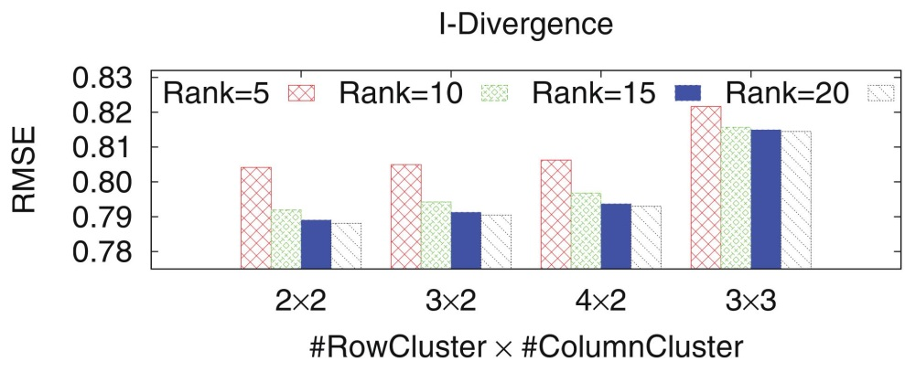
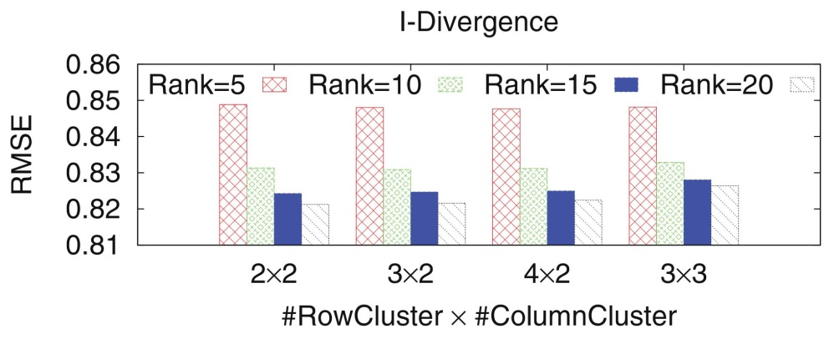
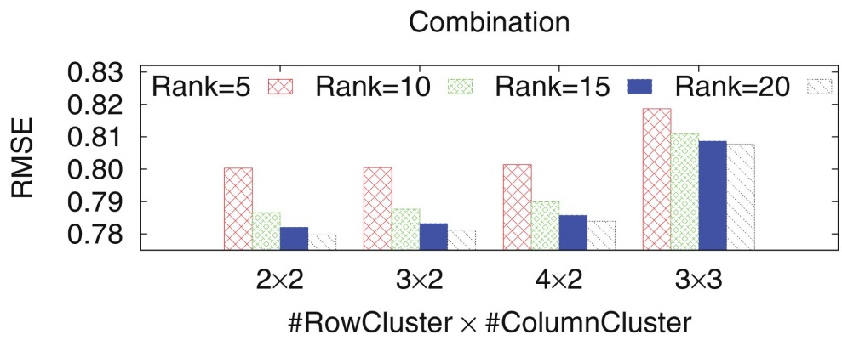
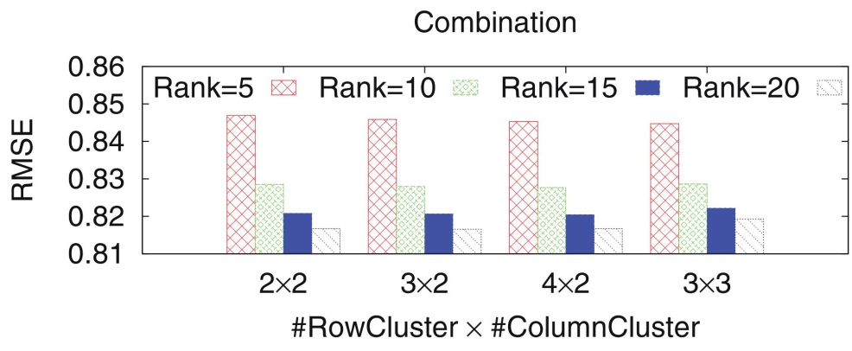
Sensitivity Analysis – Bregman Co-clustering
MovieLens 10M
Netflix
recommendation accuracy increases as rank increases
recommendation accuracy decreases as co-clustering size increases
recommendation accuracy is maintained as co-clustering size increases
Notes:
Third, we investigate the sensitivity of Bregman co-clustering using MovieLens 10M and Netflix datasets.
The first observation is, the recommendation accuracy increases as the rank increases, but the improvement become smaller for larger rank values, note that the execution time increased for larger rank.
The second observation is that, for the MovieLens 10M dataset, which is relatively small, the recommendation accuracy decreases as co-clustering size increases. On the other hand, for the relatively large Netflix dataset, recommendation ac …. These two observation are correctly predicted by our theoretical analysis.

Slide 14
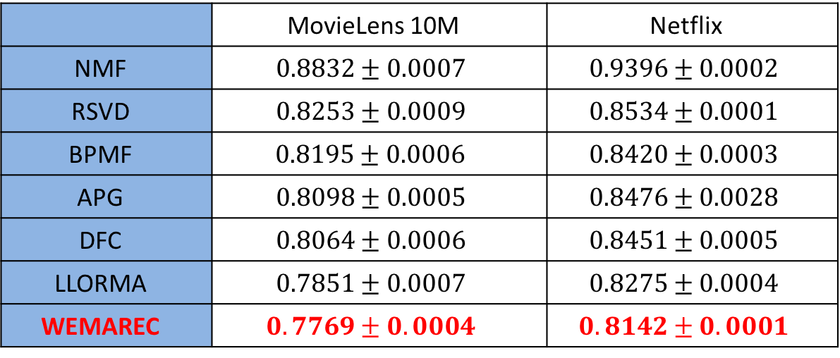
Comparison with State-of-the-art Methods (1)
– Recommendation Accuracy
 | MovieLens 10M | Netflix
NMF | $$0.8832±0.0007$$ | $$0.9396±0.0002$$
RSVD | $$0.8253±0.0009$$ | $$0.8534±0.0001$$
BPMF | $0.8195±0.0006$ | $$0.8420±0.0003$$
APG | $$0.8098±0.0005$$ | $$0.8476±0.0028$$
DFC | $$0.8064±0.0006$$ | $$0.8451±0.0005$$
LLORMA | $$0.7851±0.0007$$ | $$0.8275±0.0004$$
WEMAREC | $$0.7769±0.0004$$ | $$0.8142±0.0001$$
Notes:
Finally, We compare WEMAREC with several state-of-the-art methods. As shown in this table, the first four methods do not use clustering, and DFC and LLORMA are ensemble-based methods.
We compare the recommendation accuracy using MovieLens 10M dataset and Netflix dataset. As shown in the table, we can see the proposed method significantly outperforms all the other methods on both datasets.

Slide 15
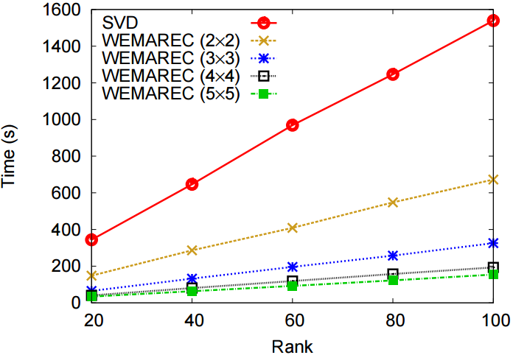
Comparison with State-of-the-art Methods (2)
– Computation Efficiency
Execution time on the MovieLens 1M dataset
Notes:
To evaluate the computation efficiency, we compare SVD with WEMAREC under different clustering settings.
The reason is that DFC and LLORMA are ensemble methods and have similar efficiency as WEMAREC, while SVD has similar efficiency as the other four matrix approximation methods.
As shown in this figure, when the rank increases, the computation time of WEMAREC increases much more slowly than that of SVD.
This two study demonstrates that proposed method can improve both recommendation accuracy and computation efficiency.

Slide 16
Conclusion
WEMAREC – Accurate and scalable recommendation
Weighted learning on submatrices
Ensemble of local models
Theoretical analysis in terms of sampling density, matrix size and co-clustering size
Empirical analysis on three benchmark datasets
Sensitivity analysis
Improvement in both accuracy and efficiency
Notes:
To conclude my talk, in this work, we have developed WEMAREC, an accurate and scalable recommendation method using weighted and ensemble matrix approximation, it has two key contributions: ….
We performed theoretical analysis in terms of …. , in order to bound the matrix approximation error.
Furthermore, we conducted empirical analysis using three real-world datasets to understand the sensitivity of our method and demonstrate the improvement in both accuracy and efficiency over state-of-the-art methods.
That is all. Thank you for your attention and I'm happy to take some questions.

Slide 17
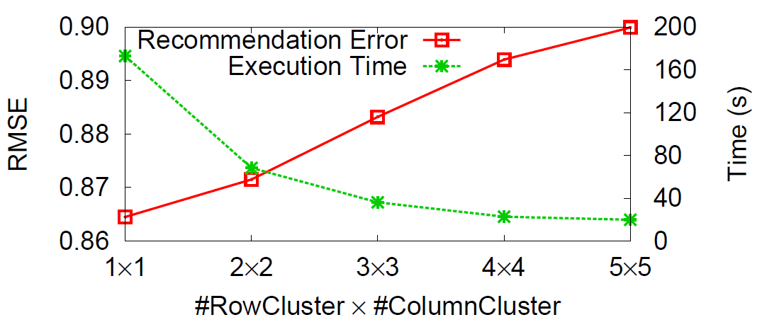
Trade-off between Accuracy and Scalability

Slide 18
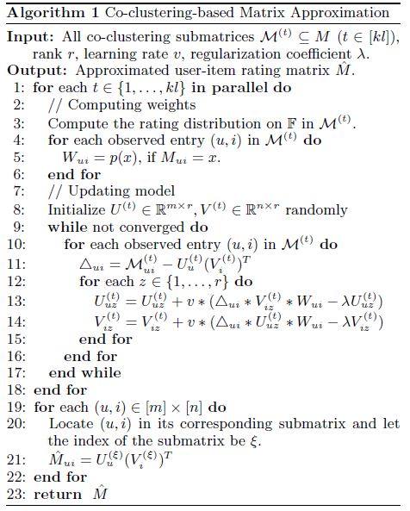
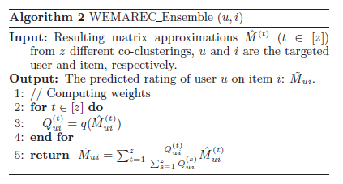
Detailed Implementation

