Slide 1
Web Project #1
Journal #1
Christen Ghaly

Slide 2
Goal
I chose to create my portfolio as a project in the Web project course. My goal for this project is to design from scratch and build the portfolio using the tools I’ve learned, to better showcase my skills as a full-stack developer and to have more experience in designing and developing.

Slide 3
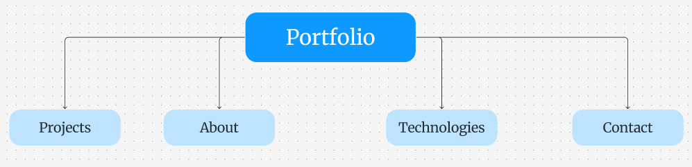
Description
The homepage will contain header, 4 sections and footer. First section, is the Main section, contains my name and the title. Second section, is the Projects section, contains 3 or 4 projects I’ve done. Third section, is the About section, contains Text and image. And fourth section, is the tools, technologies and techniques that I can use (in design, front-end and back-end) with applying keyframes animation, AOS animation and responsive layout.
The second page I am planning to be the projects page.
And it will show the projects that I’ve created in more details with animation and responsive layout.

Slide 4
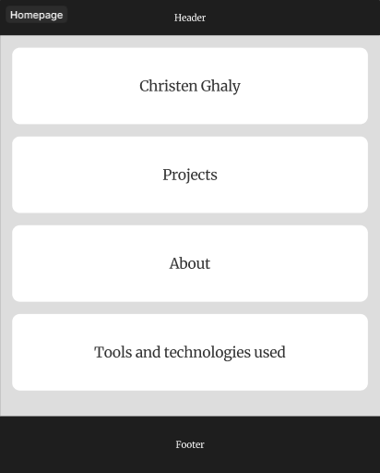
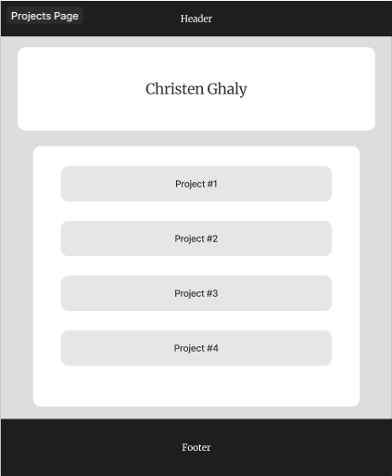
Wireframes

Slide 5
Figma
Tools
Use Figma to brainstorm the ideas , build the wireframes and the portfolio structure

Slide 6

HTML
Technologies
Use HTML to build the structure and the pages layout,
CSS, SASS and Bootstrap to style the HTML elements and create and more control the responsive layout,
Javascript to add interactivity and dynamic features to the pages.
CSS, SASS
Bootstrap
Javascript

Slide 7
Key-frames Animation
Techniques
Use Key-frames animation and animation on scroll library (AOS) to animate html elements and enhance the visualization of the portfolio,
Slider to slide between different tools, technologies and techniques that I’ve learned.
CSS
Animation
On Scroll
Slider

Slide 8
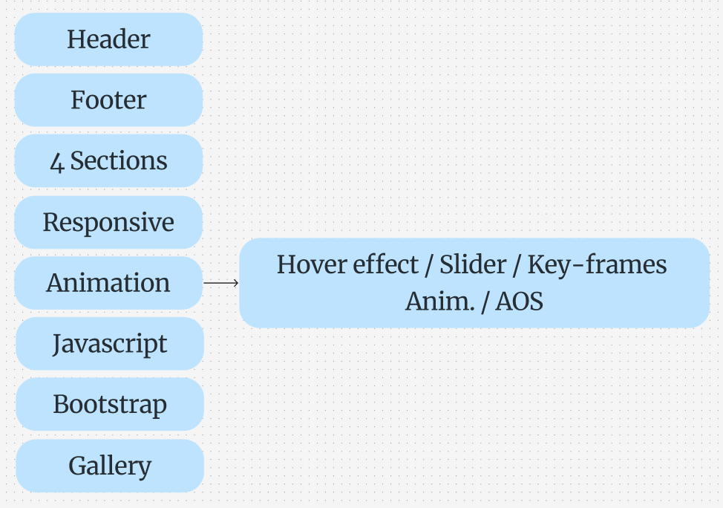

Slide 9
Steps
Define the project goal I’d like to demonstrate.
Design and organize my ideas using Figma.
Setup the project pages and follow the initial wireframes.
Start HTML coding and style using SASS and CSS at the same time for each section.
Finish the layout of the homepage and check if there is any modifications to be made.
Start responsive design and make other modification to make sure that the page looks good through all screen sizes.
Start homepage animation.
Start the second page’s layout.

Slide 10
Self-reflection
The challenges:
Creating the design from scratch: to overcome this I did some research to gather references and ideas, and then brainstormed them through Figma. Receiving guidance and feedback helped me make modifications for a better layout.
Building the homepage layout: my idea was to position some elements absolute. However, it caused some problems in creating the responsive layout. I was able to solve that with using Bootstrap and CSS to be more precise and achieve the desired responsive layout.
At this stage, I feel more confident in designing and building layouts. Practicing and identifying the tools and technologies I need to better visualize my ideas.

