Slide 1
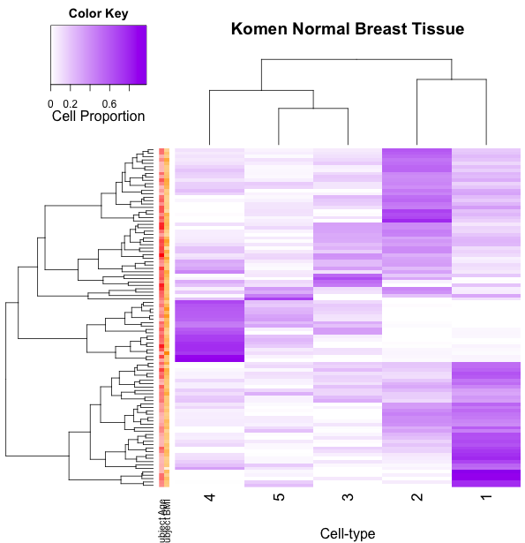
Breast-Komen[n]
Age
BMI

Slide 2
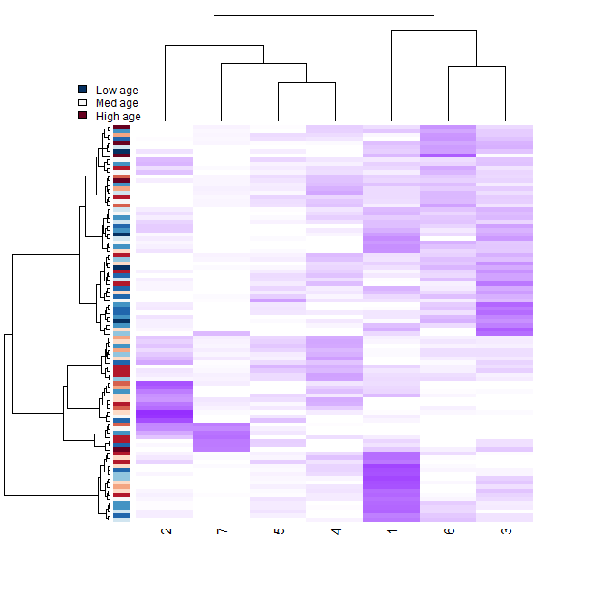
BR-tcga[n]
Heatmap with main phenotype of interest and line plot of permutation p-values

