Slide 1
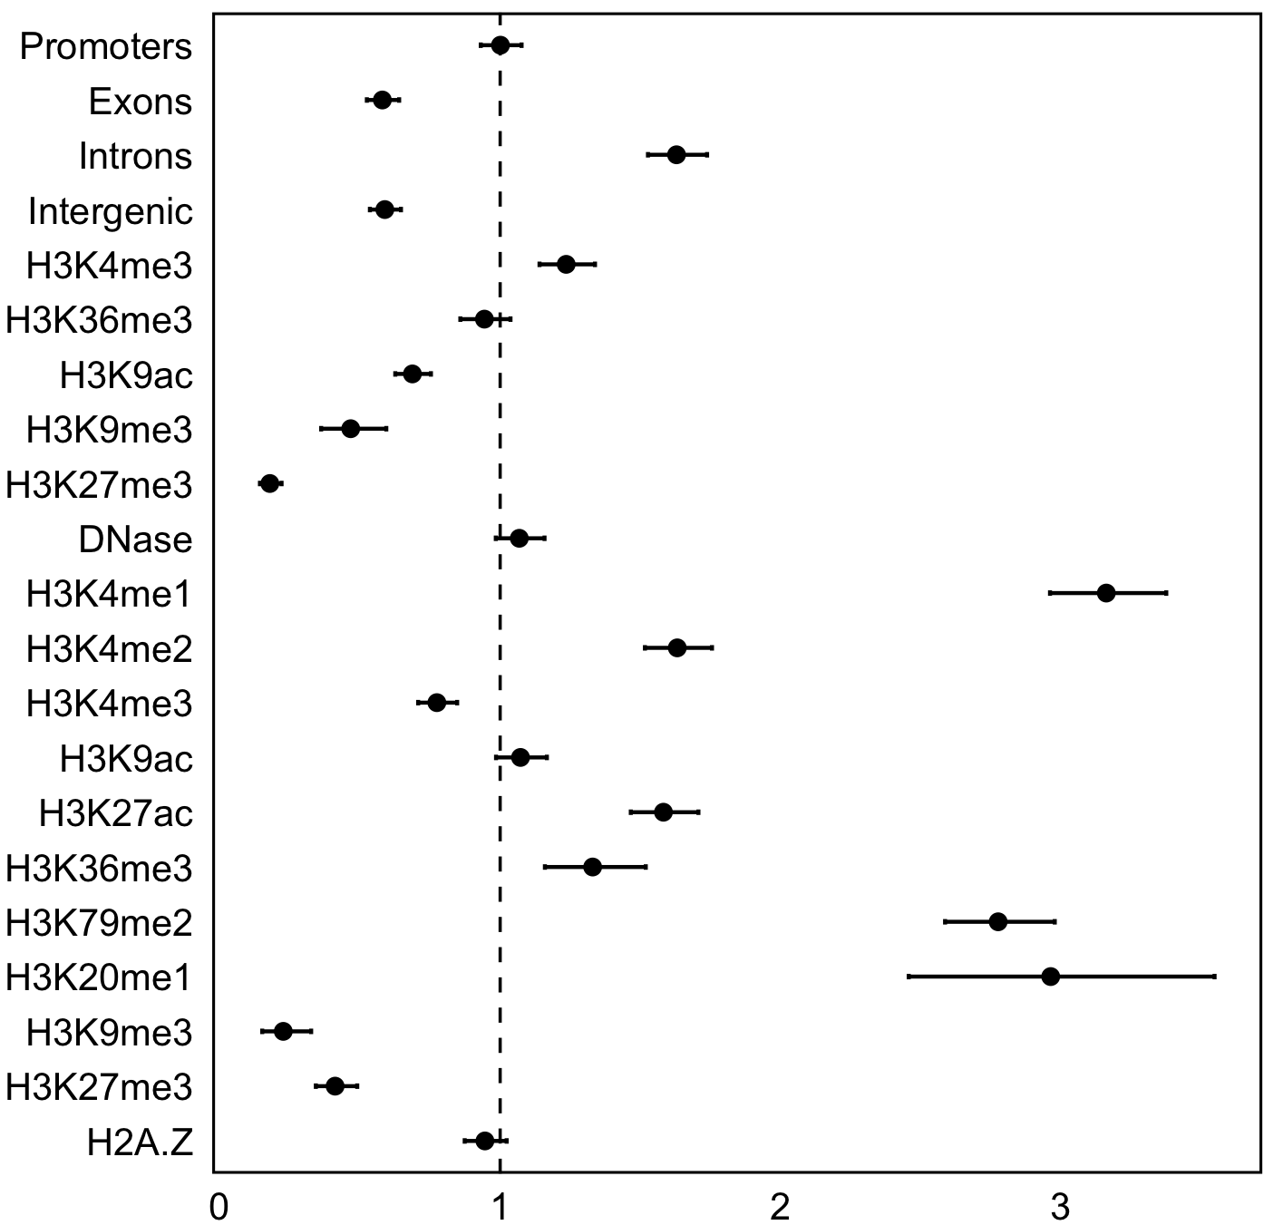
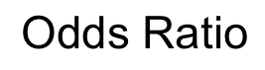
Genomic features
Odds ratio (95% CI) | P-value
1.00 (0.93-1.08) | 9.9E-01
0.56 (0.49-0.64) | 1.0E-19
1.63 (1.63-1.87) | 7.5E-56
0.59 (0.54-0.65) | 3.3E-32
1.24 (1.14-1.34) | 2.0E-07
0.94 (0.86-1.04) | 2.3E-01
0.69 (0.63-0.75) | 9.4E-17
0.47 (0.36-0.59) | 3.0E-12
0.18 (0.14-0.22) | 5.3E-103
1.07 (0.98-1.16) | 1.1E-01
3.16 (2.96-3.38) | 1.1E-244
1.63 (1.52-1.76) | 7.5E-39
0.77 (0.71-0.85) | 1.1E-08
1.07 (0.99-1.17) | 1.0E-01
1.58 (1.47-1.71) | 4.9E-31
1.33 (1.16-1.52) | 4.9E-05
2.78 (2.59-2.98) | 1.9E-158
2.96 (2.46-3.55) | 1.1E-24
0.23 (0.15-0.33) | 5.4E-25
0.41 (0.34-0.49) | 6.4E-30
0.95 (0.87-1.02) | 1.7E-01
Gene regions
Breast myoepithelial cells
Transcriptional activity
Transcriptional inactivity/repression
Human mammary epithelial cells (HMEC)
Transcriptional activity
Transcriptional inactivity/repression
Other
Depletion
Enrichment

Slide 2
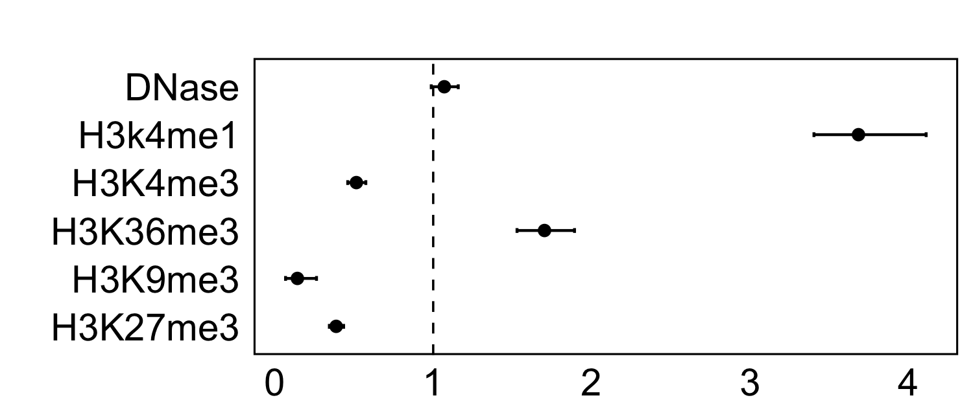
Odds ratio (95% CI) | P-value
1.07 (0.99-1.16) | 9.4E-02
3.68 (3.40-4.11) | 8.0E-304
0.52 (0.46-0.57) | 9.9E-37
1.70 (1.53-1.89) | 1.2E-20
0.14 (0.07-0.26) | 2.1E-18
0.39 (0.34-0.43) | 1.2E-75
Transcriptional activity
Transcriptional inactivity/repression
Depletion
Enrichment

