Slide 1
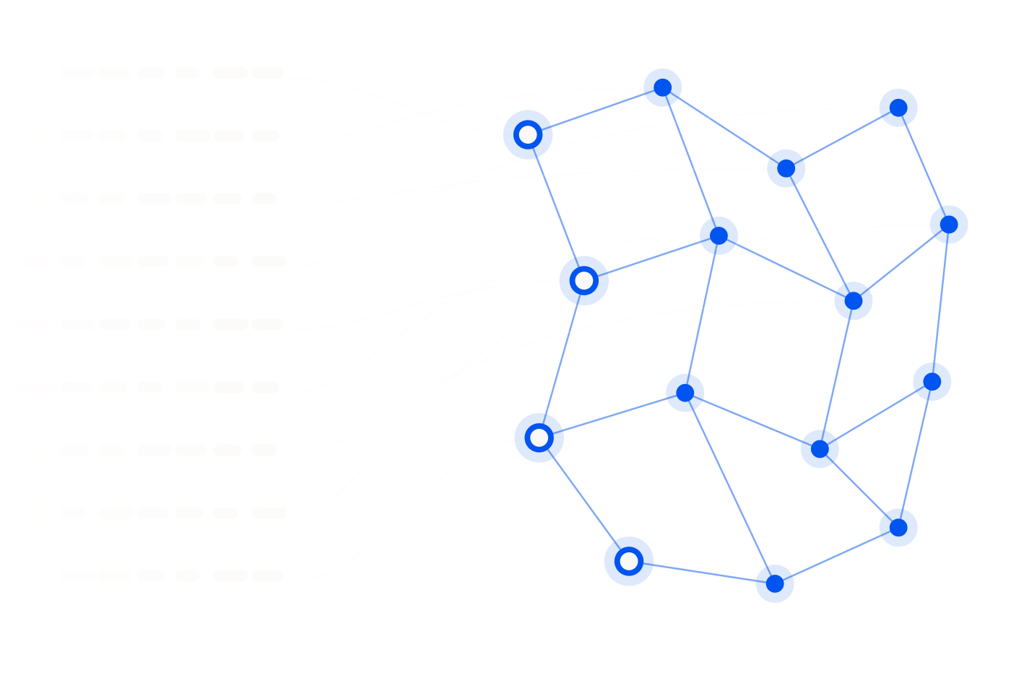

HANDS-ON WORKSHOP · 120 MINUTES
Agent
Optimization
Challenge
NordicBike AB — cut an agent from 18,400 tokens to 3,800
without losing a single correct decision.
Notes:
Set the frame before anything else: this is not a lecture with an exercise bolted on. Teams will build four versions of the same agent and their last one gets scored on a public leaderboard. The number in the subtitle is the whole workshop. Almost five times less context, and the correctness bar does not move. If anyone cuts context by breaking answers, they lose more points than they gain — the scoring is built to make that unprofitable. Say up front that the case company is fictional but the trade-offs are not. Everything they will hit today — over-stuffed context, fat handoffs, frontier models doing trivial work — is what real agent systems get wrong. Housekeeping while people settle: teams of three or four, one laptop driving per team, and the leaderboard runs at the two-hour mark whether or not everyone is finished.

Slide 2
THE NEXT TWO HOURS
Five phases, one agent, four rewrites
You will run a deliberately wasteful agent, diagnose it, and rebuild it three times. Each rebuild removes a different kind of waste — and the scoring punishes you if correctness slips.
01
Kickoff
15 min
Case, objectives, teams
02
Baseline
20 min
Run V1, diagnose the waste
The single measure that matters:
03
Optimization
45 min
cheap and still correct.
Build V2 and V3
04
Routing & quality
30 min
Build V4, run the gate
05
Leaderboard
10 min
Score, rank, retro
Phases 2 to 4 are the workshop. Phases 1 and 5 are the bookends.
2
Notes:
Keep this short — people want to start. The two things to say out loud. First, the rebuilds are cumulative: V2 keeps working in V3, V3 keeps working in V4. Nobody starts from scratch at any point. Second, and this is the one teams forget: correctness is seventy percent of the final score and cost is thirty. Every year someone optimises themselves down to a beautifully cheap agent that gets the eligibility decisions wrong, and they finish last. Say that now so nobody can claim they were not warned. Phase 3 is the long one at forty-five minutes. Protect it. If phase 1 runs over, cut your own talking, not their building time.

Slide 3





WHAT YOU WALK OUT WITH
Five skills, each one measurable today
Skills design
Context engineering
Handoff patterns
Model routing
Evaluation
Scaffold a reusable skill instead of re-explaining the procedure every run.
Cut context roughly five times over without losing a correct decision.
Pass typed facts between agents instead of dumping the whole conversation.
Send cheap decisions to cheap models and keep budget for the hard ones.
Build a quality gate and a scoring rubric you would trust in production.
Every one of these shows up in the scoring formula. None of them are theory today.
3
Notes:
Read the five, do not elaborate — the workshop teaches them, this slide just names them. The line worth adding: these are ordered by how much leverage they have. Context engineering alone gets most teams from V1 to V2 and halves their cost. Routing is the smallest change and the biggest multiplier, because a Tier 3 token costs twelve times a Tier 1 token. If anyone asks which matters most in real systems, the honest answer is context engineering, because it improves accuracy as well as cost. Everything else on this list mainly buys money and latency.

Slide 4



WHY WE RUN IT THIS WAY
Context is a scarce resource, not free storage
Every token costs money and latency
The instinct we are
breaking today
Not once — again on every subsequent call in the chain.
Irrelevant context degrades accuracy
"Give the model everything, it will figure out what matters."
This is the part people miss. Noise does not just cost. It misleads.
The V1 to V4 progression makes it measurable
It will not. It will find a plausible thread through whatever you gave it — including the wrong one.
You will not be arguing about this by the end. You will have the numbers.
4
Notes:
Two minutes, and it justifies the entire exercise structure. Spend the time on the second bullet, because the first is obvious and the second is not. Everyone accepts that more tokens cost more money. Far fewer accept that more tokens make the answer worse. But that is exactly what the NordicBike cases are built to demonstrate. When you hand the agent all four policy documents, it will find a section that plausibly applies — and in the adversarial cases, the plausible section is the wrong one. Anna and Erik later on is the clean example of this. The dark box is the sentence to leave in the room. Big context windows made this instinct feel safe. It is not safe; it is just no longer expensive enough to notice immediately.

Slide 5


WHY WE RUN IT THIS WAY
Progressive disclosure and handoff discipline
Retrieve on demand
Hand off typed facts
Route by difficulty
Only what is needed, only when it is needed. Not the whole knowledge base at step one.
A subagent needs the decision-relevant fields, not the conversation that produced them.
Cheap models on cheap decisions frees the budget for the cases that are genuinely hard.
Each of the three maps to one rebuild: V2 retrieves less, V3 hands off less, V4 routes cheaper.
5
Notes:
This slide is the map for the whole afternoon, so make the mapping explicit and then refer back to it at each phase. Progressive disclosure is the least intuitive of the three. Teams instinctively load the knowledge base once at the start because it feels efficient. It is the opposite: they pay for all of it on every turn, and most of it never gets used for that case. Handoff discipline is where the biggest surprise usually lands. Teams build a subagent split in V3, feel clever, and discover their token count barely moved — because they passed the entire context across the boundary. That disappointment is deliberate and it is the most valuable moment in the workshop. Do not spoil it now. Routing is last because it is the easiest and it only pays once the first two are done.

Slide 6

01
The case
NordicBike AB, ten support cases, and four ways to get them wrong.
Notes:
Fifteen minutes of context-setting, then teams form. Do not let this run long — the cases teach better than you do.

Slide 7



THE CLIENT
NordicBike AB
Founded 2019
Your brief
Young enough that policies have already been rewritten once.
Build the support agent that answers warranty, returns and shipping questions — correctly enough that a support lead would let it near a customer, and cheaply enough that finance would let it run.
~85 employees
Small support team. No capacity to absorb a bad automation.
Stockholm HQ
Online store plus service centres in Stockholm, Gothenburg and Malmö.
Both constraints are real. Only satisfying one of them is failure.
7
Notes:
Ninety seconds. The company is fictional and nobody needs to remember the details — the knowledge base is in the repo. The one fact worth pointing at is the founding year. A company founded in 2019 has already superseded at least one policy version, which is exactly the trap in Archetype B. Plant it now, quietly, and it pays off later. The brief on the right is the actual assignment. Say both halves and stress that only satisfying one is failure — a perfectly accurate agent that costs a fortune loses to a slightly cheaper one that is equally accurate, and a cheap agent that gets decisions wrong loses to everybody.

Slide 8

WHAT YOU ARE SUPPORTING
Three bikes, two batteries, ten cases
AX3
FJC
VPR
10
Aurora X3
Fjord Cargo
Vinter Pro
34,900 SEK
44,900 SEK
37,900 SEK
support cases
PowerPack 720 · PowerPack 900 · Accessories
4
adversarial archetypes,
each appearing at least once
Two battery variants matter more than they look. Several cases turn on which pack is fitted and when it was bought.
8
Notes:
Move quickly through the products — nobody needs to memorise a price list, and it is all in the repo. The two things to actually say. The battery variants are not decoration: several cases hinge on which pack is fitted and when it was purchased, so a team that treats all batteries as one product will get those wrong. And the ten cases are not a random sample. Every one of them is built around one of four traps, and each trap appears at least once. A team that gets nine right and one badly wrong has probably fallen into an archetype rather than made a small error — which is precisely what the penalty term in the scoring is for.

Slide 9
HOW THE CASES FIGHT BACK
Four adversarial archetypes
A
Cases 1, 2
B
Case 5
C
Cases 6, 9
D
Cases 7, 8
Symptom–Cause Confusion
Superseded / Grandfathered Policy
Out-of-Scope Escalation
Incomplete / Ambiguous Information
Two customers report the same symptom. The root causes differ, and so does the outcome.
The current policy is not the policy that applied when they bought. The newest document is the wrong one.
The right answer is to not answer. It must be recognised and handed on, not resolved.
The case file is missing a fact the decision depends on. Asking beats guessing.
A critical failure on any archetype costs 10 points. There are only 100 available.
9
Notes:
This is the slide teams will want to photograph. Give them a moment. Walk each one with the failure mode, not the definition. A fails when the agent pattern-matches on the symptom text and never checks the root cause. B fails when the agent grabs the newest policy document because it is the newest. C fails when the agent tries to be helpful and answers something it should have escalated. D fails when the agent fills a gap with a confident assumption instead of a question. Notice what all four have in common: the failure looks like competence. There is no error message. The output is fluent, well-structured and wrong — which is exactly why the quality gate has to check for citation and root cause rather than just reading nicely. Then land the penalty. Ten points each, out of a hundred. Two archetype failures and no amount of cost efficiency saves you.

Slide 10
ARCHETYPE A, IN FULL
Anna and Erik: same fault, opposite outcomes
Same product, same production batch, same reported symptom, same week. One is covered and one is not — and nothing in the symptom text tells you which.
Anna Karlsson
ELIGIBLE
Erik Svensson
NOT ELIGIBLE
BATCH
AX3-25A
BATCH
AX3-25A
SYMPTOM
Intermittent power loss
SYMPTOM
Intermittent power loss
ROOT CAUSE
No water exposure; garage-stored
ROOT CAUSE
Pressure-washed near battery compartment
DECISION
warranty.md § Section 5
DECISION
warranty.md § Section 4(i)
An agent that reads the symptom and stops gets one of these two wrong. Every time.
10
Notes:
The single most useful slide in the deck for making the whole workshop click. Take your time. Read the two cards across rather than down. Batch: identical. Symptom: identical, word for word. Then the root cause line, and the outcome flips completely. The question to ask the room: what would an agent have to do to get both of these right? It has to go looking for the cause after it has read the symptom, and it has to know that section 4(i) exists and excludes pressure-washing. Nothing in Anna's case mentions water at all — the absence is what makes her eligible. This is also the cleanest argument for the quality gate, so foreshadow it: gate item 2 requires the eligibility outcome to be justified by root cause, not symptom text alone. This case is why that line is worded exactly that way. If teams grasp only this slide, they will build a far better agent than if they had memorised the entire knowledge base.

Slide 11

02
The build
Four versions of one agent, each one cheaper than the last.
Notes:
This is the body of the workshop — phases 2, 3 and 4, roughly 95 minutes of the 120. Everything before was setup.

Slide 12
THE STARTING POINT
Meet the naive agent
V1 works. That is what makes it a good baseline and a bad agent — it produces defensible answers at a cost nobody would sign off.
What it puts in the call
Every knowledge-base file
18,400
tokens in a single call
The full customer record
The complete case text
1
model call, no delegation
The entire prior reasoning trace
Tier 3
frontier model, for all of it
Nothing here is selected. Everything here is paid for.
12
Notes:
Be fair to V1 before you attack it. It is not a strawman — it is what most first drafts look like, including in production, and it does produce reasonable answers on the easy cases. Its flaw is that it makes no decisions about what the model sees. It cannot, because it never looks at the case before assembling the context. Every case gets the same eighteen thousand tokens whether it is a simple shipping question or the Erik warranty trap. Point at the Tier 3 line. A frontier model is reading the accessories catalogue to answer a question about a battery. That is the single most expensive thing on this slide and the easiest to fix — but tell them to fix it last, because routing on top of a bloated context just makes the waste cheaper rather than smaller.

Slide 13
PHASE 1
15 min
KICKOFF
Kickoff and case introduction
WHAT HAPPENS
BY THE END
1
Introduce NordicBike and walk one case end to end.
Every team knows where the knowledge base, cases and rubric live.
2
State the five learning objectives and the scoring split: 70% quality, 30% cost.
Everyone has seen at least one adversarial case explained.
3
Form teams of three or four. One laptop drives, everyone reads.
Nobody has started optimising yet — that is deliberate.
4
Each team opens the repo and runs nothing yet.
Fifteen minutes of shared vocabulary buys ninety minutes of not explaining things twice.
Running late here steals from Phase 3, which is where the learning actually happens. Cut your own material first.
Notes:
Resist the urge to over-explain the domain. The knowledge base is in the repo and teams read faster than you talk. The one thing worth doing properly is walking a single case end to end — Anna is the best choice — so that everyone has a concrete picture of what a case file contains and what a good answer looks like. Team formation: mix technical and less technical people deliberately. The quality gate work in Phase 4 is a reading and judgement exercise, not a coding one, and mixed teams reliably score better on it. Say the scoring split now and say it again in Phase 4. Teams that hear it only once optimise for cost and lose.

Slide 14
PHASE 2
20 min
EXERCISE 1 · BASELINE
Baseline run and diagnosis
WHAT HAPPENS
MEASURED BASELINE
1
Run the naive V1 agent on Case 1, unmodified.
18,400 tokens in one call.
Record the measurement: 18,400 tokens, 1 call, Tier 3.
Tier 3 for every decision, however trivial.
2
A written list of waste sources per team.
3
Diagnose the waste — where do the tokens actually go?
4
Write down three specific things you would cut, before touching anything.
You cannot optimise what you have not measured. Everything after this is scored against this number.
Teams who skip the written diagnosis tend to optimise the wrong thing first and lose ten minutes in Phase 3.
Notes:
The diagnosis step is the one teams want to skip. Do not let them — insist on the written list before any editing starts. The interesting part is where they think the tokens are. Most teams guess the case text. It is almost never the case text; it is the knowledge base dump, which is the majority of the payload and mostly irrelevant to any single case. Walk the room during this phase and ask each team one question: for this specific case, how many of the loaded documents were actually needed? The answer is usually two out of eleven. That realisation is what powers Phase 3. Also make sure everyone has a working run before the phase ends. A team still fighting their environment at minute twenty will not recover.

Slide 15
PHASE 3
45 min
EXERCISES 2–3 · THE MAIN EVENT
Context and handoff optimization
WHAT HAPPENS
TARGETS
1
Build V2: same single call, but retrieve only the relevant excerpts. Target ≤ 9,200 tokens.
V2 ≤ 9,200 tokens — exactly half of baseline, still one Tier 3 call.
2
Verify V2 still answers Case 1 correctly before moving on.
V3 ≤ 5,500 tokens — two Tier 2 calls, 2,500 for triage plus 3,000 for the resolver.
Build V3: split into a retrieval/triage call and a resolver call. Target ≤ 5,500 tokens.
Correctness on Case 1 unchanged at every step.
3
4
Notice what your handoff payload actually contains. Most teams are surprised.
V2 buys you excerpts instead of files. V3 buys you a split — but only if the handoff is thin.
The V3 trap is real and intentional: split the agent, pass the full context anyway, and the token count barely moves.
Notes:
The longest phase and the one that teaches the most. Protect the full forty-five minutes. V2 is mostly mechanical and teams get there fast. The rule to enforce is verification: every team must confirm Case 1 still resolves correctly before they touch V3. Teams that race ahead break correctness silently and only discover it during the quality gate, when there is no time left to fix it. V3 is where the real lesson lives, and it is a trap by design. Teams will split the agent into triage and resolver, feel pleased with themselves, and find their token count has barely moved — because they passed the whole context across the boundary. Let them hit it. Do not warn them. When a team hits the wall, ask one question rather than giving the answer: what does the resolver actually need to know in order to decide? Then let them work out that it is about fifteen fields, not eleven documents. That is the next slide, and they should arrive at it themselves.

Slide 16
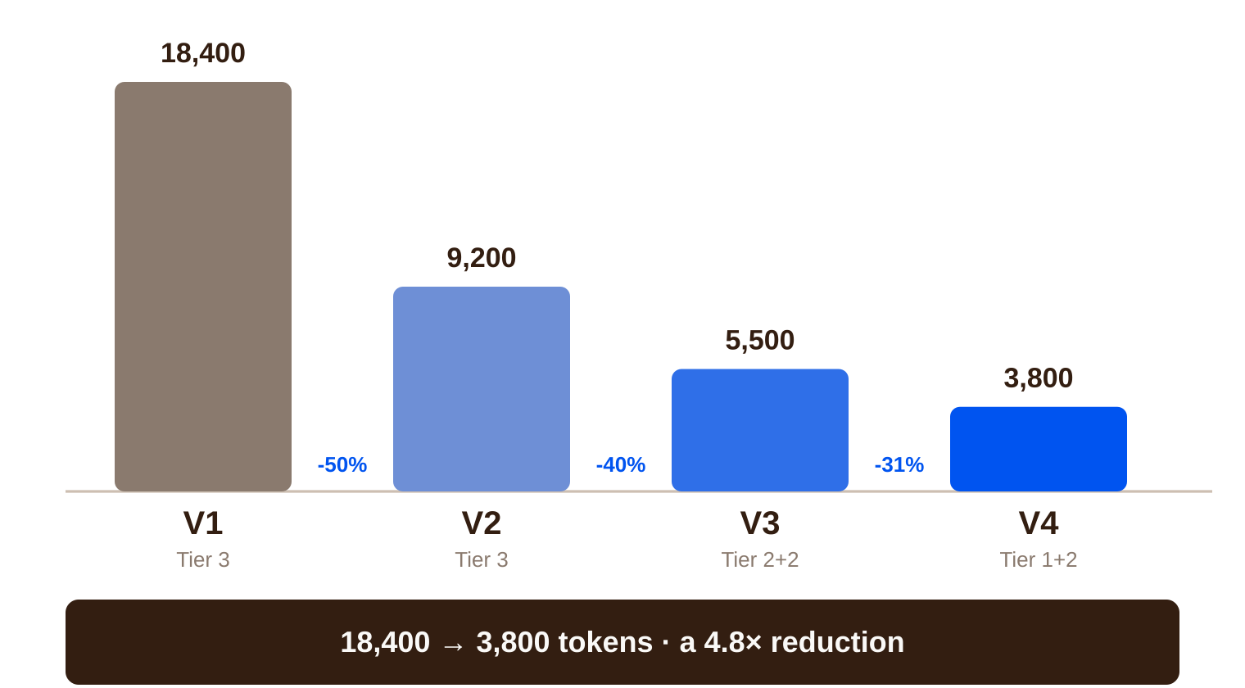
THE TARGET CURVE
V1 to V4, and what buys each drop
V2
9,200
Relevant excerpts instead of whole files. Same single Tier 3 call.
V3
5,500
Two-call subagent handoff — but still passing full context between them.
V4
3,800
Minimal typed payload plus routing: 1,000 Tier 1 triage + 2,800 Tier 2 resolver.
V3 is the smallest drop for the most work. That is the point of it.
16
Notes:
Show this at the start of Phase 3 as the map, and again at the end as the scoreboard. The shape is the message. The first cut is the easiest and the biggest — half the tokens for the least clever work, just by not loading files you do not need. Then point at V3 and be honest about it. Forty percent for a substantially harder change, because V3 still carries full context across the handoff. It is deliberately the least efficient step per unit of effort, and teams should feel that. V4 is where the two remaining ideas compound: thin the payload and route the calls. Note the split — a thousand tokens of Tier 1 triage and 2,800 of Tier 2 resolver. In cost points that is dramatically better than the token count alone suggests, because the tier weights differ by twelve times. That is the bridge to the routing slide.

Slide 17
THE V3 TRAP
The handoff that saves you nothing
{
"company_md": "<entire contents of company/about.md>",
"support_contacts_md": "<entire contents of company/support-contacts.md>",
"products": {
"aurora_x3": "<entire contents of products/aurora-x3.md>",
"fjord_cargo": "<entire contents of products/fjord-cargo.md>",
"vinter_pro": "<entire contents of products/vinter-pro.md>",
"powerpack_batteries": "<entire contents of products/powerpack-batteries.md>",
"accessories": "<entire contents of products/accessories.md>"
},
"policies": {
"warranty": "<entire contents of policies/warranty.md>",
"returns": "<entire contents of policies/returns.md>",
"shipping": "<entire contents of policies/shipping.md>",
"escalation": "<entire contents of policies/escalation.md>"
},
"customer_record_full": "<entire contents of customers/anna-karlsson.md>",
"case_full_text": "<entire contents of cases/case-01-anna-karlsson.md>",
"conversation_history": "<unbounded prior reasoning trace>"
}
1
You split the agent in two.
Architecturally, this is a subagent handoff. It has all the right shapes.
2
You saved almost nothing.
The second call receives everything the first one had, plus the reasoning trace.
3
The last line is the worst one.
An unbounded history grows with every turn and is never truncated.
Delegation without discipline is just two bills.
17
Notes:
Put this up only after teams have hit the wall themselves in Phase 3. Shown too early it is a warning; shown at the right moment it is a diagnosis, and they remember diagnoses. Ask someone to read the key names out loud. Every single one is a whole file. The structure looks disciplined — nested, typed, tidy — and it is carrying eleven complete documents across a boundary that was supposed to reduce load. The conversation_history line deserves its own moment. Unbounded means it grows every turn and nothing ever removes anything. On a long case that field alone can dwarf everything above it. The sentence at the bottom right is the one to repeat: delegation without discipline is just two bills. Splitting an agent is not an optimisation. Thinning the interface between the halves is the optimisation.

Slide 18
THE V4 PATTERN
A typed decision payload
{
"handoff_type": "typed_decision_payload",
"case_id": "CASE-01",
"customer_id": "NB-CUST-10041",
"product_sku": "AX3",
"product_name": "Aurora X3",
"serial_number": "AX3-25A-00417",
"purchase_date": "2025-03-10",
"warranty_window_end_standard": "2027-03-10",
"stated_symptom": "intermittent power loss, bike will not hold charge",
"candidate_archetype": "symptom_cause_confusion",
"applicable_policy_sections": ["warranty.md#section-5", "warranty.md#section-4"],
"root_cause_flags": {
"water_exposure_reported": false,
"pressure_washed_near_battery": false
},
"recommended_model_tier": "tier_2"
}
1
Facts, not documents.
Section pointers replace section text. The resolver fetches only if it must.
2
The triage did the thinking.
Archetype guess and root-cause flags are decisions, already made and passed forward.
3
It carries its own routing hint.
recommended_model_tier lets the resolver be chosen, not assumed.
Roughly fifteen fields replace eleven documents.
18
Notes:
Put the two handoff slides side by side mentally — same boundary, same architecture, completely different bill. Walk three fields specifically. applicable_policy_sections carries pointers rather than prose: the resolver is told where to look and fetches only if it actually needs the text. root_cause_flags is the Anna and Erik distinction reduced to two booleans, which is the entire difference between eligible and not. recommended_model_tier means routing is a decision made by something that has read the case, not a static configuration. The important conceptual point: this payload is not a compression of the old one. It is the output of thinking. The triage call read the mess and produced structured judgements, and those judgements are what crosses the boundary. Worth saying plainly — this is what "typed handoff" means in practice, and it is the single most transferable idea from the whole workshop.

Slide 19
PHASE 4
30 min
EXERCISES 4–5 · ROUTING & GATE
Model routing and the quality gate
WHAT HAPPENS
TARGETS
1
Build V4: minimal typed payload plus tier routing. Target ≤ 3,800 tokens.
V4 ≤ 3,800 tokens: 1,000 Tier 1 triage + 2,800 Tier 2 resolver.
2
Triage on Tier 1, resolve on Tier 2. Escalation-flagged cases skip the resolver entirely.
One call, not two, for anything flagged for escalation.
Run the six-item quality gate across all ten cases, not just Case 1.
All six gate items passing on as many of the ten cases as you can manage.
3
4
Fix what the gate catches. Expect it to catch something.
This is where teams discover their cheap agent quietly broke two of the adversarial cases.
Quality is 70% of the score. A team polishing token counts while a gate item fails is losing points, not gaining them.
Notes:
Two exercises in thirty minutes is tight, and the second one matters more. Announce the split at the start: fifteen minutes on V4, fifteen on the gate, and mean it. The escalation short-circuit is the cleverest trick available and teams routinely miss it. If triage flags a case as out of scope, there is nothing for the resolver to resolve — the second call should not happen at all. That is a whole call saved on two of the ten cases. The gate is where the workshop's real lesson lands. Teams have spent an hour optimising against Case 1 and now discover their agent fails Case 5 or Case 7. That is not a workshop artefact; it is exactly what happens when you tune an agent against a single example. Walk the room repeating one thing: quality is seventy percent. Any team still shaving tokens while a gate item fails is actively losing.

Slide 20
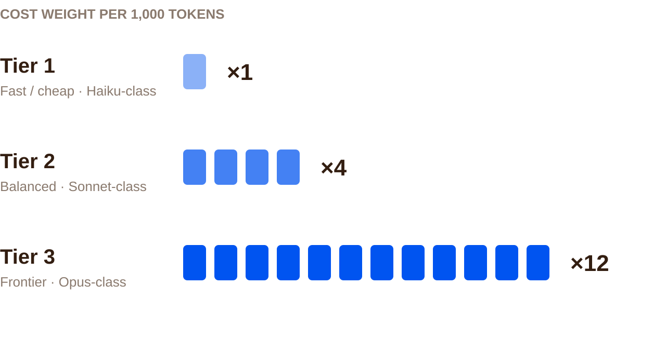


WHERE THE REAL SAVING IS
Routing: one token, twelve times the price
Triage on Tier 1
Extracting fields and flagging an archetype does not need a frontier model.
Resolve on Tier 2
The judgement call gets the balanced model — where it actually earns its cost.
Escalations skip the resolver
If triage says out of scope, there is nothing left to resolve. Save the entire call.
Same tokens, different tier, twelve times the bill. Routing is the cheapest optimisation on the list.
20
Notes:
The number to make people feel is the twelve. A token processed by a frontier model costs twelve times the same token on the fast model, and V1 spent every single one of its eighteen thousand tokens at that rate. Then the reframe that makes routing obvious: ask what the triage step is actually doing. It is reading a case file and pulling out a serial number, a purchase date and two boolean flags. That is extraction. It does not require the most capable model available, and using one there is like couriering a letter across town by helicopter. Be careful to say what routing does not fix. It makes waste cheaper; it does not make it smaller. A team that routes a bloated V1 down to Tier 1 will get a decent cost score and fail on quality, because the small model drowns in the same irrelevant context. Routing pays off only after the context work is done — which is exactly why it is exercise four and not exercise one.

Slide 21
SIX ITEMS, ALL MUST PASS
The quality gate
1
Cites the policy section
2
States the outcome explicitly
3
Confirms the facts first
The specific section number used for the decision — not the document name.
Eligible, Not Eligible or Escalate, justified by root cause rather than symptom text alone.
Purchase date and product identity read from the record. No assumed facts.
4
Escalates what it must
5
Asks instead of guessing
6
Tone is right
Anything matching an escalation trigger is handed on, not resolved.
If a needed fact is missing from the case file, ask a clarifying question.
Professional, empathetic, concise — and in the customer's stated language.
A case counts as passing only if it scores ≥16/20 on the rubric AND clears all six of these.
21
Notes:
Read items 2 and 5 slowly — they are the two that decide most teams' scores. Item 2 is the Anna and Erik gate. The wording is deliberate: justified by root cause, not symptom text alone. An answer that says not eligible for the right reason passes; an answer that reaches the same verdict by pattern-matching the symptom does not. Item 5 is counter-intuitive and worth defending explicitly. Asking a clarifying question feels like failure to a team that has built an agent to answer things. It is the correct behaviour for archetype D, and it is the behaviour production support teams actually want. An agent that guesses confidently on missing information is worse than one that stops. Item 6 sounds soft, but the language clause is not decoration. If the customer wrote in Swedish, an English answer fails the gate. Note the AND at the bottom. Sixteen out of twenty on the rubric is not enough on its own. Both conditions.

Slide 22
HOW YOU WIN
The scoring formula
PER-CASE RUBRIC — 20 POINTS
FinalScore
Correct eligibility decision
0–4
(Q × 70) + (M × 30) − Penalty
Root-cause grounding
0–4
Policy citation accuracy
0–4
Escalation / scope judgement
0–4
Rounded to one decimal, clamped to 0–100.
Clarity and tone
0–4
Quality is worth more than twice cost. Deliberately.
BCP = 12 × 18.4 = 220.8
CostPoints(call) = TierWeight × (tokens ÷ 1000)
TotalCostPoints = Σ CostPoints over every call
CostEfficiency = max(0, 1 − TotalCostPoints / BCP)
M = mean(CostEfficiency) across all 10 cases
Q = cases scoring ≥16/20 AND passing all 6 gates ÷ 10
Penalty = 10 × (critical archetype failures)
70
Q — quality share
30
M — cost-efficiency share
−10
per critical archetype failure
22
Notes:
Do not read the formula aloud line by line. Explain the shape and let teams read the detail. The shape: quality is worth seventy, cost is worth thirty, and archetype failures come straight off the top. A team that halves its cost gains at most fifteen points. A team that blows two adversarial cases loses twenty and probably fails those cases on quality too — so the real swing is much larger. The baseline cost points figure is worth one sentence. BCP is what V1 costs: twelve times 18.4 thousand tokens, or 220.8. Cost efficiency is measured as how far below that you got, so a V4 at 3,800 tokens across two tiers scores extremely well. Then say the thing that decides the leaderboard every time: the winning team is almost never the cheapest. It is the team that got to roughly V3 or V4 cost with zero archetype failures. Cheap and wrong loses to slightly-less-cheap and right, every single run.

Slide 23
PHASE 5
10 min
LEADERBOARD & DEBRIEF
Scoring, ranking and retro
WHAT HAPPENS
THE DEBRIEF QUESTIONS
1
Each team submits their V4 output for all ten cases.
Where did your token count drop most — and was it where you expected?
2
Facilitator scores against evaluation/expected-results.md and the rubric.
Which archetype caught you, and what would have caught it earlier?
3
FinalScore computed per formula. Leaderboard displayed live.
What would you take back to a real agent on Monday?
4
Retro: what surprised you, and what would you keep for real work?
The leaderboard is the hook. The retro is the part that survives the afternoon.
Ten minutes goes fast. Score during Phase 4 as submissions arrive, not after the clock stops.
Notes:
Start scoring while Phase 4 is still running, as submissions land. Ten minutes is not enough to score from cold and still hold a discussion. Reveal the leaderboard bottom-up; it keeps attention and it is kinder. Before showing the top, ask the room to guess whether the winner was the cheapest agent. They will guess yes. It usually is not, and that reveal makes the scoring philosophy land better than any explanation of the formula. Protect the retro even if the leaderboard runs long. The third question is the one that matters — teams have just built a typed handoff and a quality gate under time pressure, and they will never have a better moment to decide what to carry into real work. Close by naming the one transferable idea: the handoff payload. Most people here will not build a scoring rubric next week, but nearly all of them will design an interface between two agents.

Slide 24



HOW THE RANKING WORKS
Leaderboard mechanics
Submit
→
Score
→
Compute
→
Rank
Each team submits their V4 agent output for all ten cases.
Facilitator scores against expected-results.md and the 20-point rubric.
FinalScore per the formula: quality 70, cost 30, penalties off the top.
Ranked leaderboard displayed live, revealed from the bottom up.
Ask the room to predict whether the cheapest agent won, before you reveal the top. It usually did not — and that is the whole lesson in one moment.
24
Notes:
Mechanically simple; the value is in how you stage the reveal. Be transparent that scoring is partly judgement. The rubric has five categories at zero to four each, and reasonable people can differ by a point. Say so before the reveal rather than defending it after. What is not judgement is the archetype penalty and the cost arithmetic — those are mechanical, and they decide most of the ranking. The prompt in the dark box is the highest-value ten seconds of the phase. Teams have spent two hours optimising cost, so they assume cheapest wins. When it does not, the seventy-thirty split stops being a rule on a slide and becomes something they felt.

Slide 25
RECAP
What you can do now that you could not at 09:00
Skills design
Context engineering
Handoff patterns
Model routing
Evaluation
Scaffold a reusable skill
Cut context 5× without losing correctness
Design typed payloads, not context dumps
Route by cost and complexity
Build a quality gate and a scoring rubric
The transferable idea is the handoff payload. Most of you will design an interface between two agents long before you build a scoring rubric.
25
Notes:
Close fast — energy is high after the leaderboard and a long recap wastes it. Read the five as capabilities rather than topics. Every one of them was measured today, not asserted. Then land the final line and stop. Scoring rubrics and evaluation harnesses are specialist work that not everyone will do. Designing the interface between two agents is something nearly everyone in this room will do within a month, and the difference between the two JSON payloads they saw today is the whole discipline in one picture. If you want a closing question rather than a closing statement: ask which of their current systems is passing a fat handoff right now. Somebody always knows the answer, and it is usually uncomfortable.

