Slide 1
Single Cell Workflow Install Instructions
First section is about the Data Tables and Data Managers required
  Each Data Manager included Screen shots
Second part is about the tools needed
  When an install is required code is in a seperate “package”
    Code just copied is included in the tool
  Version number where correct last time I checked
“Installed” refers to on centaurus

Slide 2
all_fasta Data_table
mm10_random_chrM_chrUn.fa
  Needed for bwa_index
  /mnt/data-sets/bcf/genomeIndexes/mm10_random_chrM_chrUn/fasta/mm10_random_chrM_chrUn.fa
ercc_and_TPA_mouse_rRNA.fa
  Used in workflow (can also used from history) (Currently not on Hydra)
  https://www.dropbox.com/s/f76chqyepgi1z07/ercc_and_TPA_mouse_rRNA.fa?dl=0
One off:
  Manually add path to data table
  all_fasta_path_data_manager
    https://toolshed.g2.bx.psu.edu/view/brenninc/data_manager_all_fasta_path/33e7d904fdc3
  data_manager_fetch_genome_all_fasta
    https://toolshed.g2.bx.psu.edu/view/devteam/data_manager_fetch_genome_all_fasta

Slide 3
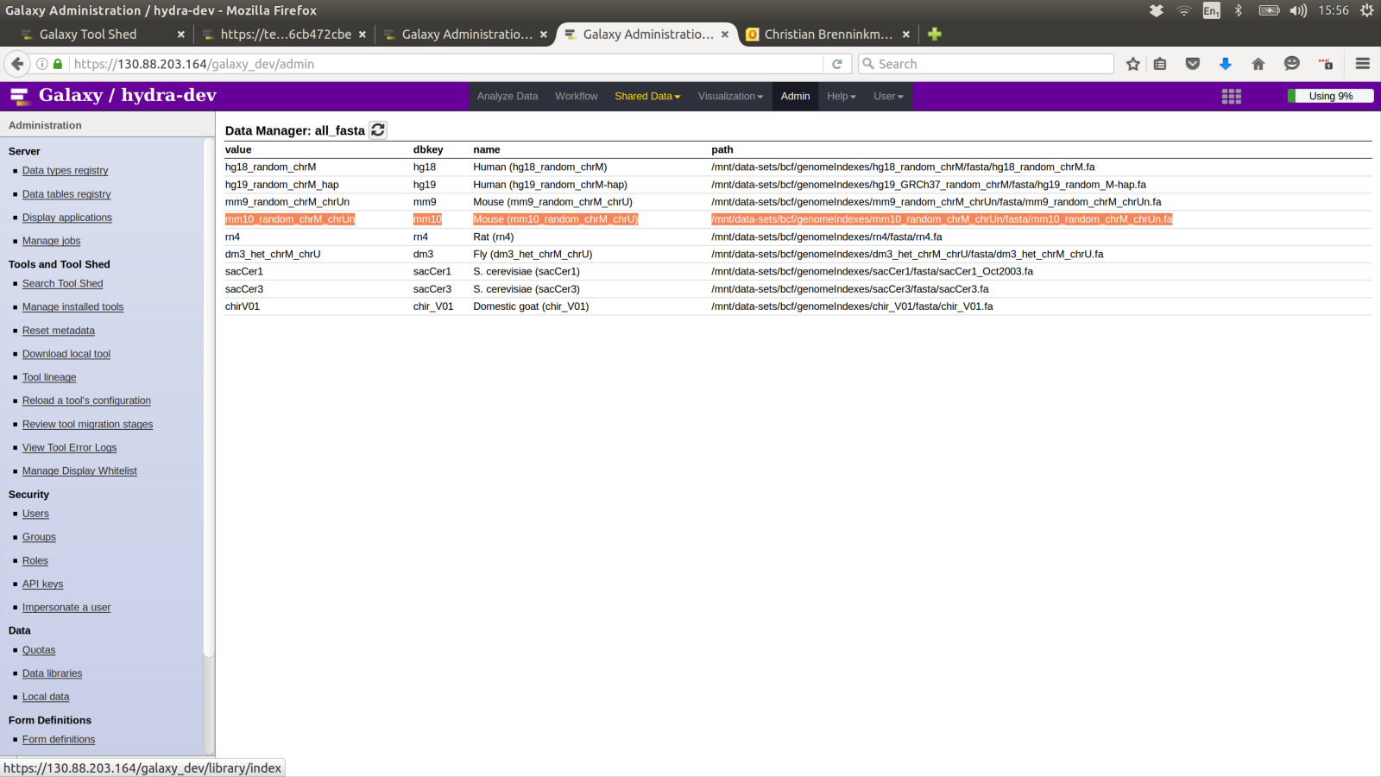
mm10_random_chrM_chrUn.fa in all_fasta

Slide 4
Data Manager for bwa_indexes
Index: mm10_random_chrM_chrUn.fa
  Otherwise has to re index repeatedly
Manually adding to “bwa_indexes” data table is also possible
  Same way as Human (hg18_random_chrM) currently is. (on centaurus)
https://toolshed.g2.bx.psu.edu/view/devteam/data_manager_bwa_index_builder
  Needs values in “all_fasta” Data Table
Depends on:
  https://toolshed.g2.bx.psu.edu/view/devteam/package_bwa_0_5_9/ec2595e4d313 (Installed)

Slide 5
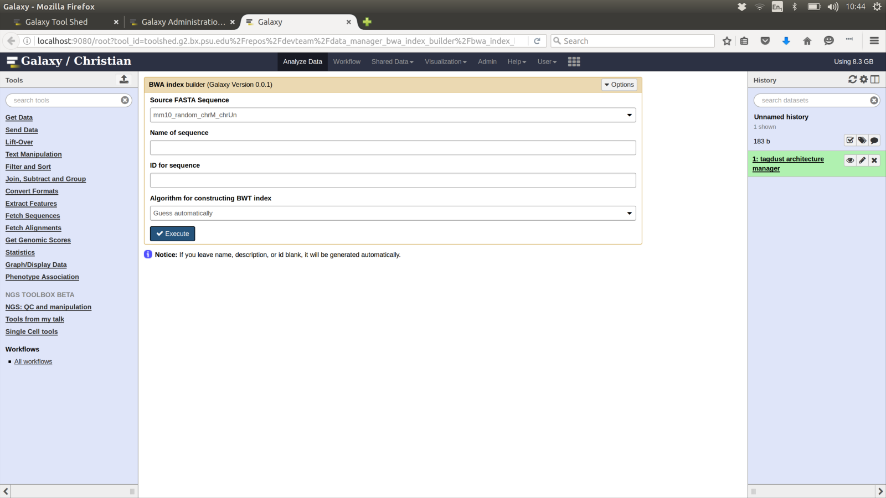
Configure bwa_indexes data manager

Slide 6
Data Manager for Directory Data
Used by tool which reads all data of a type from a directory on the server.
Points to a directory on the server
Selects the extension to include
Sets the galaxy type to use
Allows the files to be unzipped
https://toolshed.g2.bx.psu.edu/view/brenninc/data_manager_for_directory_data/43083927dfc5

Slide 7
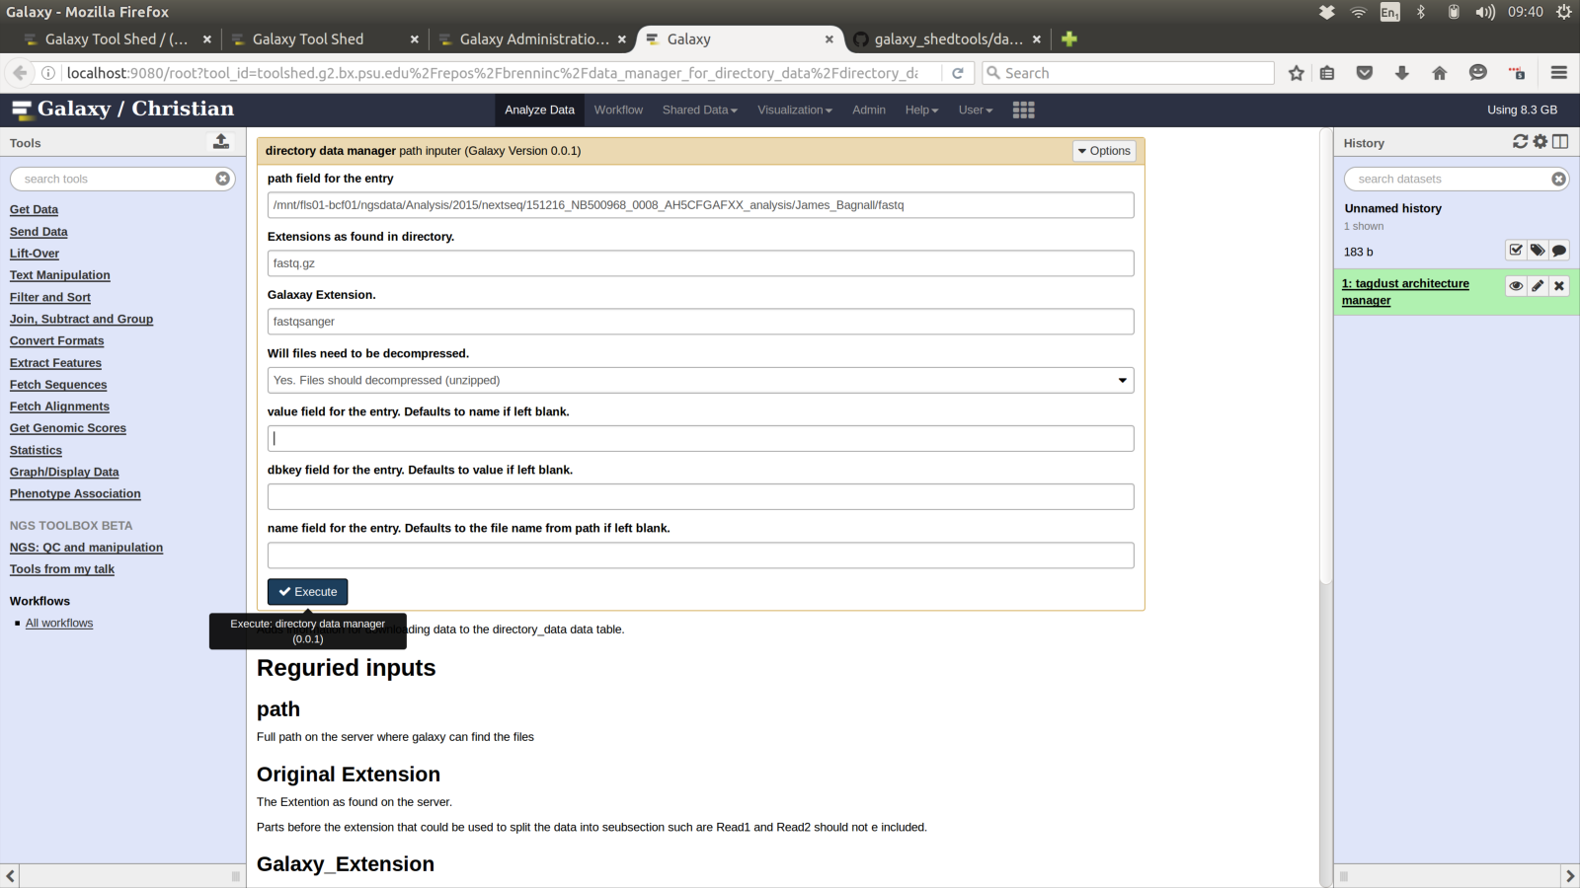
Configure Single Cell Data as fastqsanger (decompressed)

Slide 8
tagdust_architecture
Tagdust tool appears to hang if incorrect architecture is used.
  So architecture must come from a Data Table
https://toolshed.g2.bx.psu.edu/view/brenninc/data_manager_tagdust_architecture/e3b3261e5498
Two Architectures needed for workflow
  R:N
  HMM Building Blocks: R:N
  F:NNNNNNNN_S:TATAGGG_R:N
  HMM Building Blocks: F:NNNNNNNN
  HMM Building Blocks: S:TATAGGG
  HMM Building Blocks: R:N

Slide 9
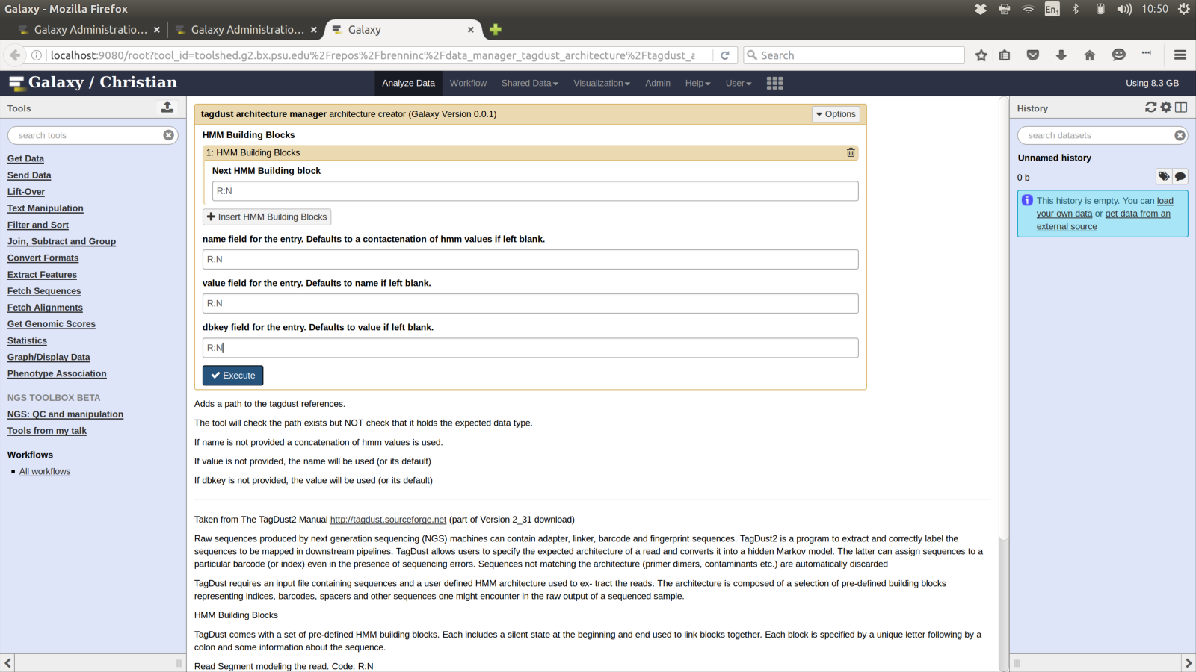
Tagdust Architecture Data Manager
R:N

Slide 10
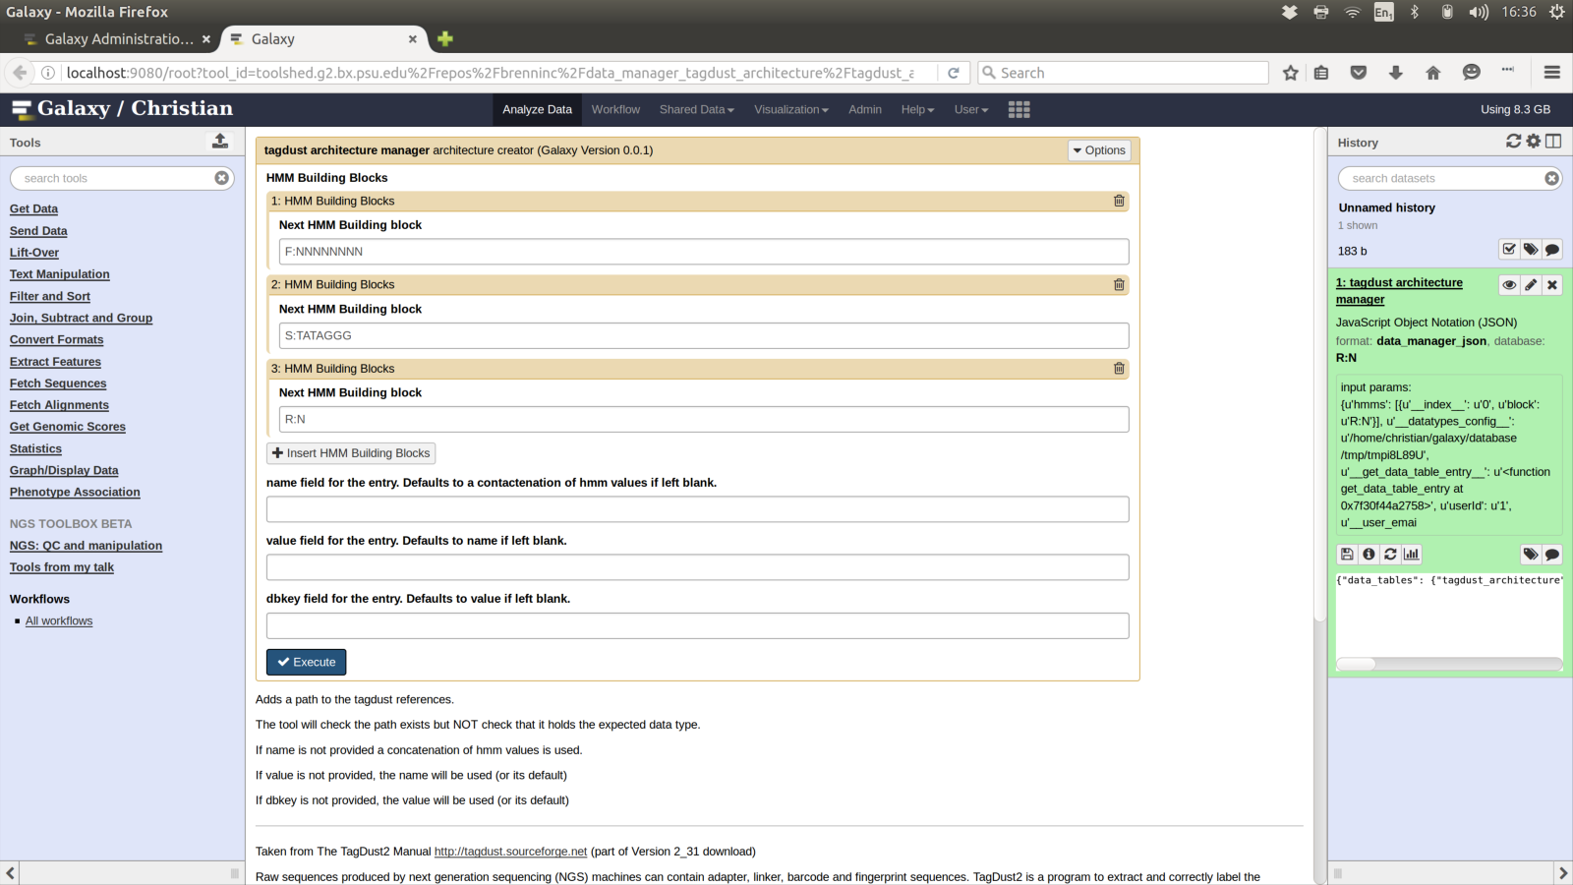
Tagdust Architecture Data Manager
F:NNNNNNNN S:TATAGGG R:N

Slide 11
gencode.vM5.annotation.gtf
One of:
  Manually add to “gene transfer” data table
  gene_transfer by path data manager
    https://toolshed.g2.bx.psu.edu/view/brenninc/data_manager_gene_transfer_by_path/af7b7c99ae9f
  Use galaxy history

Slide 12
Tools to install
preconfigured_directory_reader
tagdust_2_31
sync_paired_end_reads
samtools_flag_filter_1_2
pairedbamtobed12
umicount
bedtools_bedtobam
subread_featurecounts1_5_0_p1

Slide 13
Directory Reader
https://toolshed.g2.bx.psu.edu/view/brenninc/preconfigured_directory_reader/97a9636974bc
Loads all files in a preconfigured directory on the server into a Data Collections
  With a specific ending
  Setting the ending to galaxy type
  Decompressing if required
Generates a file with a list of all the files in the Data Collection

Slide 14
Tagdust Application
In workflow used to filter fastq files
TagDust allows users to specify the expected architecture of a read and converts it into a hidden Markov model. The latter can assign sequences to a particular barcode (or index) even in the presence of sequencing errors. Sequences not matching the architecture (primer dimers, contaminants etc.) are automatically discarded:
  http://tagdust.sourceforge.net/

Slide 15
Tagdust tools
Dependencies:
  https://toolshed.g2.bx.psu.edu/view/brenninc/package_tagdust_2_31/1b0267fab15a
Tool:
  https://toolshed.g2.bx.psu.edu/view/brenninc/tagdust_2_31/40c86e14b674

Slide 16
Sync Pairs Application
sync_paired_end_reads is a python tool to synchronise paired-end reads when reads1 or reads2 were modified.
When working with paired-end sequencing data, it is common to filter out reads that do not pass basic quality controls. This leads to pairs that are not synced anymore. This tool streams reads1 and search for the associated read2 in reads2. Additionally it synchronises the sequence identifiers of the reads so if a software modified the sequence identifier of the reads1 then same identifiers will be used for reads2. Finally it replaces all space characters by an arbitrary '___' pattern.
This tool was mainly developed to process the output of tagdust2 when ran in single-end mode which appends the UMIs found in the raw sequences to the sequence identifier.
Source: https://github.com/mmendez12/sync_paired_end_reads

Slide 17
Altas issue and fix
Sync Pairs depends on biopython
Ideal biopython is version by biopython
This depends on numpy
Which had the Altas bug
Alternatively biopython by ulfschaefer can be used used
Which depends on package_python_2_7_numpy_1_9

Slide 18
Sync Pairs Tool Dependencies
(Installed) dependencies
https://toolshed.g2.bx.psu.edu/view/biopython/package_biopython_1_66/8433ee4531ff (Installed)
  https://toolshed.g2.bx.psu.edu/view/iuc/package_ncurses_6_0/0efde9889efd
  https://toolshed.g2.bx.psu.edu/view/iuc/package_gdbm_1_11/ed2537bccffc
  https://toolshed.g2.bx.psu.edu/view/iuc/package_sqlite_3_8_3/c8a5c11cc921
  https://toolshed.g2.bx.psu.edu/view/iuc/package_libtool_2_4/7f67694b167c
  https://toolshed.g2.bx.psu.edu/view/iuc/package_bzlib_1_0/af4887e1f595
  https://toolshed.g2.bx.psu.edu/view/iuc/package_xz_5_0_5/944f93d45594
  https://toolshed.g2.bx.psu.edu/view/iuc/package_readline_6_3/ca1a9400d4e1
  https://toolshed.g2.bx.psu.edu/view/iuc/package_zlib_1_2_8/63a4a902cda2
  https://toolshed.g2.bx.psu.edu/view/iuc/package_python_2_7/8b09fe018cac
  https://toolshed.g2.bx.psu.edu/view/iuc/package_atlas_3_10/f27d2f8761ae
  https://toolshed.g2.bx.psu.edu/view/iuc/package_numpy_1_9/842bb2f02723

Slide 19
Sync Pairs Tool Dependencies
Alternative Avoiding currently fixed Atlas bug
https://toolshed.g2.bx.psu.edu/view/ulfschaefer/package_python_2_7_biopython_1_66/c722591ee0aa
  https://toolshed.g2.bx.psu.edu/view/iuc/package_ncurses_6_0/0efde9889efd
  https://toolshed.g2.bx.psu.edu/view/iuc/package_gdbm_1_11/ed2537bccffc
  https://toolshed.g2.bx.psu.edu/view/iuc/package_sqlite_3_8_3/c8a5c11cc921
  https://toolshed.g2.bx.psu.edu/view/iuc/package_libtool_2_4/7f67694b167 c
  https://toolshed.g2.bx.psu.edu/view/iuc/package_bzlib_1_0/af4887e1f595
  https://toolshed.g2.bx.psu.edu/view/iuc/package_xz_5_0_5/944f93d45594
  https://toolshed.g2.bx.psu.edu/view/iuc/package_readline_6_3/ca1a9400d4e1
  https://toolshed.g2.bx.psu.edu/view/iuc/package_zlib_1_2_8/63a4a902cda2
  https://toolshed.g2.bx.psu.edu/view/iuc/package_python_2_7_10/0339c4a9b87b
  https://toolshed.g2.bx.psu.edu/view/iuc/package_atlas_3_10/f27d2f8761ae
  https://toolshed.g2.bx.psu.edu/view/iuc/package_python_2_7_numpy_1_9/57b37f63cb84

Slide 20
Sync Pairs
Tool:
Version 2:
  https://toolshed.g2.bx.psu.edu/view/brenninc/sync_paired_end_reads/79682a423af7
  Uses official biopython currently with altas fixed
Version 1:
  https://toolshed.g2.bx.psu.edu/view/brenninc/sync_paired_end_reads/622f0b43ce57
  Uses ulfschaefer biopython and therefor package_python_2_7_numpy_1_9

Slide 21
Map with BWA for Illumina
Dependency:
  https://toolshed.g2.bx.psu.edu/view/devteam/package_bwa_0_5_9 (Installed)
Tool:
  https://toolshed.g2.bx.psu.edu/view/devteam/bwa_wrappers (Installed)
No known reason why an older version of the tool would not work.

Slide 22
Samtools flag_filter
Uses samtools to:
Filter the sam file based on flag field values
Convert the data to bam format
Sort the bam file to order required by galaxy

Slide 23
Samtools flag_filter tool
Dependency:
  https://toolshed.g2.bx.psu.edu/view/iuc/package_samtools_1_2/f6ae3ba3f3c1 (Installed)
    https://toolshed.g2.bx.psu.edu/view/iuc/package_ncurses_5_9/a6cbb3aaecf6 (installed)
    https://toolshed.g2.bx.psu.edu/view/iuc/package_zlib_1_2_8/63a4a902cda2 (same as sync pairs)
Tool:
  https://toolshed.g2.bx.psu.edu/view/brenninc/samtools_flag_filter_1_2/97bb72be07f9

Slide 24
PairedBamToBed12 application
pairedBamToBed12 converts properly paired BAM alignments to BED12 format. Typical proper pairs will be represented by a 2 blocks BED12 entry. Additional blocks are produced when an alignment contains long deletion (CIGAR N-op). Thickness indicates the first read of the pair. The BAM input file must be grouped/sorted by query name (not alignment position).
Source: https://github.com/Population-Transcriptomics/pairedBamToBed12

Slide 25
PairedBamToBed12 tool
Dependency:
  https://toolshed.g2.bx.psu.edu/view/brenninc/package_pairedbamtobed12/82c063a00753
  Samtools (same as Flag filter and Installed)
Tool:
  https://toolshed.g2.bx.psu.edu/view/brenninc/pairedbamtobed12/c6efe5d78140

Slide 26
Umicount Application
umicount is a collection of Python scripts which allows to remove and count PCR duplicates from paired-end libraries prepared with unique molecular identifiers (UMIs).
The main difference between existing approaches (rmdup or MarkDuplicates) is that it uses UMI and Transcription Start Site information to remove duplicates rather than the reads size.
It was mainly developed for single-cell CAGE and single-cell nanoCAGE protocols where a tagmentation step is performed between two PCRs (see example below).
Source: http://umicount.readthedocs.io/en/latest/introduction.html

Slide 27
Umicount Tool
No Dependency as no install required
Tool:
  https://toolshed.g2.bx.psu.edu/view/brenninc/umicount/d1d0ee366702

Slide 28
Adapted Bedtools2 bedtobam
Based on standard Bedtools2 bed to bam
  https://toolshed.g2.bx.psu.edu/view/iuc/bedtools/f8b7dc21b4ee (Install NOT required)
Additional step of sorting the resulting bam file to Galaxy required order.
  Using samtools
If standard bedtool's version is fixed to sort the resulting bam files there is not reason not to use that!

Slide 29
Bedtobam tool
Dependencies
  https://toolshed.g2.bx.psu.edu/view/iuc/package_bedtools_2_24/39b86c1e267d
  Samtools (same as Flag filter and Installed)
Tool:
  https://toolshed.g2.bx.psu.edu/view/brenninc/bedtools_bedtobam/a993f4a9aeaa

Slide 30
Subread Feature Count
The Subread software package is a tool kit for processing next-gen sequencing data. It includes Subread aligner, Subjunc exon-exon junction detector and featureCounts read summarization program.
Subread aligner can be used to align both gDNA-seq and RNA-seq reads. Subjunc aligner was specified designed for the detection of exon-exon junction. For the mapping of RNA-seq reads, Subread performs local alignments and Subjunc performs global alignments.
Source: https://sourceforge.net/projects/subread/

Slide 31
Subread Feature Count Tool
Dependency:
  https://toolshed.g2.bx.psu.edu/view/brenninc/package_subread_1_5_0_p1/7f2795b29d61
Tool:
  https://toolshed.g2.bx.psu.edu/view/brenninc/subread_featurecounts1_5_0_p1/58ad7b512590

