Slide 1
Dissipation element analysis
Christian Boehme
Institute for Combustion Technology RWTH Aachen University

Slide 2
DE theory
Overview
Regime diagram

Slide 3
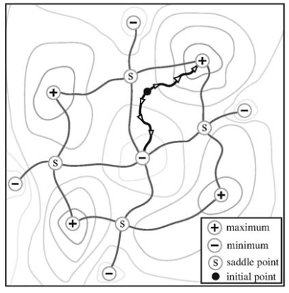
Dissipation element theory 1/3
Goal: search for random geometrical elements in turbulence (represent turbulent “eddies”)
Subdivide the flow into finite size regions
Subdivision follows the structure of the flow
Independent from an arbitrary numerical mesh
Method:
Trajectories normal to iso-surfaces (on a scalar field)
Identify minimum and maximum points (local extreme points)
Finite elements between minimum and maximum points are referred to as “dissipation elements”
Within this region, the scalar filed is monotonic
Peters and Wang https://linkinghub.elsevier.com/retrieve/pii/S1631072106001173

Slide 4
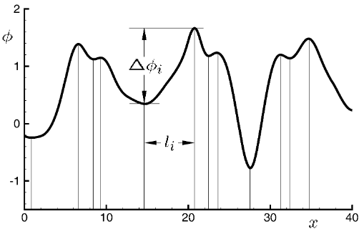
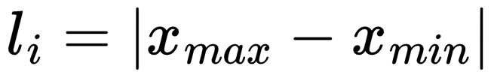
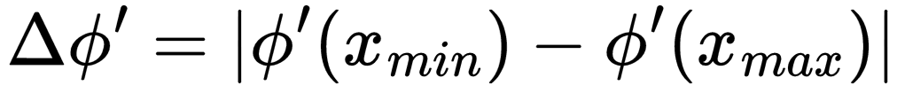
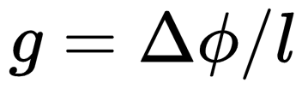
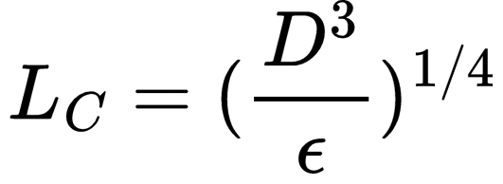
Dissipation element theory 2/3
Statistical properties of dissipation elements (DE)
Linear distance between minimum and maximum
Absolute of scalar difference at these points
Scalar gradient
Mechanism of extreme points generation
Same order of magnitude for diffusion velocity and local convective velocity leads to the generation of extreme points
Convective motion alone is unable to generate extreme points
Extreme points are generated at scales of the Obukhov-Corrsin length
DEs: Space-filling objects which subdivide the entire turbulent scalar field into smaller sub-units.
DEs: Tool for describing & investigating the effect of turbulence & diffusive transport on scalar fields.
Peters and Wang https://linkinghub.elsevier.com/retrieve/pii/S1631072106001173
Notes:
Obukhov-Corrsin length: Kolmogarov velocity v_k=(eps*r)^(1/3) equals diffusion velocity v_c=D/r

Slide 5
Dissipation element theory 3/3
Probability density of elements with length l
Postulate: time evolution of extremal points exhibits several stochastic features
Generation of new extremal points resulting from eddy turnover of Obukhov-Corrsin eddies
“cutting process”
Merging of two extremal points that are at a very small distance to each other. Leads to disappearance of these points, resulting in a reconnection of the adjacent elements
“reconnection process”
Peters and Wang https://linkinghub.elsevier.com/retrieve/pii/S1631072106001173

Slide 6
DE analysis of non-premixed jet flames
Denker2020
What was done?
DE analysis applied to mixture fraction field of DNS of non-premixed jet flames with different jet Reynolds numbers and stoichiometric mixture fractions
Comparison of statistics of DE parameters of non-premixed flames to non-reacting jets
What was found out?
Universality of the normalized length distribution of the DE observed in non-reacting cases also holds true for the reacting flows
Effects of combustion on the scalar difference in DEs
Diminish as the Reynolds number and the fuel dilution increases
New regime diagram for non-premixed combustion is introduced
DE parameters for a local classification of the turbulent flame surface
Flamelet-like zones / fine-scale mixing zones / burning zone / non-burning zone
Denker et al. https://www.cambridge.org/core/product/identifier/S0022112020007168/type/journal_article

Slide 7
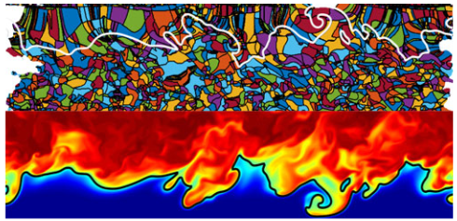
DE analysis of non-premixed jet flames
Denker2020
Mixture fraction Z is used as scalar field – non-premixed combustion
Provides most meaningful scales for the investigation of turbulent/chemistry interaction
DE analysis of mixture fraction field
Mirrored mixture fraction Z field
Observations:
DEs are intersected by the flame
Size of DEs increases toward the flame
Increased diffusivity caused by the heat release & mean relative velocity in the cross-stream direction
Intersection area depends on the DE orientation
DE tend to be elongated tube-like structures
Denker et al. https://www.cambridge.org/core/product/identifier/S0022112020007168/type/journal_article

Slide 8


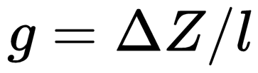
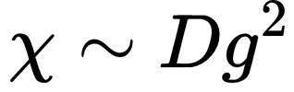
DE analysis of non-premixed jet flames
Denker2020
Influence of small scale turbulence in combustion
Normally: local reaction layer thickness compared to turbulent length scale
Non-premixed combustion: width of reaction layer changes locally with mixture fraction gradient
Comparison of scales between the scalar difference with the reaction layer thickness
Comparison in mixture fraction field
= length in Z-space (flamelet like solutions exist)
Gradient trajectories used to identify DEs are identical to the physical coordinates of flamelets
DEs as groupings of flamelet solutions
Flame thickness in non-premixed flames varies greatly with the mixture fraction gradient
Introduction of second parameter to characterize DE:
Its square is related to the scalar dissipation rate
Denker et al. https://www.cambridge.org/core/product/identifier/S0022112020007168/type/journal_article

Slide 9
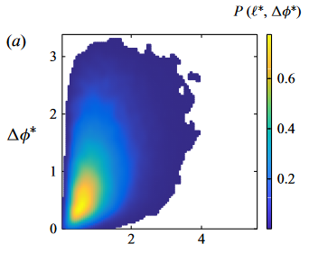
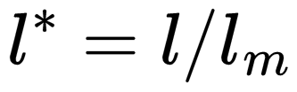
DE analysis of non-premixed jet flames
Denker2020
(1) global maximum of jPDF
diffusive drift of the extreme points leading to an annihilation of small DEs
(2) probability of ramp-cliff structures
structures are linked to external and internal intermittency and manifest themselves in very steep gradients of the scalar followed by a very gradual decent.
(3) physical mechanism of splitting and reconnection of DEs
jPDF reactive cases => see Denker et al.
General observations:
High Reynolds numbers: jPDF resembles non-reactive case
Low Reynolds numbers jPDFs are different to the non-reactive case
poor mixing in the reactive regions of the flow
(2)
(3)
(1)
Non-reactive case I
Denker et al. https://www.cambridge.org/core/product/identifier/S0022112020007168/type/journal_article

Slide 10
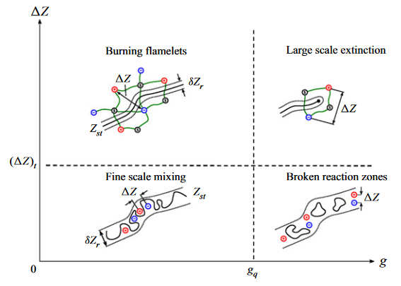
DE analysis of non-premixed jet flames
Denker2020
Categorization of combustion regimes based on DE parameters
DE parameter based regime diagram
Gradient
Boundary: quenching gradient
Scalar difference
Boundary: threshold value Z-space - below this value no coherent 1-D flame structure can be formed
Regimes:
Burning flamelets
Large scale extinction
Fine scale mixing
Broken reaction zones
Denker et al. https://www.cambridge.org/core/product/identifier/S0022112020007168/type/journal_article
Notes:
Threshold in Z-space: Equation (2) Niemietz et al.

Slide 11
DE analysis of non-premixed jet flames
Denker2020
Regimes:
Burning flamelets
Regions of the flames should adhere to the classical steady flamelet model
Large scale extinction
“large scale”: characteristic scale of the extinction-inducing event, which is large compared to the scale indicated by the local DE
Large cliff-ramp structures with significant strain; Large-scale extinct regions such as flame holes
Extinction corresponds to the low Damköhler type extinction caused by eddies of integral scale size
Fine scale mixing
Very short flamelet solutions; questionable if chemical reactions can be sustained
Rapid splitting and reconnection
Flame structure should not exist (comp. homogeneous reactor); intense turbulent advection is the dominant transport mechanism
Broken reaction zones
small-scale extinction zones due to locally high turbulence activity
type of extinction corresponds to a high Karlovitz-type effect - eddies of the size of the Kolmogorov-scale transport radicals out of the inner reaction zone
Denker et al. https://www.cambridge.org/core/product/identifier/S0022112020007168/type/journal_article

Slide 12
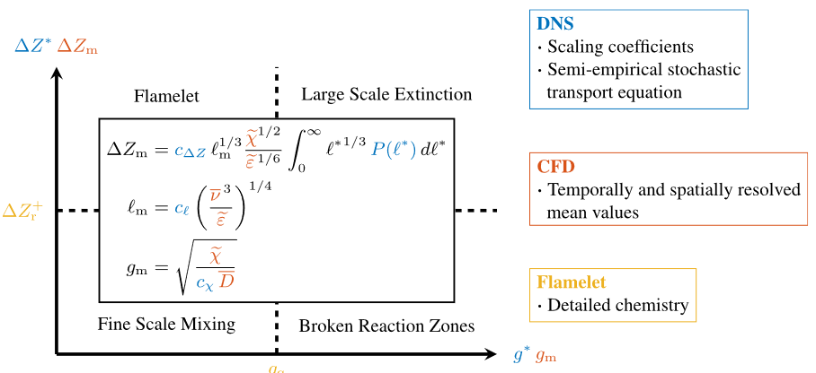
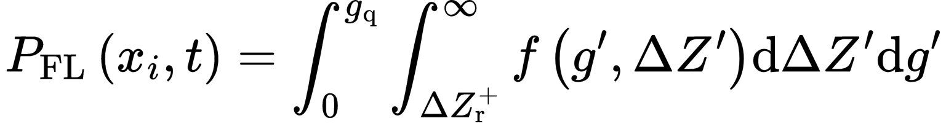
Prediction of non-premixed combustion regimes in DI-compression engines
What was done?
Methodology to link DNS and RANS
Three-ponged approach combines universal scaling relations of turbulence and chemistry from DNS data with the mean values from RANS and 1D detailed chemistry calculations
Test case: direct injection compression ignition engine
Local probabilities of each regime based on universal DE-statistics
i.e. for the flamelet regime:
Local combustion regime distribution:
Local probability:
What was found out?
Applied framework to predict non-premixed combustion regimes in RANS based on DNS, 1D detailed chemistry & CFD
For the largest part (~90%), combustion took place in the flamelet regime
Confirms suitability of the flamelet model
Niemietz et al. https://linkinghub.elsevier.com/retrieve/pii/S1540748924002505

Slide 13
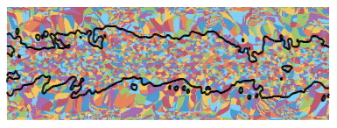
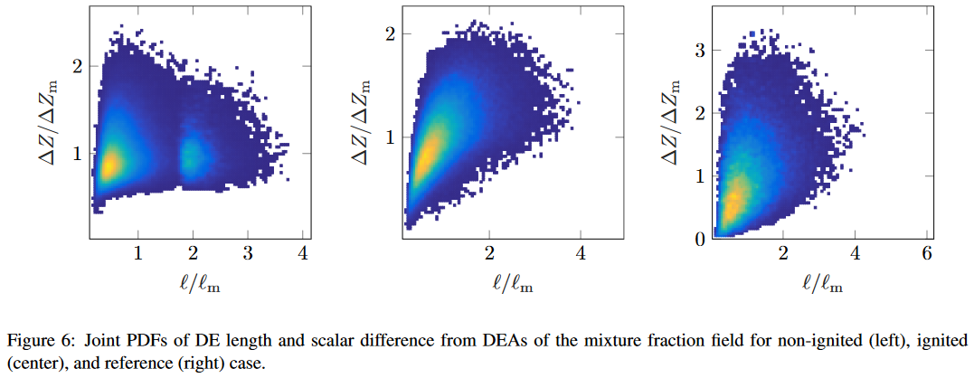
Spray combustion and dissipation elements; a novel analysis approach
What was done?
DE applied to DNS data of spray combustion
Analysis of temperature and mixture fraction field
Spray combustion: DE applied to combustion and liquid evaporation
Prior ignition and after ignition
What was found out?
Application of DE to spray combustion
Analysis of combustion modeling approaches based on DE
DE statistics of ignited spray similar to homogeneous isotropic turbulence
DE statistic before ignition is different due to another DE length scale corresponding to the droplet distribution
Droplet length scale is no longer characteristic after ignition
Bode et al. “Spray combustion and dissipation elements: a novel analysis approach”
Notes:
Used “in-house trajectory search code” (DESC) => access this code/ITV-code?

Slide 14
Project
Idea

Slide 15
Idea
Determine regime diagram for ..
Check if flamelet solution is applicable
Further:
Calculate regime diagram for two-time steps to see the evolution in the regime-diagram
0.5 (ignition end + small flame)
0.65 (evolved flame)
Consumption speed
Reactants at Zst front (reaction rates)
Two different time steps

