Slide 1
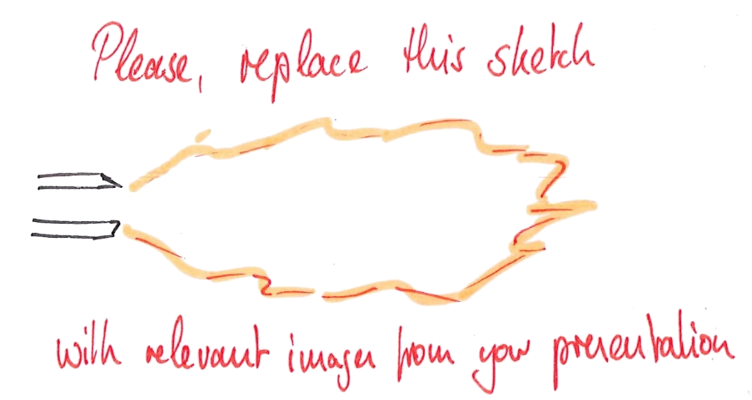
DNS meeting
Pooria Farmand
Institute for Combustion Technology RWTH Aachen University

Slide 2
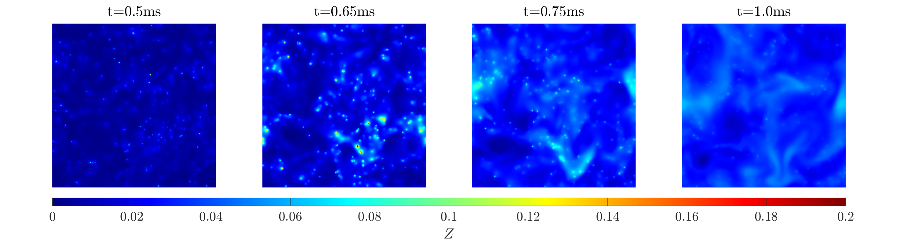
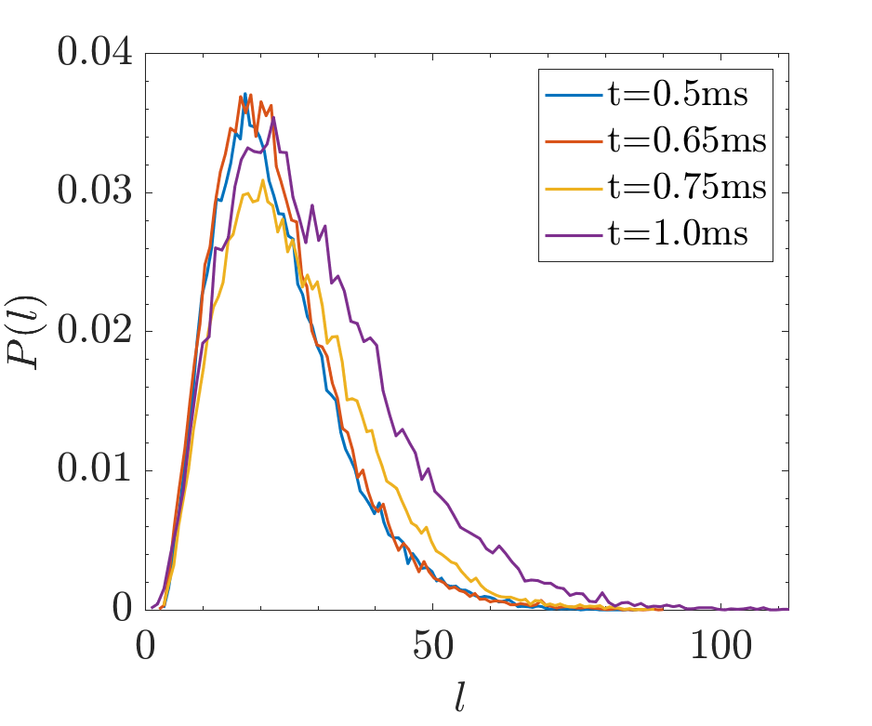
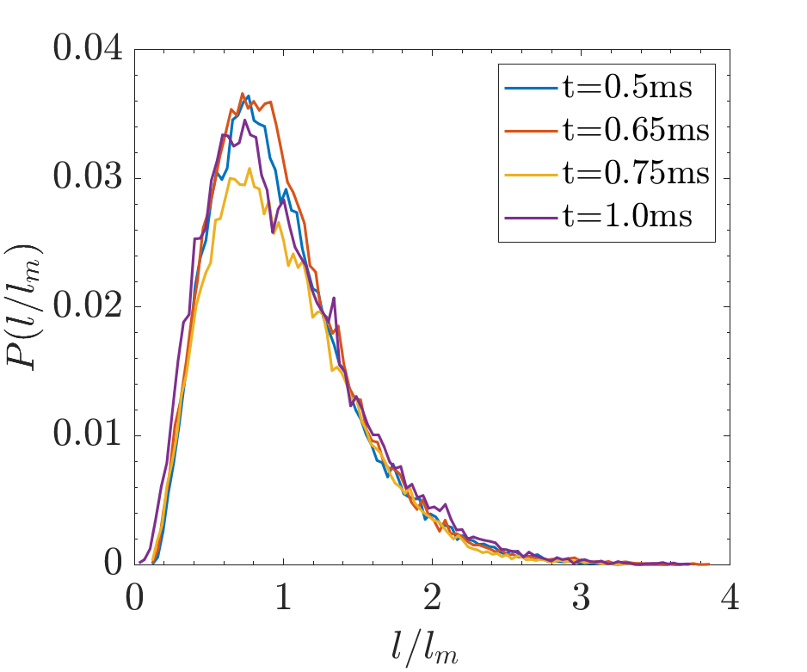
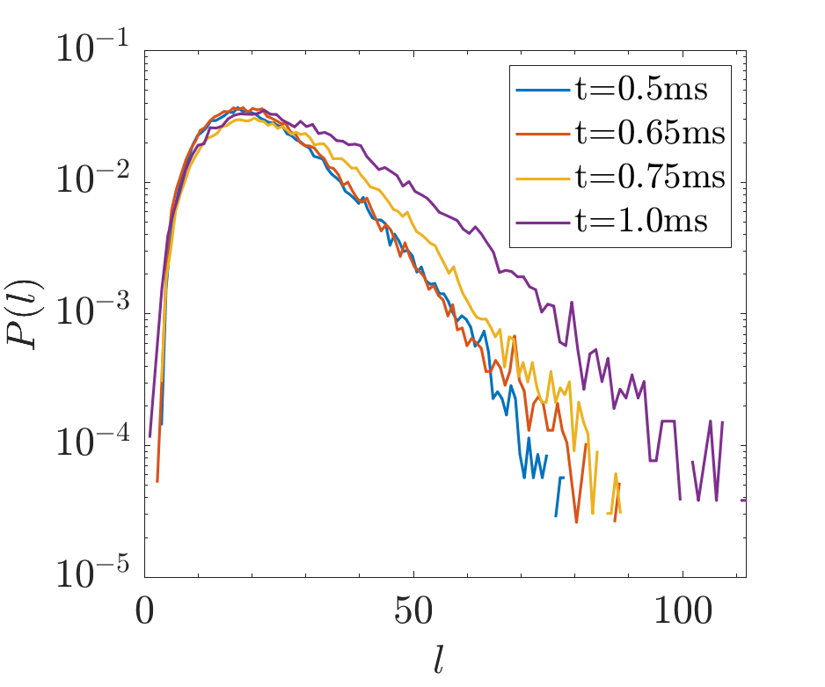
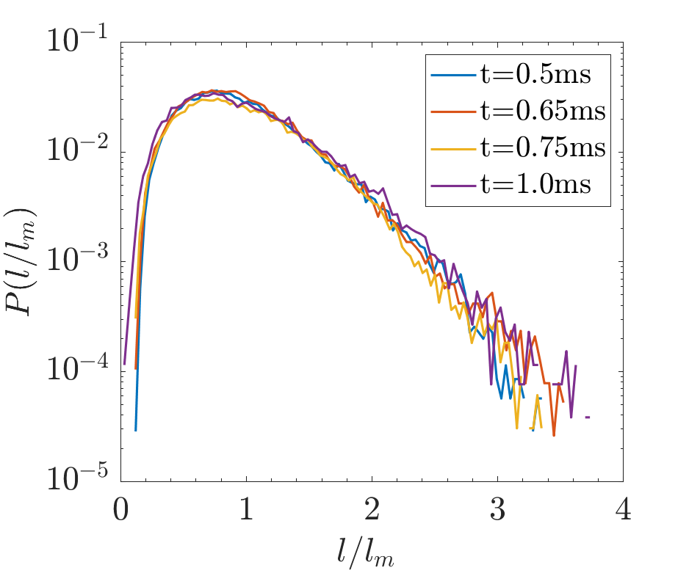
Dissipation element analysis
<number>

Slide 3
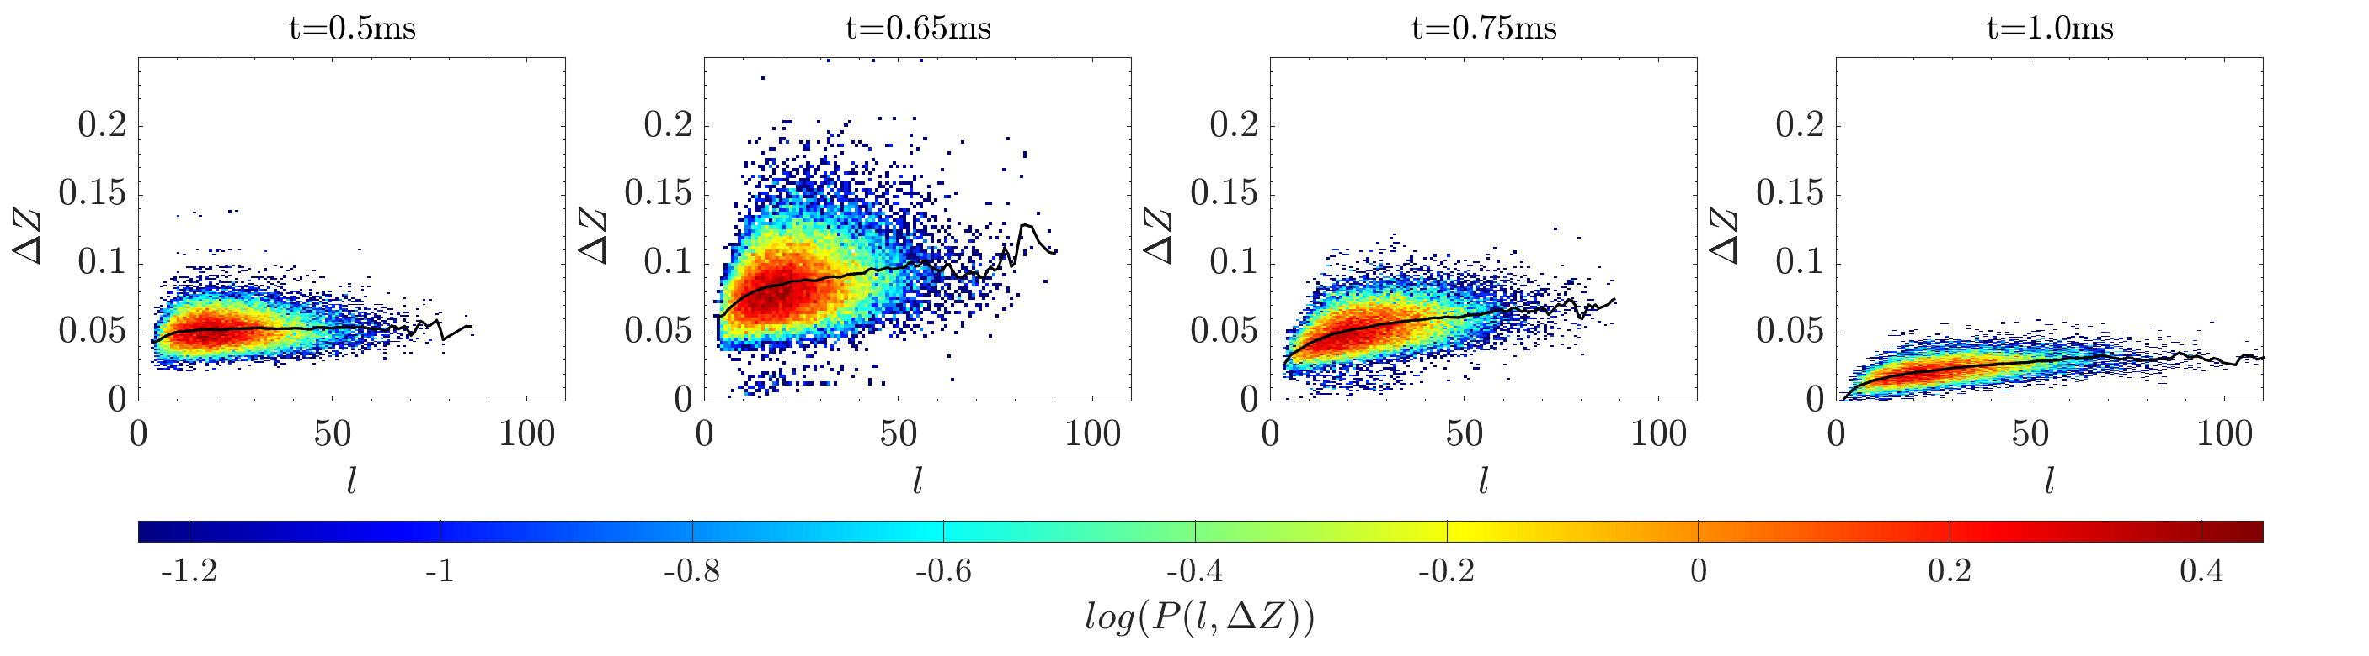
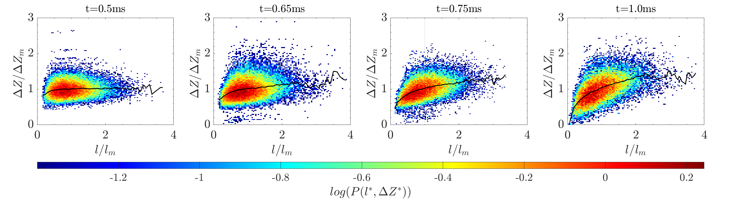
Dissipation element analysis
<number>

Slide 4
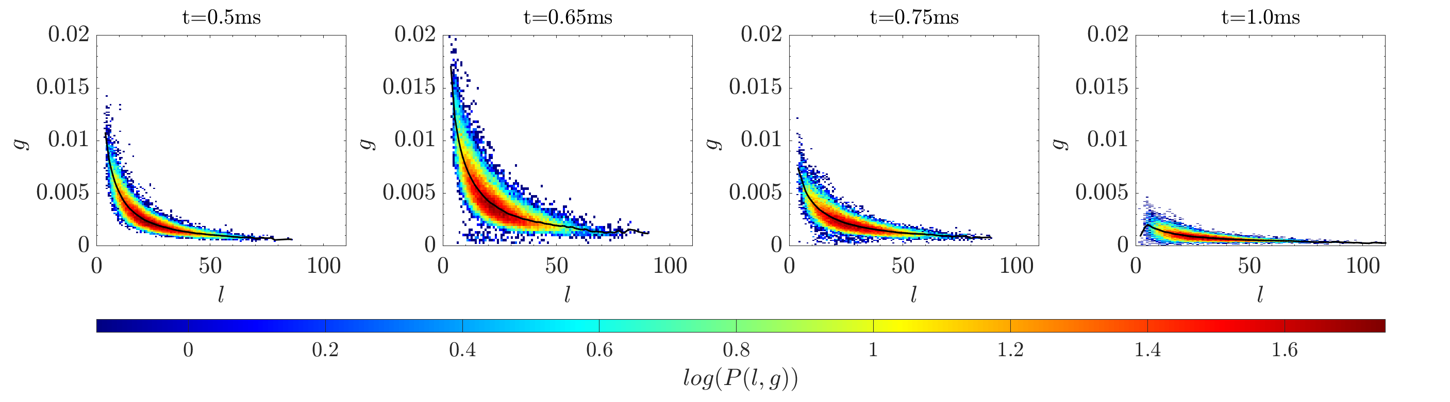
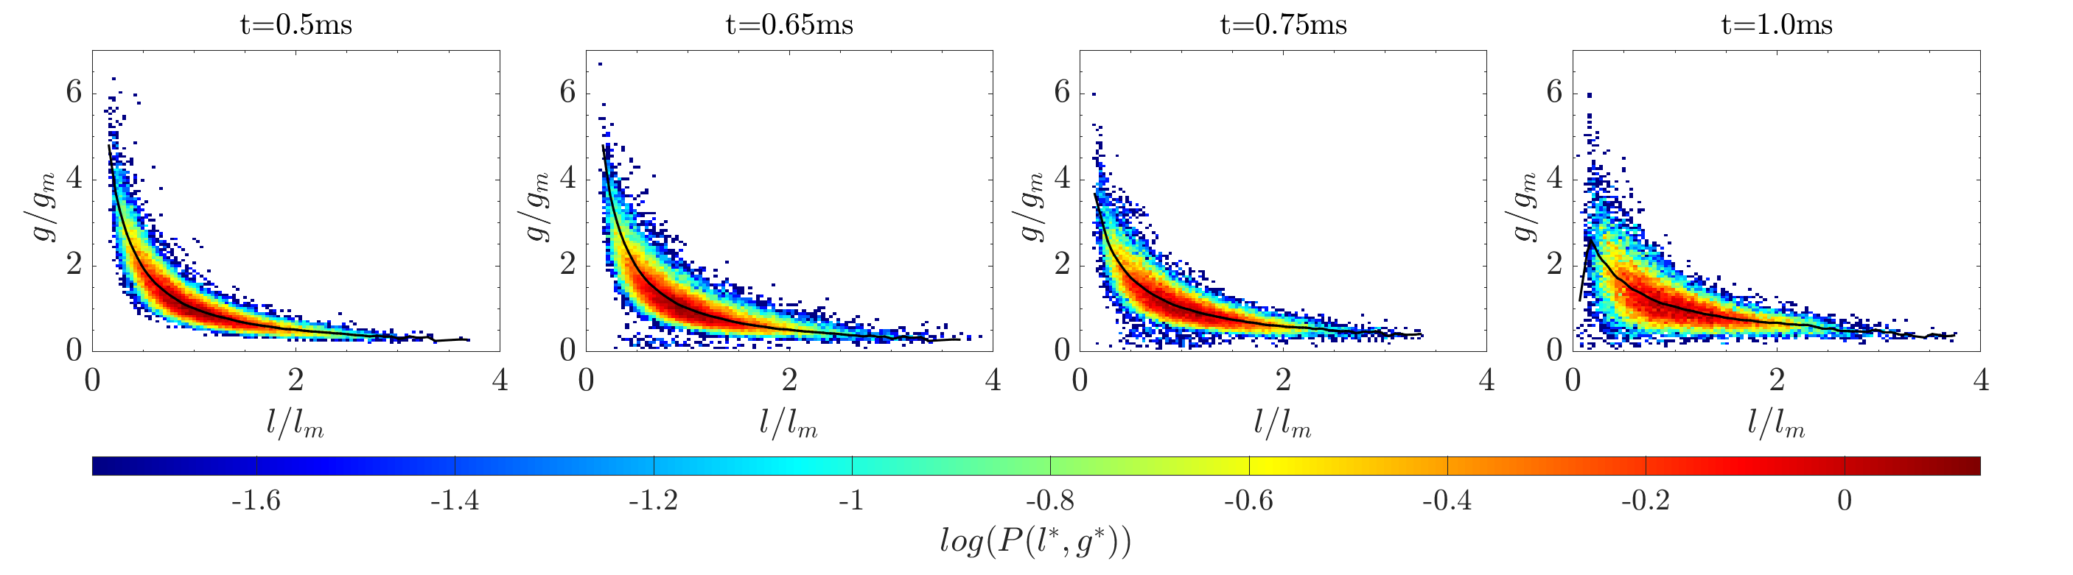
Dissipation element analysis
<number>

Slide 5
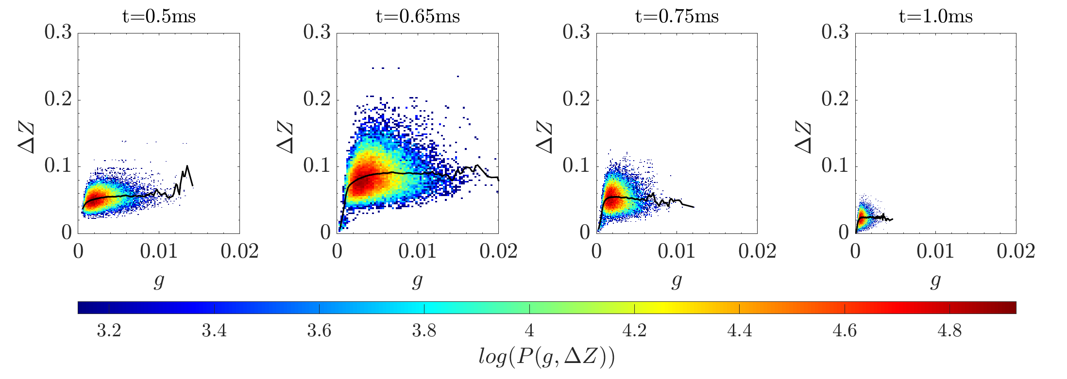
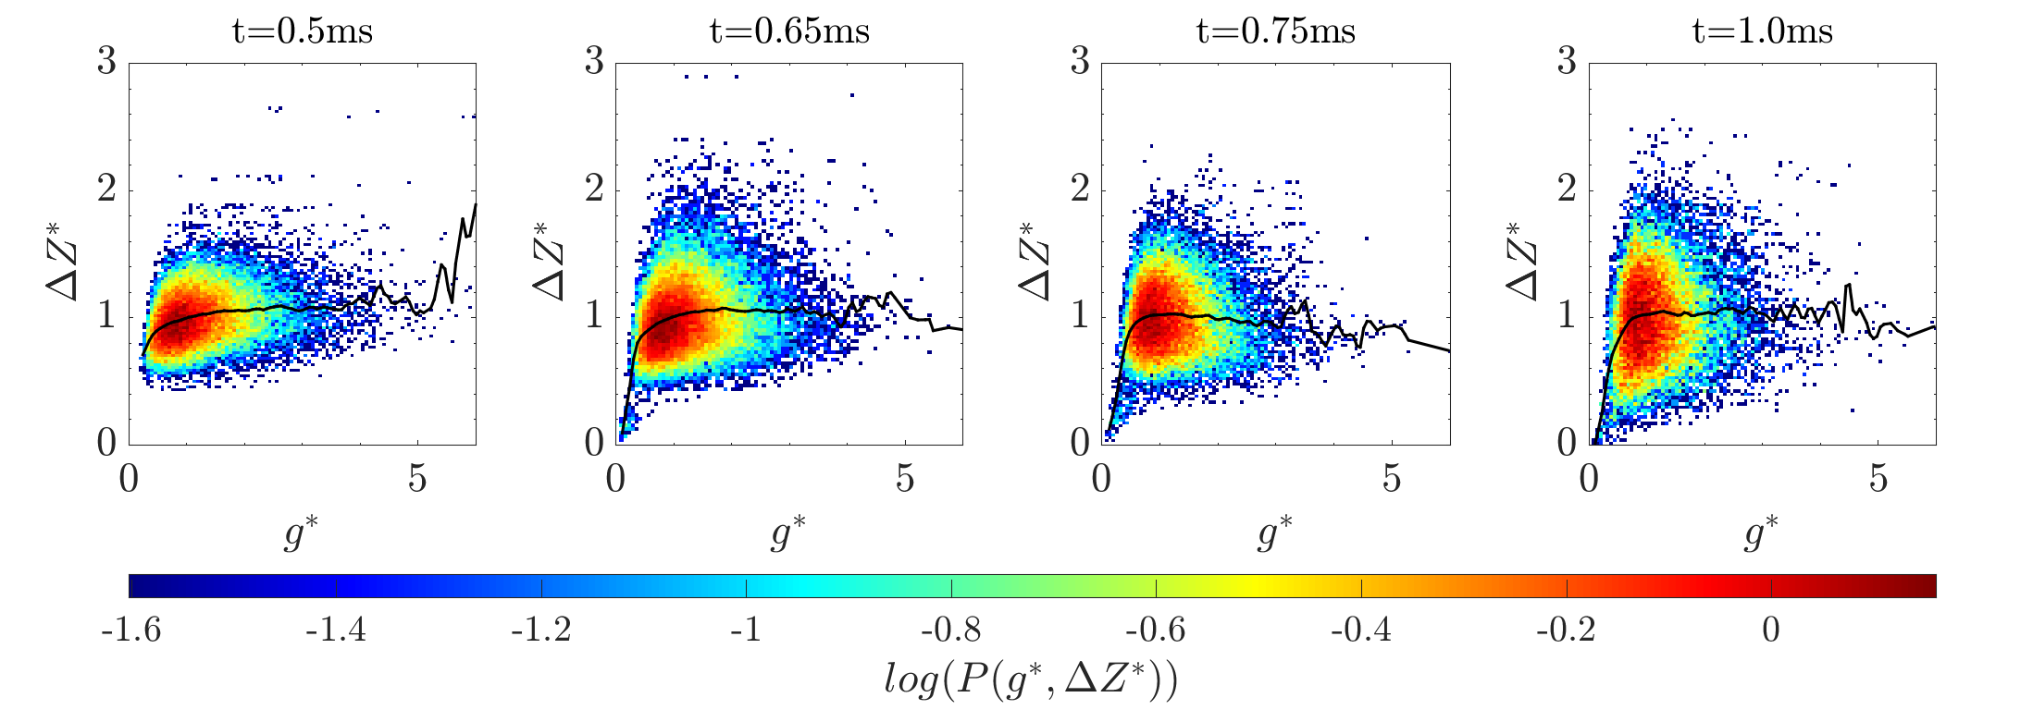
Dissipation element analysis
<number>

Slide 6
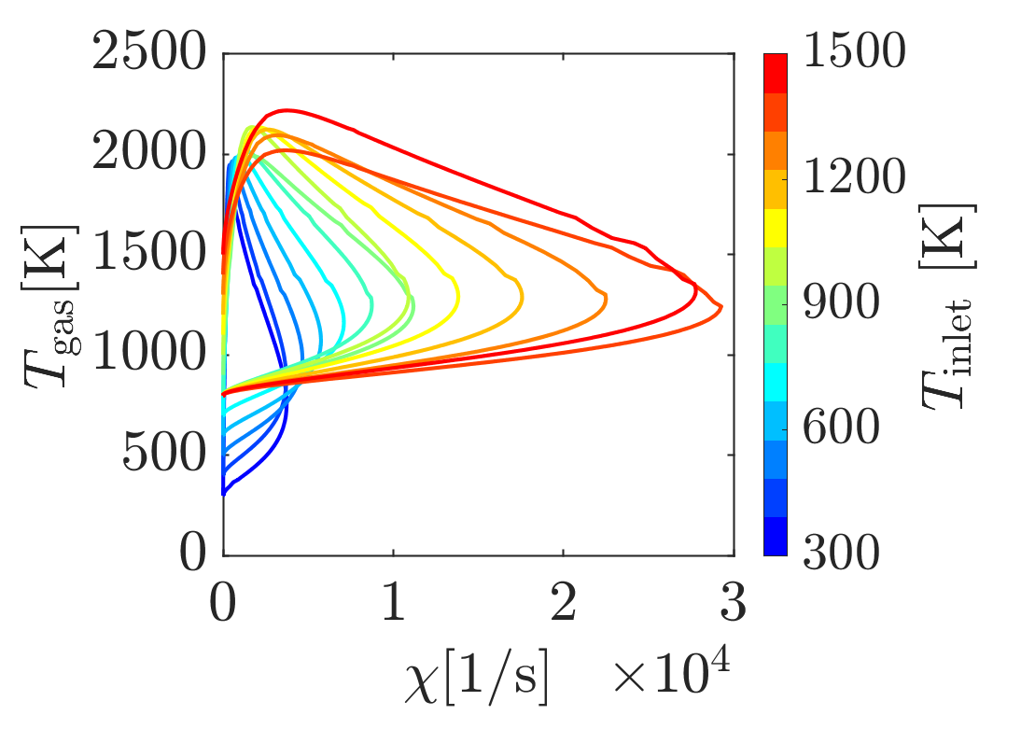
Quenching dissipation rate – flamelets (1400K is max)
<number>

Slide 7
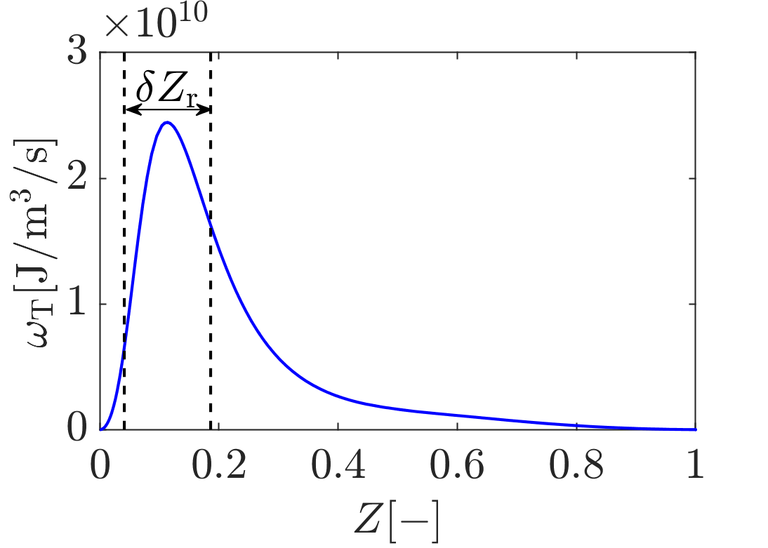
Reaction zone thickness – Flamelet (1400K)
<number>

Slide 8
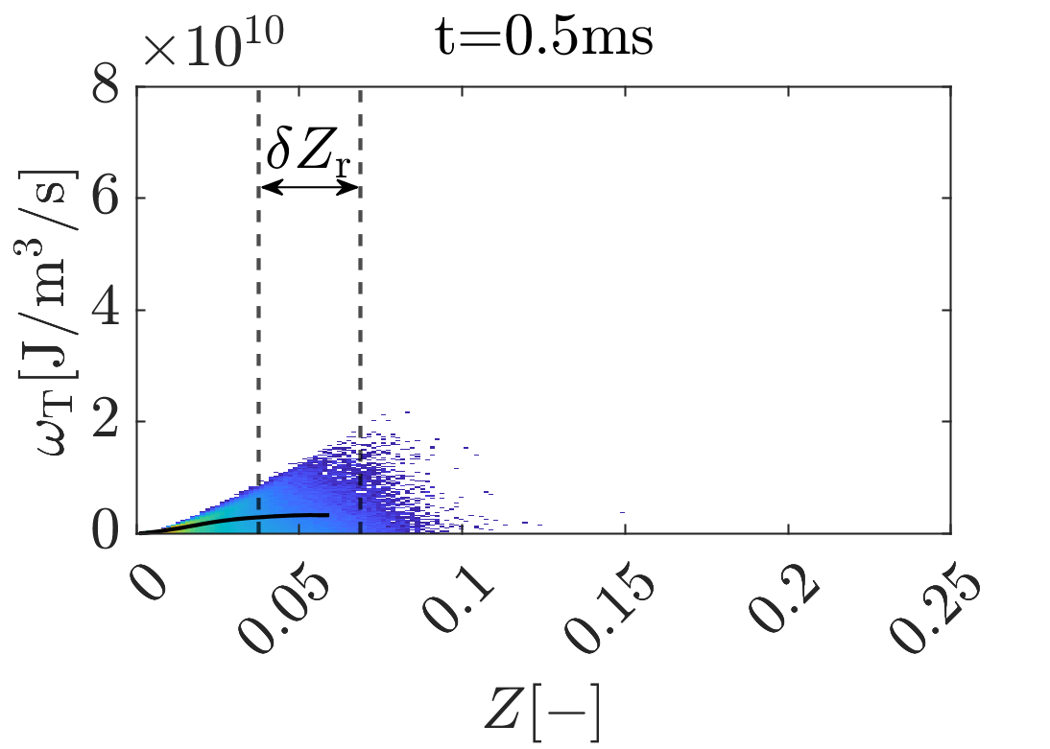
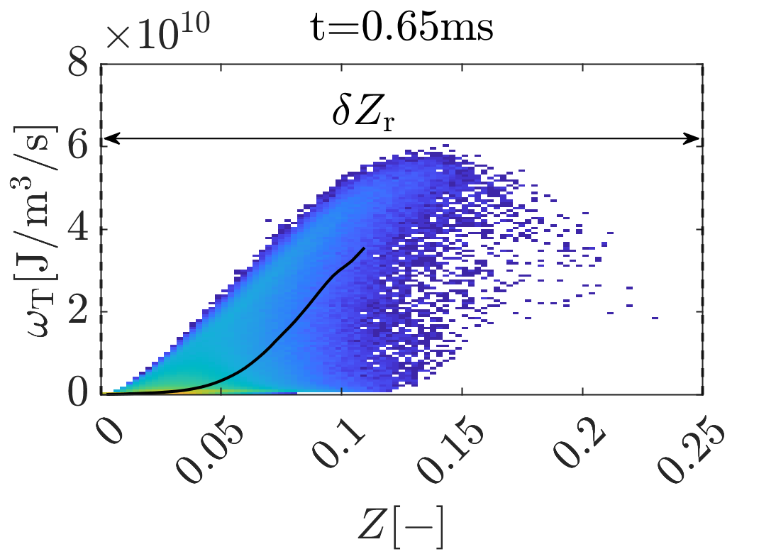
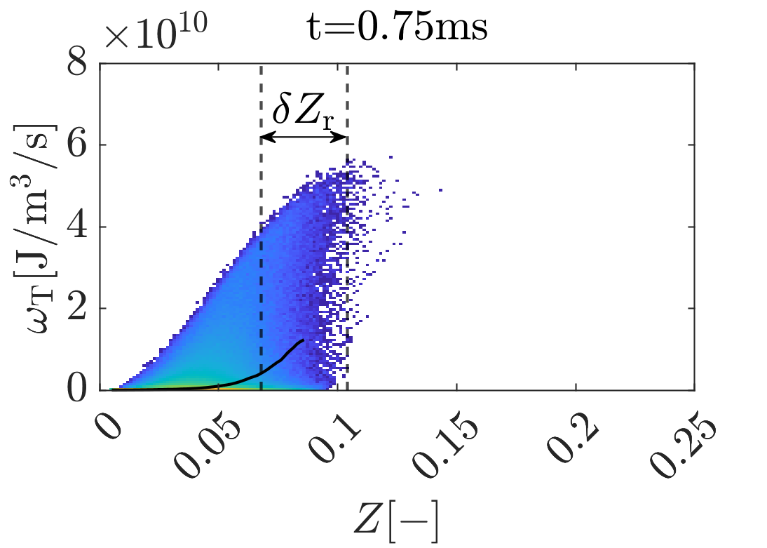
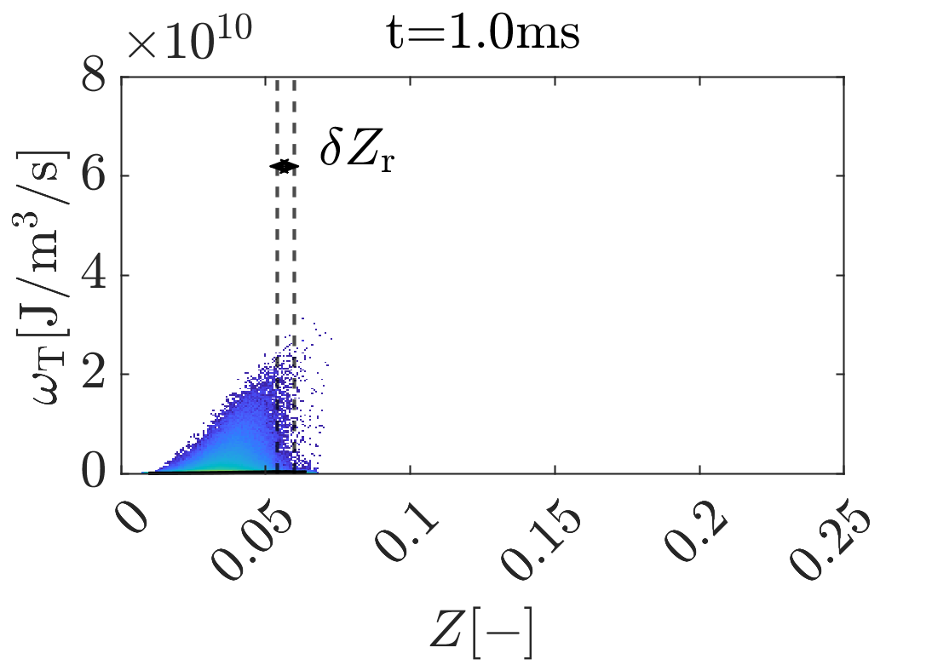
Reaction zone thickness based on conditional mean - DNS
<number>

Slide 9
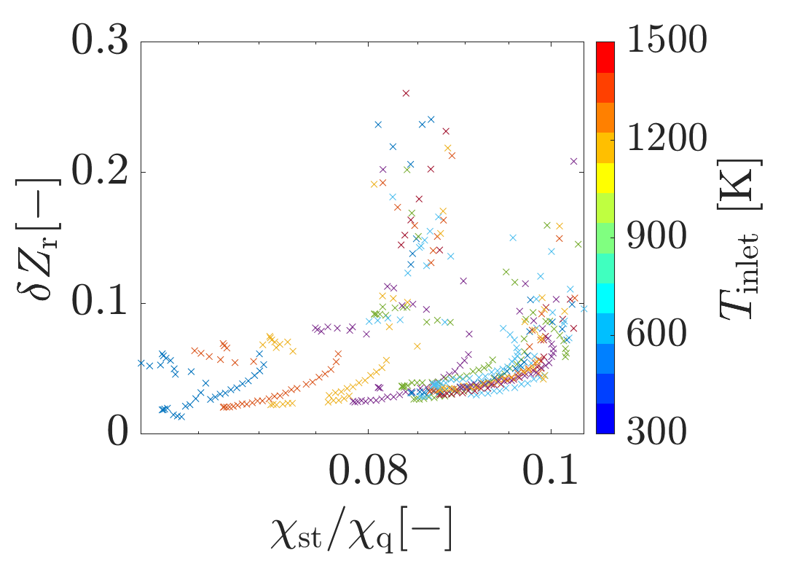
Reaction zone thickness over dissipation rate ratio - flamelets
<number>

Slide 10
Name of Presenter
Institute for Combustion Technology
RWTH Aachen University
http://www.itv.rwth-aachen.de

Slide 11
Univ.-Prof. Dr.-Ing. Heinz Pitsch
Institute for Combustion Technology
RWTH Aachen University
http://www.itv.rwth-aachen.de

