Slide 1
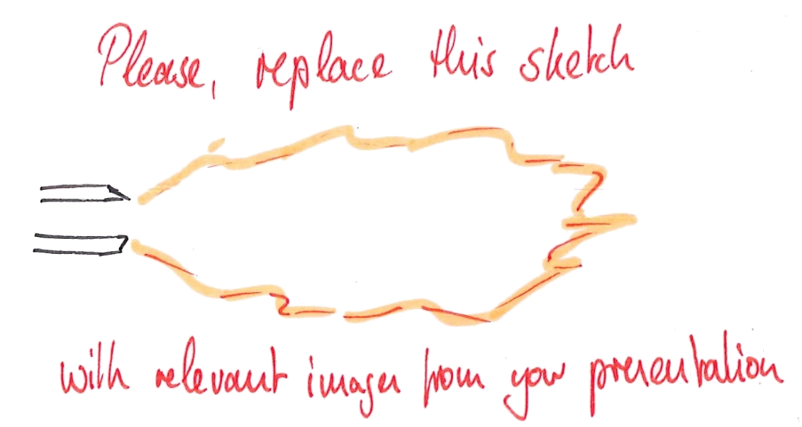
DNS meeting
Pooria Farmand
Institute for Combustion Technology RWTH Aachen University

Slide 2
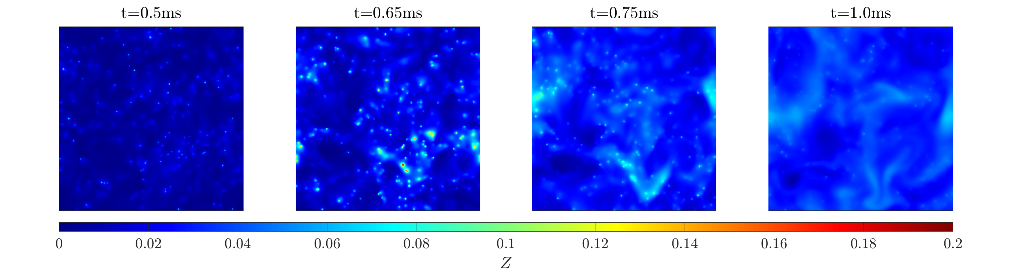
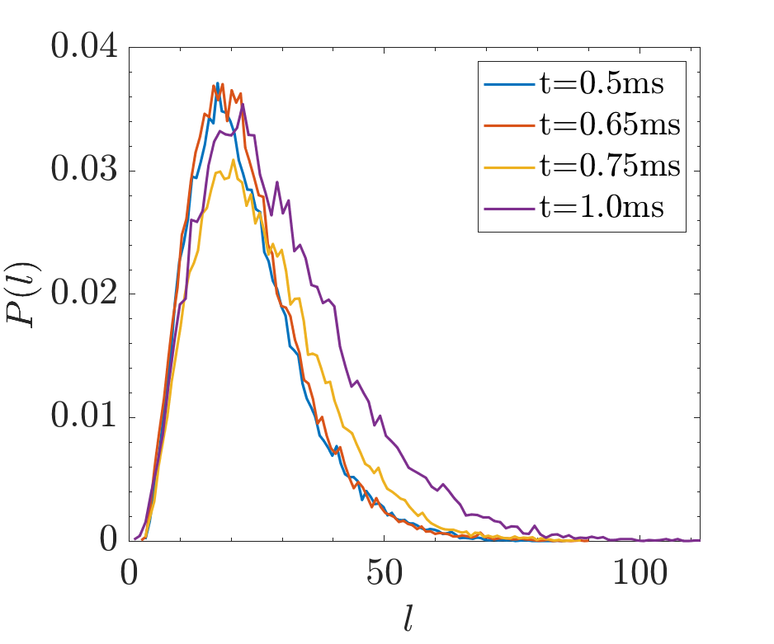
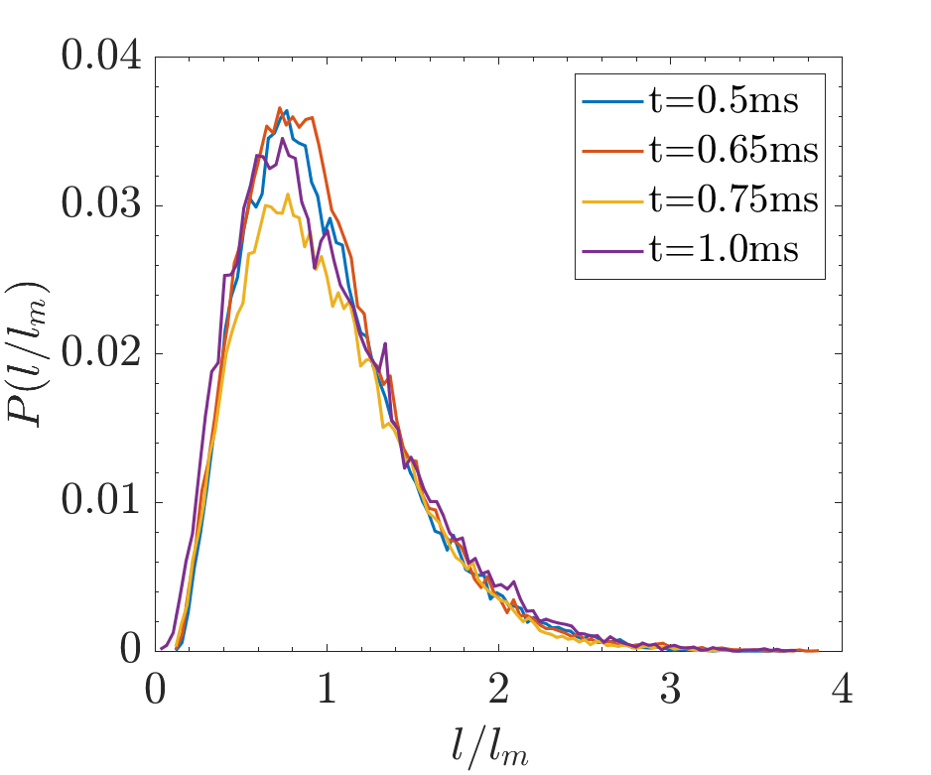
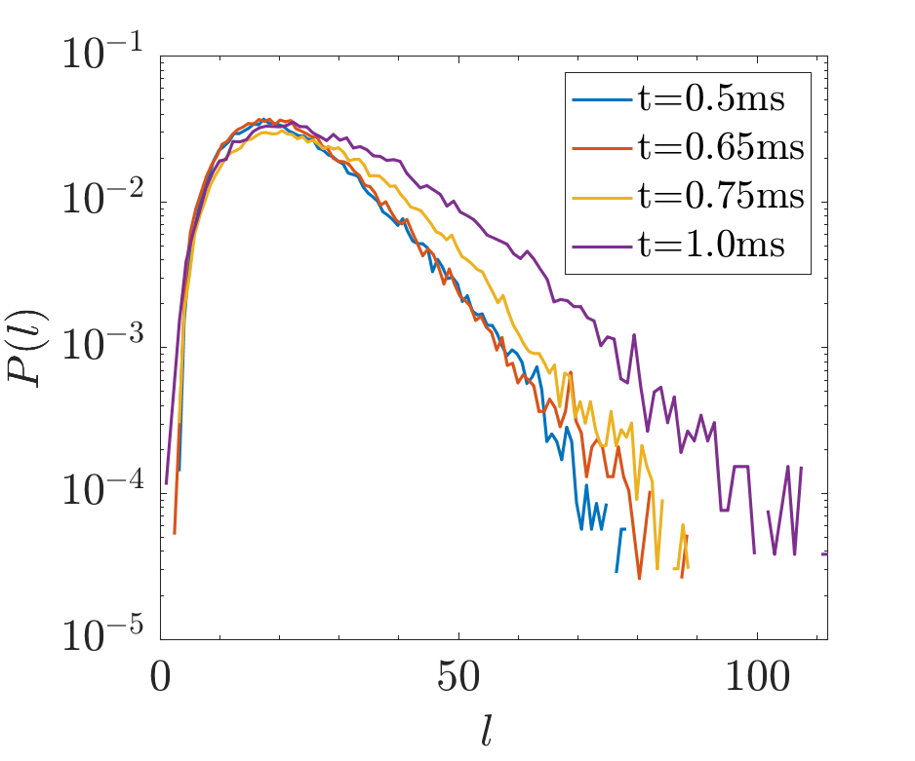
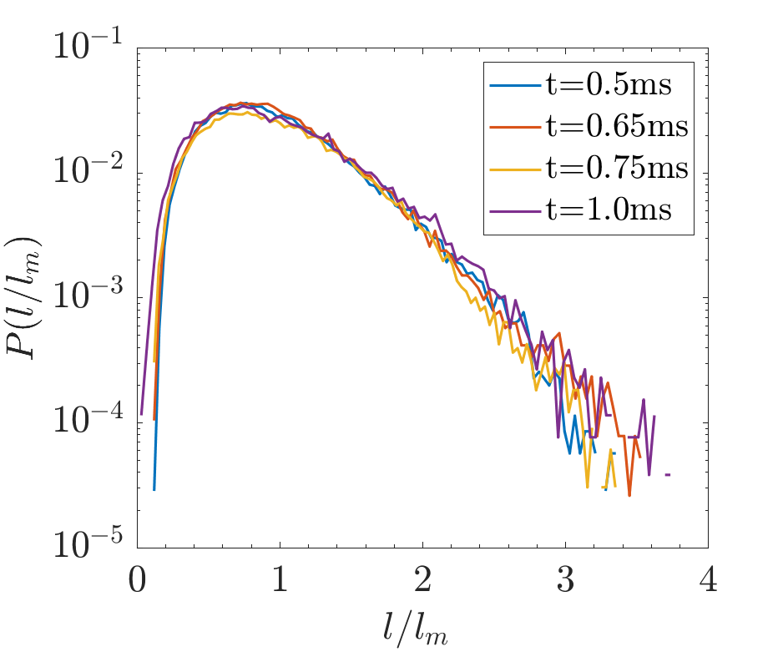
Dissipation element analysis
1

Slide 3
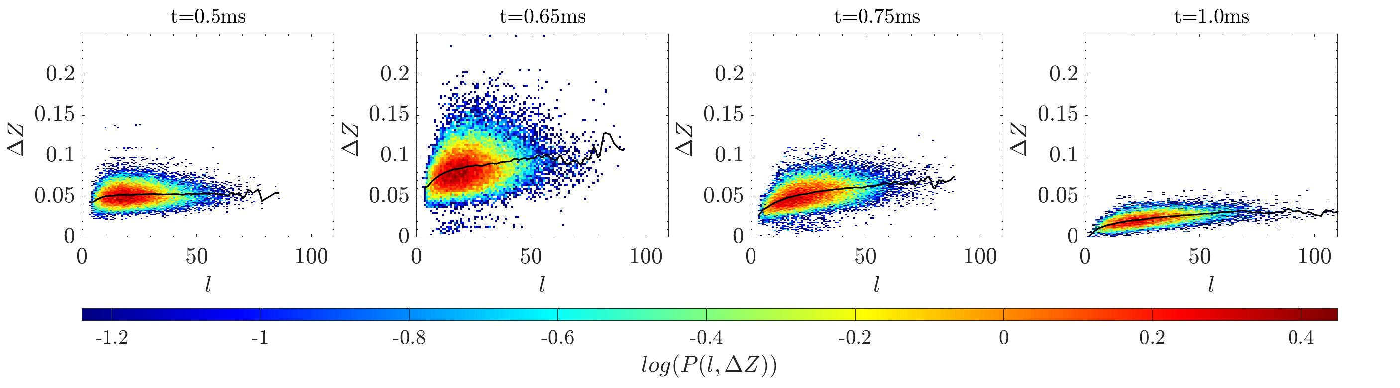
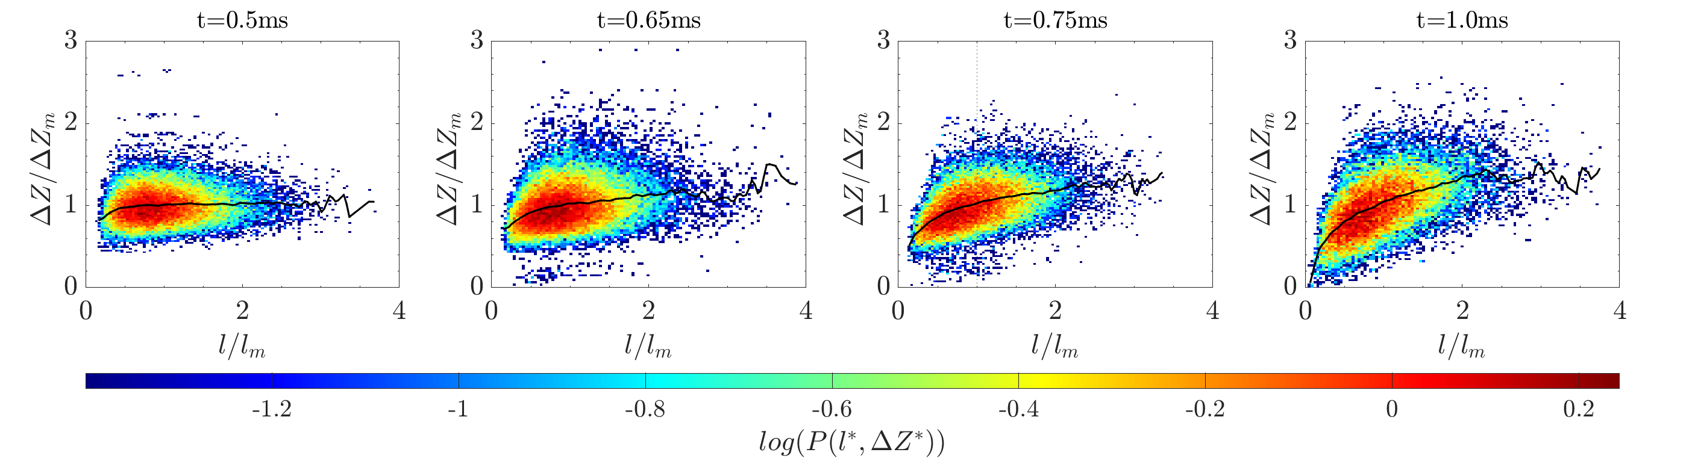
Dissipation element analysis
<number>

Slide 4
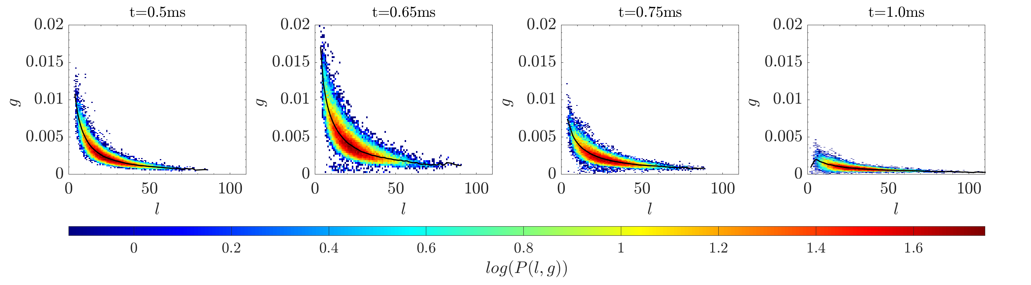
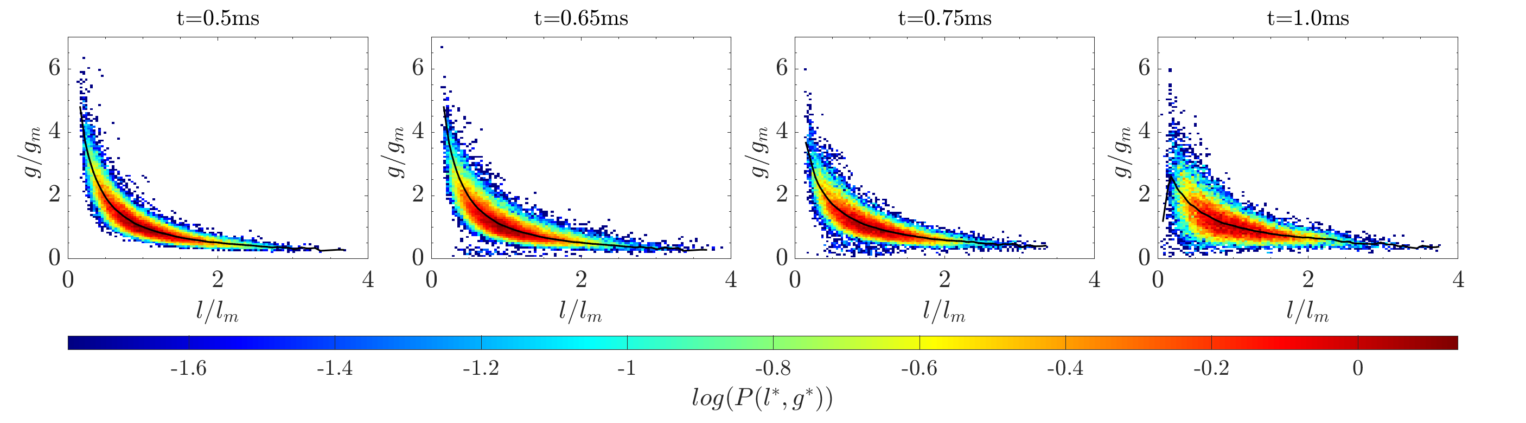
Dissipation element analysis
<number>

Slide 5
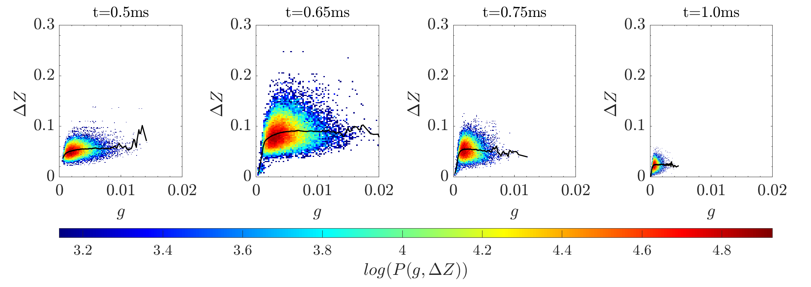
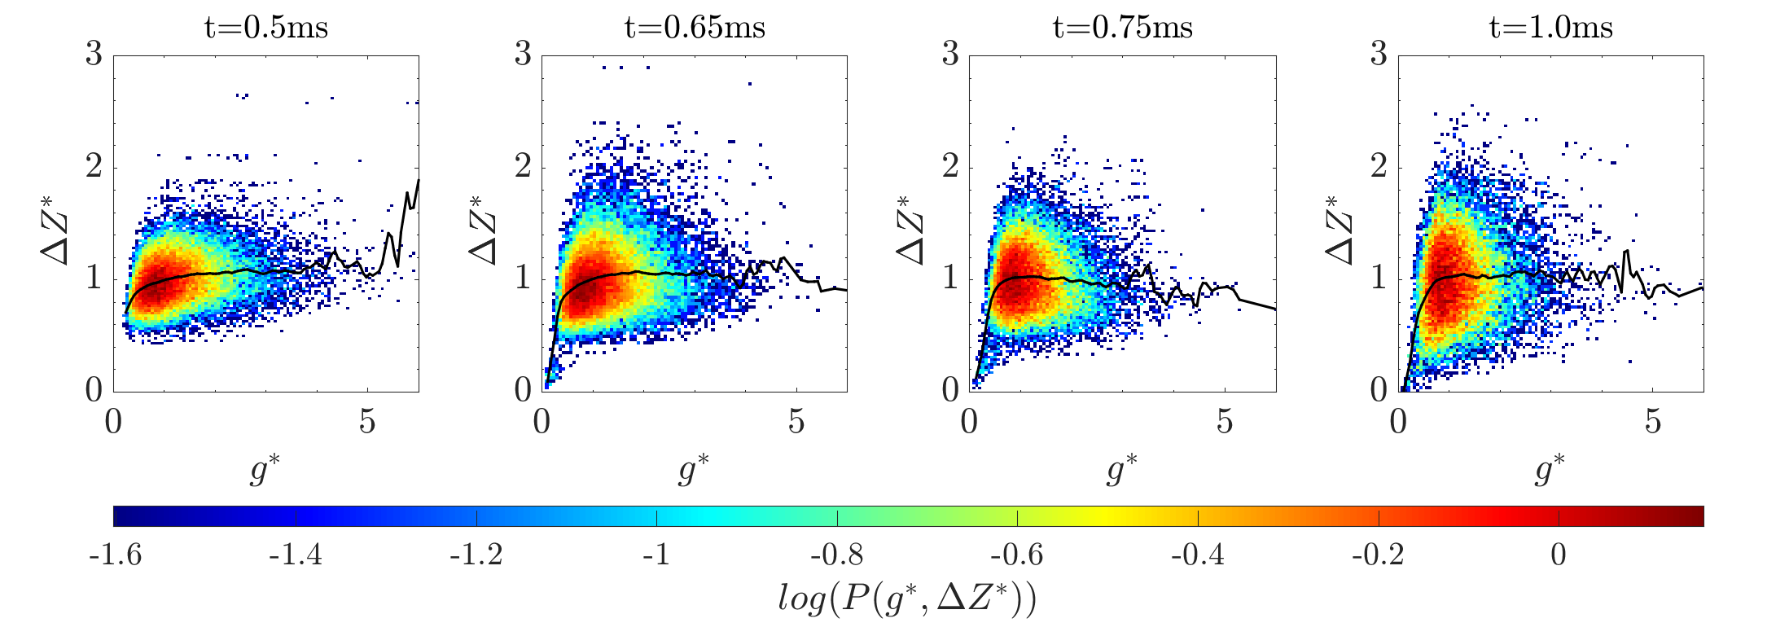
Dissipation element analysis
<number>

Slide 6
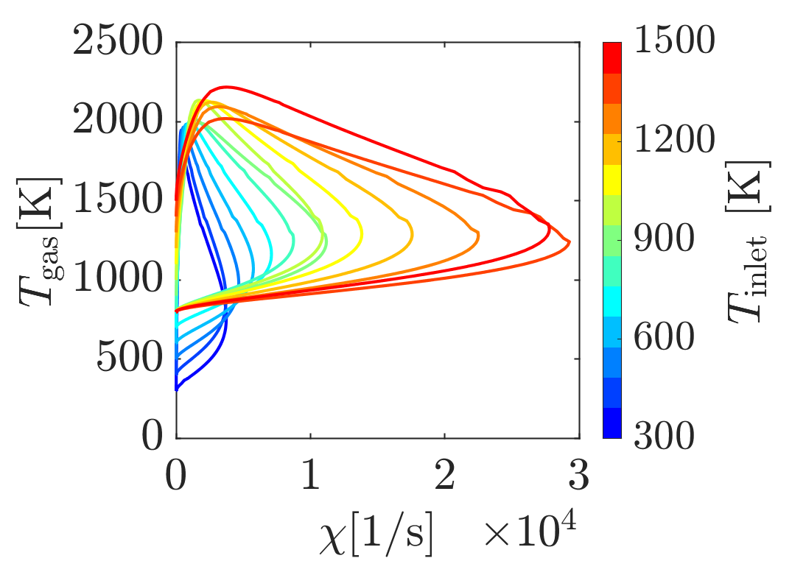
Quenching dissipation rate – flamelets (1400K is max)
Previous results
<number>

Slide 7
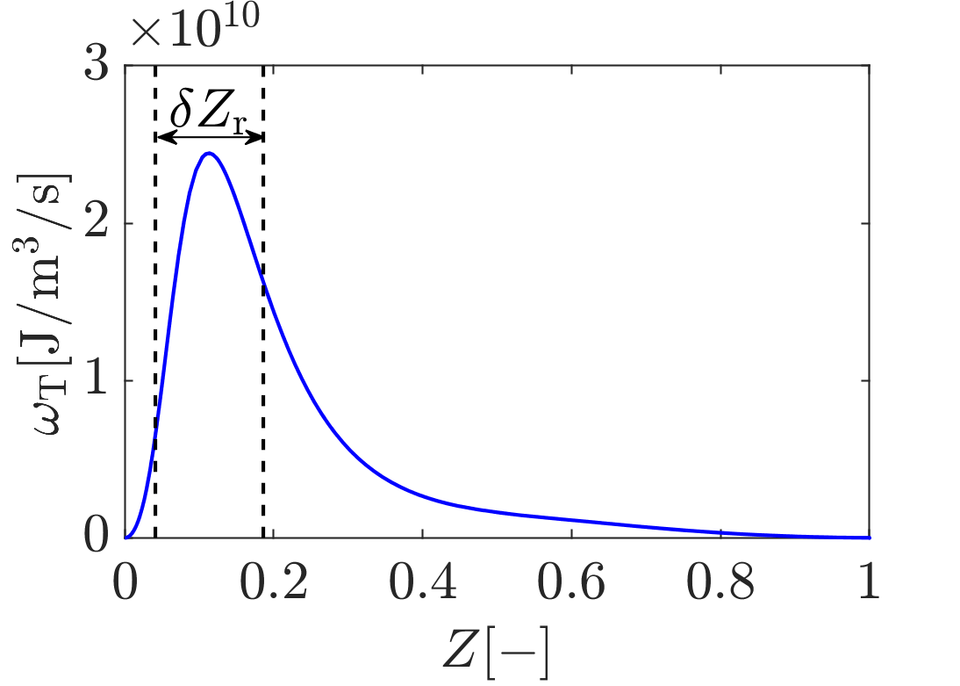
Reaction zone thickness – Flamelet (1400K)
Previous results
<number>

Slide 8
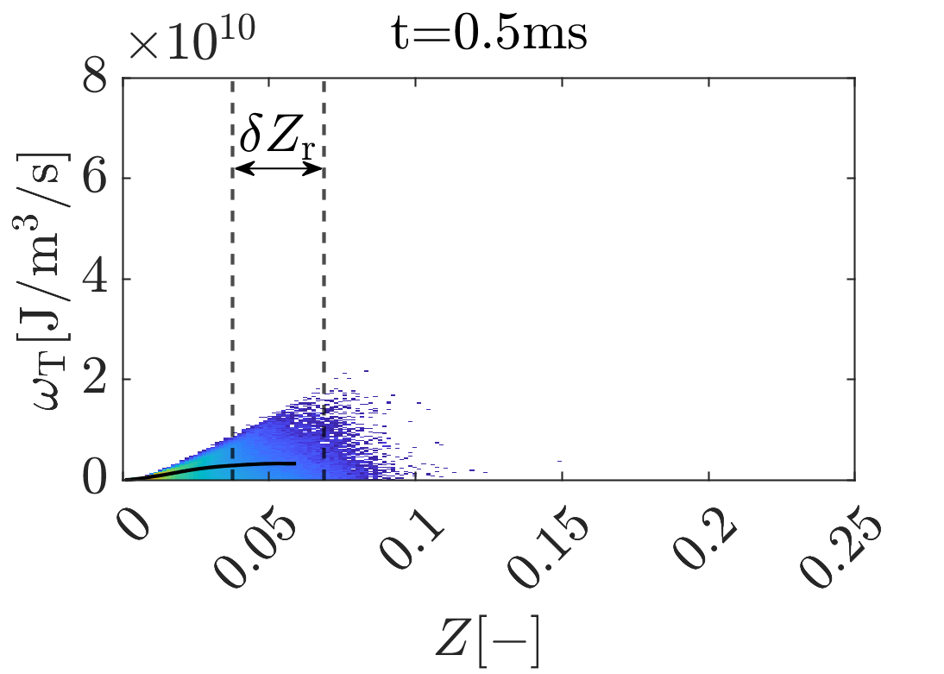
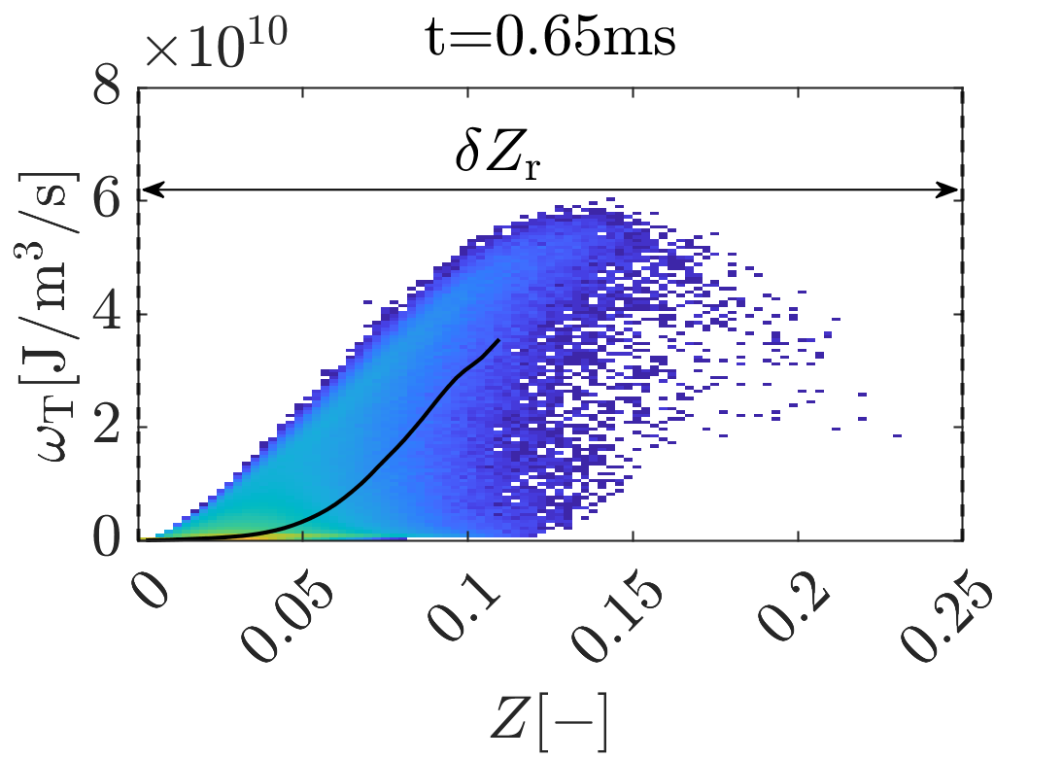
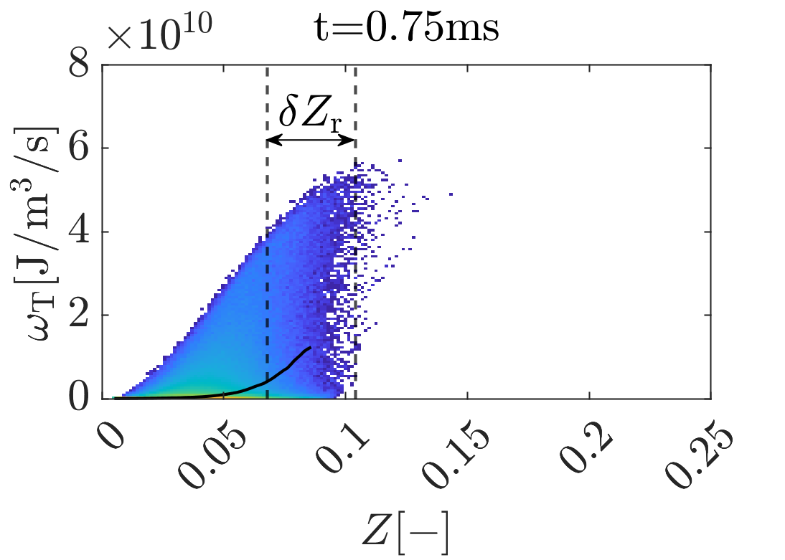
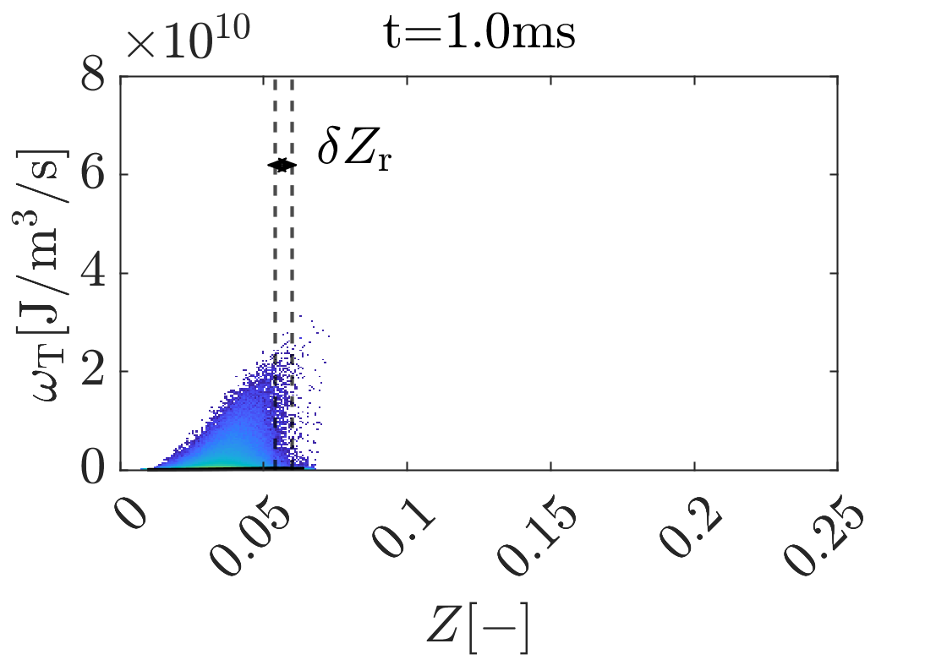
Reaction zone thickness based on conditional mean - DNS
Previous results
<number>

Slide 9
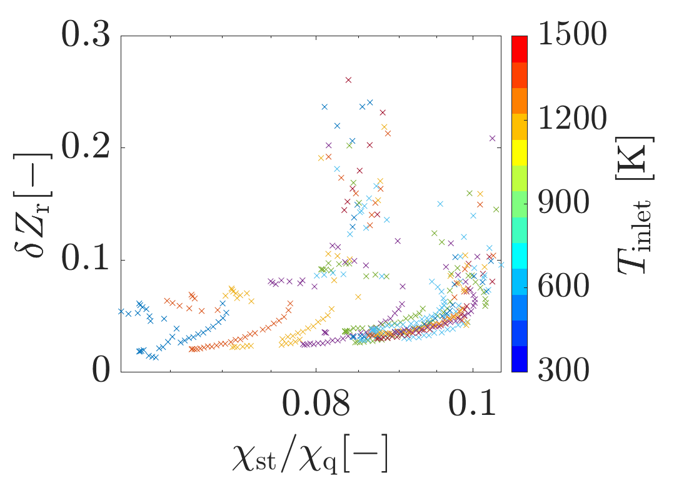
Reaction zone thickness over dissipation rate ratio - flamelets
Previous results
<number>

Slide 10
Regime diagram: boundary conditions
<number>

Slide 11
Regime diagram: Reaction-zone thickness
<number>

Slide 12
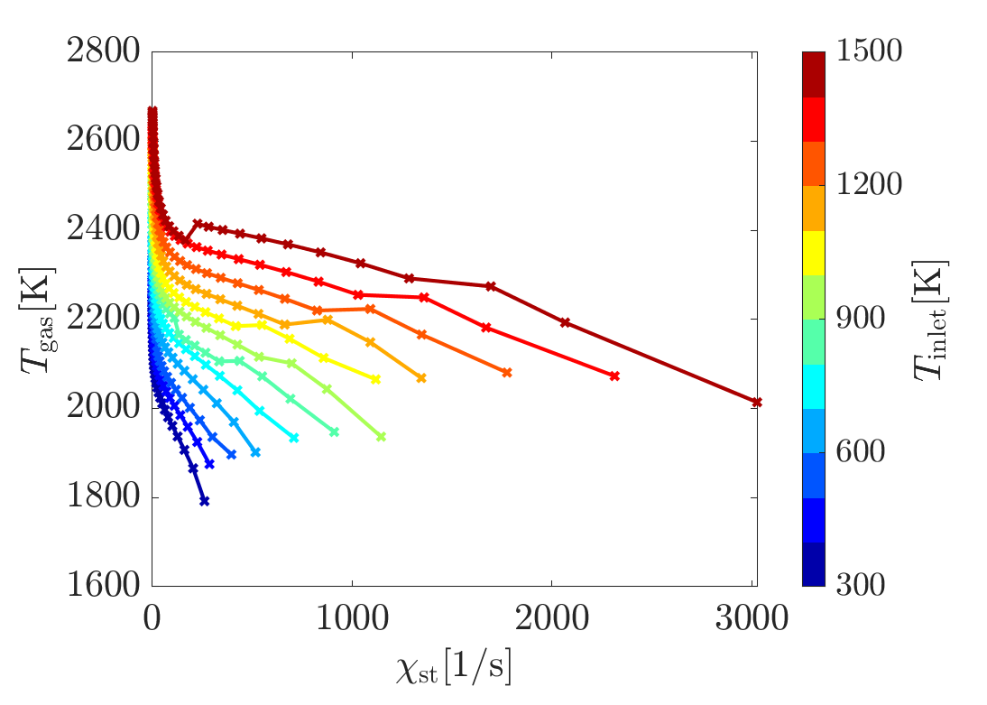
Regime diagram: quenching gradient
<number>

Slide 13
Regime diagram
<number>

Slide 14
Regime diagram
<number>

Slide 15
Regime diagram
<number>

Slide 16
Name of Presenter
Institute for Combustion Technology
RWTH Aachen University
http://www.itv.rwth-aachen.de

Slide 17
Univ.-Prof. Dr.-Ing. Heinz Pitsch
Institute for Combustion Technology
RWTH Aachen University
http://www.itv.rwth-aachen.de

