Slide 1


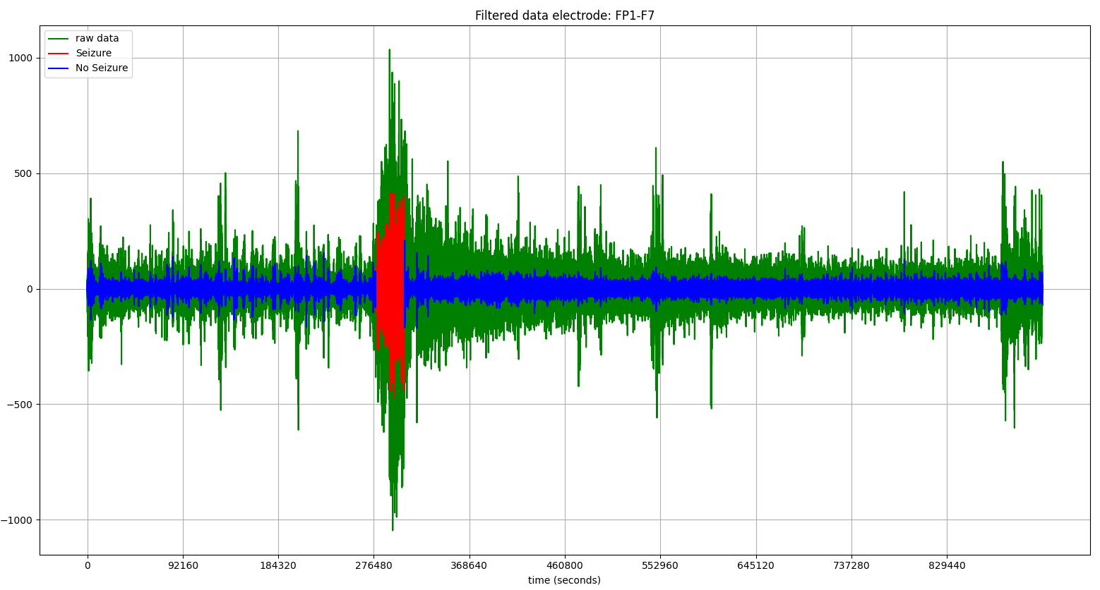
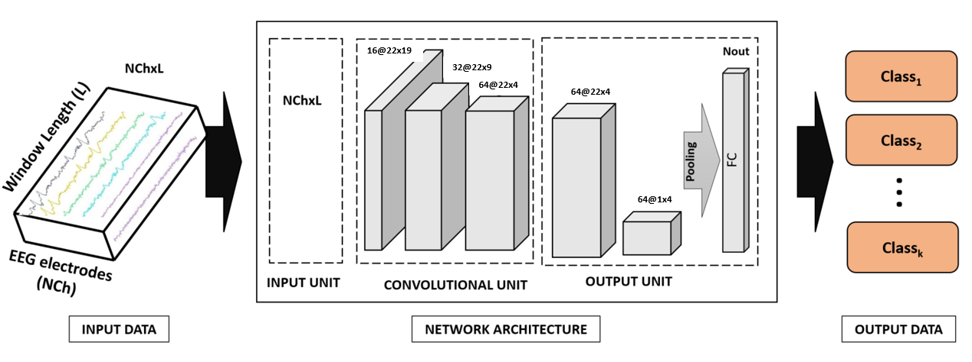


Recognition of epileptic seizures from EEG data
Christian Espinosa Reboredo
Treball Final de Grau
Curs 2021 - 2022
Enginyeria Informàtica - Menció Computació
INTRODUCTION
An electroencephalogram (EEG) is a test that detects electrical activity of the brain. This paper tries to go a step further to interpret seizures from electroencephalograms using deep learning algorithms. The data used in this paper is a public dataset CHB-MIT of recordings of pediatric subjects with intractable seizures. Different methods of data processing are done and documented to make the most of the algorithms used as well as the strategy. The objective is to train an algorithm to classify when the subject is having a seizure and when it is not.
Data Processing
Filtering
Data classification
Normalize
Results
Save
Labeling
Windowing
Formatting
Split
Train
Test
Plot results
OBJECTIVES
The main goal in this study is to detect seizures from the dataset CHB-MIT. To fulfil the objective an architecture has been created working within a pipeline of events. Starting by finding the best data analysis and processing method before feeding it to the deep learning algorithms. The main strategy of the scripts execute in sequence.
METHODOLOGY
All files have been filtered within a frequency bandwidth, labeled and windowed to input the models.
Data from subject 1 to 10 has been used to train the model, and data from 11 to 16 has been used to test the accuracy of the predictions of the model. For every file 50 epochs have been done to ensure a good understanding from the model of the data.
FUTURE WORK
For future work it would be strictly necessary first of all, to change the windowing function setting the windows files. I would also consider adding a weighted cross entropy loss to avoid so much one-sided data, for the model to learn more uniformly. This is an ongoing project, so further study and other models will be added to test the capabilities of the scripts. Assuming the model works as it should, getting the right processed data would be enough to have a consistent result.
RESULTS
The data from the dataset has been labeled, filtered and classified correctly except for the windowing. The models accept and classify data from the input.
Tutor: Aura Hernandez Sabaté
Departament: Departament d’Enginyeria de la informació de les Comunicacions

