Slide 1
Recognition of epileptic seizures from EEG data
Christian Espinosa

Slide 2
Seizure Recognition
Motivation

Slide 3
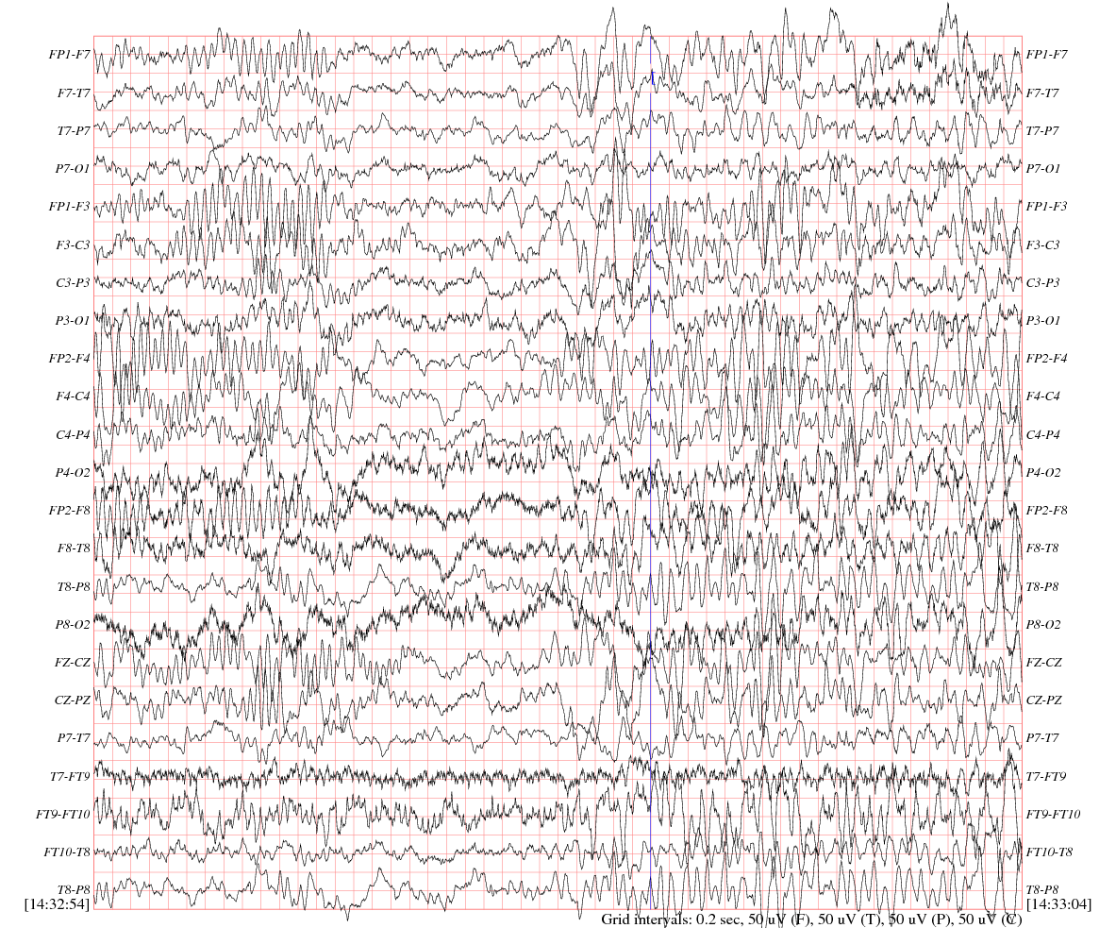
What is a EEG?
Seizure Recognition
Electroencephalogram

Slide 4
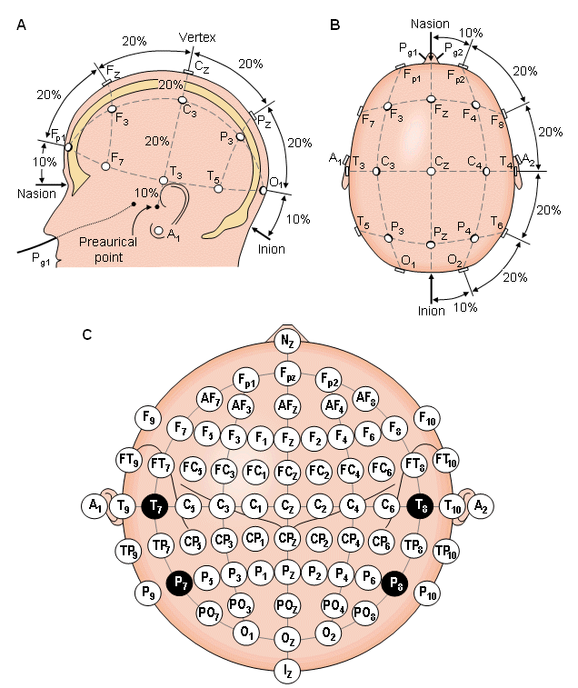
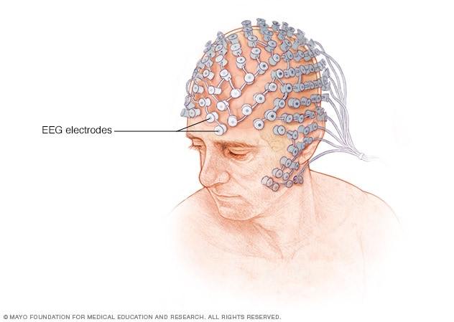
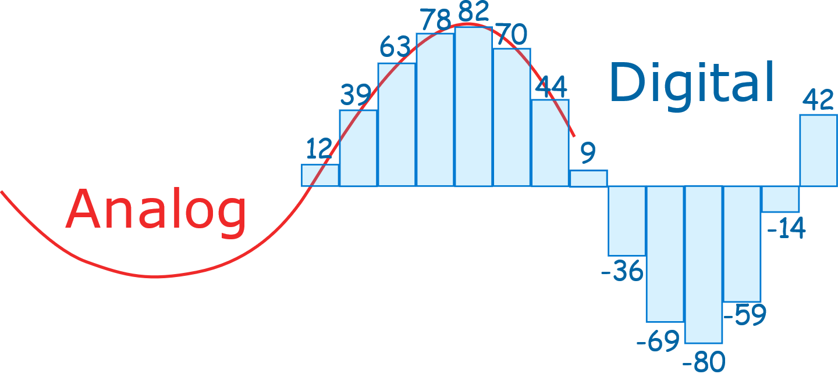
International 10-20 system
Electrode 1: data . . .
Electrode 2: data . . .
Electrode 3: data . . .
Electrode 4: data . . .
Electrode 5: data . . .
.
.
.
FP1-F7: data . . .
F7-T7: data . . .
T7-P7: data . . .
P7-O1: data . . .
FP1-F3: data . . .
.
.
.

Slide 5
CHB-MIT Scalp EEG Database
23 cases
9 to 42 .edf files
256Hz, 16bit resolution
22 electrodes
1 to 4 hours long
Interruptions

Slide 6

Pipeline
Data Processing
Filtering
Data classification
Normalize
Results
Save
Labeling
Windowing
Formatting
Split
Train
Test
Plot results

Slide 7
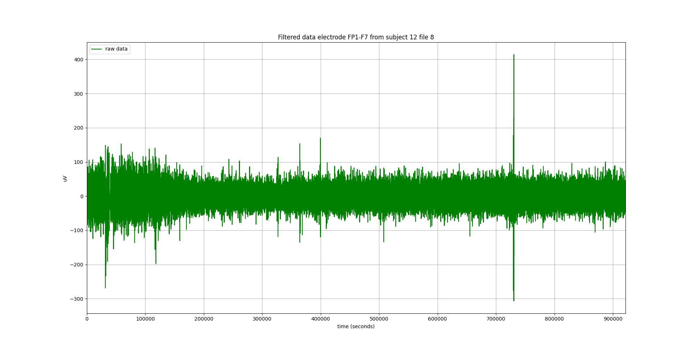
Data processing
0
(hours)
1

Slide 8
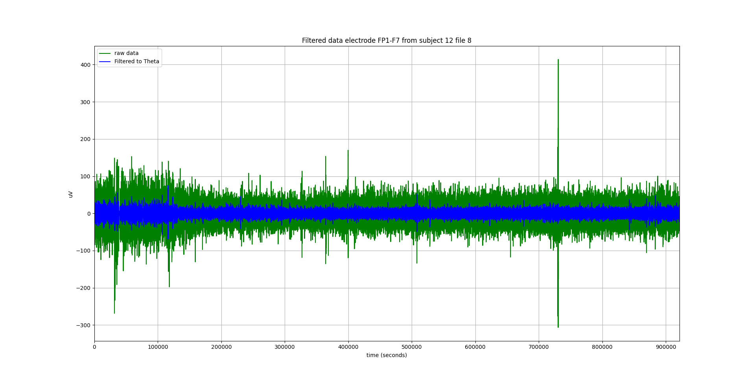
Data processing
Butter band pass filter: Theta 4Hz – 8Hz
0
(hours)
1

Slide 9

Data processing
0
(hours)
1

Slide 10
Data processing
Filtering
Labeled data in parquet
Windowed data in numpy
Modular code
data_x
n_windows
electrodes
values
data_y
num_seizure_window
window_seizure

Slide 11
Pipeline
Data Processing
Filtering
Data classification
Normalize
Results
Save
Labeling
Windowing
Formatting
Split
Train
Test
Plot results

Slide 12
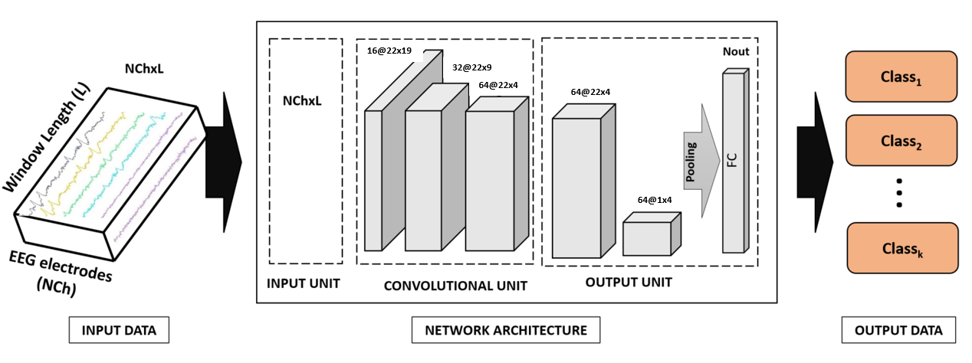
Data classification
Model CNN ProjOut Conv

Slide 13
Data classification
Execution modes
Check model
Train
Test

Slide 14

Data classification
Execution modes
Check model
Train
Test
cuda

Slide 15

Data classification
Execution modes
Check model
Train
Test
torch.rand

Slide 16
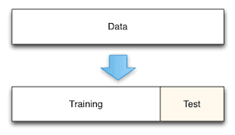
Data classification
Execution modes
Check model
Train
Test
From 1 to 10 case
0% to split

Slide 17
Data classification
Execution modes
Check model
Train
Test
From 11 to 16 case
100% to split

Slide 18
Data classification
Execution modes
Check model
Train
Test
Normalization
Get Scalers

Slide 19
Pipeline
Data Processing
Filtering
Data classification
Normalize
Results
Save
Labeling
Windowing
Formatting
Split
Train
Test
Plot results

Slide 20
Results
 | 0 | Accuracy
Precision | 1,0 | 1,0
Recall | 1,0 | 1,0
support | 360.0 | 1,0
Results From Subject Chb14 File 11

Slide 21
Results
 | 0 | 1 | Accuracy
Precision | 0,983 | 0,0 | 0,983
Recall | 1,000 | 0,0 | 0,994
F1-score | 0,997 | 0,0 | 0,994
Support | 358.00 | 2,0 | 0,994
Results From Subject Chb14 File 6

Slide 22
Results
 | 0 | 1 | Accuracy
Precision | 0,983 | 0,0 | 0,983
Recall | 1,000 | 0,0 | 0,994
F1-score | 0,997 | 0,0 | 0,994
Support | 358.00 | 2,0 | 0,994
 | 0 | Accuracy
Precision | 1,0 | 1,0
Recall | 1,0 | 1,0
support | 360.0 | 1,0
Results From Subject Chb14 File 11
Results From Subject Chb14 File 6

Slide 23
Results
No Seizure
Seizure
 | 0 | 1 | Accuracy
Precision | 0,983 | 0,0 | 0,983
Recall | 1,000 | 0,0 | 0,994
F1-score | 0,997 | 0,0 | 0,994
Support | 358.00 | 2,0 | 0,994
 | 0 | Accuracy
Precision | 1,0 | 1,0
Recall | 1,0 | 1,0
support | 360.0 | 1,0
Results From Subject Chb14 File 11
Results From Subject Chb14 File 6

Slide 24
Conclusions
Results
Inconsistent data processing
Add normalization to data processing
Different strategies
Data Processing
Filtering
Data classification
Split
Results
Save
Labeling
Windowing
Formatting
Train
Test
Plot results
Normalize

Slide 25
Thank you for your attention
Any Questions?

