Slide 1
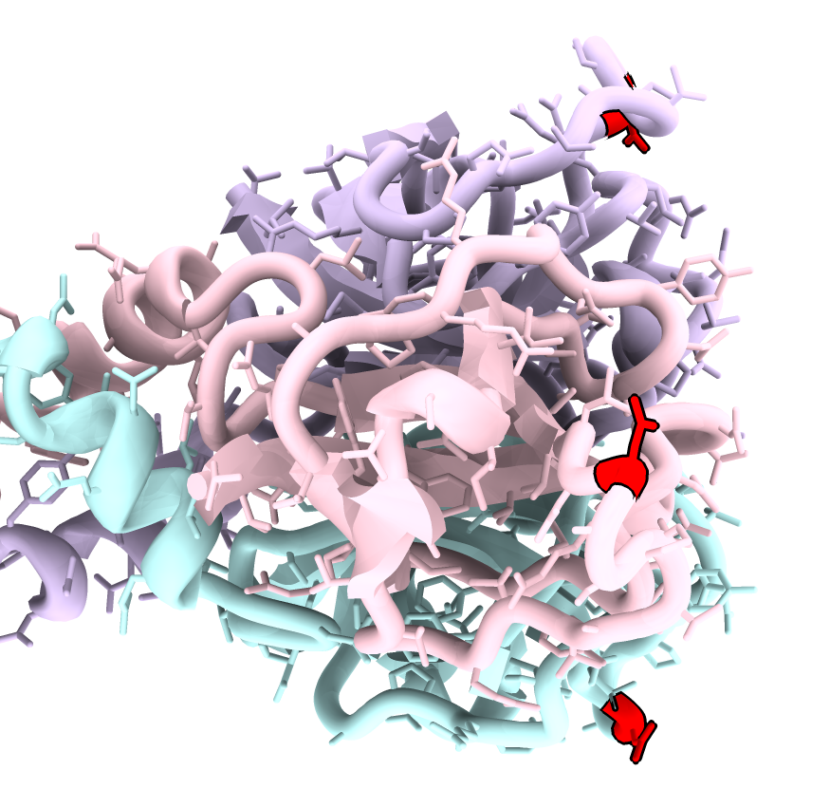
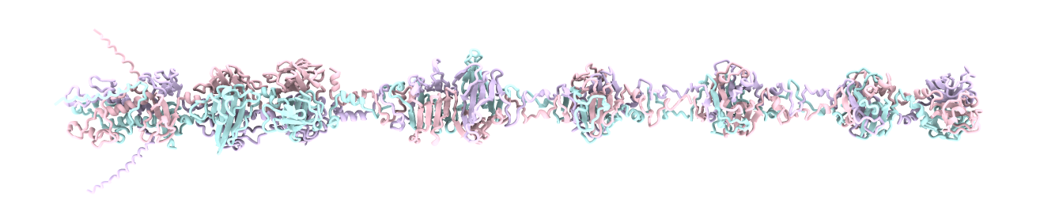
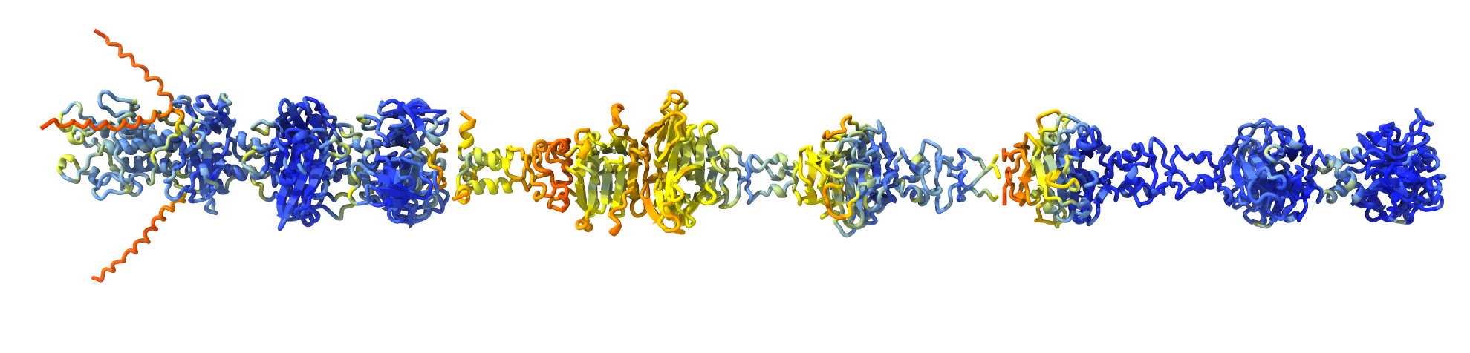
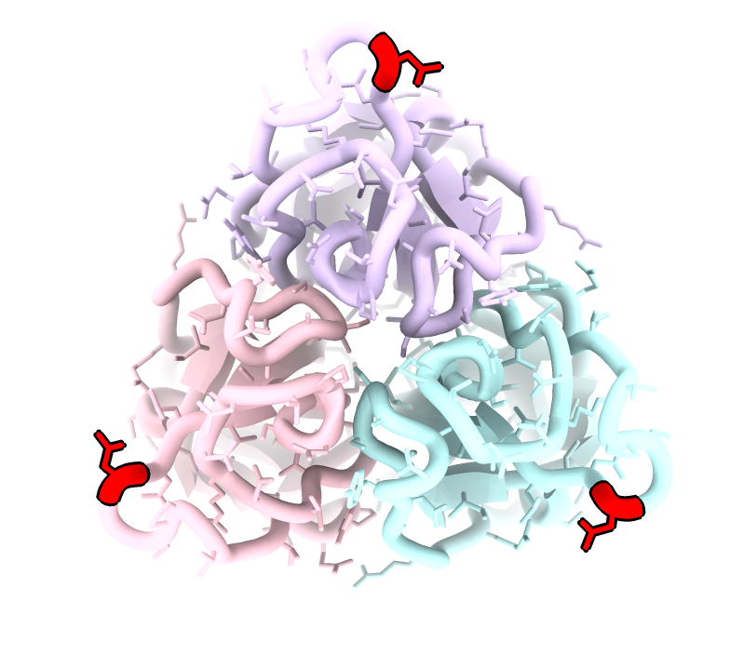
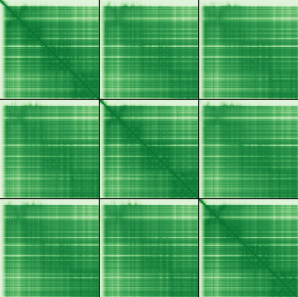
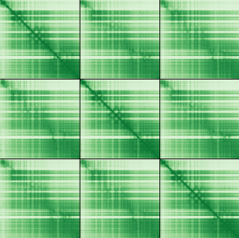

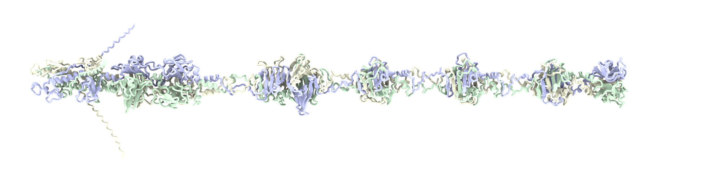
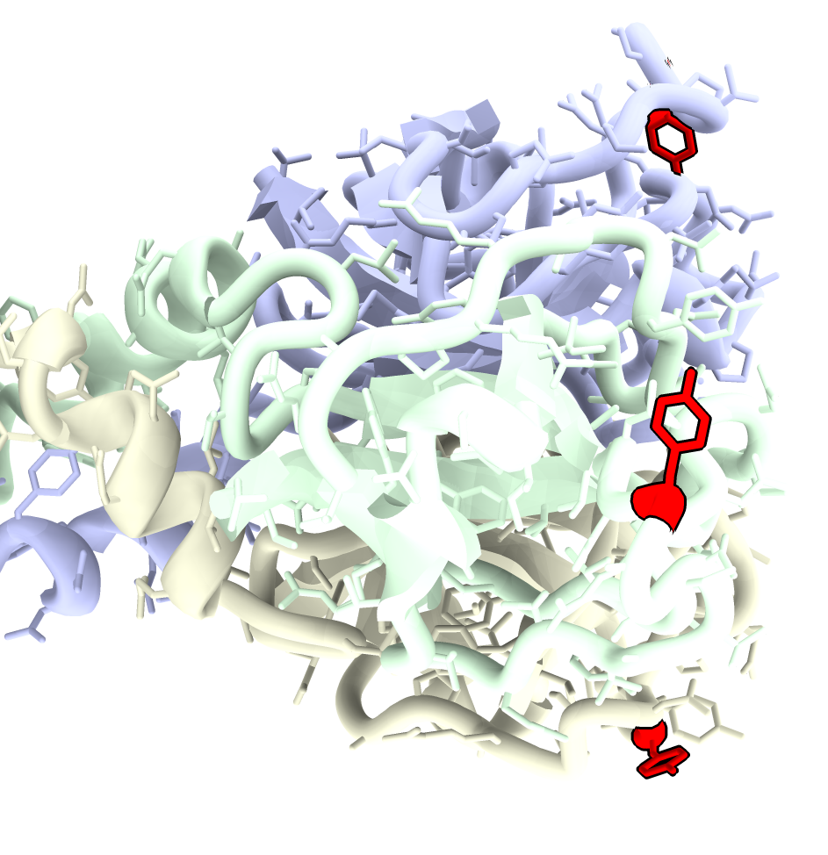
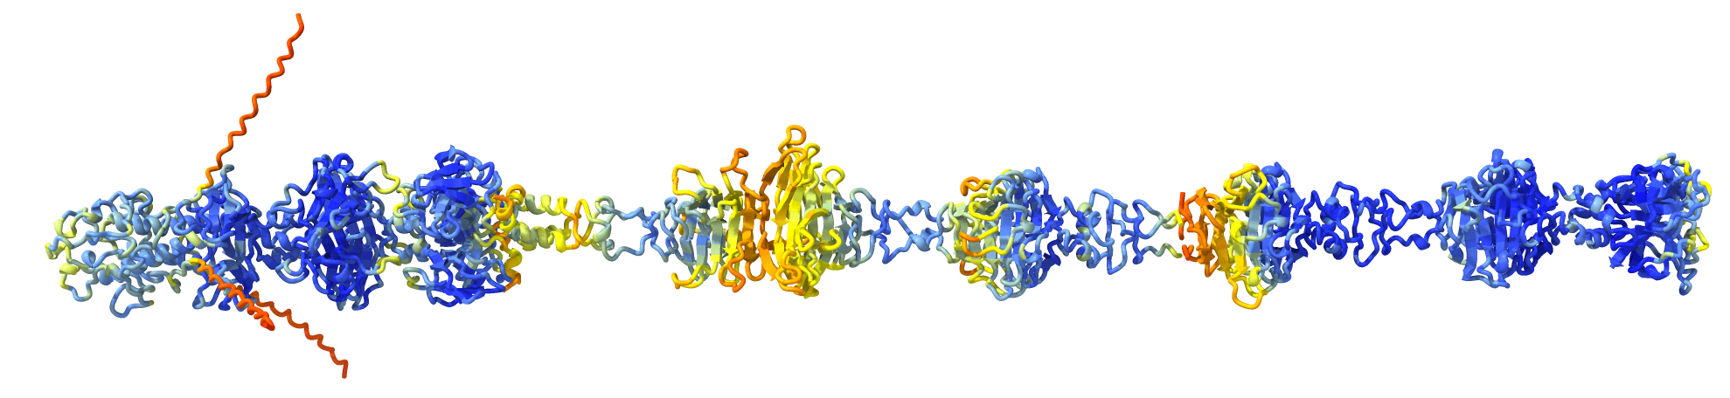
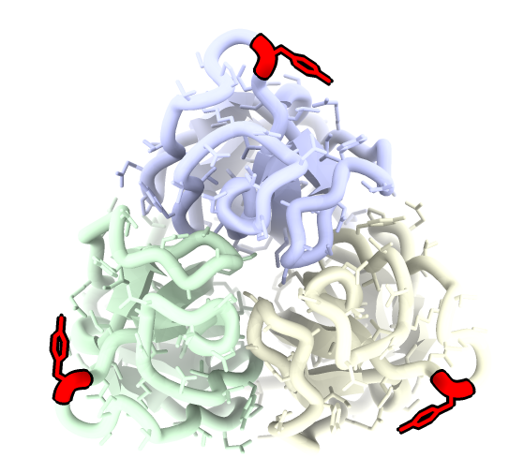
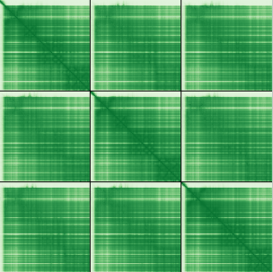
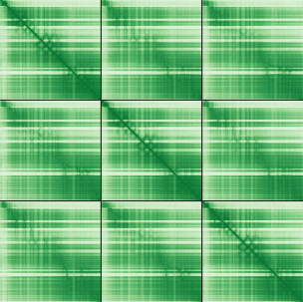
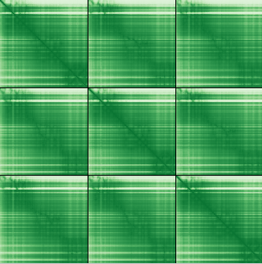
a
Asn 926
Tor gp48
Asn 926
90°
Asn 926
Asn 926
ipTM = 0.82
pTM = 0.83
ipTM = 0.63
pTM = 0.64
689
363
ipTM = 0.82
pTM = 0.82
987
1-363
364-689
690-987
Asn 926
Asn 926
Aligned residue
Aligned residue
Aligned residue
Model confidence
Scored residue
Scored residue
Scored residue
Very high (pLDDT > 90)
High (90 > pLDDT > 80)
0
10
20
Low (80 > pLDDT > 60)
30
Very low (pLDDT < 60)
Expected Position Error (Å)
b
Tor v1.1 gp48
Tyr 926
Tyr 926
Tyr 926
90°
Tyr 926
ipTM = 0.82
pTM = 0.83
689
ipTM = 0.67
pTM = 0.68
ipTM = 0.82
pTM = 0.82
363
987
1-363
364-689
690-987
Aligned residue
Aligned residue
Aligned residue
Tyr 926
Tyr 926
Scored residue
Scored residue
Scored residue
0
10
20
30
Expected Position Error (Å)

Slide 2
