Slide 1
Git’n Jiggy with HTML/CSS
Day 2
August 4, 2016

Slide 2
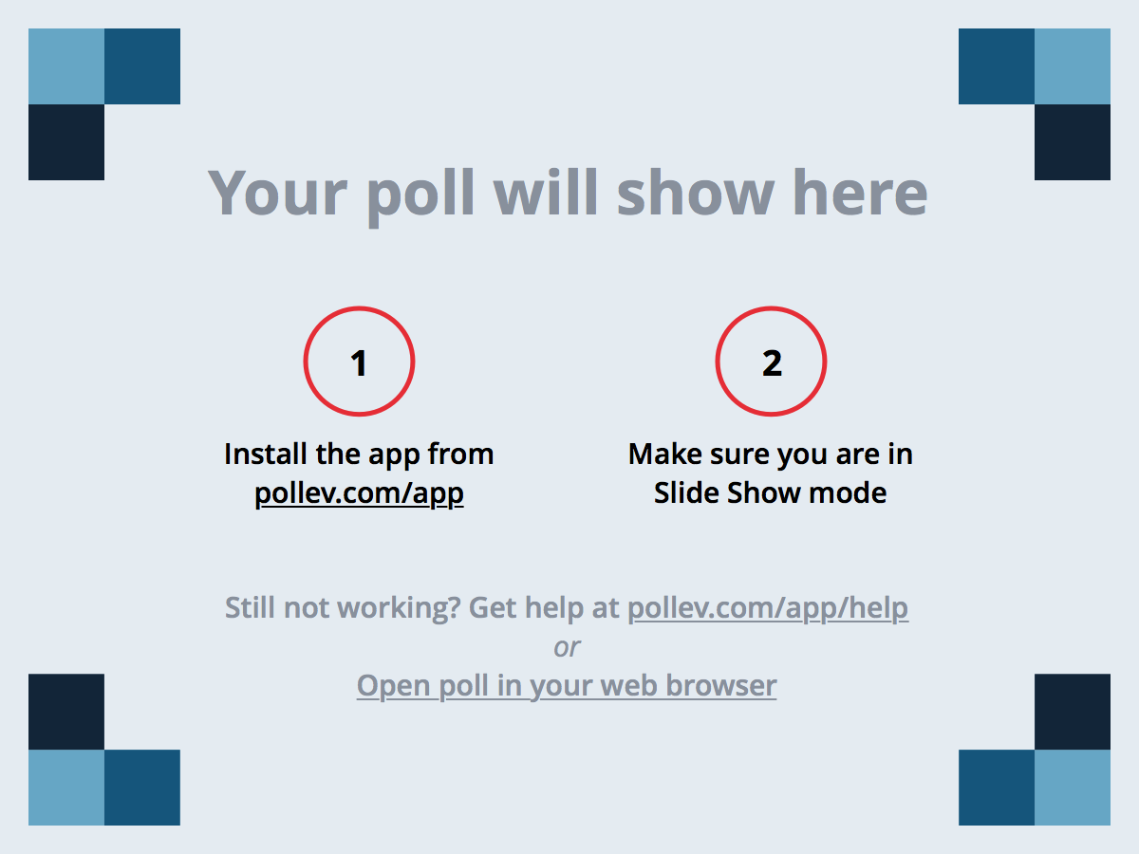
Notes:
Poll Title: How's the pace of the class treating you so far? https://www.polleverywhere.com/multiple_choice_polls/7byPuOfCtkiAuXo

Slide 3
Notes:
Poll Title: Which of these is the correct commands to create a new folder using the command line? https://www.polleverywhere.com/multiple_choice_polls/1PzveSYLcDVUjyF

Slide 4
Notes:
Poll Title: Which of these is the first line in an HTML document https://www.polleverywhere.com/multiple_choice_polls/aES5A7pT29phDxo

Slide 5
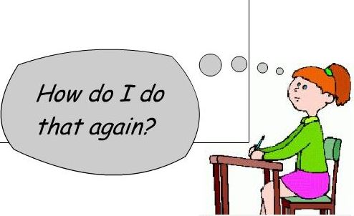
It’s Okay!

Slide 6
Admin Items

Slide 7
Where to Get Help
Practice, Practice, Practice: Work Individually or in Groups
Review In Class Material (Exercises and Slides): https://github.com/RutgersCodingBootcamp/08-16-JC-Class-Content
Re-Watch Class Videos: https://codingbootcamp.hosted.panopto.com/Panopto/Pages/Sessions/List.aspx#folderID=%223efd6343-fa34-4b20-aed9-e9c7f5282398%22&folderSets=3
In Class Office Hours: 45 minutes before class, 30 minutes after
One-on-One Sessions: By Request
Contact Student Success: Anytime!

Slide 8

Homework #1 - Assignment
Homework Assignment #1 is due next Thursday (8/11/16)
Remember! You MUST do the recommended assignment!
Be prepared to put in the hours!

Slide 9
Today’s Class!

Slide 10
Today’s Objectives
Students will understand the importance of Git Version Control and how to use it.
Students will create GitHub Repositories, push code into them and share with class.
Students will make more HTML documents.
Students will learn to properly use basic HTML tags.
Students will implement basic CSS styling to HTML documents.

Slide 11
Know Thyself
If you are a complete beginner to HTML/CSS and Coding:
Continue getting comfortable with HTML.
Be able to completely write a basic HTML document (like in last class).
Understand what CSS is, what it’s for and how it works with HTML.
Be able to use Git and GitHub to upload code.
If you’ve had past exposure and felt comfortable with the last lesson:
Aim to build up your skills. Clear up any questions or confusions about HTML.
Become knowledgeable about a wider range of HTML and CSS tags.
Be able to selectively apply CSS to specific HTML elements.
Be able to use Git and GitHub to upload code.

Slide 12
What / Why Git?

Slide 13
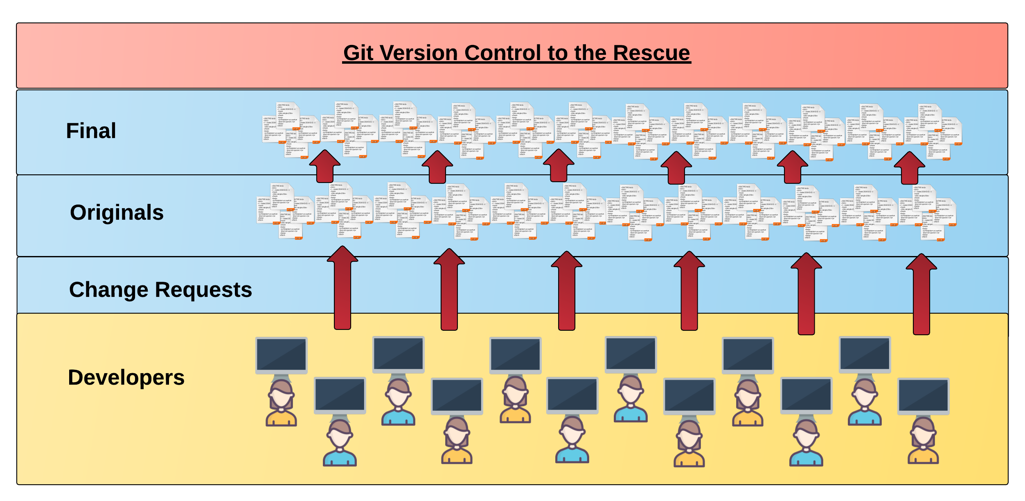
Collaborative Coding
Modern web development is highly collaborative.
Teams are often extremely large and separated across the country — or planet.
Apps sometimes comprise hundreds or even thousands of files.

Slide 14

The Group Project
OMG. I HAZ THE GREATEST HTML IDEA!!!!!
DiegosDigs.com

Slide 15

The Group Project
Programming Away…

Slide 16

The Group Project
Programming Away…
Diego’s idea is dumb. We should call it…
Juanitazzzzz.com

Slide 17
The Group Project
Programming Away…
Diego’s Version
Programming Away…
Juanita’s Version

Slide 18
The Group Project
Programming Away…
Now they have two completely different versions.
Programming Away…

Slide 19

The Group Project
Programming Away…
Programming Away…

Slide 20
The Group Project
Programming Away…
Hai guyz!!!
How R Kan help??
Programming Away…

Slide 21
The Group Project – Tragedy #2
Programming Away…
OK.
Delete. Delete. Delete. Delete.
Delete. Delete
Programming Away…

Slide 22
The Group Project
Lesson:
You should use Version Control.
….And be wary of group members.

Slide 23
Version Control
Git Version Control: Provides a organized system for managing code for when multiple developers work on a project
at the same time.
The Benefits of Git:
A strict system for resolving conflicts in code.
Version History.

Slide 24
The Group Project
Programming Away…
Now they have two completely different versions.
Programming Away…

Slide 25
The Group Project with Version Control
Main Branch (Diego’s)
Diego continues programming
1
2
3
4
5
Juanita pushes (uploads) his code changes into the main branch.
Code conflicts are resolved before inclusion.
Juanita’s Branch

Slide 26
The Group Project – Tragedy 2 (Revisited)
Programming Away…
OK.
Delete. Delete. Delete. Delete.
Delete. Delete
Programming Away…

Slide 27
The Group Project with version control
Main Branch (Diego’s)
1
2
3
4
Matt pushes his (bad) code deletions.
Matt’s Awful, Terrible Branch

Slide 28
The Group Project with version control
Main Branch (Diego’s)
1
2
3
4
5
But this time, Diego rolls back the code to an earlier version.
Matt’s Awful, Terrible Branch

Slide 29
The Group Project
Lesson:
You should use Version Control!

Slide 30
Quick Activity!
Suggested Time: 3 min
Turn to your neighbor and have one of you explain to the other:
The concept of version control.
Then the other should explain:
Two of the key advantages to using a version control system.

Slide 31

So… What’s this GitHub?
GitHub is a Web-Based hosting service to store code online.
It allows developers to pull (download) code or push (upload) code to the same repository (directory).
It also allows developers to view histories of code changes and track issues.

Slide 32

Pushing and Pulling to GitHub
1
2
3
4
GitHub Branch
Pull Code
Push Code
Pull Code
Pull Code
Push Code
Pull Code
Push Code

Slide 33
Get Started with Git

Slide 34
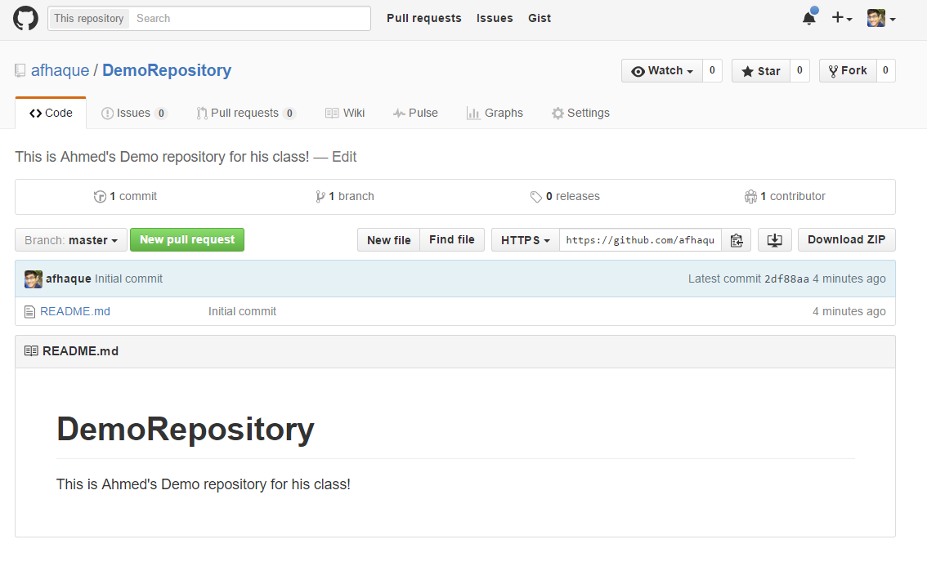
Instructor Git Demo!

Slide 35
Basic Git Commands
At its most basic, these are the five git commands to get started
git clone
git add
git commit
git push
git pull

Slide 36
Basic Git Commands
At its most basic, these are the five git commands to get started
git clone – copies an entire repo (to begin).
git add – adds a file for inclusion in Git.
git commit – notes a change to the local repo.
git push – sends changes to hosting service.
git pull – downloads freshest version of repo.

Slide 37
> YOUR TURN!
Activity: Git Add, Commit, Push | Suggested Time: 20 min
Assignment:
Using GitHub and the Command Line:
Create a new public GitHub repository and name it whatever you like. Be sure to check the box for “initialize this repository with a README.”
Next, clone the repo to your local directory.
Then create an HTML file inside the local directory.
Add, Commit, and Push the code to GitHub.
Bonus:
Find a partner in class and fork their repository to your own GitHub account. Clone this forked repository to your local directory.
Add, Commit, and Push the code back to your forked copy.
Finally, submit a pull request to send your changes to your partner’s repo.

Slide 38
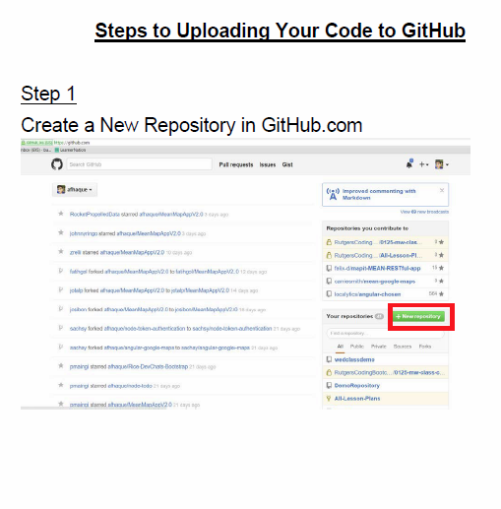
Still a Bit Lost? Never Worry!
Follow this handy Guide!
Practice a few times on your own before our next class.

Slide 39
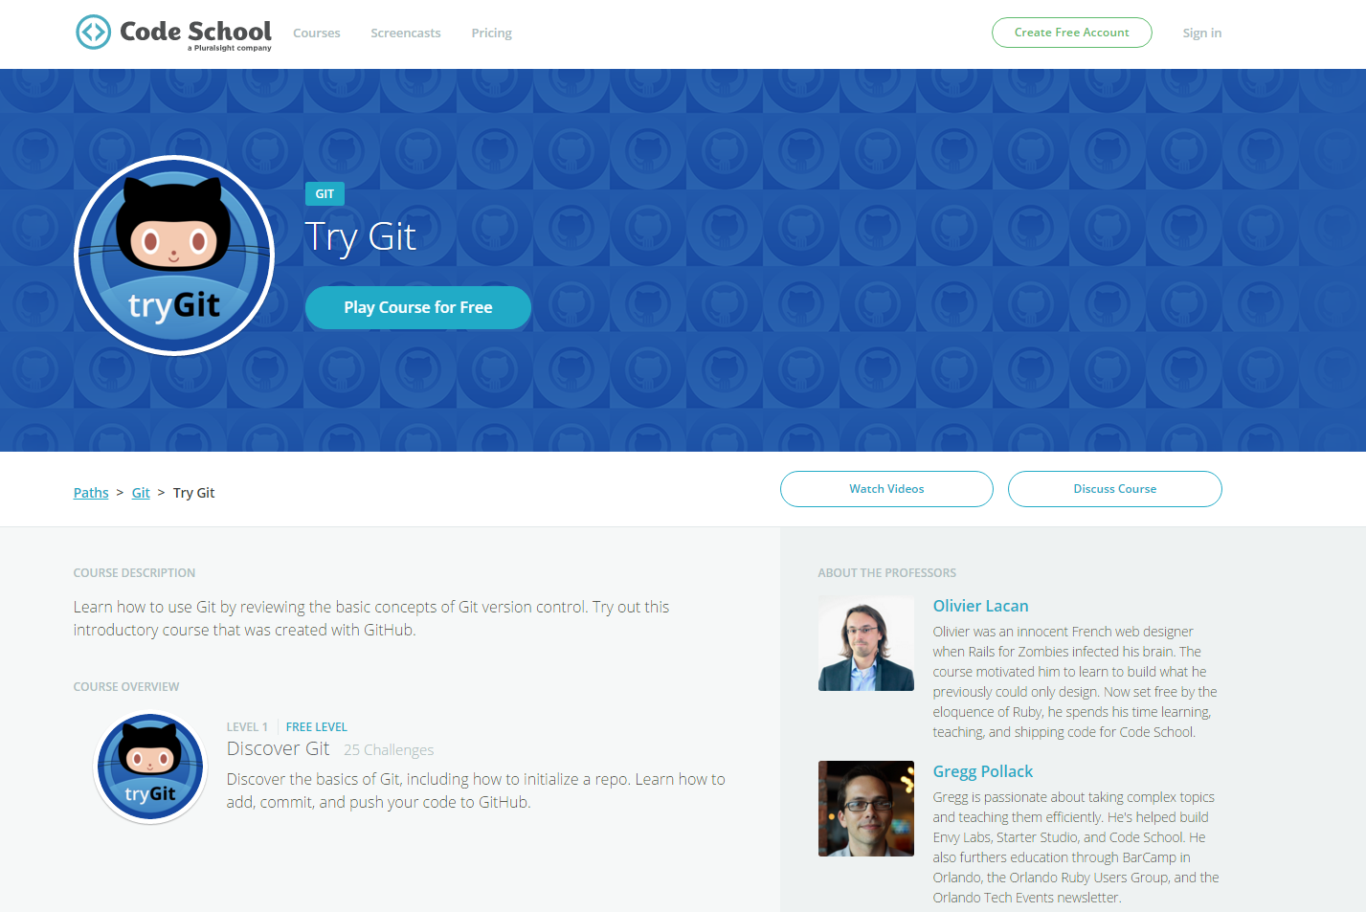
If You’re Still Lost… Here’s a (Free) Course
https://www.codeschool.com/courses/try-git

Slide 40
HTML Round 2

Slide 41
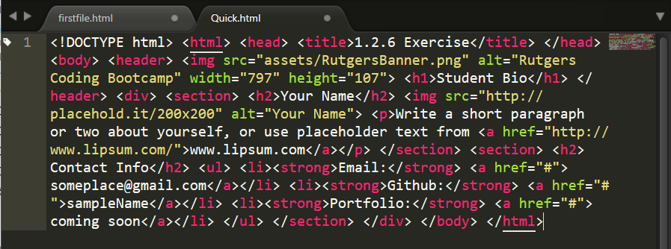
On Ugly HTML
Don’t do this… Use proper indentation and sectioning.
Readable code is easier to maintain.
Invest time to get better about this now. It will pay dividends!

Slide 42
HTML Syntax (Basic)
Content
<h1>
This is Mah House
</h1>
Opening Tag
Closing Tag

Slide 43
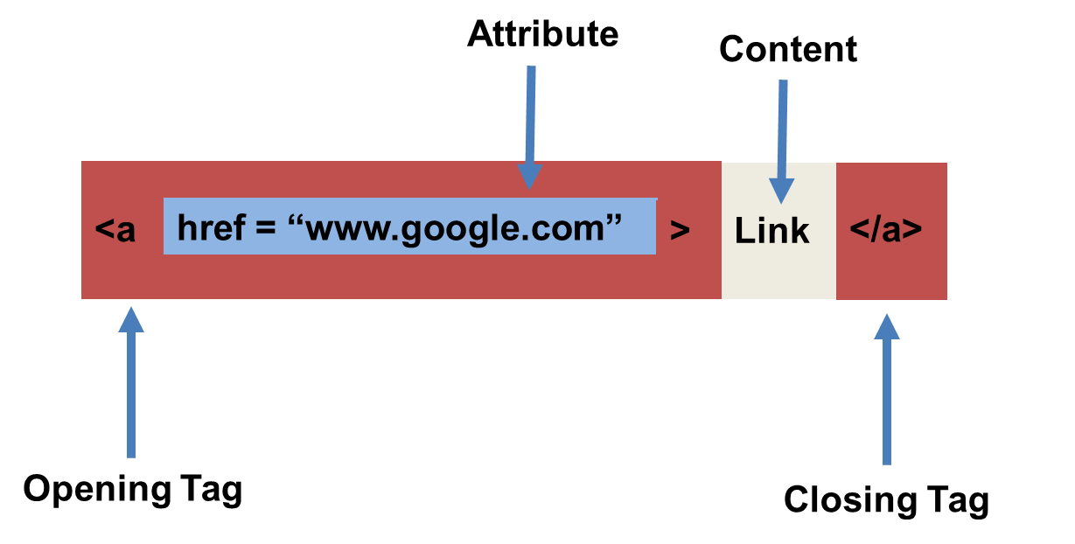
HTML Syntax (with Attribute)

Slide 44
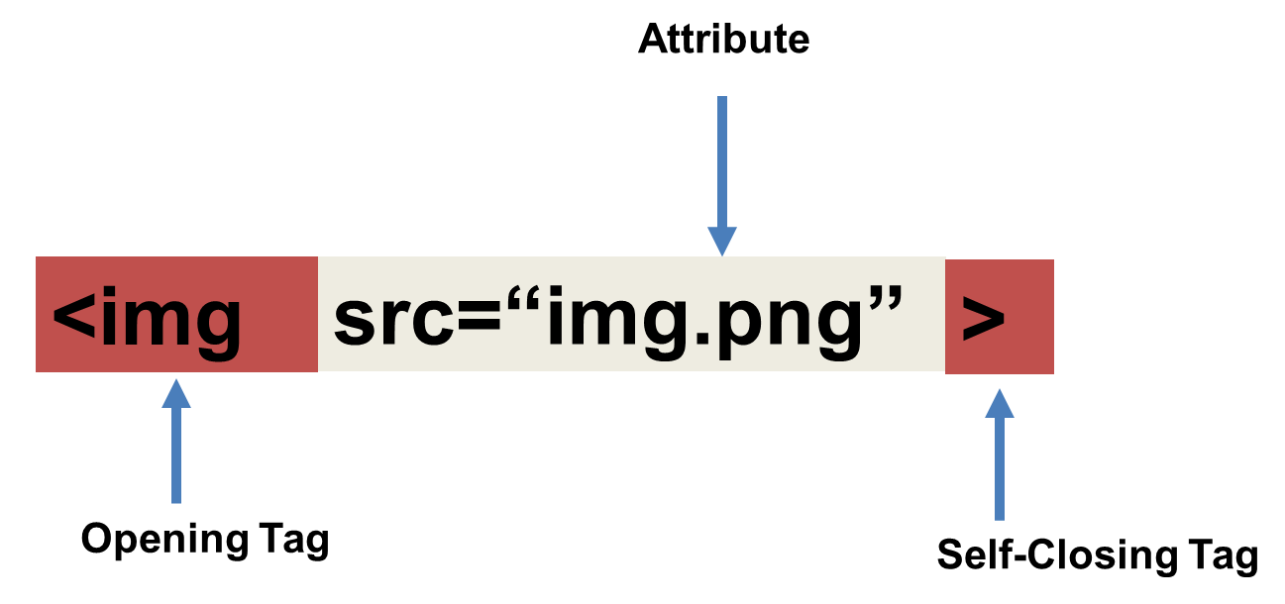
Tricky Tags (Self-Closing)

Slide 45
Important Common Tags
Headers:
<h1> </h1> - Header 1 (Largest Header)
<h2> </h2> - Header 2 (Next Largest Header)
<h3> </h3> - Header 3
…
Containers:
<html> </html> - Wraps the entire page
<head> </head> - Wraps the header of the page
<body> </body> - Wraps the main content
<div> </div> - Logical Container ***
<p> </p> - Wraps individual Paragraphs
Others:
<strong> (bold), <em> (emphasis)
<img> (images), <a href> (links), <li> (list items) , <title> (title), <br> (line break), <table> (tables), <!-- --> (comments)

Slide 46
Less Common Tags
All HTML Tags are listed here: http://www.w3schools.com/tags/
Don’t try to memorize them! Simply refer back to documentation as needed.
Other tags:
<video> for Videos
<audio> for Audio files
<embed> for Embedded files
<code> for including computer code
<header> for headers
<nav> for navigation bars
<footer> for footers

Slide 47
HTML for Forms
Common UI (User Interface) Form Elements:
<form> - Creates a form section in HTML
<input> - Input boxes
<label> - Labels for boxes
<button> - Button
<textarea> - Large textbox

Slide 48
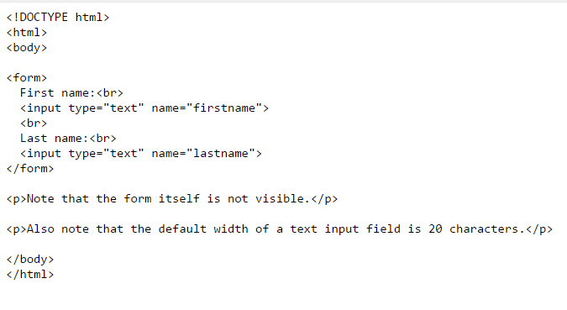
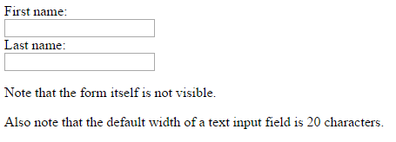
HTML for Forms

Slide 49
> YOUR TURN!
Activity: 1-HTML_Git | Suggested Time: 20 min
Assignment
In this activity, you’ll create a student bio using HTML. You will then add, commit, and push your completed HTML to GitHub for the world to see.
Create a basic HTML page with your own information that looks similar to the design shown on the next screen.

Slide 50
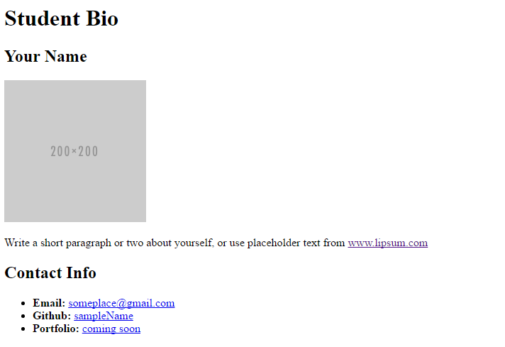
> YOUR TURN!

Slide 51
CSS Stylin’

Slide 52
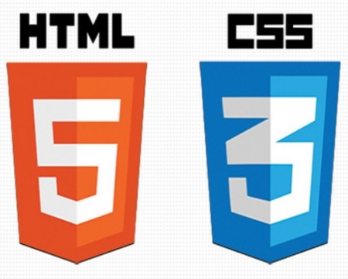

HTML / CSS Definitions (*yawn* unimportant)
HTML: Hypertext Markup Language – (Content)
CSS: Cascading Style Sheets – (Appearance)
HTML/CSS are the “languages of the web.” Together they define both the content and the aesthetics of a webpage – handling everything from the layouts, colors, fonts and content placement. (JavaScript is the third – handling logic, animation, etc.)

Slide 53


HTML / CSS Analogy
HTML Alone
Like writing papers in “Notepad.”
Can only write unformatted text.
HTML / CSS
Like writing papers in Microsoft Word.
Can format text, page settings, alignment, etc. based on “highlighting” and menu options.

Slide 54
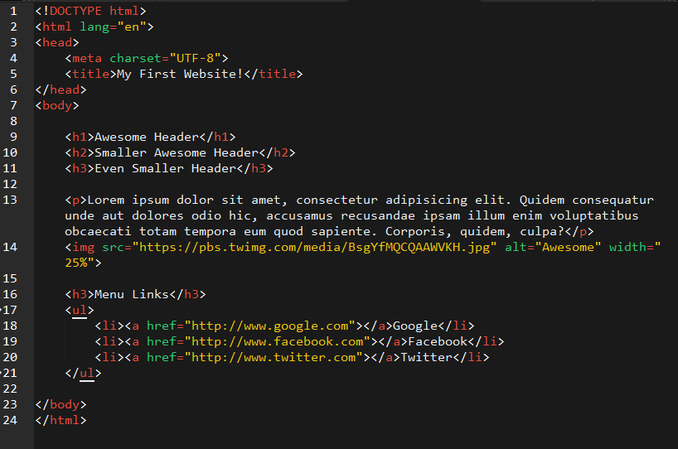
Basic HTML Page

Slide 55
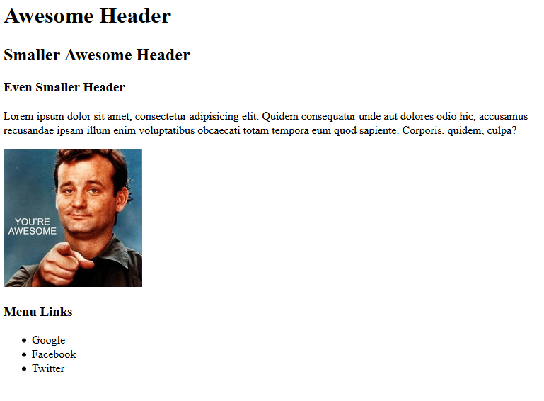
Basic HTML Page - Result

Slide 56
Basic HTML Page - Result
Hella Boring…

Slide 57
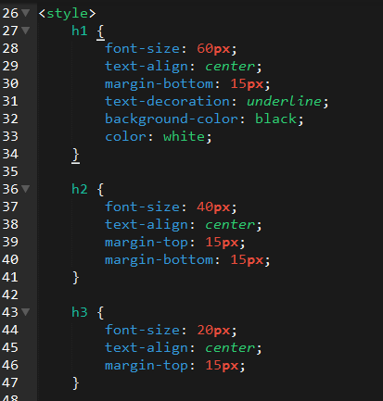
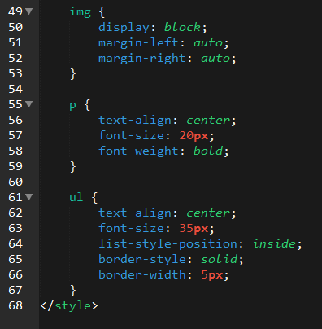
Enter CSS

Slide 58
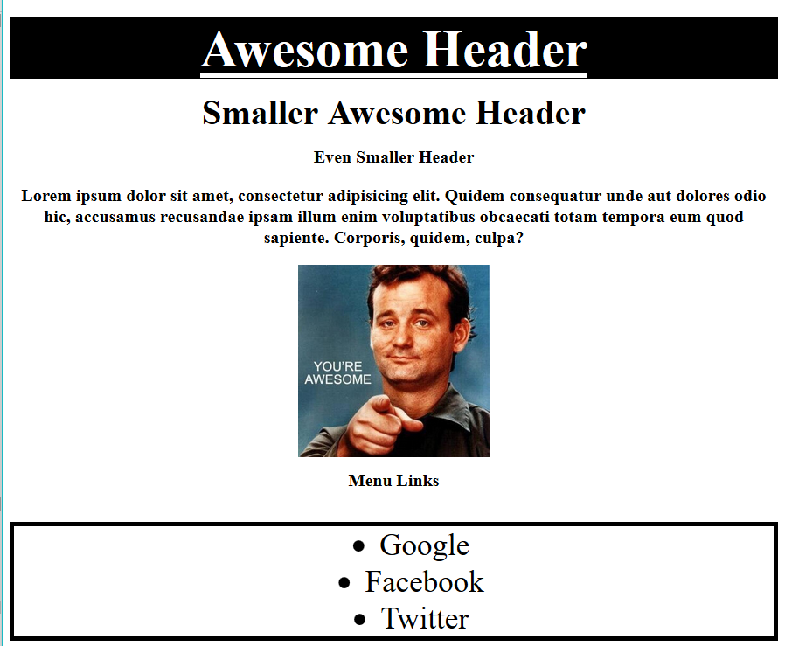
Enter CSS - Result

Slide 59
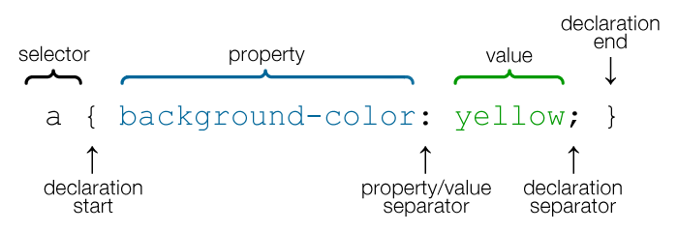
CSS Syntax
CSS works by hooking onto selectors added into HTML using “classes and identifiers.”
Once hooked, we apply styles to those HTML elements using CSS.

Slide 60
CSS Example
In the below example the “Header” would be turned blue and MUCH larger because of the CSS.
We can incorporate an element’s class or ID to apply a CSS style to a particular part of the document.
Just remember to include the necessary symbol before the CSS: “.” for class, “#” for ID.
Example (HTML):
<p class=“bigBlue”>Header</p>
Example (CSS):
.bigBlue
{
font-size: 100px;
color: blue;
}

Slide 61
Key CSS Attributes
Font / Color:
color: Sets color of text.
font-size: Sets size of the font.
font-style: Sets italics.
font-weight: Sets bold .
Alignment / Spacing:
margin-top(bottom/left/right): Adds space between element and its own border.
margin-top (bottom/left/right): Adds space between element and surrounding elements.
float: Forces elements to the sides, centers, or tops.
Background:
background-color: sets background color.
background-image: sets background image.

Slide 62
Powerful Duo
Believe it or not, HTML / CSS is all you need
to develop a vivid, full-blown website.

Slide 63
INSTRUCTOR DEMO
Instructor: Demo
(quickexample_internalcss.html | 2-BasicCSS)

Slide 64
> YOUR TURN!
Activity: 3-HTML_CSS_Layout | Suggested Time: 20 min
Assignment
In this activity, you’ll upgrade your previous HTML bio-page using CSS style rules. Once you’re done, commit and push up your changes to GitHub.
We’ll send you additional instructions via Slack.

Slide 65
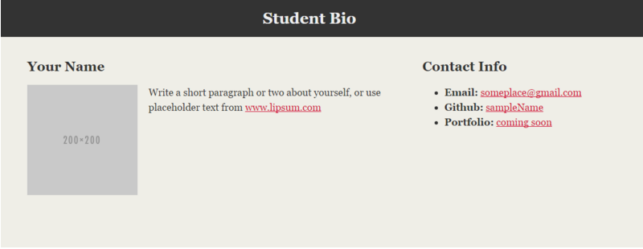
> YOUR TURN!

Slide 66
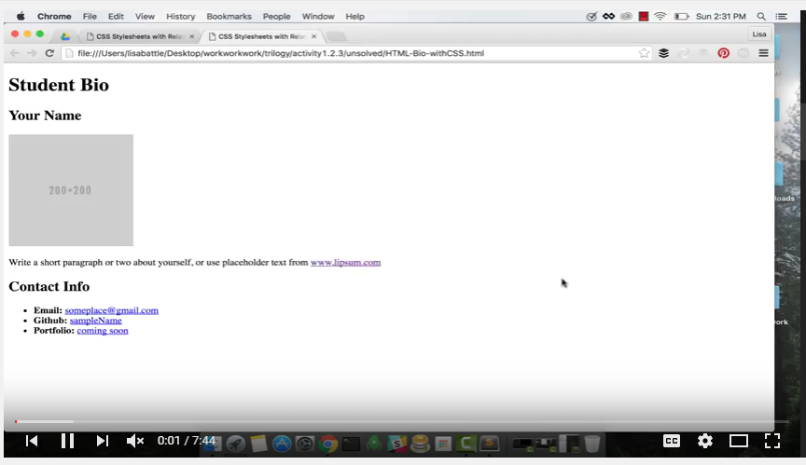
Video Walkthrough!!
https://www.youtube.com/watch?v=kMBinXTCrXI&list=PLgJ8UgkiorCnMLsUevoQRxH8t9bt7ne14&index=2

Slide 67
Recap + Questions

Slide 68
Remember: Know Thyself
If you are a complete beginner to HTML/CSS and Coding:
Continue getting comfortable with HTML.
Be able to completely write a basic HTML document (like in last class).
Understand what CSS is, what it’s for and how it works with HTML.
Be able to use Git and GitHub to upload code.
If you’ve had past exposure and felt comfortable with the last lesson:
Aim to build up your skills. Clear up any questions or confusions about HTML.
Become knowledgeable about a wider range of HTML and CSS tags.
Be able to selectively apply CSS to specific HTML elements.
Be able to use Git and GitHub to upload code.

