Slide 1
Algorithms
Wining the Netflix prize
117010408 118010045 118010422
Bote, Zheng & Yuncong, Cui & Xinyi,Zhang

Slide 2

OUTline
Data Set
BellKor’s Pragmatic Chaos
Differences

Slide 3
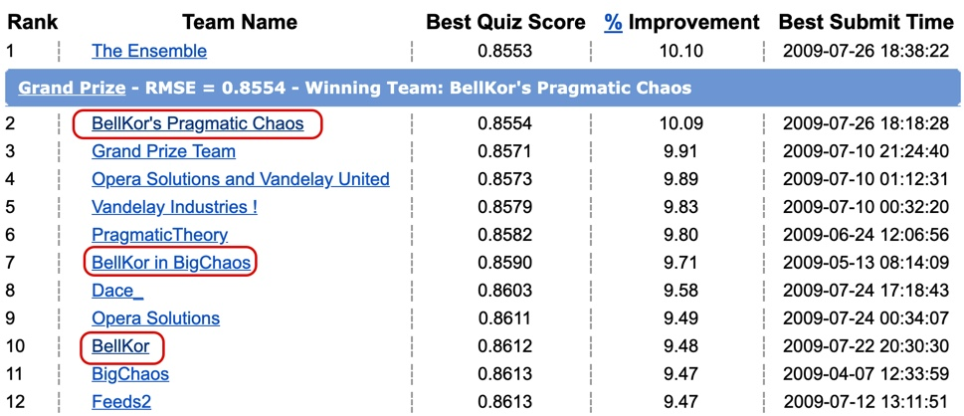
Leader board

Slide 4
Data set

Slide 5
Training set
Qualifying and Probe

Slide 6
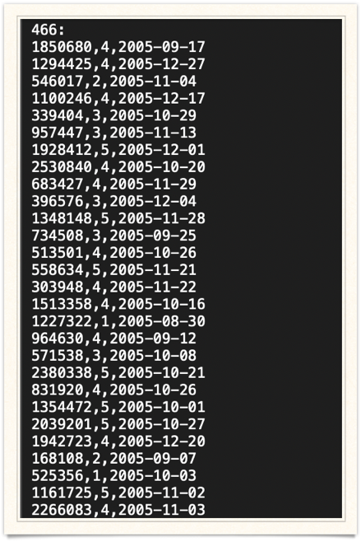
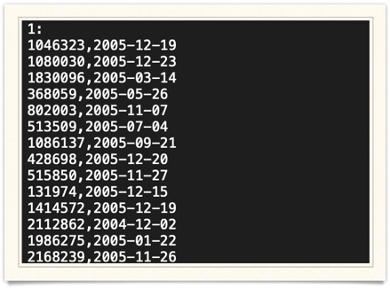
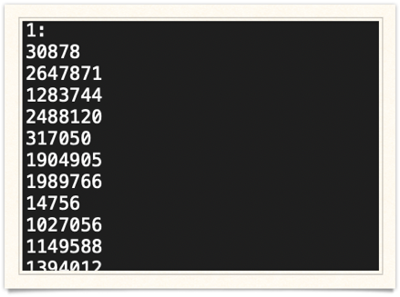

Slide 7
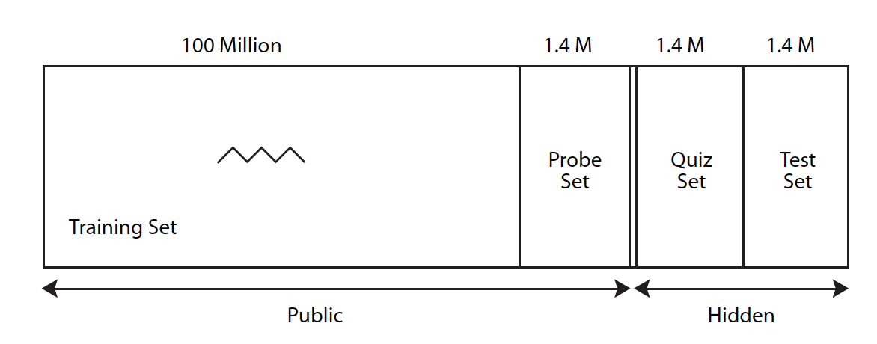
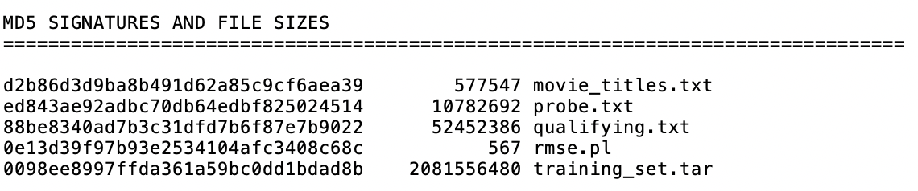

Slide 8
Algorithms
From 2007-2009

Slide 9
2007
5 ways

Slide 10
1 kNN

Slide 11
•Data and features determine the upper bound of machine learning, and our models and algorithms only allows us to approach the upper bound.

Slide 12
2 A Factorization Model
•The essence of this model is alternating between computing all movie factors and all user factors, by optimally solving regularized least squares problems.

Slide 13
3 Restricted Boltzmann machine
•a reduction of dimension

Slide 14
•Restricted Boltzmann Machines (RBM) for collaborative filtering were recently described by one of the leading teams in this challenge.
•RBMs lead to competitive results in terms of accuracy, with a relatively low sensitivity to parameter setting.

Slide 15
4 asymmetric factor models
5 regression models
•This method involved a clear redundancy, as user parameter are dependent on the movie-parameters, and vice-versa.

Slide 16
•In the end, they combined multiple results and got the best RMSE 0.8712.

Slide 17
2008

Slide 18
Asymmetric SVD
And
SVD++
•New models
•The combined solution has a RMSE=0.8616

Slide 19
•The other methods were somehow changed in the 2009 final version. Therefore, we will not go into further discussion.

Slide 20
2009

Slide 21



Baseline predictor

Slide 22
Other key improvement on models
• Matrix Factorization Model
•Neighborhood Models with Temporal Dynamics
•Extension Restricted Boltzmann Machines
•Gradient Boosted Decision Trees
RMSE=0.8563

Slide 23

The bellkor solution 2007
Neighborhoodod-based model (K-NN)
A Factoration Model

Slide 24
Differences

Slide 25
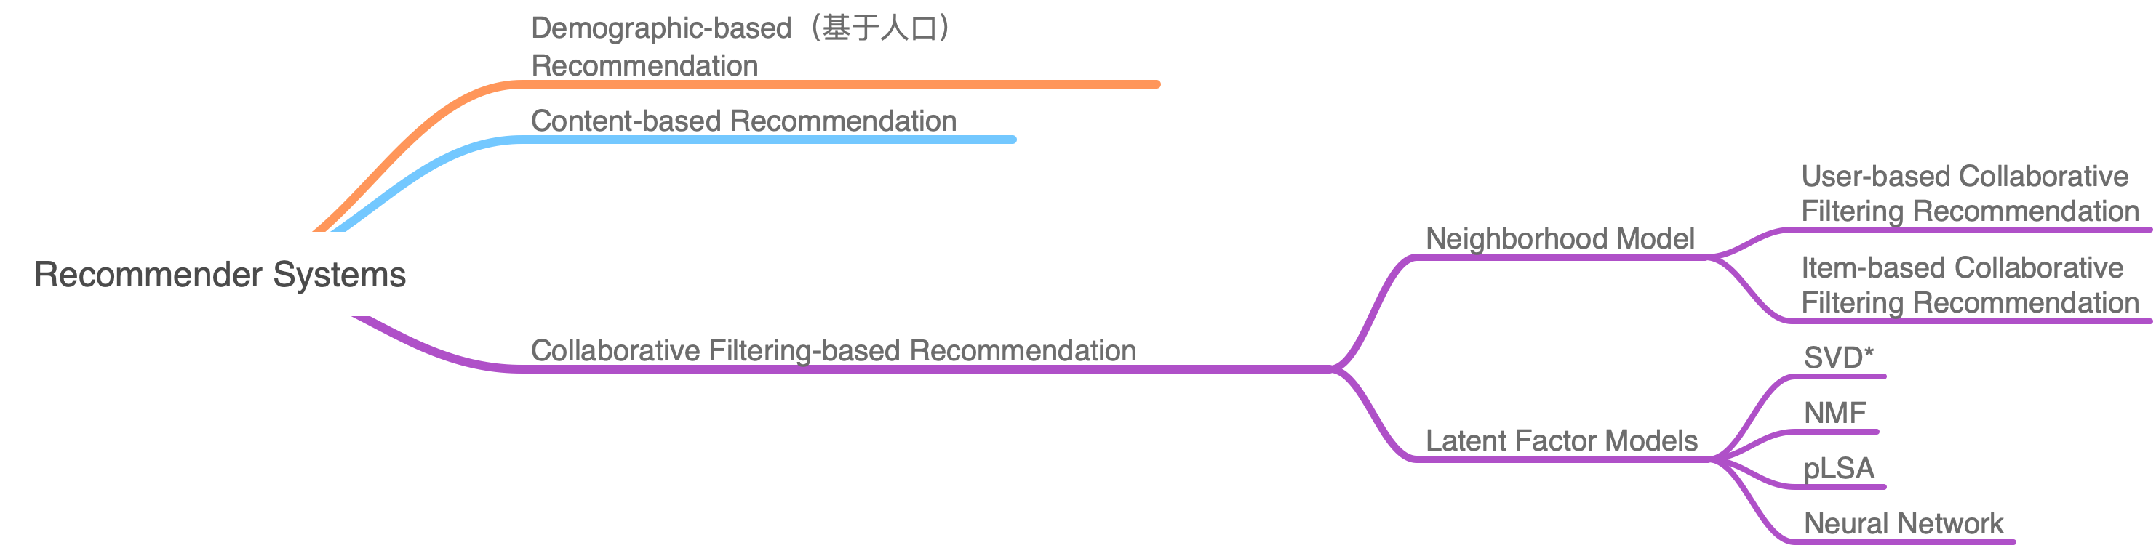

Slide 26
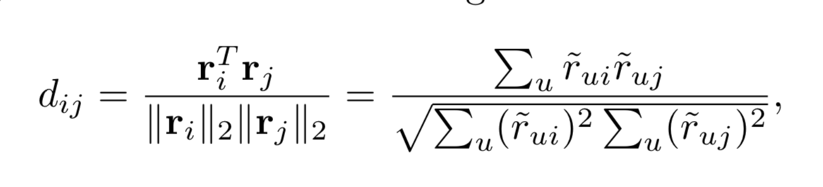
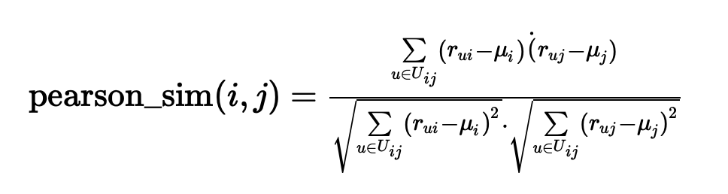

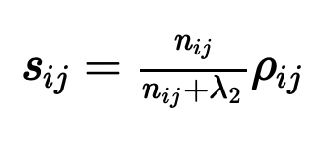
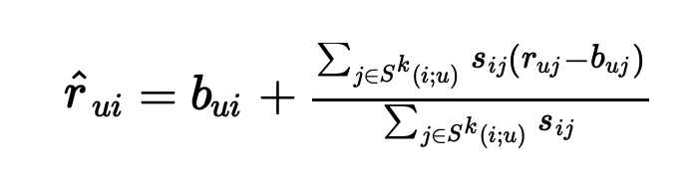
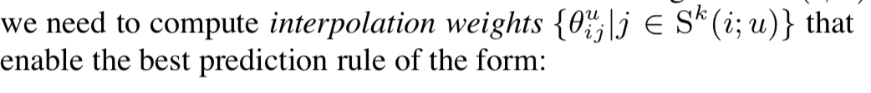
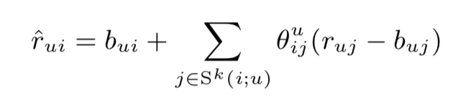
Neighborhood method
Based on movie
Statistical Method
http://citeseerx.ist.psu.edu/viewdoc/download?doi=10.1.1.183.979&rep=rep1&type=pdf
https://www.cs.rochester.edu/twiki/pub/Main/HarpSeminar/Factorization_Meets_the_Neighborhood-_a_Multifaceted_Collaborative_Filtering_Model.pdf

Slide 27
Explicit feedback: R(u)[Rating]
Implicit feedback:N(u)[Click]
The dataset does not only tell us the rating values, but also which movies users rate, regardless of how they rated these movies. In other words, a user implicitly tells us about her preferences by choosing to voice her opinion and vote a (high or low) rating.

Slide 28
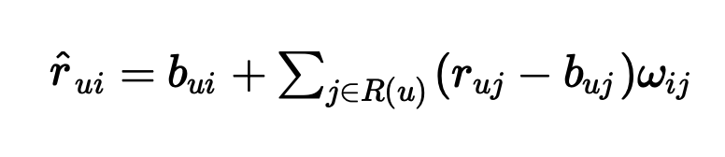
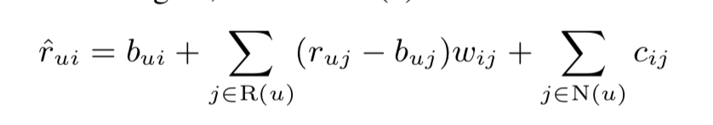
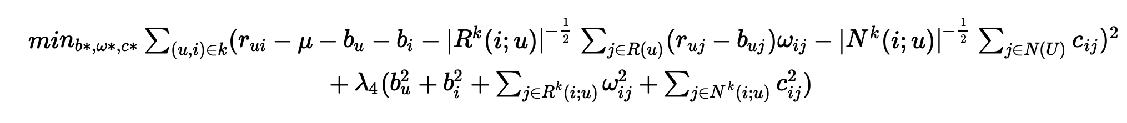
global weights independent of a specific user
(Personal Preference)
Decrease the effect
K items
A

Slide 29
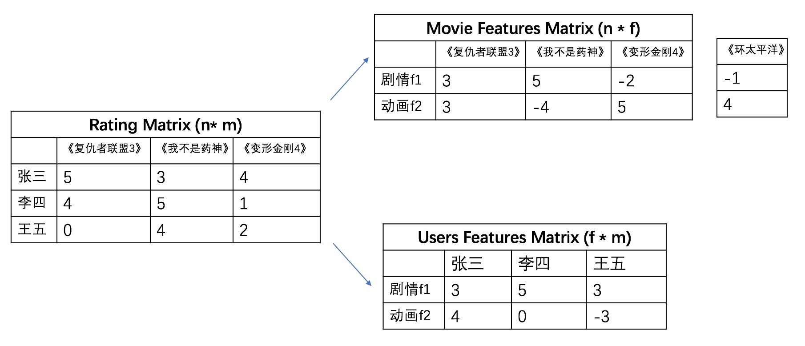
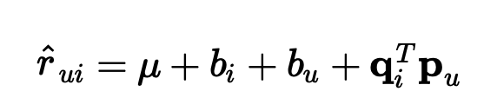
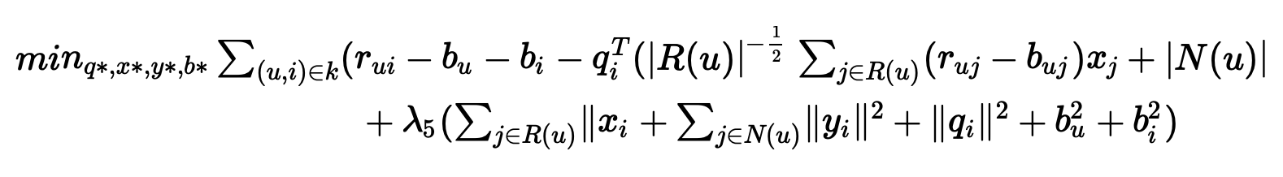
SVD
Only have j!
Asymmetric SVD
https://www.cnblogs.com/bjwu/p/9358777.html

Slide 30
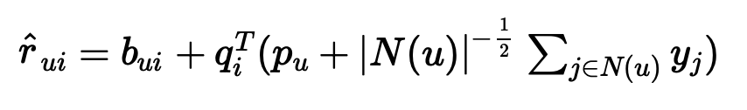
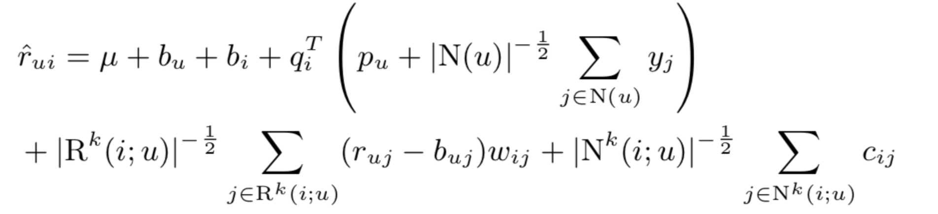
SVD++
From basic
SVD++
Versus
Asymmetric SVD
Integrated model

Slide 31
Summary
KNN vs SVD
KNN vs Naive Neighborhood method
(Collaborative Filtering with Temporal Dynamics*)
http://cseweb.ucsd.edu/classes/fa17/cse291-b/reading/p447-koren.pdf

Slide 32
Algorithm Simulation

Slide 33
Prerequisite
The same training data
The same baseline predictor (the basic one)

Slide 34
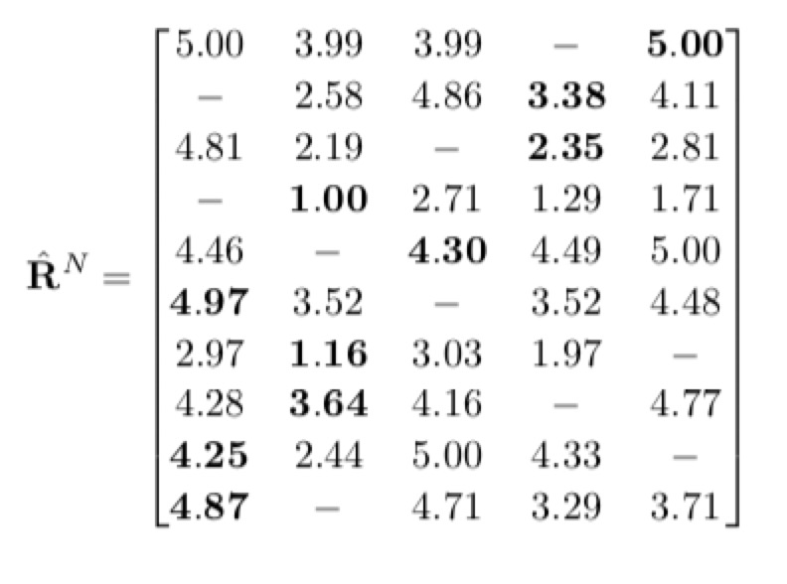
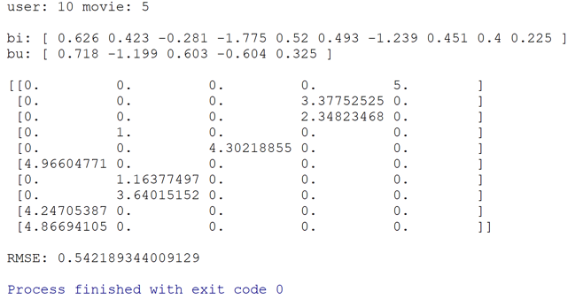
The Example in Textbook
Result Screenshot:

Slide 35


1. Neighborhood Model
(1) dataset 1
Result Screenshot:
(2) dataset 2
Result Screenshot:

Slide 36


2. Neighborhood Model with Regularization
(1) dataset 1
Result Screenshot:
(2) dataset 2
Result Screenshot:

Slide 37
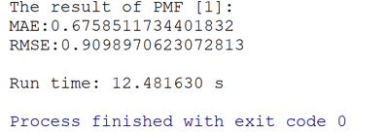
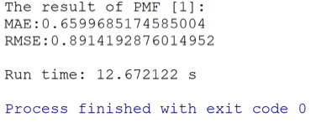
3. Matrix Factorization
(1) dataset 1
Result Screenshot:
(2) dataset 2
Result Screenshot:

Slide 38
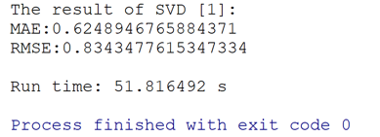
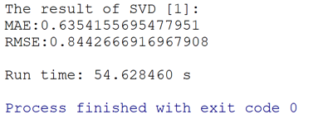
4. Matrix Factorization (SVD)
(1) dataset 1
Result Screenshot:
(2) dataset 2
Result Screenshot:

Slide 39
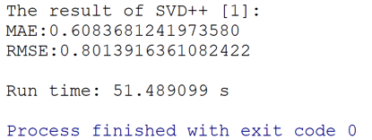
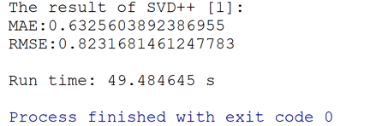
5. Matrix Factorization (SVD++)
(1) dataset 1
Result Screenshot:
(2) dataset 2
Result Screenshot:

Slide 40
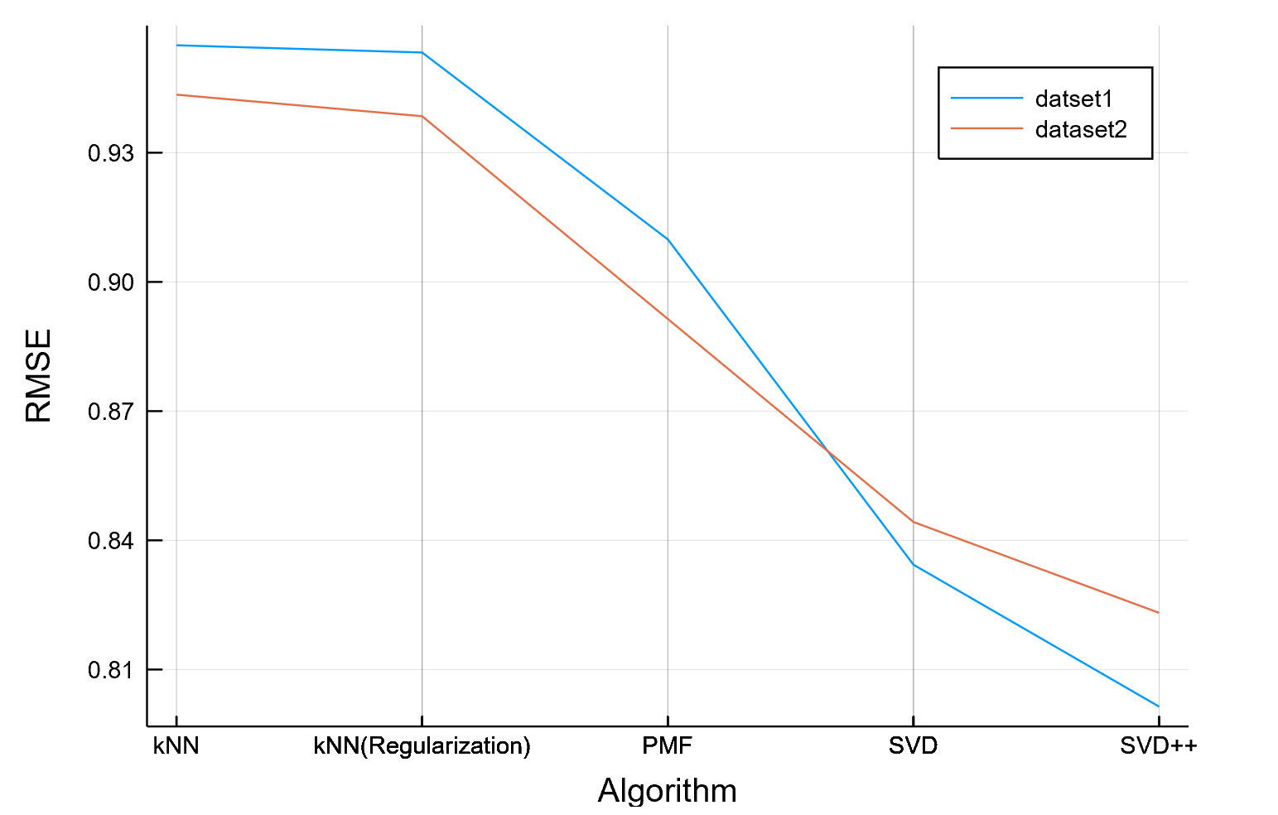
RMSE V.S. ALGORITHM

Slide 41
“Thank you.”

