Slide 1
Project - Event Management ( Pro FIT )
Pro FIT is looking for an event management software which will help them to manage their events very effectively along with the attends & location information. As a developer you have been asked to develop the solution using Salesforce Platform. Here are the complete information of the project.

Slide 2
Involved Entities (Objects)
Location ( Address Book )
Street ( Text )
City ( Text )
State ( Text )
Postal Code ( Text )
Country ( PickList )
Landmark ( Text )
Verified ( checkbox )
Event
Event # ( Standard Auto Number )
Name ( Text )
Status ( Created, Published, In Progress, Completed, Post Poned, Cancelled ) - Picklist
Organizer ( Lookup - Event Organizer )
Start Date/Time
End Date/Time
Max Seats ( Number )
# People Attending ( Rollup Summary Field )
Remaining Seats ( Formula field - “Max Seats - # People Attending“ )
Lookup ( Location )
Location Verified ( Formula Location__r.Verified__c )
Live? ( Checkbox )
Recurring? ( Checkbox )
Event Type ( In-Person, Virtual ) - Picklist
Frequency ( Daily, Weekly ) - Picklist
Event Organizer
Name ( Standard field )
Email ( Email )
Alternative Email ( Email )
Phone ( Phone )
Alternative Phone ( Phone )
Address ( Lookup - Location )

Slide 3
Involved Entities
Attendees
Name ( Standard )
Email ( Email )
Phone ( Phone )
Company Name ( Text )
Address ( Lookup - Location )
Location ( Address Book )
Speaker
Name ( Standard Name Field )
Email ( Email )
Phone ( Phone )
Company ( Text )
Error Log
Log Date/Tile ( Store the Date & Time details when the Error Occurred )
Log Details ( Stores the Complete Stack Track about the Problem ) - Text Area Long
Process Name ( The Name of Either Apex Class or Apex Trigger ) - Text
Log # ( Auto Generated Number )
Event-Attendee
Event ( M-D Event )
Attendee ( M-D Attendee )
Event-Speaker
Event ( M-D Event )
Speaker( M-D Speaker )

Slide 4
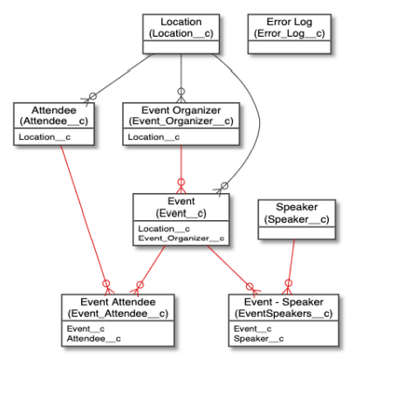
ER Diagram

Slide 5
Milestone 1
Complete the object structure
Create all the fields with right Data type
Create One Application called as Pro Fit. Use one logo.
Must have – Each field will be having description and help text.

Slide 6
Milestone 1.1
Validation Rule Setup #
Validation Rule on Event Object
If Recurring? checkbox is checked then user must need to fill Frequency field & If checkbox is unchecked then User can not select Frequency field.
If Virtual is Selected as Value for Event Type field then Prevent User to Select Location on Event Record.
End Date/Time must be at-least 1 day ahead of Start Date/Time ( If there is a value in End Date/Time field )
If Event Type field value is In-Person then user must need to select Location on Event Record.
Event Attendee Object
Attendee can only be associated with the Event whose End Date is in future & Event Live Checkbox is checked and Event is accepting the Attendees ( means Remaining Seats field value is not 0 )
Event Speaker Object
Speaker can only be associated with the Event whose End Date is in future & Event Live Checkbox is checked

Slide 7
Milestone 1.2
Duplicate Rule Setup #
Speaker Object
User can not create duplicate speaker record with the same Email & Phone
Attendee Object
User can not Create duplicate attendee with the Same Name, Email & Phone
Event Organizer Object
Apply the same rule as Speaker object for not to having duplicate Organizer in the System

Slide 8
Milestone 3
Trigger Development ( Event - Speaker Object ) –
Develop a Trigger on Event – Speaker object which will throw an error if the Speaker Selected on Event - Speaker Record already have an Event against his name.
i.e - For a Speaker there will be only one event at a time. Reject Duplicate Bookings.
Question 1 - In which object the Trigger will be.
Question 2 - What are the events and output?

Slide 9
Milestone 4
Trigger Development ( Event - Attendee Object ) –
Develop an Apex Trigger on Event Attendee Object ( Whenever a New Record gets created ) to send the email to Attendee saying that registration has been confirmed . In the email include the basic details of attendee like name, email, phone. Also, send an email to attendee. Use below format for email
Subject - Pass for the “ Event name Here”
Email Body –
Dear Attendee Name,
Thank you for registering for “ Event Name Here” which will be Organized on “ Event Date Here ” & will be held in “Event Location Here”. We are excited to have you, see you in the event.
Find the Google Map Location for the Event Here. (https://www.google.com/maps/place/) + Add your Location Here
Thanks,
“Organizer Name Here”
Must Have –
Bulk record handling along with the Exception handling.
Use of Handler/Helper Class

Slide 10
Milestone 5
Develop Apex Batch – Add a new value on Status as ‘Deleted’. Write an Apex Batch which should update Status(set to Deleted) all the event records which are more than 4 months old & have been never Organized. Also you need to ensure that the records will be marked with red flag on new field ‘Status Indicator’ which are having status as deleted.
In the finish method of the batch apex send an email to “youremail@gmail.com“ email address saying that execution of the batch has been processed.
No handler class should be used for the batch
Send Email from the finish method as outlined in the requirement.

Slide 11
Milestone 6
Develop Unit Test - Develop the unit test for the above batch with at-least 95% code coverage
Must Have –
Unit Test must be tested for at-least 199 records
Code coverage must be 95%

Slide 12
Milestone 7
Make Call-out to SmartyStreets API –
SmartyStreets API is used to verify the address and ZIP.
In this milestone you need to consume below Apis
Street API - https://smartystreets.com/products/apis/us-street-api.
Zip Code API - https://www.smartystreets.com/products/apis/us-zipcode-api
Requirement –
The business ask is to verify the address of the Location Object. Use the above API to verify the address & update “Location Verified” field on Location Object using Street API.
The business also want to check if the Zip code is correct for Location Object. So if that is correct please flag the newly created field “Is Zip correct?” using Zip code API.
Must Have - Use of Error Handling and code re-usability

Slide 13
Milestone 8
AttendeeEvents Component:-
Develop a Lightning web component which will sit inside the detail page of the Attendee object and display the details of the Event that attendee has attended or registered. The component must have 2 sections
Upcoming Events: - Display all the event that attendee has registered Event Details
Past Events - Display all the Event that the user was part of.
These should be displayed as Data table.
Expose Salesforce Object - Develop Apex Rest API to send the Event Details to 3rd party in JSON format.
Create Test classes.

Slide 14
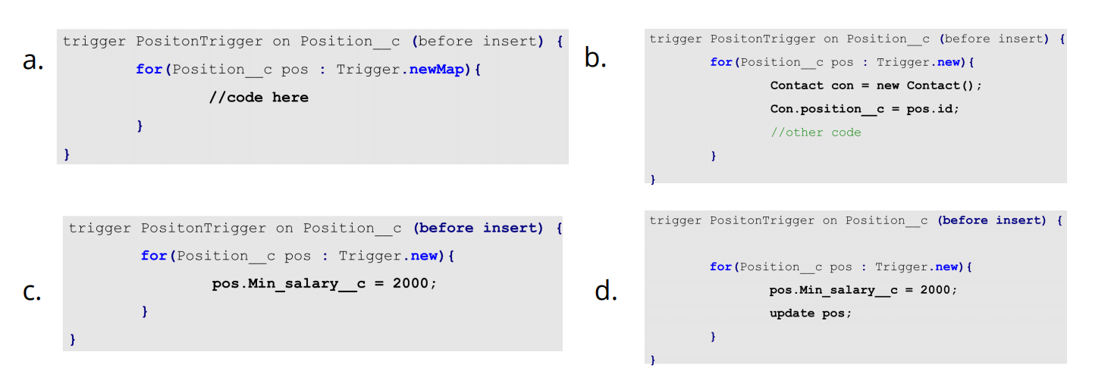
Which of these code snippets will save and run successfully?

