Slide 1

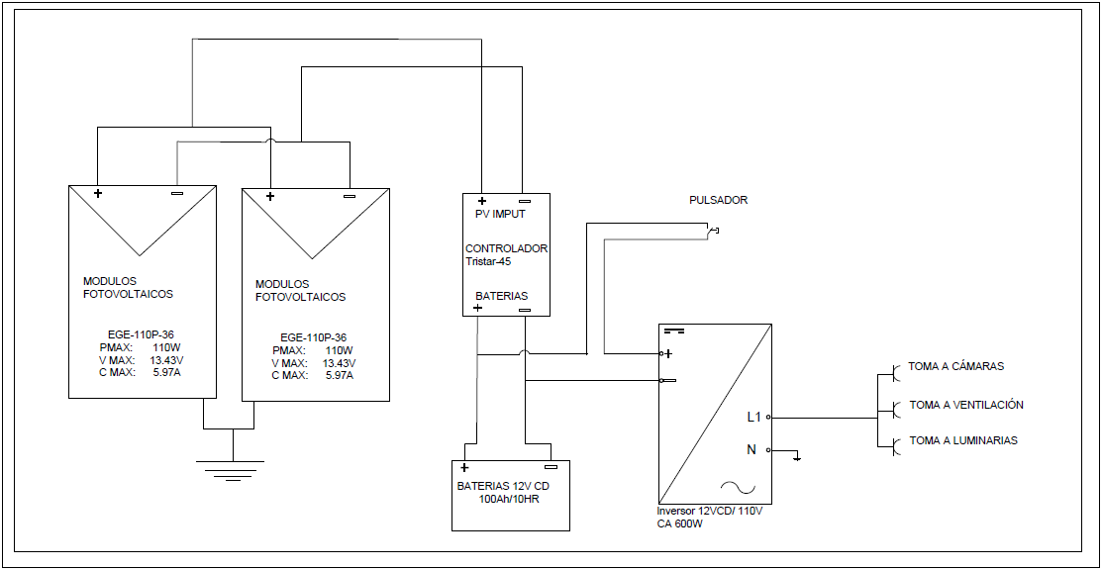
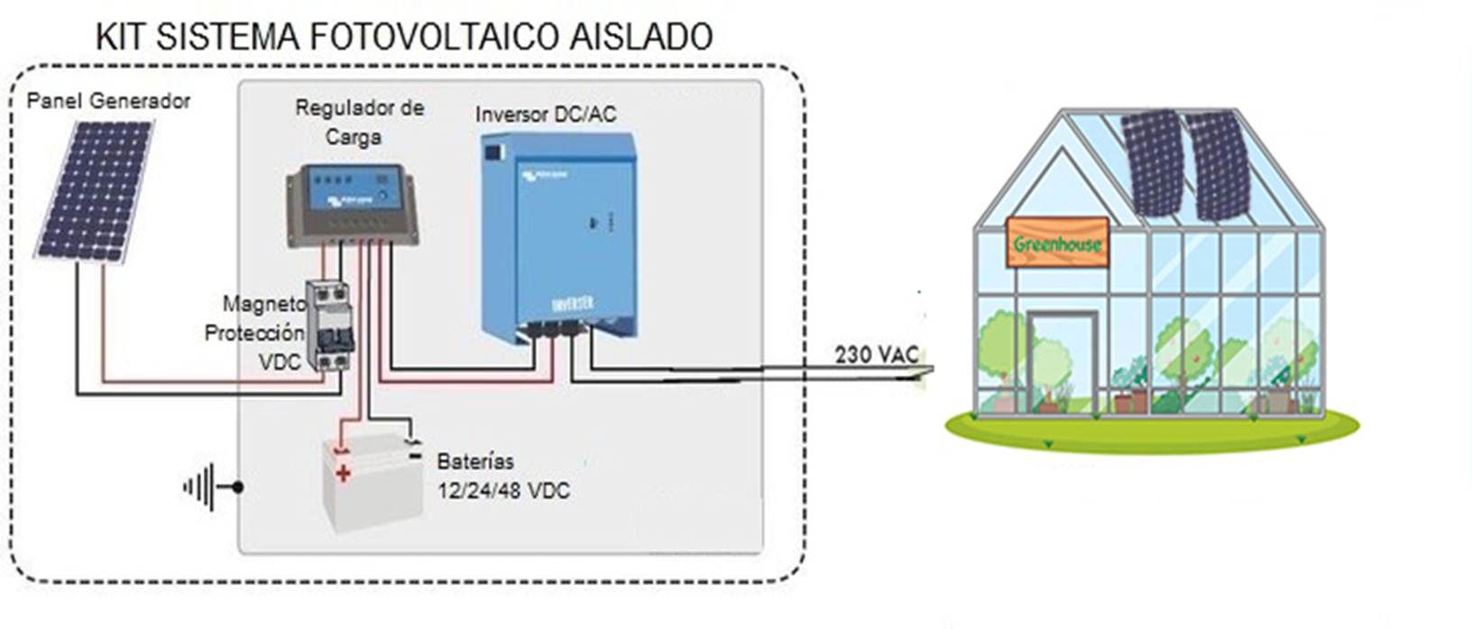
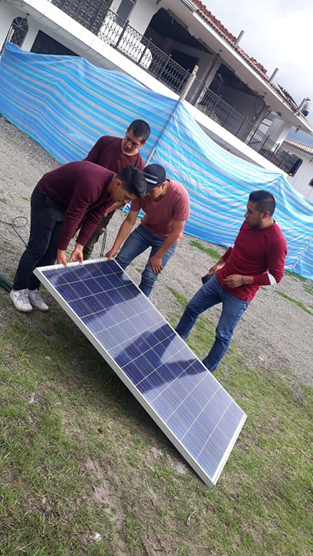
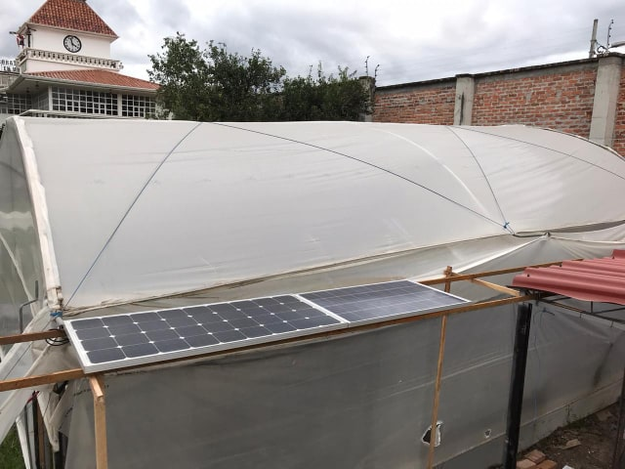
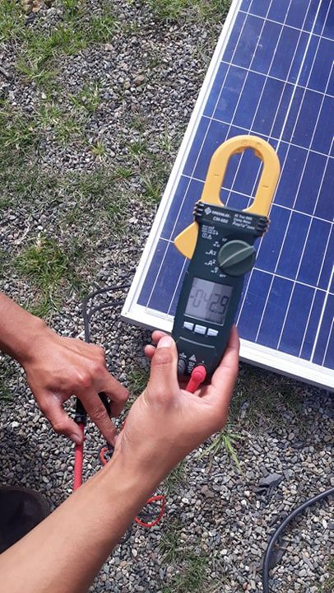
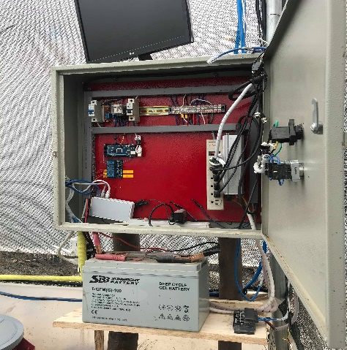
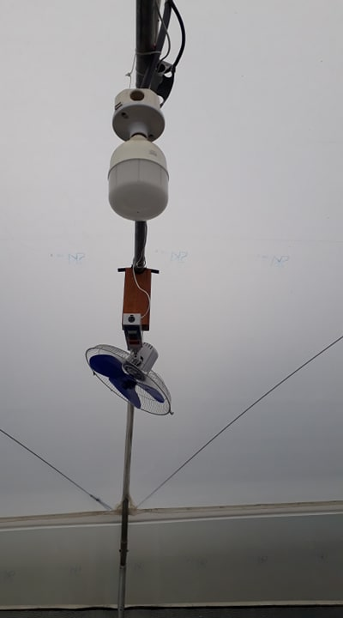
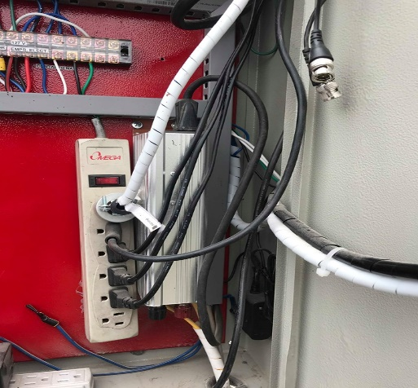
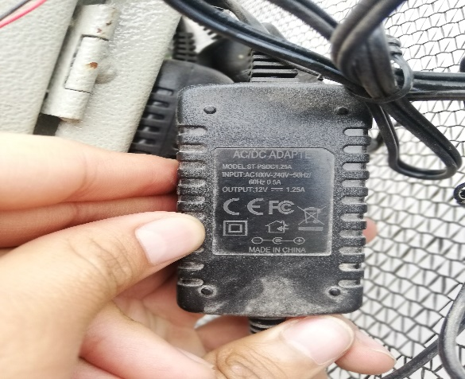
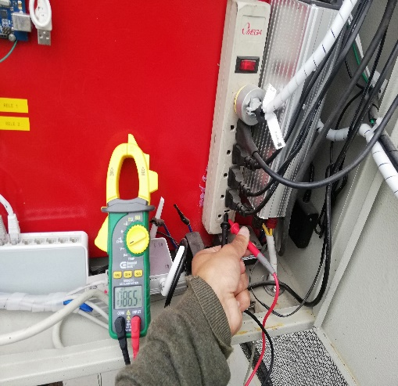
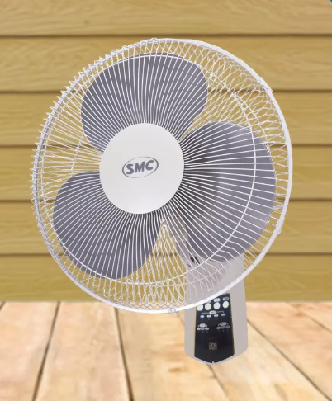
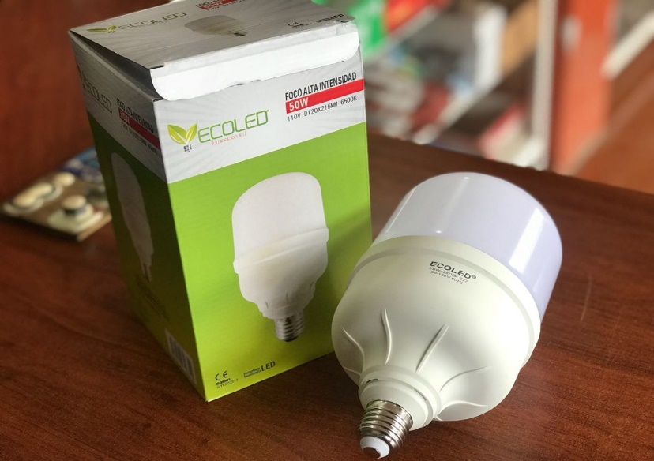
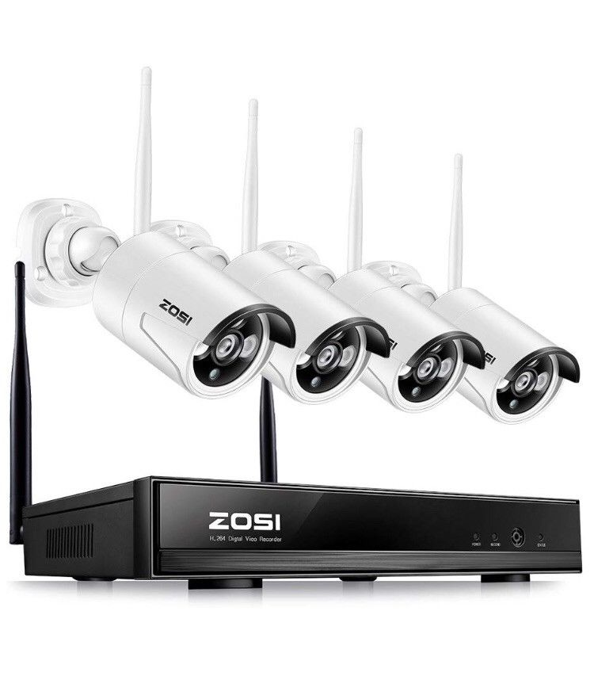
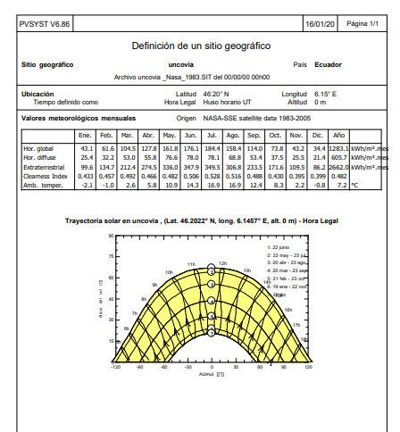
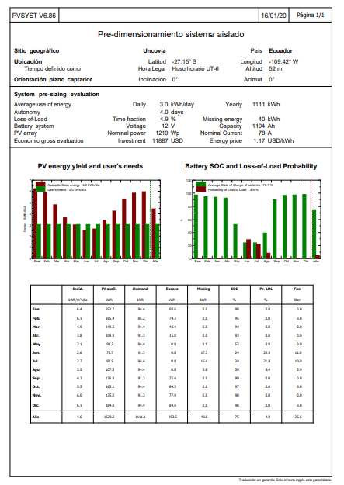
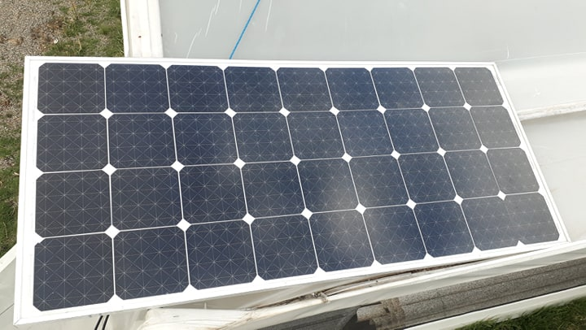


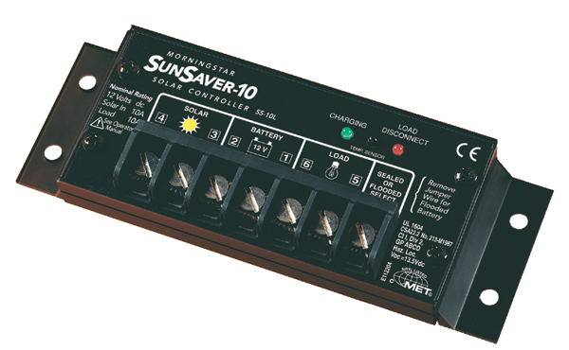
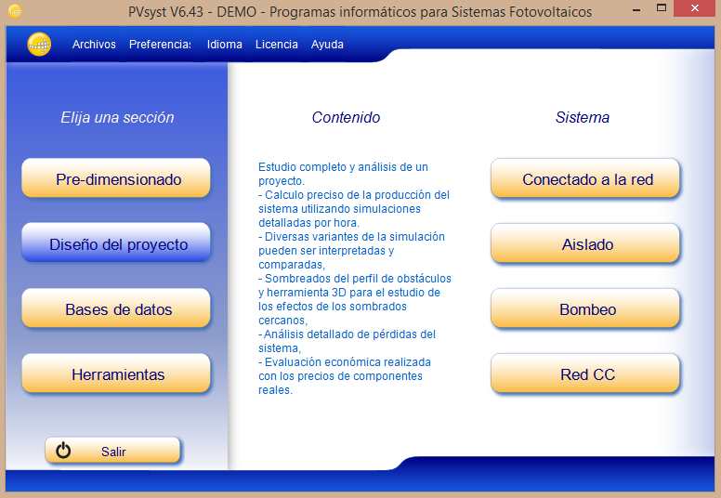
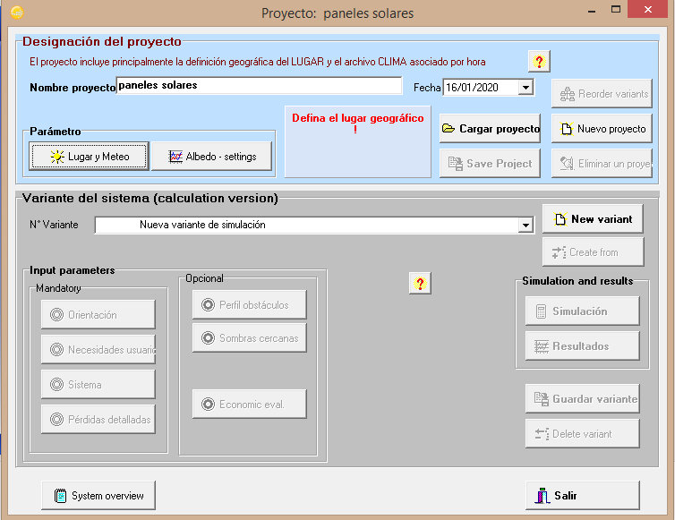
UNIVERSIDAD CATÓLICA DE CUENCA
CARRERA DE INGENIERÍA ELÉCTRICA
INSTALLATION OF PHOTOVOLTICAL MODULES FOR ELECTRICAL IN A GREENHOUSE.
Christian Alvarez, Brian Arévalo, Marcos Puin, Ismael Yupa
briansebas7@Gmail.com , faviangarcia1998@gmail.com , jiyupaq81@gmail.com, marcomuevecela@Gmail.com, Electrical engineering. Cuenca, Ecuador
I- Introduction
  Thee purpose of carrying out and launching this project is to supply electrical energy for the different loads that are used in a greenhouse, being an isolated installation, that is, it is not connected to the local electricity grid.
  It will be located within the development and research and postgraduate center of the university, to encourage the efficient use that will be a system of security cameras, fans and their respective lighting.
  The installation consists of 2 photovoltaic modules, connected in parallel where the generated energy is directed towards the voltage controller that carries energy to the batteries which in turn this conducts electricity to the inverter.
  The operation of the solar panels and their components will be explained, exposing practical calculations that will allow us to see how it supplies each of the aforementioned charges
II. Diagram of modules photovoltaic
IV. Experimental Results
  The installation of the photovoltaic modules is detailed in Figure 1 where the single-line diagram showing how the study was done, with their respective loads that are fed in the greenhouse
  The photovoltaic modules have a voltage of 18.5V and their maximum power is 150W.
  Construction of the structure for the supports of the photovoltaic modules (height is 1.90m and its angle 0 °).
  Installation and placement of different components, photovoltaic generators as well as loads.
  Mathematical and manual calculations of the different equipment (powers (P), current (I), voltages (V)).
  Figure 1. Block diagram of the proposed multilevel converter
INSTALLATION OF EQUIPMENT AND LOADS
III. Description of equipement
  Air Fans Marasaki of pedestal 110V/60Hz(fig.1)
  Ecoled 50W(fig.2)
  Sistem of camara of security (fig.3)
  Photovoltaic module solar Eco Green energy 350 w (fig.4)
  Inversor Zonhan 600 w (fig.5)
  Battery Sunbright 12 V (fig.6)
  Morningstar SunSaver 10SSL 12V/24v Charge Controller 10A(fig.7)
DATA OBTAINED FROM THE PVSYST SOFTWARE.
Figura 1: Air Fans Marasaki of pedestal 110V/60Hz
Figura 2: Ecoled 50W
Figura 3: Sistem of camara of security
Figura 4: Photovoltaic module solar Eco Green energy 350 w
Figura 5: Inversor Zonhan 600 w
Figura 6: Battery Sunbright 12 V
Figura 7: Morningstar SunSaver 10SSL 12V/24v Charge Controller 10A(fig
V. Conclusion
SOFTWARE TO MEASURE SOLAR RADIATION
  The energy supply through photovoltaic systems facilitates access to the energy service in the most remote areas and communities in places where there is no or insufficient electrical infrastructure, for our project we want to take advantage of solar radiation to provide energy to these places, So it becomes the best alternative.
  The energy that a photovoltaic solar panel captures will depend so much on the climatology of the place as of the angle of inclination that the panel has Regarding sunrays.
  The use of the PvSyst software for the sizing of photovoltaic systems is very useful, since it helped to carry out the design of systems in a faster and more practical way, in the same way it served to corroborate the results obtained mathematically from the sizing.
The PVsyst software is a tool that allows its users to accurately analyze different configurations and evaluate the results and identify the best possible solution.
For our project we provide the data shown in the pictures.

