Slide 1
Phase 8: Final Integration and Documentation
IT Helpdesk Ticket Tracker
Student: Karuranga ID: 27541

Slide 2
Project Overview
This capstone project provides a PL/SQL-based solution for managing helpdesk tickets.
Features:
- Automated escalation and resolution tracking
- Modular procedures, functions, and packages
- Security enforcement and auditing
- Holiday and weekday restrictions using compound triggers

Slide 3
PL/SQL Features Applied
- Parameterized Procedures and Functions
- Packages for ticket handling and auditing
- Triggers: Simple and Compound for restriction and auditing
- Cursors for iterative data processing
- Exception handling and logging
- Use of SEQUENCE for ticket IDs

Slide 4
Advanced Triggers and Auditing
- Restricts DML operations during weekdays and public holidays
- Compound trigger ensures multiple-row consistency
- Audit log table captures:
* User ID
* Operation Type
* Timestamp
* Status (Allowed/Denied)
- Holiday reference table for dynamic checking

Slide 5
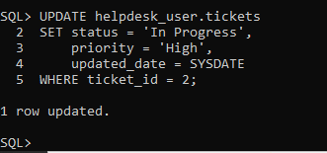
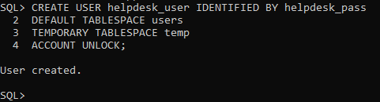
Testing and Validation
- DML operations tested: INSERT, UPDATE, DELETE
- DDL operations validated: CREATE, DROP

Slide 6
- Execution of procedures and functions verified
- Trigger functionality confirmed with different test dates
- Logging verified in audit_log table.

Slide 7
Conclusion and Reflection
- System automates and secures ticket lifecycle
- Modular design improves maintenance and scalability
- Learned advanced PL/SQL concepts including compound triggers and packages
- Real-world practices applied: security, auditing, error handling

