Slide 1
Fitness Tracker Project
Team members:
Akshay J
Christian Mario Thomas C
Harish
Rithvik
Senthan Selvi
Shruti Rajesh
Swaminathan
Mechanical Engineering (DM)
Computer Science and Engineering
Computer Science and Engineering-(AI&DS)
Computer Science and Engineering-(AIDS)
Computer Science and Engineering-(AIDS)
3RD Year
3RD Year
3RD Year
3RD Year
3RD Year
3RD Year

Slide 2
Steps that we followed
Collect Data
Clean Data set
Compute Average Acceleration For Each Datum
Plotting
KNN Modelling
Computing Maximum Accuracy
Testing

Slide 3
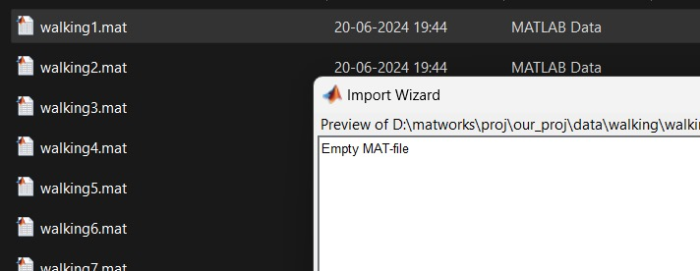
Collection of Data
Using Matlab Mobile Sensors for Acceleration, we recorded the differences in x, y and z axis for four activities: 1. Sitting
2. Walking
3. Jumping
4. Jumping and Walking.
We further cleaned all the empty data sets before computation.

Slide 4
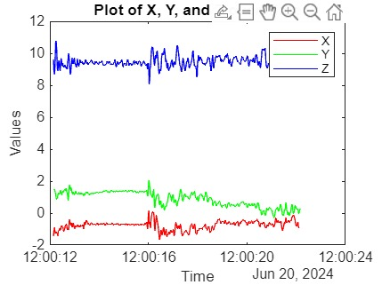
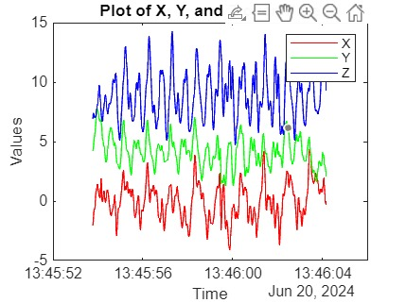
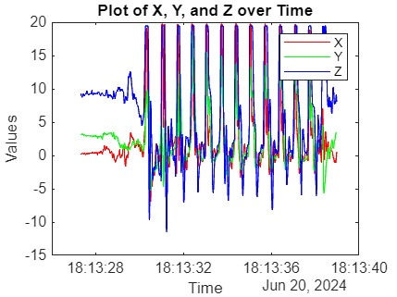
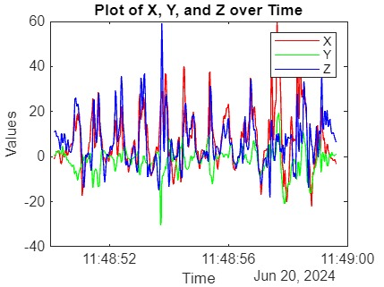
Computing average acceleration
Walking
Sitting
Jumping and
Walking
Jumping

Slide 5
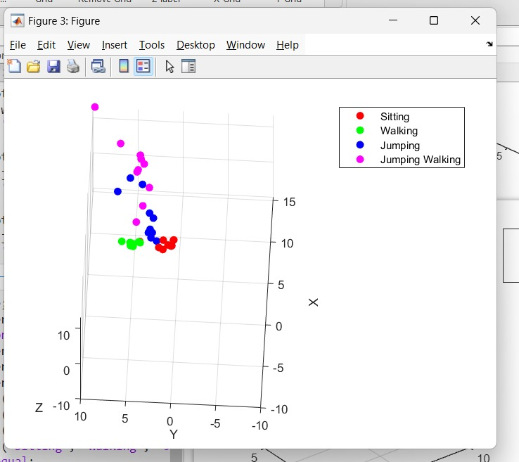
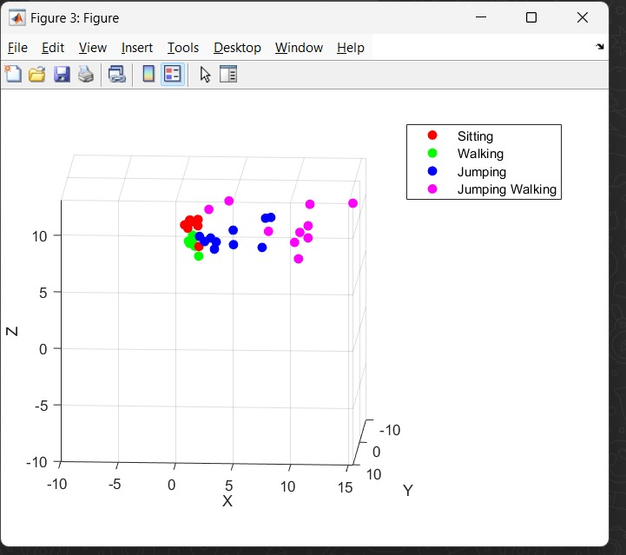
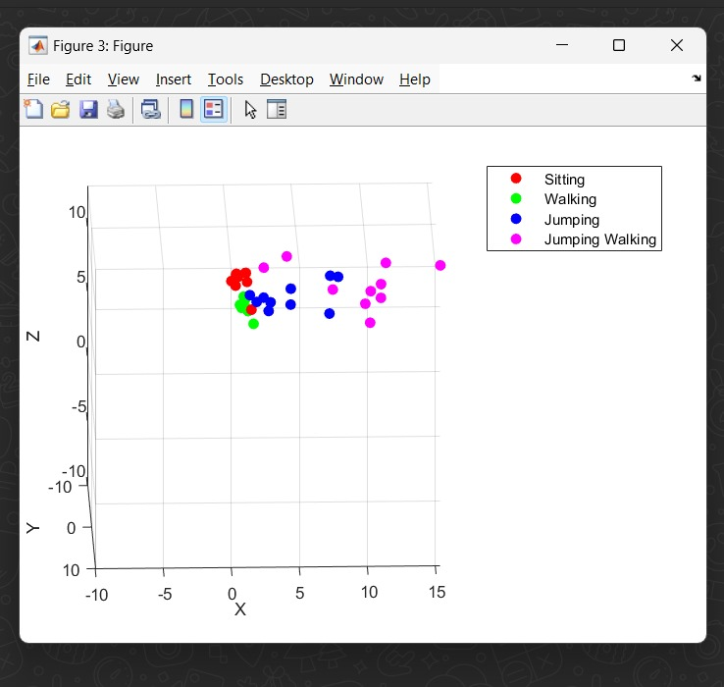
Plotting [3D]

Slide 6
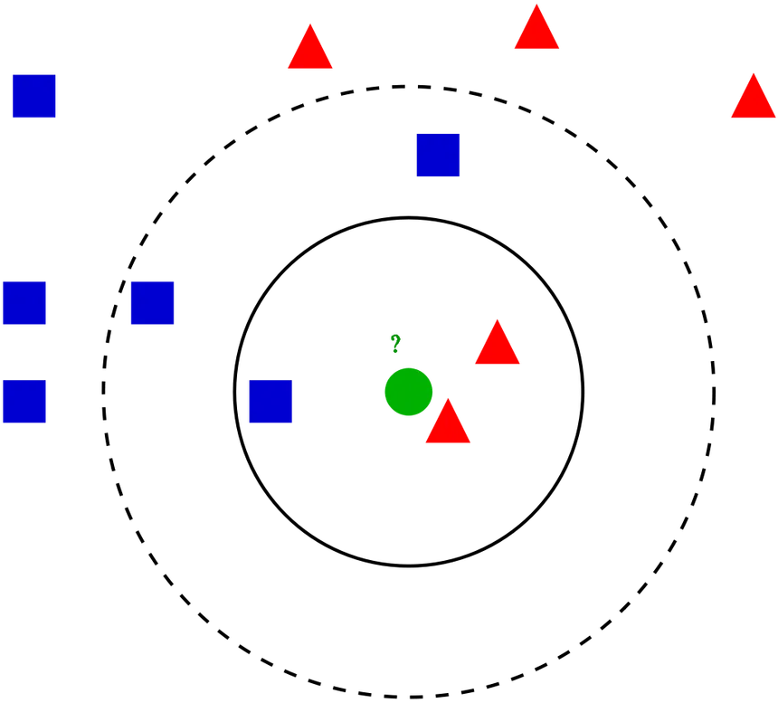
Forming a KNN Model
Split the data into two sets Training and Testing [80-20]
Build a Model.
Scale the data.
Model prediction.
Testing.
Evaluation.
Launch.

Slide 7
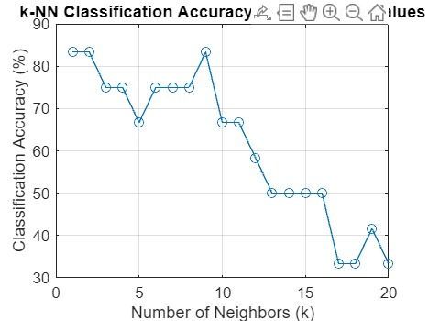
Plotting an Accuracy Chart
The maximum Accuracy is at k = 2 and k = 8.
The maximum Accuracy achieved by our model is 83.33%.

Slide 8
Learnings
The lectures were completely useful and the onramp courses filled any gaps that we had while practicing hands-on.
The functions of matlab helped us in analysing the data easily.
We learnt how to categories and classify using different datasets.
We used different trained models and gathered insights on which model was most suitable to train and predict.
We learnt the different ways to increase the accuracy of our models such as confusion matrix.
We also learnt how to visualize the data using different methods such as plotting, pie charts,etc.

Slide 9
Feedback
We had a great experience during the lectures as well as homeworks.
The course helped us gain knowledge about the principles of machine learning,deep learning.
The practical experiments also helped us understand the real time uses.
The project helped in bringing together our teammates and also made us all brainstorm and think differently.
We were able to produce a model that could classify the data given as input,and predict the right activity.
Overall, a really great experience and a wonderful course to have been a part of.

Slide 10
Members:
Name Degree Branch year (for Certificate) Email id | MATLAB Onramp Certificate Link | Machine Learning Onramp Certificate Link | Deep Learning Onramp Certificate Link
Akshay J B.Tech- Mechanical Engineering (DM) 3rd Year
Christian Mario Thomas C B.Tech-Computer Science and Engineering 3rd Year
Harish B.Tech-Computer Science and Engineering-(AI&DS) 3RD Year

Slide 11
Members continued
Name Degree Branch year (for Certificate) Email id | MATLAB Onramp Certificate Link | Machine Learning Onramp Certificate Link | Deep Learning Onramp Certificate Link
Rithvik 3RD Year
Senthan Selvi B.Tech-Computer Science and Engineering-(AIDS) 3rd Year
Shruti Rajesh B.Tech-Computer Science and Engineering-(AIDS) 3rd Year 126156144@sastra.ac.in | https://matlabacademy.mathworks.com/progress/share/certificate.html?id=fdc5385a-8a6d-4311-9cfb-13f5be56d69d& | https://matlabacademy.mathworks.com/progress/share/certificate.html?id=561b7e22-9ad7-4060-bd1d-f39ea5d998a6& | https://matlabacademy.mathworks.com/progress/share/certificate.html?id=36d7a397-8ebb-4e4a-82dc-8dd5b48e03bb&
Swaminathan 3rd Year

Slide 12
Thankyou

