Slide 1


Real Time Detection of calibration
Universidad Católica San Pablo
Teacher: D. Sc Manuel Loaiza
Course: Computer Vision
Speakers: Christian Cordova
Zoser Quenaya

Slide 2
Universidad Católica San Pablo
Process of Implementation:
Read the frames of a camera (in real time).
Applied cv::cvtColor() - convert a color image to gray sacale image.
Smoothing: cv::GaussianBlur().
Applied: cv::adaptiveThreshold().
cv::Canny to detection.
cv::findContours().

Slide 3
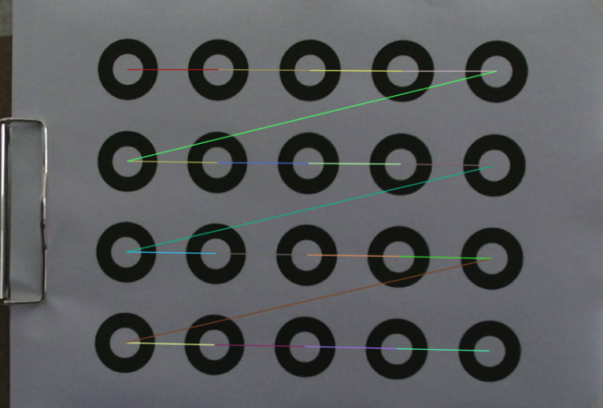
Universidad Católica San Pablo
Process of Implementation:
Allocate into vector<RotatedRect>.
There are nearby centers.

Slide 4
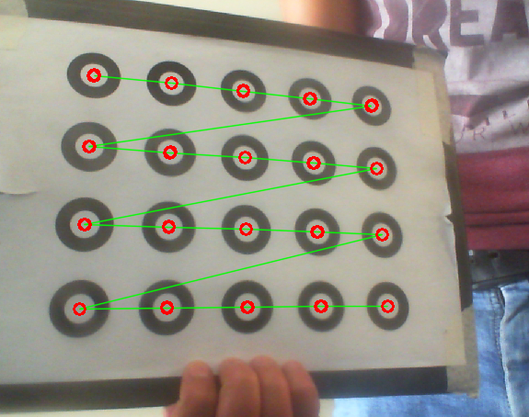
Universidad Católica San Pablo
Results:

Slide 5
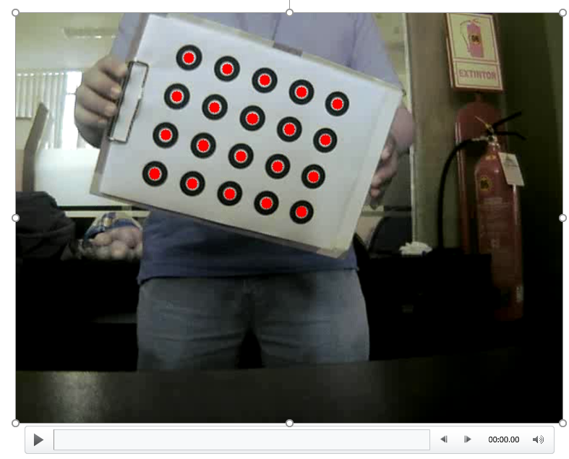
Universidad Católica San Pablo

Slide 6
Thanks
Universidad Católica San Pablo

