Slide 1



CALIBRATION CAMERA WITH TRACKING IN REAL TIME
Universidad Católica San Pablo
Teacher: D. Sc Manuel Loaiza
Course: Computer Vision
Speakers: Christian Córdova
Zoser Quenaya

Slide 2
Universidad Católica San Pablo
Pipeline:
Read the frames of a camera (in real time).
Applied cv::cvtColor() - convert a color image to gray sacale image.
Smoothing: cv::GaussianBlur().
Applied: cv::adaptiveThreshold().
cv::Canny to detection.
cv::findContours().

Slide 3
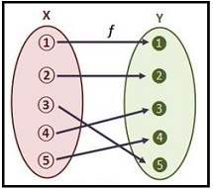
Bijection function: Permutation

Slide 4
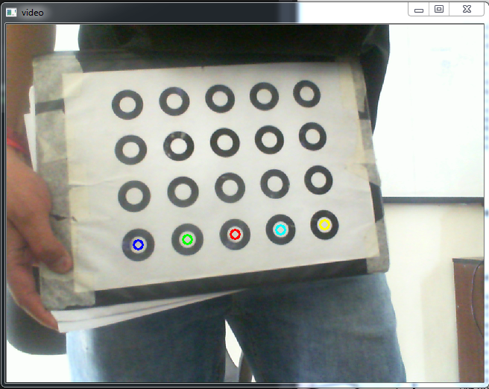
Tracking

Slide 5
Reprojection Values:
Pattern | LifeCam | PSP 3 Camera
Chess Board | 0.329978 | 0.330631
Asymmetric Circles | 0.190614 | 0.30129
Rings | 28.1405 | 27.36541

Slide 6
Intrinsic Parameters:
Pattern | Focal: x | Focal: y | Center: x | Center: y
Chess Board (LifeCam) | 16 | 0 | 51 | 51
Chess Board (PS3 Camera) | 16 | 0 | 91 | 91
Asymmetric Circles (LifeCam) | 182 | 0 | 140 | 140
Asymmetric Circles (PS3 Camera) | 182 | 0 | 226 | 226

Slide 7
Thanks
Universidad Católica San Pablo

