Slide 1
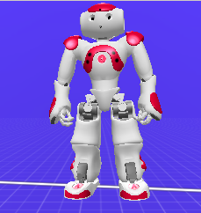
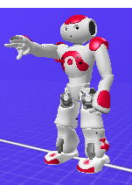
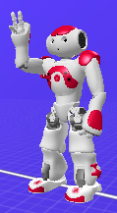
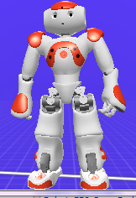
Push
Medium
Medium
Short Hold
Medium Hold
Fast
Medium

Slide 2
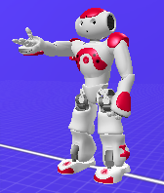
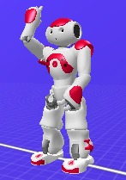
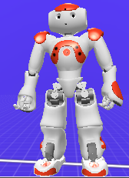
Pull
Medium
Fast
Short Hold
Medium Hold
Medium

Slide 3
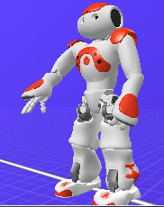
Push Slow-Down
Medium
Medium
Fast
Short Hold
Short Hold
Slow
Slow
Medium
Short Hold

Slide 4
Pull Slow-Down
Medium
Fast
Short Hold
Short Hold
Slow
Slow
Medium
Short Hold

Slide 5
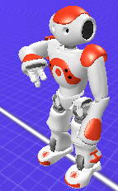
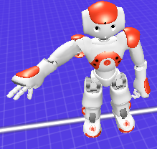
Push Weave
Medium
Medium
Fast
Short Hold
Short Hold
Slow
Slow
Slow
Medium

Slide 6
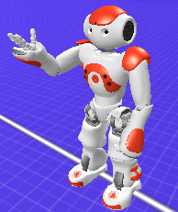
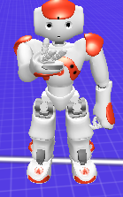
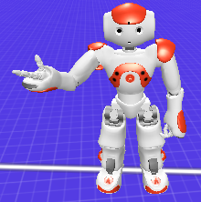
Pull Weave
Medium
Fast
Medium
Short Hold
Short Hold
Slow
Slow
Slow
Medium

