Slide 1
Serverless
Christian Daniel Avila Sánchez

Slide 2
History
Data center
Hardware as unit of scale
Abstracts physical hosting environment
IaaS
Operating System as unit of scale
Abstracts the hardware
Containers
Application as the unit of scale
Abstracts the OS
Serverless
Functions as unit of scale
Abstracts the language runtime

Slide 3
Serverless
The essence of the serverless trend is the absence of the server concept during software development.
— Auth0

Slide 4

Advantages
Focus on business logic
Virtually ‘infinite’ auto-scaling
Pay per use
Decreased time to market

Slide 5
Drawbacks
Vendor lock-in
Not efficient for long-running applications
Architectural Complexity
Test functions locally

Slide 6
What can we build?
📱 Mobile Backends
🔌 APIs & Microservices
📦 Data Processing pipelines
⚡ Webhooks
🤖 Bots and integrations
⚙ IoT Backends
💻 Single page web applications

Slide 7
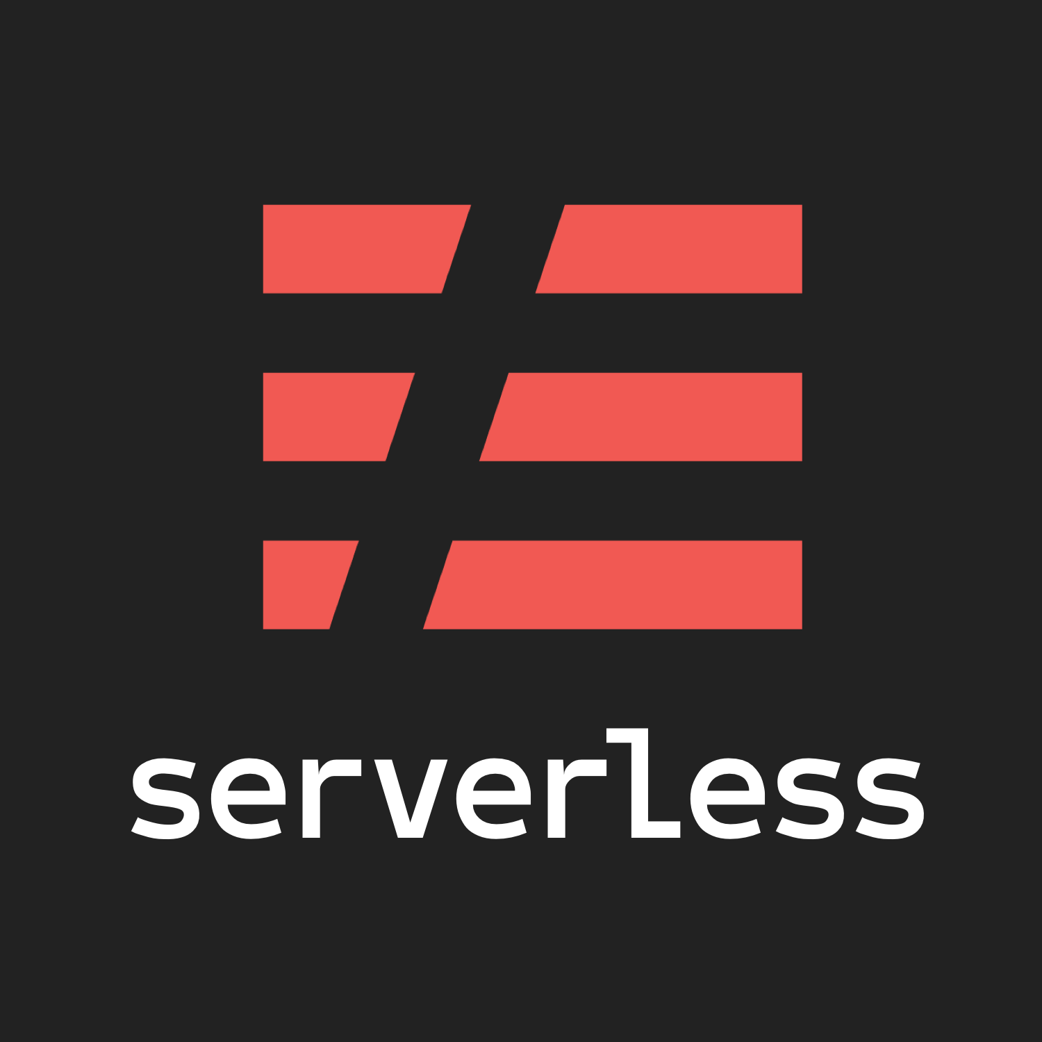



Serverless frameworks

Slide 8
Demo
🔌 APIs & Microservices & SAM

