Slide 1
Infrastructure as Code (IaC)
How to get started in the AWS Cloud?
Christian Avila – DevOps @ GBM
GBM Tech Talks Vol. 2 – November 22, 2018

Slide 2
Infrastructure Challenges
Change management process are commonly ignored, bypassed, or overruled by people who need to get things done.
Keep infrastructure up and running within the application.
Provisioning new infrastructure that only some people know the details.
Rapidly scale up in situations with more demand.

Slide 3
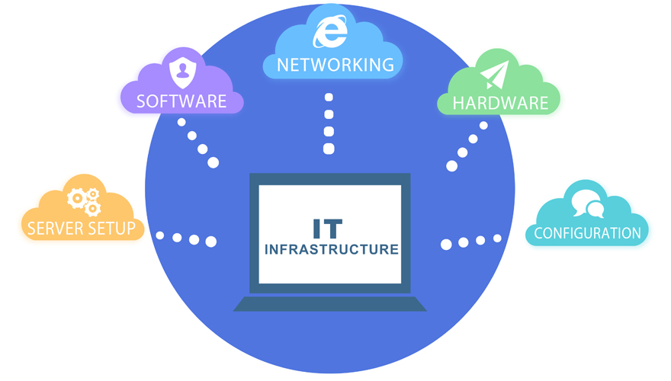

Slide 4
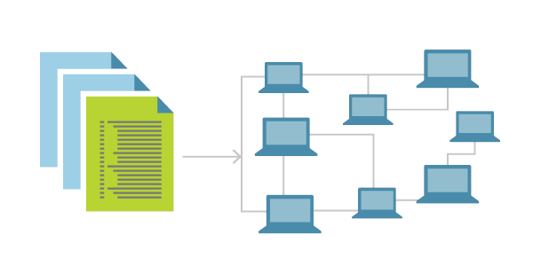

Slide 5
Infrastructure as Code (IaC)
Defining infrastructure and services through code that can then be treated just like any software system.
Emphasize consistent, repeatable routines for provisioning and changing systems and their configuration in a descriptive model.
Use software development tools such as version control, automated testing, and deployment orchestration.
Deliver stable environments rapidly and at scale.

Slide 6
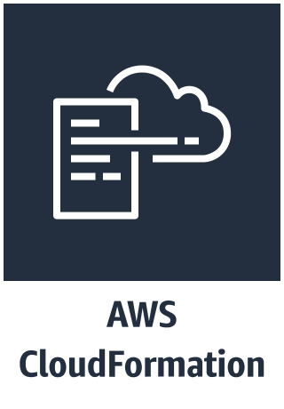

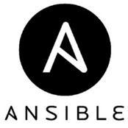


Common Tools

Slide 7
AWS CloudFormation
Provides a common language to describe and provision all the infrastructure resources in your cloud environment.
Use a simple text file to model and provision, in an automated and secure manner, all the resources needed for your applications across all regions and accounts.
Serves as the single source of truth for your cloud environment.

Slide 8
Benefits
Easy to use, it’s simple as code
Flexible and declarative
Customization through parameters
Automate and Deploy

Slide 9
Features
Safety Controls
Preview Changes before applying to environments
Dependency Management
Cross Account and Cross-Region
Extensibility

Slide 10
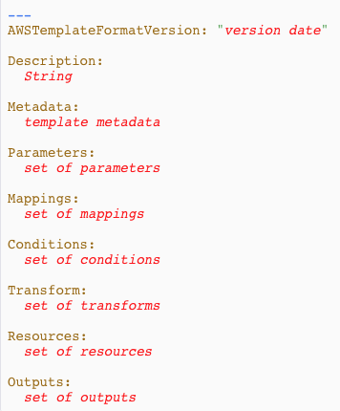
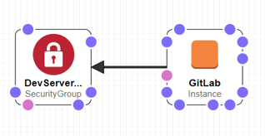
Templates
JSON and YAML support
Visual Designer

Slide 11
Workflow
Version Control
Code Review
Code
Deploy
Text Editor
Git
Pull Request
Code Pipeline

Slide 12
Demo

Slide 13

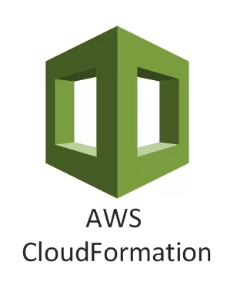
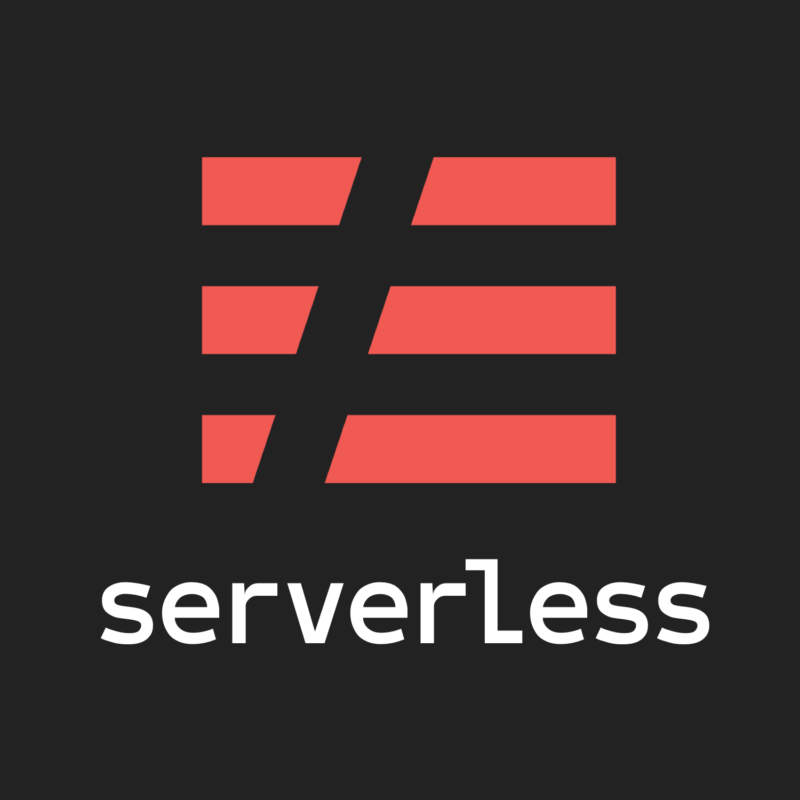
Serverless + CloudFormation...
+
=

Slide 14
Demo again!

Slide 15
Questions?
Thanks!

