Slide 1
Infrastructure as a code
Christian Daniel Avila Sánchez

Slide 2
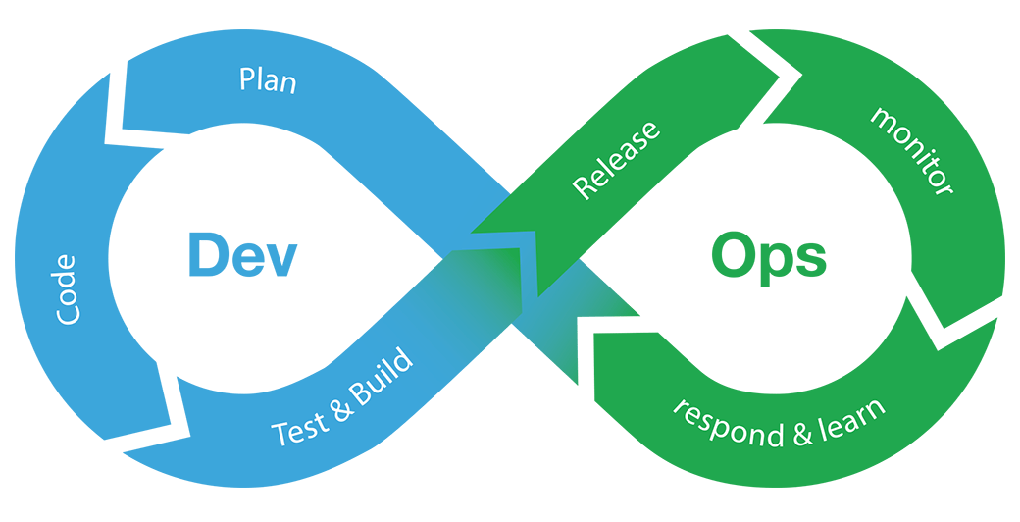
DevOps
Practice of operations and development engineers participating together in the entire service lifecycle, from design through the development process to production support.

Slide 3
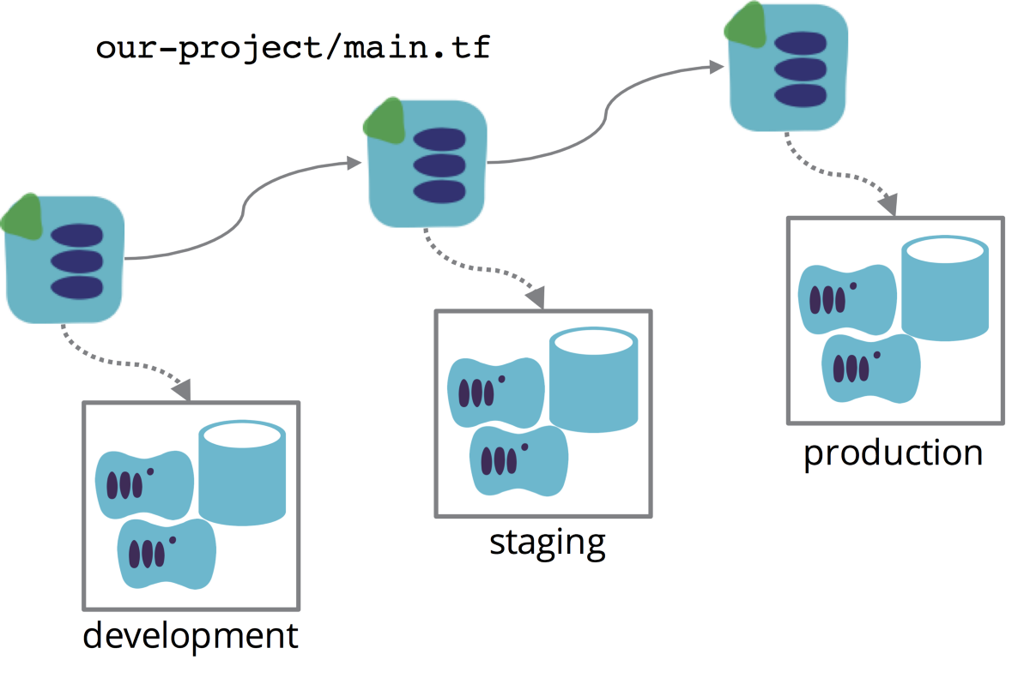
Infrastructure as a Code
Automate the creation and maintenance of infrastructure
Management in a descriptive model using the same versioning model.
Key in DevOps practice.
Deliver stable environments rapidly and at scale.

Slide 4






Tools

Slide 5
Terraform
Terraform is a tool for building, changing, and versioning infrastructure safely and efficiently. Terraform can manage existing and popular service providers as well as custom in-house solutions.

Slide 6
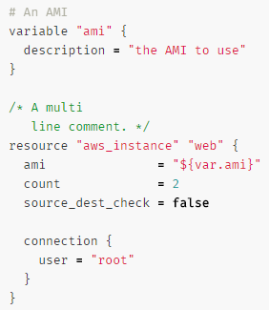
Configuration Files
JSON or Terraform format (HCL)
HashiCorp Configuration Language
Interpolation Syntax
Variables
Resources Configuration
Data sources
Outputs
Modules

Slide 7
Commands
Init -> Initialize a new or exiting terraform configurations
Validate -> Validates the Terraform files
Plan -> Generate and show an execution plan
Apply -> Builds or changes infraestructure
Destroy -> Destroy terraform-managed infraestructure

Slide 8
State
Store state about your managed infrastructure and configuration
Keep track of metadata
Store in ‘terraform.tfstate’
Support S3 as state storage

Slide 9



Providers
AWS
Azure
Google
Kubernetes
MySQL
RabbitMQ
See more -> https://www.terraform.io/docs/providers/index.html

Slide 10
Cloudformation
Provides a common language for you to describe and provision all the infrastructure resources in your cloud environment

Slide 11
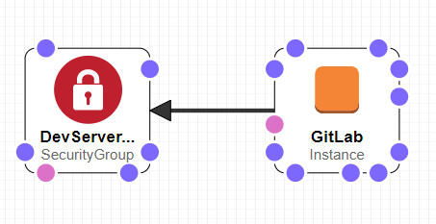
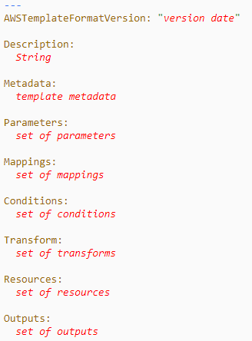
Templates
JSON and YAML
Visual Designer
https://docs.aws.amazon.com/AWSCloudFormation/latest/UserGuide/template-anatomy.html

Slide 12
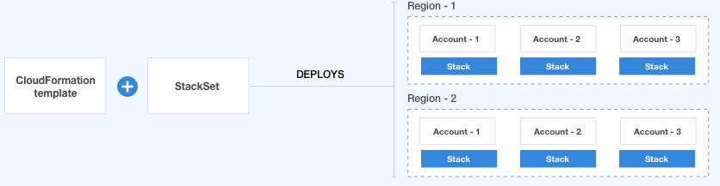
StackSet
A StackSet is a container for AWS CloudFormation stacks that lets you provision stacks across AWS accounts and regions by using a single AWS CloudFormation template.

Slide 13
Features
Preview Changes To Your Environment
Dependency Management
Cross Account And Cross-Region Management
Extensibility
Lambda

Slide 14

Demo Time!

Slide 15


