Slide 1











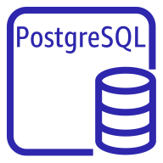









AWS Cloud
VPC
Amazon Simple Storage Service
Public subnet
Private subnet
Private subnet
Amazon Elastic Kubernetes Service
Amazon Relational Database
Auto Scaling group
Internet
Projects and results
NAT gateway
PostgreSQL instance
Keycloak
Service nodes
Users
Internet gateway
Auto Scaling group
PostgreSQL instance
SIMPHERA
Network Load Balancer
License server
configuration files
Applications
Execution nodes
Amazon Elastic File System (Amazon EFS)
Amazon Elastic Compute Cloud
License server
File system

