Slide 1
Ticket Tagger v2.0
Label Classification with Machine Learning
L.Fried, T. Moser, D. Steiger & C.Birchler
Notes:
Lara

Slide 2
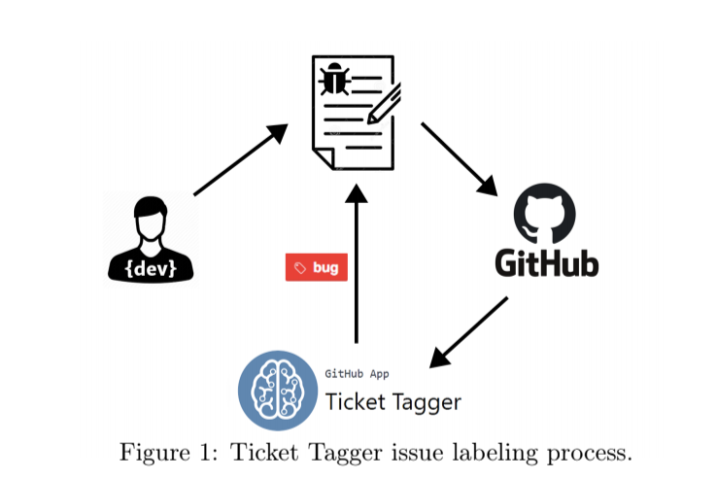
Ticket Tagger Introduction
SMaE Project of Rafael Kallis (2018)
GitHub App (NodeJS Server)
Label GitHub Issues based on Title & Description
Bug, Enhancement, Question
Helps organizing big projects automatically
Uses Fasttext for text classification
Notes:
Lara

Slide 3
Ticket Tagger Limitations
Uses only fasttext as its classifier
Evaluation and training on different repositories
No preprocessing
Model size < 5MB
Notes:
Lara

Slide 4
Research Questions
To what extent can we increase performance (F1-score) with other classifiers?
To what extent do preprocessing techniques affect the models for issue classification?
Notes:
Lara

Slide 5
Study Methodology
Acquire appropriate Data Set
WEKA / MEKA
Multi Binary Label Classification
Preprocessing
Results
Summary
Notes:
David

Slide 6
A new Dataset: Pandas
Limitations
>1000 issues / label (bug, question, enhancement)
One single Repository
All in English
Not in Java Ecosystem
Find fitting repository
Scrape GitHub
Convert dump to Data Set format (fasttext & arff)
Balance to equal label distribution (n=1230)
Notes:
David

Slide 7
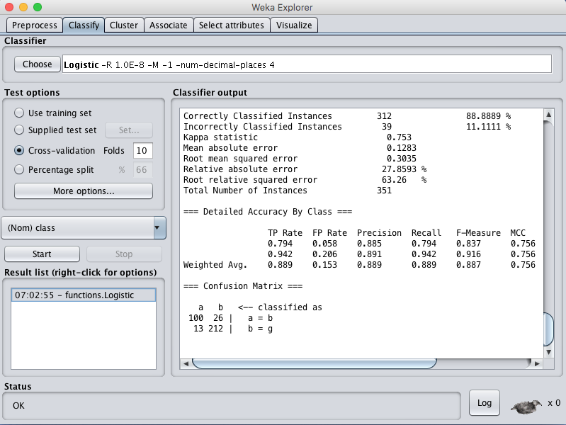

WEKA and MEKA: An introduction
WEKA: Waikato Environment for Knowledge Analysis
MEKA: Based on Weka, multi-label learning
Notes:
David

Slide 8
WEKA and MEKA - Approaches
Different Models:
J48
RandomForest
LogitBoost
AdaBoost
NaiveBayes
HoeffdingTree
Binary Relevance
Notes:
David

Slide 9
Preprocessing
Stemming
e.g., argue, argued, argues, arguing, and argus to the stem argu
Porter
Snowball
Stanford tool
Stopword removal
‘the’, ‘a’, ‘in’, ‘on’, etc.
Combinations!
12 different datasets with different preprocessing combinations
Notes:
Christian

Slide 10
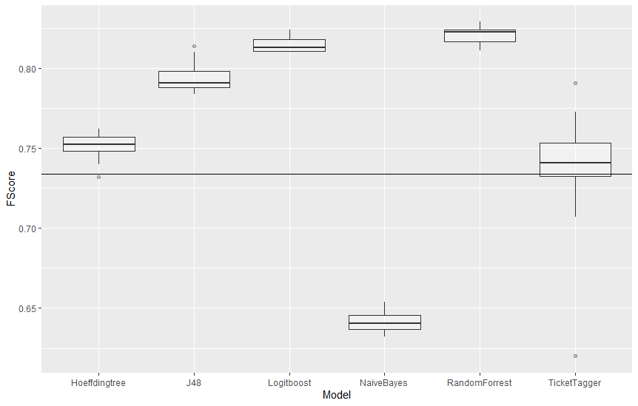
Results - Preprocessing
Notes:
Christian

Slide 11
Results - MEKA & WEKA
Every Model increased F1
except Naive Bayes
Binary Relevance decreased F1
Transforms a multi-label classification problem with L labels into L single-label separate binary classification problems using the same base classifier
The prediction output is the union of all per label classifiers
Boost models have best results
slow (chained models)
Notes:
Christian

Slide 12
Multi Binary Label with Fasttext
Train one model for each label
Split data set in 3 for each label
Test every case on 3 models, use the one with highest probability as answer
Ten fold validation
Calculate Statistics
Notes:
Tim

Slide 13
Results - MBL in Fasttext
Similar F1 to ticket-tagger but not an increase
Not a good trade-off
more models
more memory
longer training
longer predictions
Notes:
Tim

Slide 14
Limitations
Only applied techniques to Pandas issues
Cannot generalize
Model size not restricted
Ticket Tagger was restricted to 5MB
Processing time not restricted
Better performance but longer calculations
Trade-off?
Not integrated into Ticket Tagger itself
Maybe some approaches would not be feasible in NodeJs
Notes:
Tim

Slide 15
Future Work
Ticket Tagger integration
Replication on other repos
Try more preprocessing approaches
More labels
Notes:
Tim

Slide 16
Summary
Ticket Tagger F1-score of 73.4 %
Our project’s pipelines reached consistently over 75% (maximum of 82.5%)
Preprocessing has a considerable effect on performance
fasttext varies between 66% and 79%
Notes:
Tim

Slide 17
Questions and Discussion
Notes:
Tim

