Slide 1
Demo

Slide 2
Ocean Simulator
Iteration 1
Group 4

Slide 3
Target User
Defined Target User: Adolescent Demographic
Interested in Sciences and Animals, New Technology, and Exploration
Target Audience assumed to be able to play this simulator using an accessible device, and do not need any external installation of hardware (already has a webcam)

Slide 4
Plan
Assumed 60 hours of Development for total remaining project timeframe
Develop Motion Control for Diver (Iteration2 - Iteration 3)
Create 3D models for the marine life to be generated into simulation environment (Iteration 2 - Iteration 3)
Start screen and simulator navigation (Iteration 3 - Iteration 4)
After main features: Various marine life generation, simple AI patterns, polished motion control recognition, dynamically generated marine life, multi-device setup (Iteration 5)

Slide 5
Risks
TV/Large Monitor Multi-Device Implementation: 100% x 60 hr = 60 hr
Effect: Difficult Implementation for multi-device setups
Mitigation: Begin computer webcam implementation, then begin simple prototype; classify project as single device so this is not classified as a major risk – Justified with market study that shows most target users only have access to single device setup
Unrealistic Schedule: 60% x 60 hr = 36 hr
Effect: Incomplete or lower quality product
Mitigation: Create incremental delivery schedule for main features, focus on supplemental features in later iterations; ensure there is core feature functionality
Failure of Pose Detection Functionality: 40% x 60 hr = 24 hr
Effect: Main feature not properly implemented, product is different to its initial description
Mitigation: Focus on this functionality first to ensure the core feature is included in the project

Slide 6
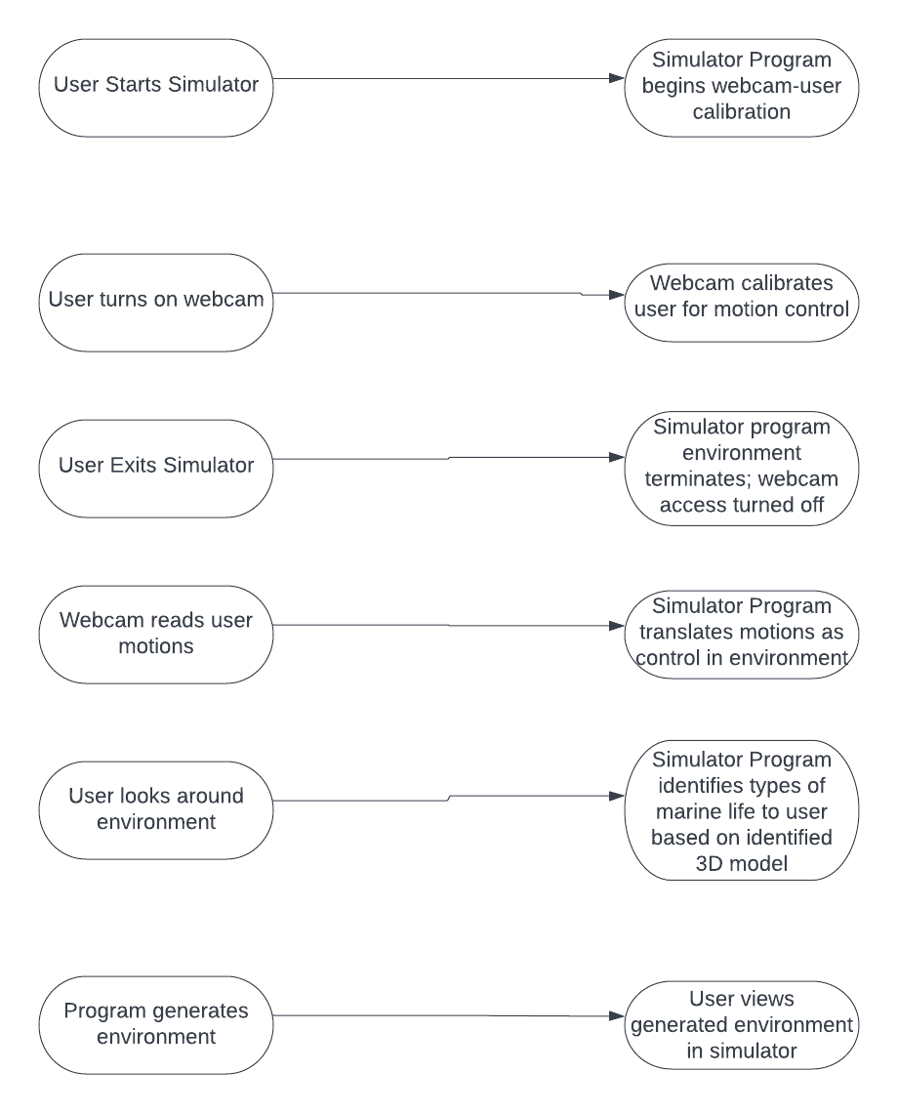
Use cases

Slide 7
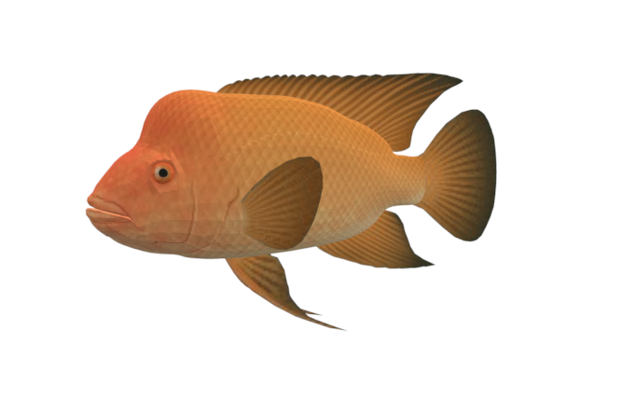
Current Progress
Implementation of motion control calibration/recognition (Demo)
3D modeling sources identified for generation
3D model that will be used in the Ocean Simulator

Slide 8
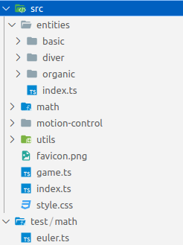
Code Organization
Organized by Topic
"entities" may get an "animals" folder
Key Data Structures:
Keypoints Map
Pose Angle
Key code:
Euler Angle Decomposition
Pose Angle Decomposition

Slide 9
Running the Code
Install nodejs
Clone ocean simulator repository
Run "npm install" in there
Run "npm run dev" in there
Navigate to http://localhost:8080 from development computer and wait for it to load
Let web page access camera
Back up so the camera can see your arms
Swim!
May want to use multiple devices for a single game so multiple cameras can give higher-resolution pose detection.
In that case, a certificate for https will be needed.

Slide 10
Testing
Pose Angle Decomposition
Think
Code
Play
Colored cubes visualized positions of key points
Blue rectangle visualized rotation of component currently being debugged
console.log()
Debug visualizations were removed for the demo version

Slide 11
Test Cases
13 Test Cases for motion control calibration / webcam detection
9 Test cases for decompose of identity rotation
4 Test cases for Euler angle rotation

Slide 12
Customer Feedback
Positive
Negative
Responsive to joints, especially elbows and shoulders.
Needs to be responsive to all other joints, like wrists, legs, and possibly hands as well.
Isaac showed the demo to his brother Jacob.
Jacob represents the target audience as he is a young male who is interested in new technology and exploring ocean life
After interacting with the demo, Jacob gave these comments:

Slide 13
Questions?
https://github.com/i12345/ocean-simulator/tree/f0d4c7b4b86193571ed0fc8349a64b3a0f2f9c85

Slide 14
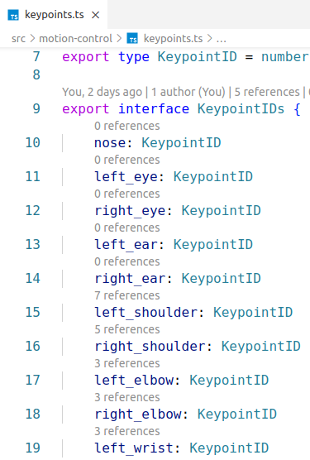
Keypoints Map (1/3)

Slide 15
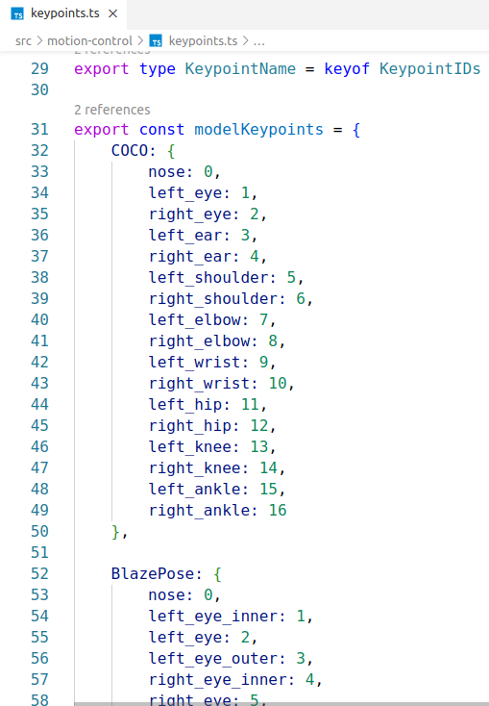
Keypoints Map (2/3)

Slide 16
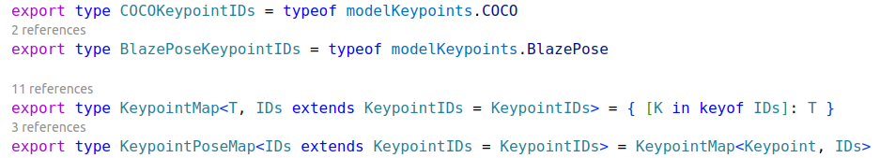
Keypoints Map (3/3)

Slide 17
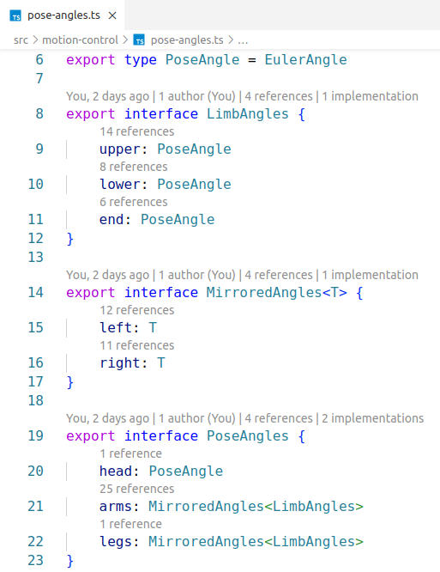
Pose Angle

Slide 18
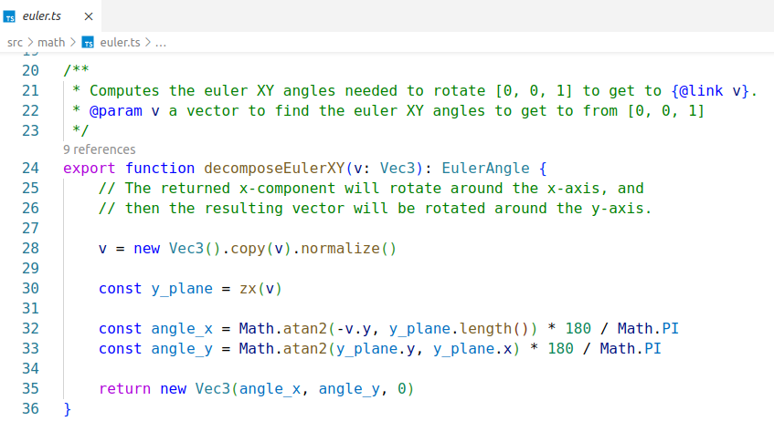
Euler Angle Decomposition (1/2)

Slide 19
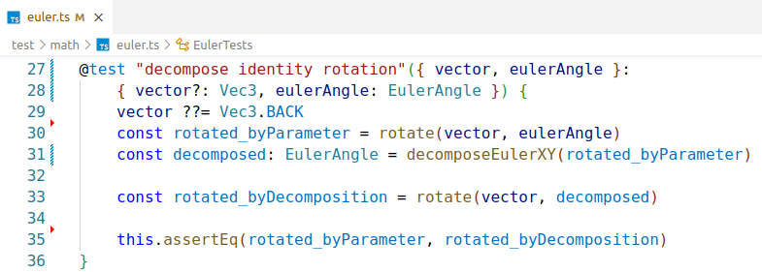
Euler Angle Decomposition
Euler Angle Decomposition (2/2)

Slide 20
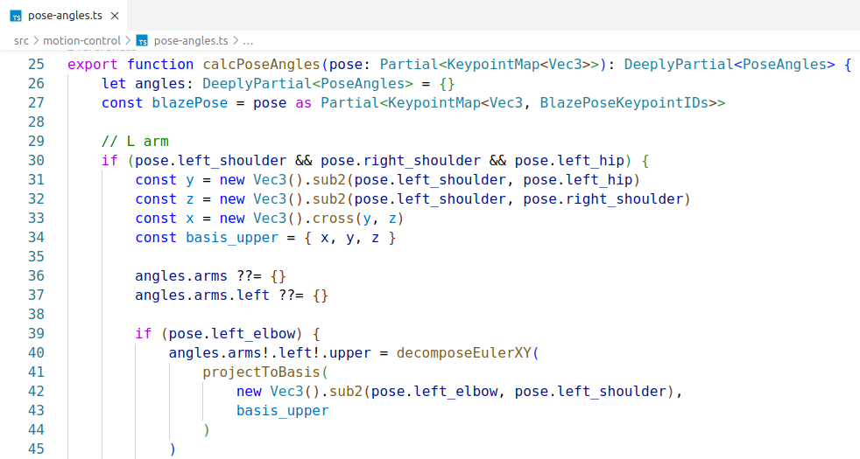
Pose Angle Decomposition (1/2)

Slide 21
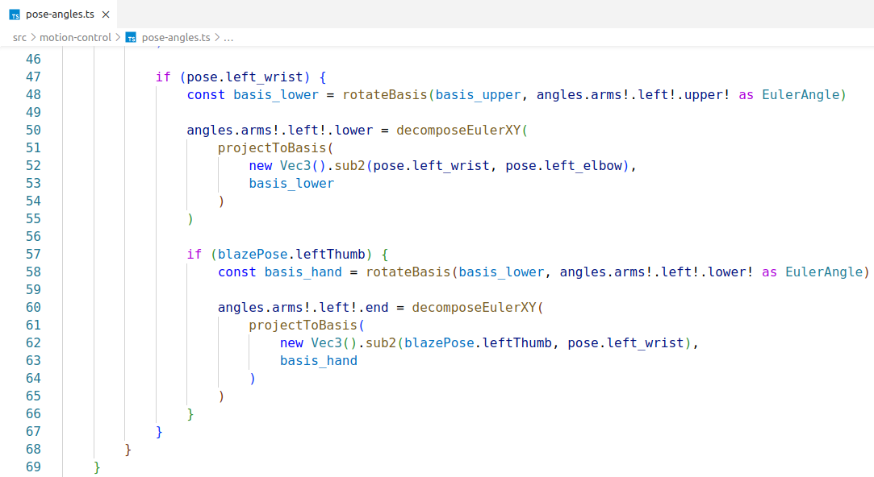
Pose Angle Decomposition (2/2)
(Similar for the right arm)

