Slide 1
Demo

Slide 2
Ocean Simulator
Iteration 2
Group 4

Slide 3
Target User
Defined Target User: Adolescent Demographic
Interested in Sciences and Animals, New Technology, and Exploration
Target Audience assumed to be able to play this simulator using an accessible device, and do not need any external installation of hardware (already has a webcam)

Slide 4
Plan
Assumed 30 hours remaining of development for | project timeframe
Polish Motion Control for Diver | Iteration 3
Create 3D models for the marine life to be generated into simulation environment | Iteration 3
Start screen and simulator navigation | Iteration 4
After main features: Various marine life generation, simple AI patterns, polished motion control recognition, dynamically generated marine life, multi-device setup | Iteration 4

Slide 5
Risks
TV/Large Monitor Multi-Device Implementation: 100% x 30 hr = 30 hr
Effect: Difficult Implementation for multi-device setups
Mitigation: Begin computer webcam implementation, then begin simple prototype; classify project as single device so this is not classified as a major risk – Justified with market study that shows most target users only have access to single device setup
Unrealistic Schedule: 60% x 30 hr = 18 hr
Effect: Incomplete or lower quality product
Mitigation: Create incremental delivery schedule for main features, focus on supplemental features in later iterations; ensure there is core feature functionality
Failure of Pose Detection Functionality: 40% x 30 hr = 12 hr
Effect: Main feature not properly implemented, product is different to its initial description
Mitigation: Focus on this functionality first to ensure the core feature is included in the project

Slide 6
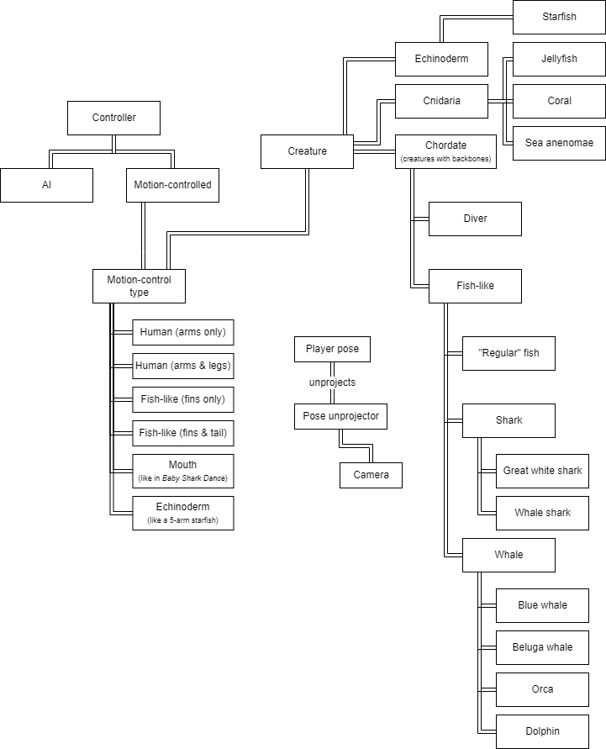
Domain Model

Slide 7
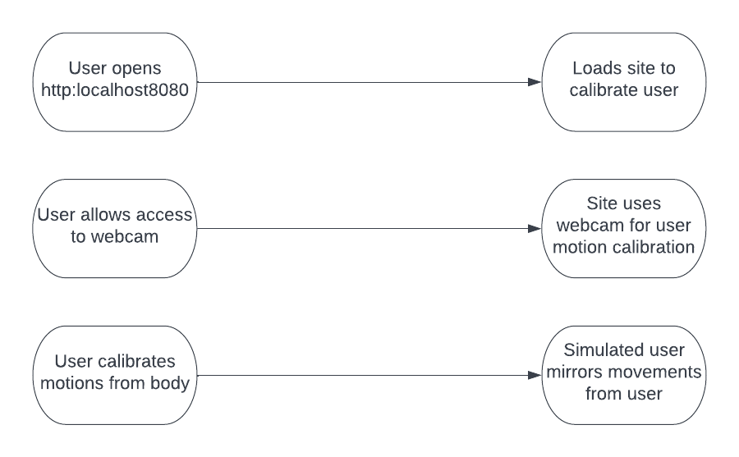
Webcam Motion Control Use case

Slide 8
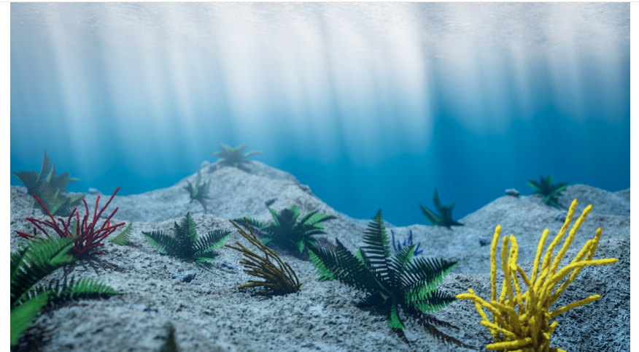
Iteration 2 Progress
Motion diver + video calibration/recognition (Demo)
3D modeling sources for simulation environment (Public Domain – CadNav)
Public Domain Sources in use for simulator (Smithsonian Institution)
Image of 3D environment for the Ocean Simulator

Slide 9
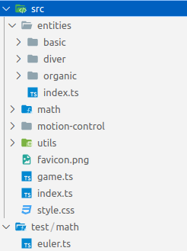
Current Software
Organized by Topic
Key Data Structures:
Keypoints Map
Pose Angle
Key code:
Euler Angle Decomposition
Pose Angle Decomposition

Slide 10
Running the Code
Install nodejs
Clone ocean simulator repository
Run "npm install" in there
Run "npm run dev" in there
Navigate to https://localhost:8080 from development computer and wait for it to load
Let web page access camera
Back up so the camera can see your arms
Test movement of all joints (upper body)
May want to use multiple devices for a single game so multiple cameras can give higher-resolution pose detection.
In that case, a certificate for https will be needed.

Slide 11
Test Cases (Updated)
22 Test cases total
19 Test cases for euler angle functions
3 Test cases for pose angle decomposition

Slide 12
Testing
Pose Angle Decomposition
Think
Code
Play
Colored cubes visualized positions of key points
Blue rectangle visualized rotation of component currently being debugged
console.log()
Debug visualizations were removed for the demo version

Slide 13
Customer Feedback
Positive
Negative
Better response from webcam motion control than last iteration
Current Environment setup needs to feel more immersive; main priority to encounter marine life not only to swim
Isaac showed the demo of iteration 2 to his twin brother Jacob.
Jacob represents the target audience as he is a young male who is interested in new technology and exploring ocean life
After interacting with the demo, Jacob gave these comments:

Slide 14
Questions?
https://github.com/i12345/ocean-simulator/commit/c66a1a8c6b1573688c9a33a378faa0cb58b82449

