Slide 1
Demo

Slide 2
Ocean Simulator
Iteration 3
Group 4
Christian Blundell Shaina Ayer Isaac Valdez

Slide 3
Target User
Defined Target User: Adolescent Demographic
Interested in Sciences and Animals, New Technology, and Exploration
Target Audience assumed to be able to play this simulator using an accessible device, and do not need any external installation of hardware (already has a webcam)

Slide 4
Updated Plan
Assumed 30 hours remaining of development for | project timeframe
For 3D environment: Generate the marine life into simulation environment | Iteration 4
Start screen and simulator navigation | Iteration 4
After main features: Various marine life generation, simple AI patterns, polished motion control recognition, dynamically generated marine life, multi-device setup | Iteration 4

Slide 5
Risks
TV/Large Monitor Multi-Device Implementation: 100% x 15 hr = 15 hr
Effect: Difficult Implementation for multi-device setups
Mitigation: Begin computer webcam implementation, then begin simple prototype; classify project as single device so this is not classified as a major risk – Justified with market study that shows most target users only have access to single device setup
Unrealistic Schedule: 80% x 15 hr = 12 hr
Effect: Incomplete or lower quality product
Mitigation: Create incremental delivery schedule for main features, focus on supplemental features in later iterations; ensure there is core feature functionality
Failure of Pose Detection Functionality: 60% x 15 hr = 9 hr
Effect: Main feature not properly implemented, product is different to its initial description
Mitigation: Focus on this functionality first to ensure the core feature is included in the project

Slide 6
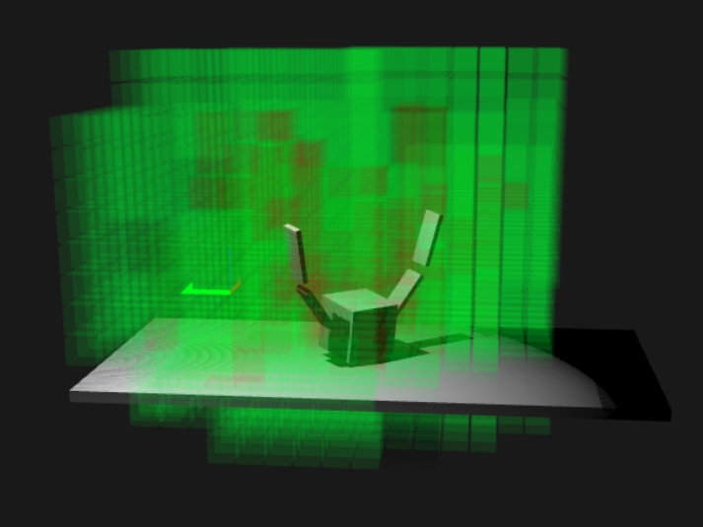
Iteration 3 Progress
Fluid simulator and hinge joints – to be implemented for diver movement in environment
3D environment (static)
Image of Hinge Testing

Slide 7
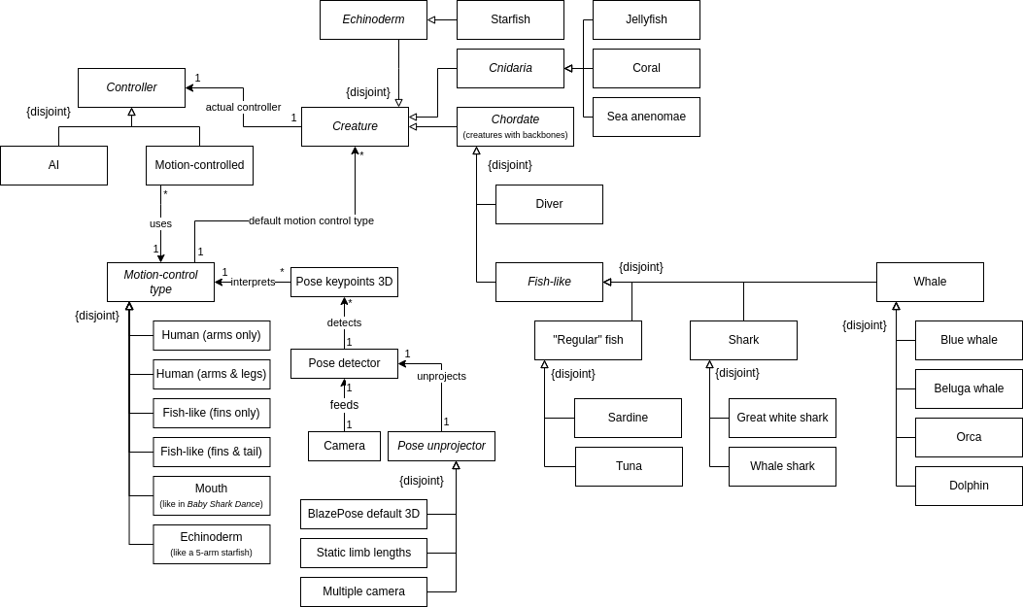
Domain Model

Slide 8
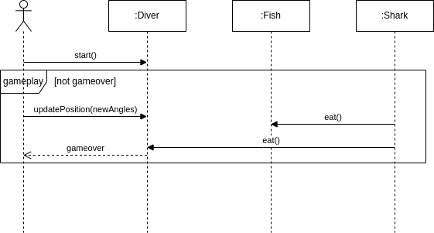
System Sequence Diagram: Gameplay

Slide 9
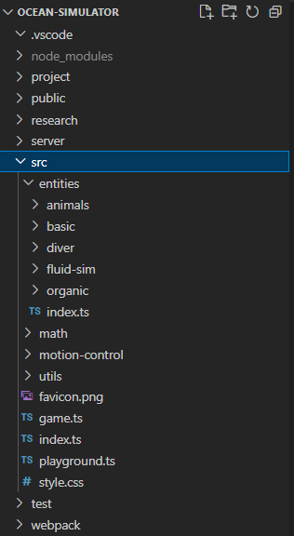
Software Organization

Slide 10
Running the Code
Install nodejs.
Clone ocean simulator repository.
Run "npm install" in there.
Run "npm run dev" in there.
Navigate to https://localhost:8080 from the development computer and wait for it to load.
Check for movement of test object (fluidity simulation and hinge testing)

Slide 11
Test Cases (Updated)
Math tests
Observation tests
Automated tests given expected inputs and output(s)
Euler angle rotations
Transformations
Pose angle decomposition
Tester observes rendering & physics of "playground" functions
Hinges
Capsule, sphere, and box entity generators
Moving rigid bodies
Diver & components

Slide 12
Customer Feedback
Positive
Negative
Immersive movement (fluidity: as if moving in water)
Current static environment must be implemented to determine complete simulation immersivity
Jacob represents the target audience as he is a young male who is interested in new technology and exploring ocean life
We will need to interconnect more features before getting further feedback from Jacob.

Slide 13
Questions?
https://github.com/i12345/ocean-simulator/commit/c66a1a8c6b1573688c9a33a378faa0cb58b82449

