Slide 1
Demo

Slide 2
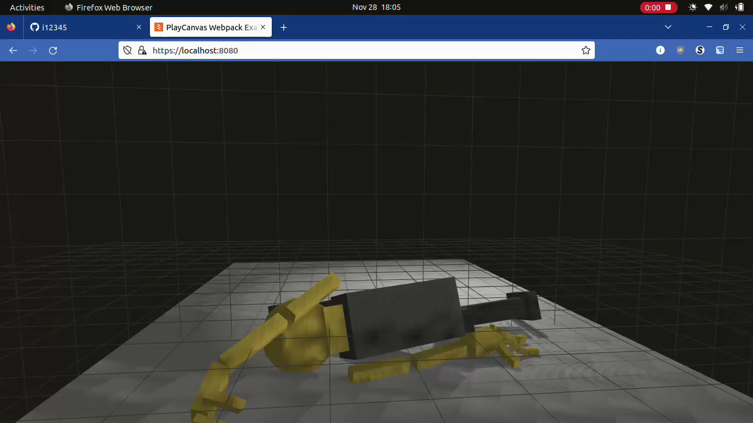

Slide 3
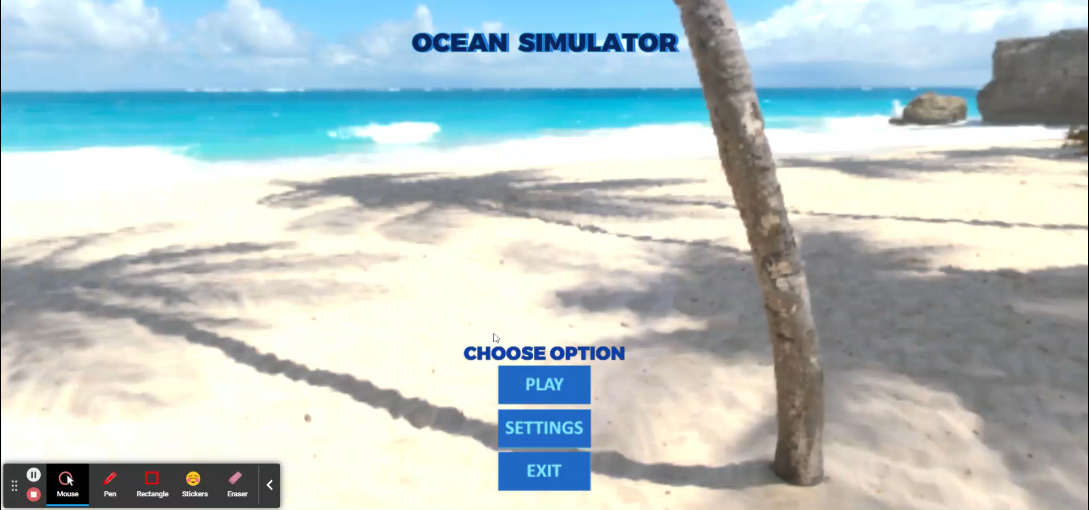

Slide 4
Ocean Simulator
Group 4
Christian Blundell Shaina Ayer Isaac Valdez

Slide 5
Target User
Defined Target User: Adolescent Demographic
Interested in Sciences and Animals, New Technology, and Exploration
Target Audience assumed to be able to play this simulator using an accessible device, and do not need any external installation of hardware (already has a webcam)

Slide 6
Competitors
Video games / interactive projects with marine life
Motion-controlled video games
Ultimate Ocean Simulator
lets the player “play” as one of the marine animals
Ocean Mammals: Blue Whale Mari
Fish Abyss: Aquarium Simulator
David Attenborough’s Great Barrier Reef
has many educational videos and articles as well.
(Besides these, there are many non-interactive underwater experiences available on the Internet, such as regular and 3D videos.)
However, these games lack motion-controlled input.
Move!
(Various Kinect and PlayStation games)
After several Internet searches, I could not find any motion-controlled marine life / ocean simulator games

Slide 7
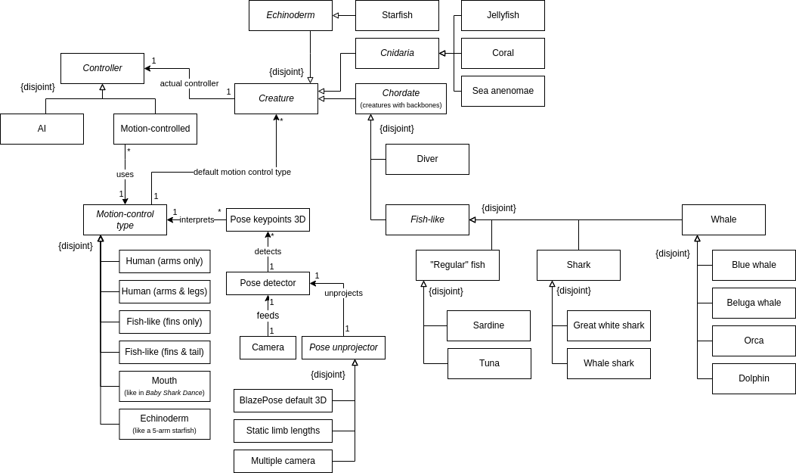
Domain Model

Slide 8
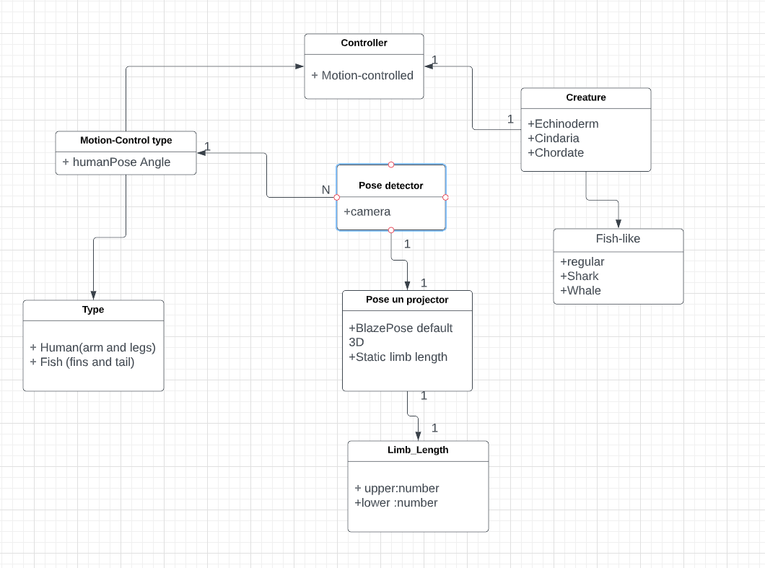
UML

Slide 9
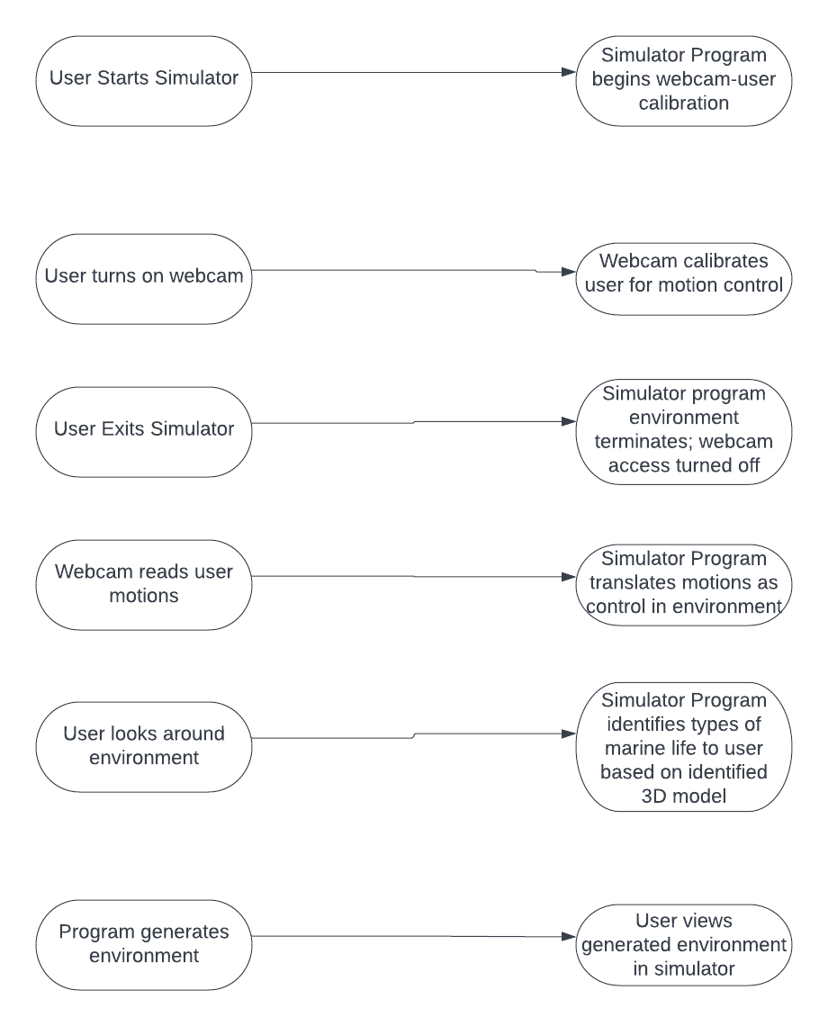
Use Case Webcam Calibration

Slide 10
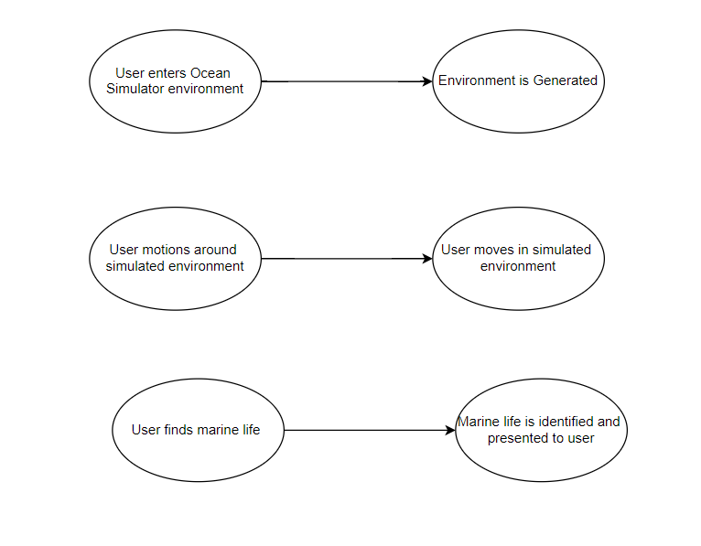
Use Case Gameplay

Slide 11
Risks
TV/Monitor Multi-Device Implementation: 100% x 80 hr = 80 hr
Effect: Incomplete Implementation for multi-device setups
Mitigation: Begin computer webcam implementation, then begin simple prototype; classify project as single device so this is not classified as a major risk – Justified with market study that shows most target users only have access to single device setup
Unrealistic Schedule: 100% x 80 hr = 80 hr
Effect: Incomplete or lower quality product
Mitigation: Create incremental delivery schedule for main features, focus on supplemental features in later iterations; ensure there is core feature functionality
Environment Pose Detection Implementation Failure: 100% x 80 hr = 80 hr
Effect: Main feature not implemented, product is different to its initial description
Mitigation: Focus on this functionality first to ensure the core feature is included

Slide 12
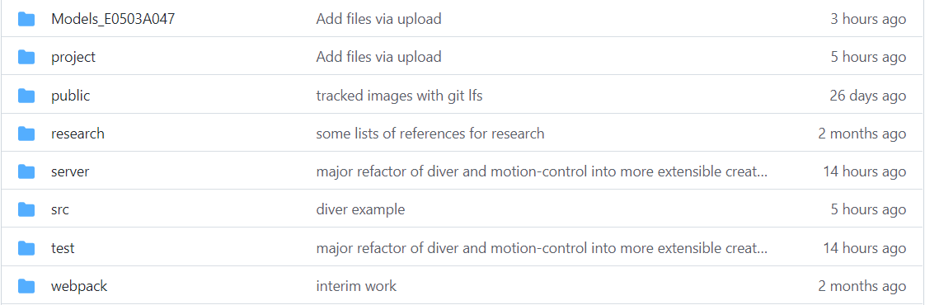
Project Status
Progress Update:
Animal hierarchy is expanded and generalized (different models can be created)
Generic pose controlling system
GitHub Repo Organization (Extensibility feature for future development)
Hinge joints generically implemented for diver (controlled by user)
Incomplete Core Features:
Home Screen (Main Menu)
Demo 3D environment
AI Generation of 3D models (marine life and simulation environment)

Slide 13
Customer Feedback
Simulator Foundation shown to Target Audience Representative
Feedback was based on foundation and quality of webcam calibration and motion control (not simulated environment statically created in Iteration 3)
Representative liked physics-based fluid simulation
Prepresentative would like calibration done after environment set up
Added requirement for future project plan

Slide 14
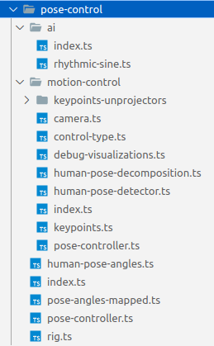
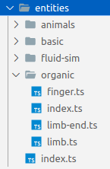
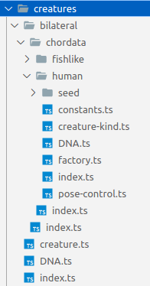
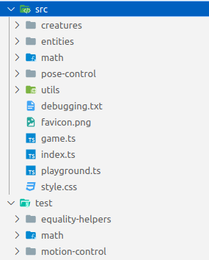
Software Organization

Slide 15
Running the Code
Install nodejs.
Clone ocean simulator repository.
Run "npm install" in there.
Run "npm run dev" in there.
Navigate to https://localhost:8080 from the development computer and wait for it to load.
Check for movement of test object (fluidity simulation and hinge joint testing)

Slide 16
Test Cases
Math tests (42)
Observation tests (40)
Automated tests given expected inputs and outputs
Euler angle rotations
Transformations
Pose angle decomposition
Tester observes rendering & physics of "playground" functions
Hinge and "cone-twist" joints
Capsule, sphere, and box entity generators
Moving rigid bodies
Diver, hand, and arm(s)

Slide 17
Future Project Plans
Implement the game features previously mentioned
Create Simulator Screen & Navigation
Create ocean environments
Implement animal perspective (move as marine animal)

Slide 18
Questions?
https://github.com/i12345/ocean-simulator/commit/e57d62ffe6e1422dd2223211fc9d851b0ba98b73

